Slide 1
Price Prediction Of Deals Price
With Linear Regression and ARIMA Models
Author: Jonathan Brown
Advisor: Dr. Feng Yu

Slide 2
Overview
Deals website
Deals database
Python
Data structure
String matching
Levenshtein Distance
Fuzzy Wuzzy String matching
Linear Regression model
ARIMA Model
Iphone 7
Bluetooth earphones
Future expansion possibility
Conclusion

Slide 3
Deals website
Dealnews.com
Retail outlet for discounted goods
Each item is a “deal”
“deals” have descriptions, prices Identifiers, Etc..

Slide 4
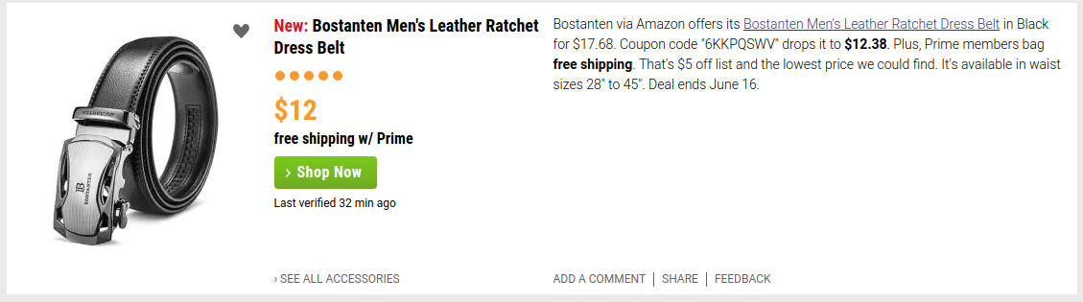
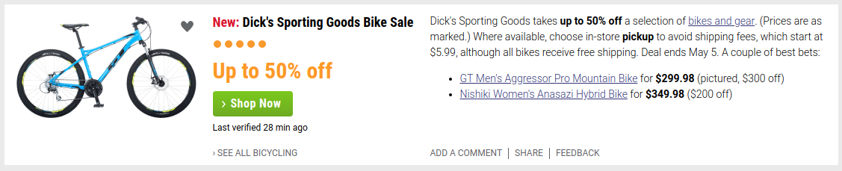

Slide 5
Deals DataBase
Mongo DataBase
'id', 'category', 'description', 'editors_choice', 'hotness', 'picture_url', 'price', 'shipping', 'time_crawled', 'time_modified', 'time_published', 'title', 'url', 'uuid'
Uuid is unique for each individual deal
Need to match similar items

Slide 6
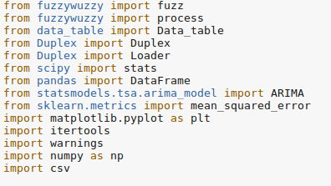
Python
Fewer lines of code
Statistical packages
Competitor With R for Data analysis

Slide 7
Data Structure Data Table
List of lists for each attribute
Keeps track of column name in .csv
Allows addition from other .csv so long as columns are similar

Slide 8
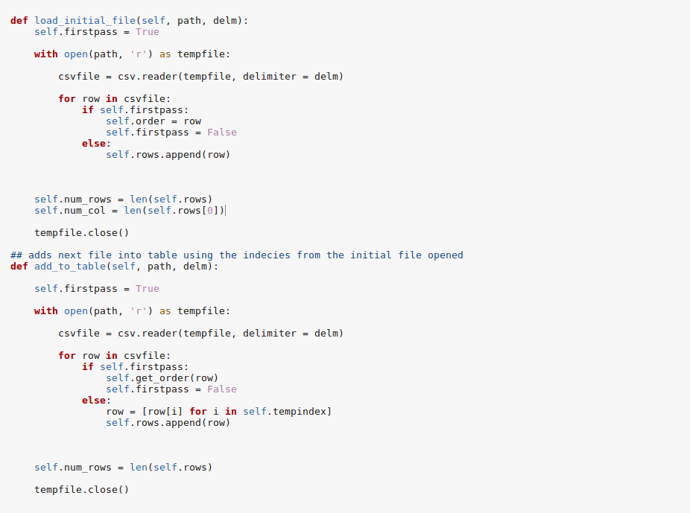
Data Table code

Slide 9
String matching
Edit distance
Partial string similarity
Token sort

Slide 10
Levenshtein Distance
Measure of string difference
Test vs Test LD = 0
Test vs Tent LD = 0

Slide 11
Fuzzy Wuzzy String matching
String Comparison python package
Uses Levenshtein Distance
Options for Simple Ratio, Partial Ratio, token sort ratio
and Token set Ratio

Slide 12
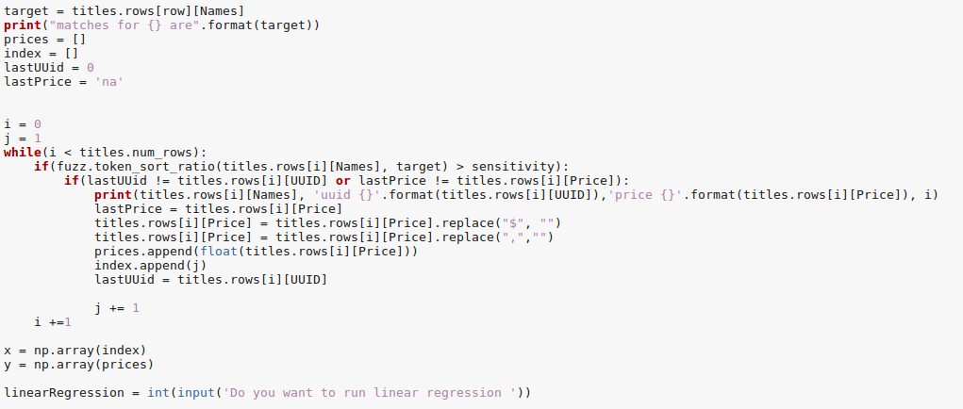
Item separating code

Slide 13
Linear Regression
Line of best fit to the data
Minimizes error between points and predicted values
Good for finding general trends in correlated data
quick

Slide 14
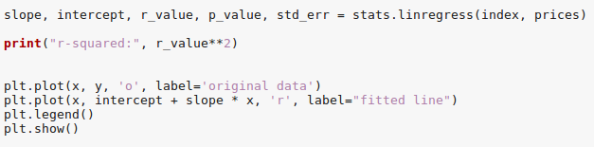
Liner Regression code

Slide 15
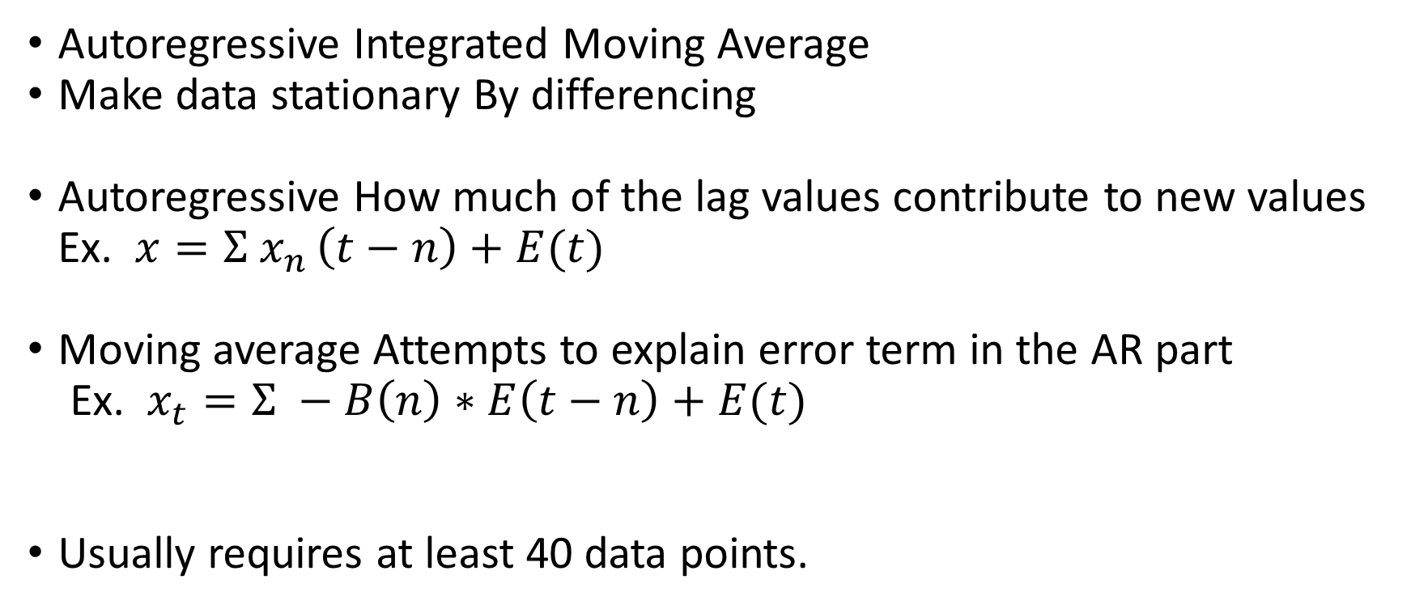
ARIMA
Autoregressive Integrated Moving Average
Make data stationary By differencing
Autoregressive How much of the lag values contribute to new values Ex. $x=Σ{ x}_{n }\left(t−n\right)+E(t)$
Moving average Attempts to explain error term in the AR part
Ex. $x_{t}=Σ −B\left(n\right)∗E\left(t−n\right)+E(t)$
Usually requires at least 40 data points.
Notes:
.

Slide 16
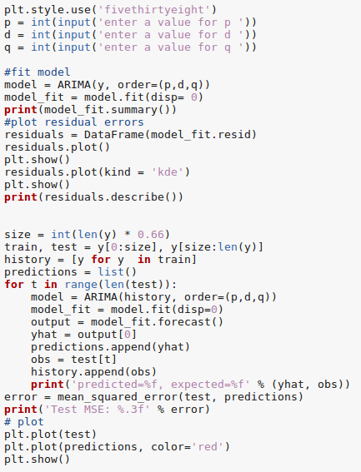
ARIMA Code

Slide 17
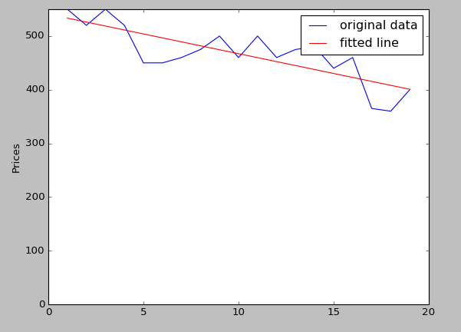

Iphone 7 Linear Regression
Notes:
Aikin’s had forgotten the primary and foreign keys… Invalidating most of his project.

Slide 18
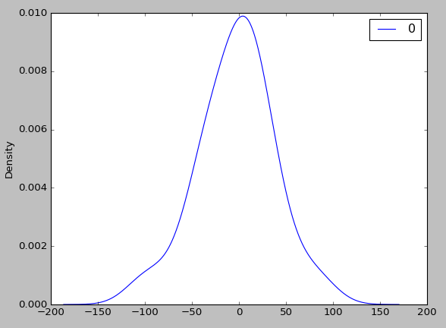
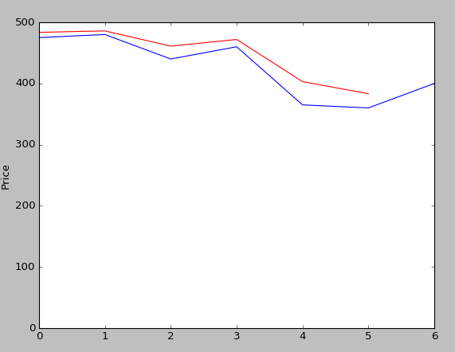
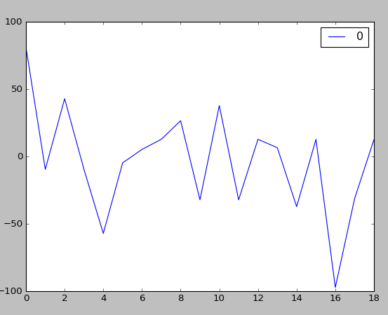
Iphone 7 AR(1)

Slide 19
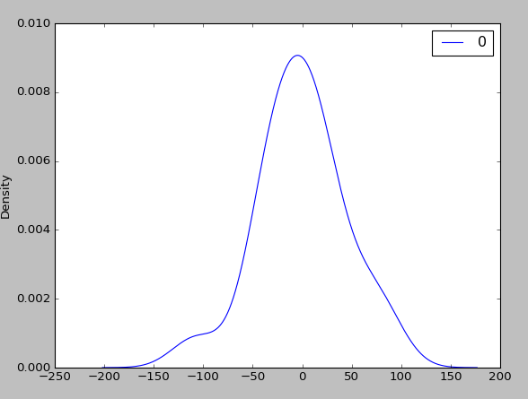
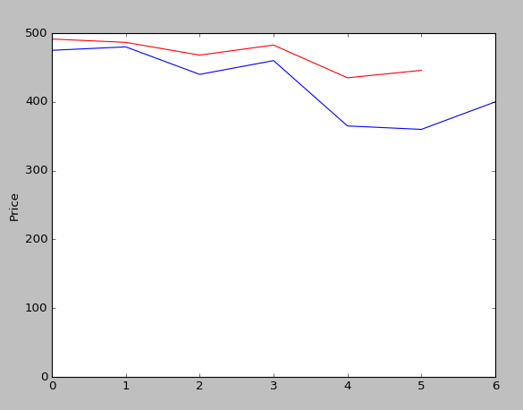
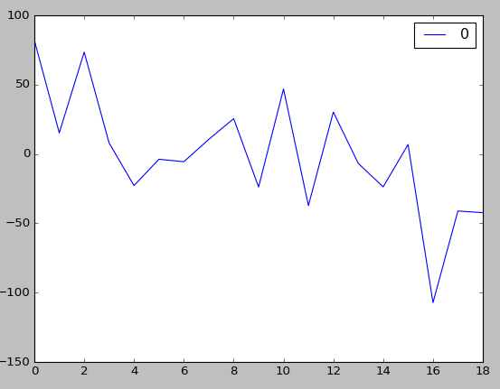
Iphone 7 MA(1)

Slide 20
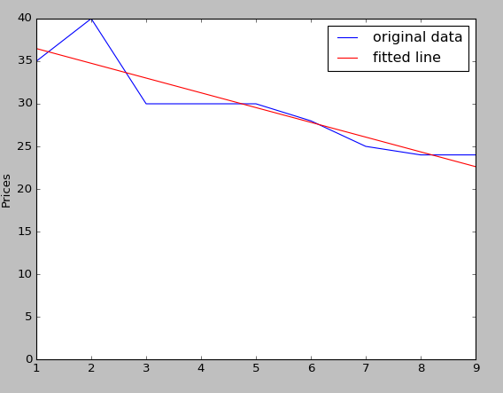

Earphones* Linear Regression
* Bohm Audio S10 Bluetooth Sports Earphones

Slide 21
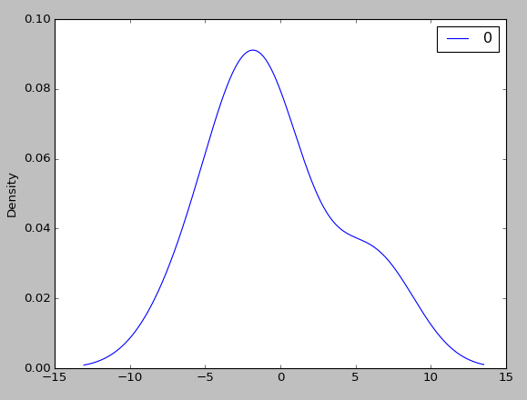
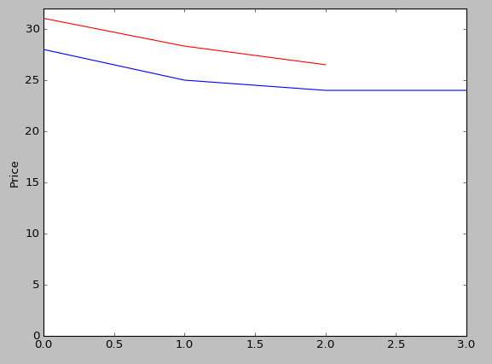
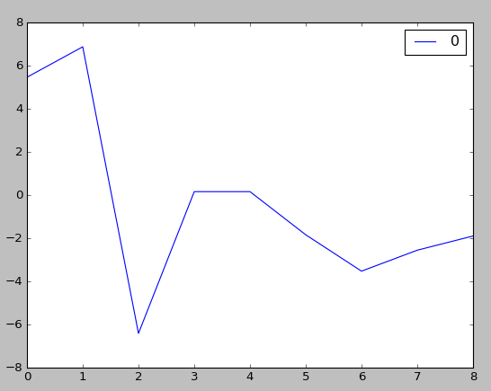
*Earphones AR(1)
* Bohm Audio S10 Bluetooth Sports Earphones

Slide 22
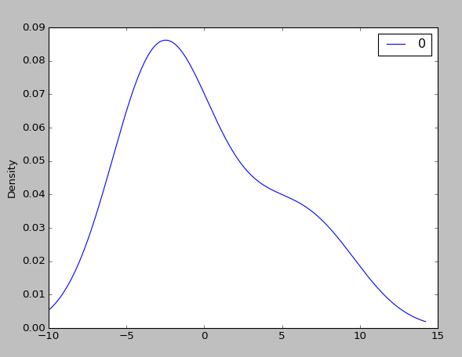
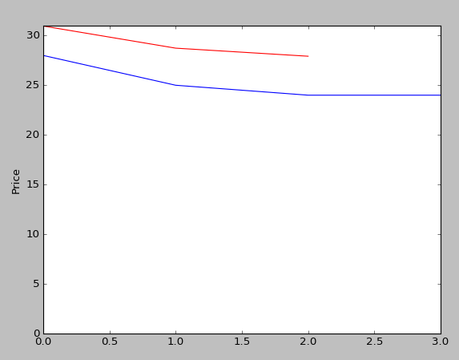
*Earphones MA(1)
* Bohm Audio S10 Bluetooth Sports Earphones

Slide 23
Future Expansions to Project
Logistic Regression for future Hotness scores
Automatic generation of p,d,q variables for best fit ARIMA model
Dynamic calculation of Price models as deals added to database.

Slide 24
Conclusion
Linear regression helps show overall trends
ARIMA Model works well for short term Prediction
Requires few outliers, and at least 40 data points
Other variables from dataset could be predicted in future projects
Hard to determine effectiveness with small data set

