Slide 1

A Data Analysis Using Python and Other Statistical Tools.
TOPIC: Factors that impact on ‘Hotness’ of Online Deal.
Presented By:

Slide 2
Outline of Study
Motivation
RESEARCH Objective
Research Background
Research Question
Data
Experiment and Analysis
Results and Conclusions
Motivation:
Good problem solver
Learn something new
Build an interest
Identify career path

Slide 3
hypothesis
The law of DD(Px↓Qty↑)
The argument is that whenever an online deal exist, consumers purchases become skewed towards the product on sale. How true or false is this statement with regards to popularity of a product ?
In (Duch-Brown et al, 2015), they found online sales doesn’t increase total sales in itself however it diverts sales from the traditional channel of selling.
In (Tu et al,2017) however, they found online promotion has the tendency of increasing more impulsive buying behavior.

Slide 4
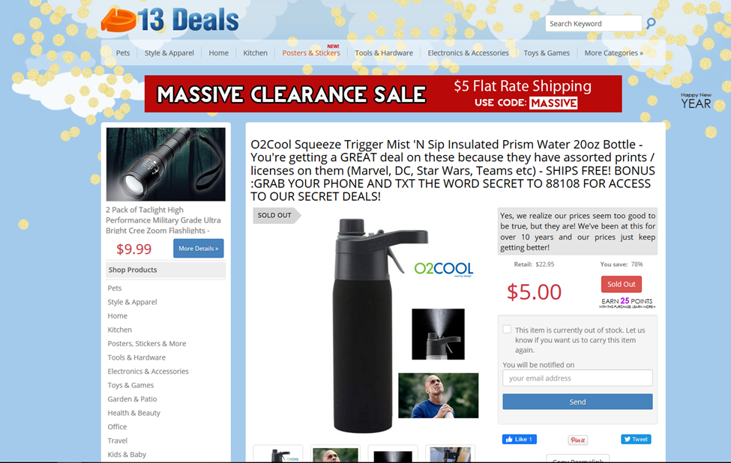
Research Question
What are the factors that influence ratings?
Why does price gets mentioned as a major contributor of the factors?
website
Dealnews.com is a website where online deal communities submit discounted products in a one-stop online shopping website.

Slide 5
Background
Some authors have provided evidence that discounted price plays a dual role in consumer evaluation.
(Erickson and Johansson 1985) identified that, price negatively affect purchase probabilities. In this respect, Song et al. (2016) show that more expensive products are generally less popular in the online deal context.
Ba and Pavlou (2002) find that consumers in electronic markets perceive higher prices as an indication of high product quality. Furthermore, setting the price of a product above the competing products’ prices attracts more quality-conscious consumers (Kayhan et al. 2010).

Slide 6
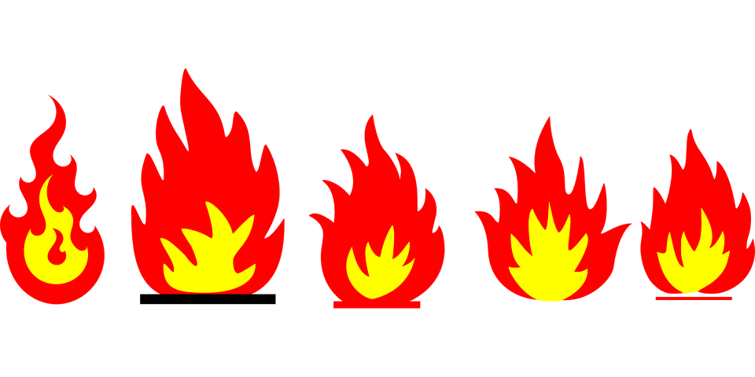
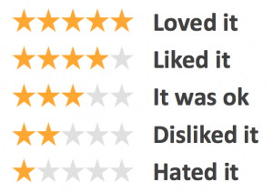
Online Ratings and Reviews vs Dealnews
What are these reviews?
A means of getting feedback from shoppers.
Either an objective or a relative pros and cons of a product by a customer.
A rating on the other hand represents the customer’s opinion on a speciﬁed scale.
A popular rating scheme is the star-rating.
The ratings generated by the user are then published on the website of the retailer.
Staff pick
Online shoppers then get the opportunity to vote the popularity (‘hotness’) of these products being advertised on the website.
popularity

Slide 7
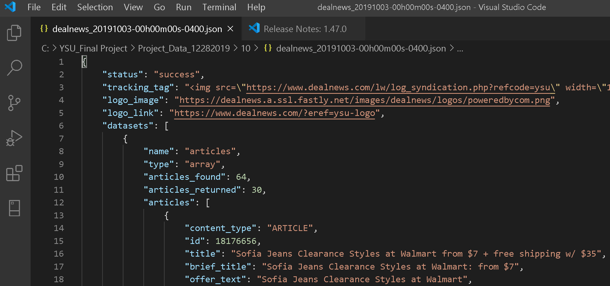
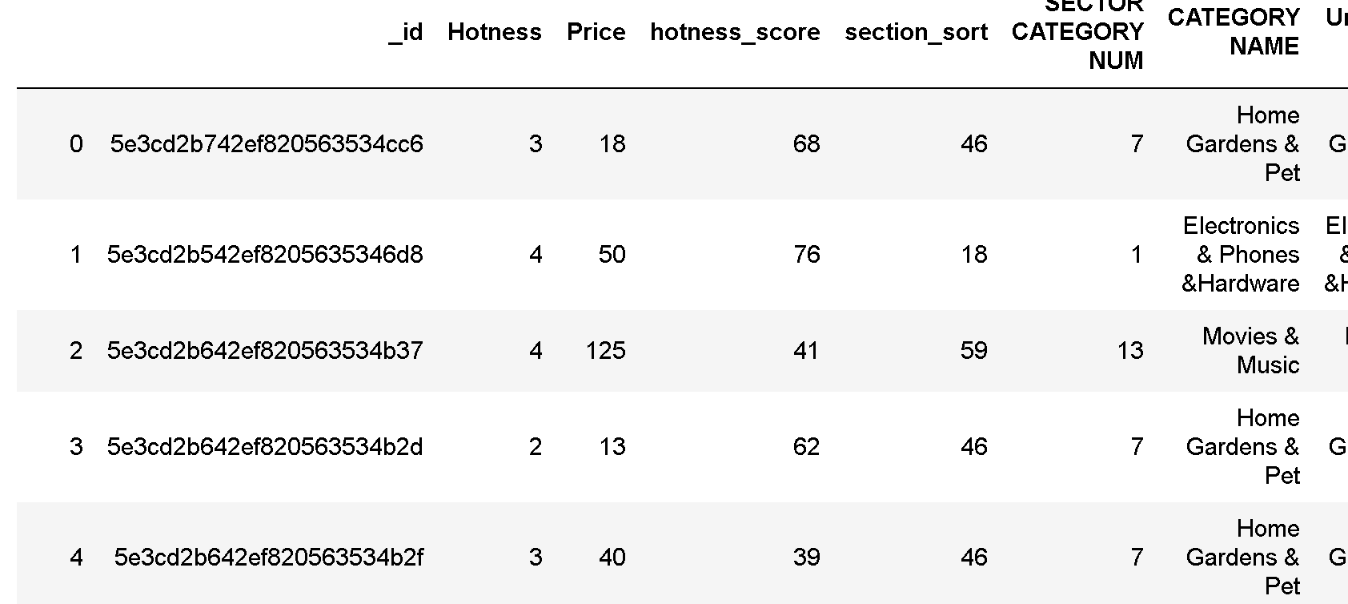
Data transformation
Before
After

Slide 8
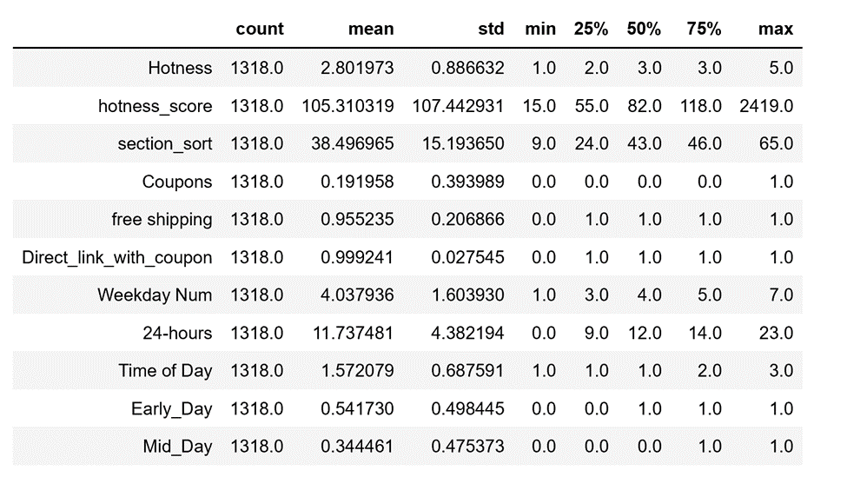
Data
Summary Statistics
Data source: dealnews.com
Data Span: October 1, 2019 to October 31, 2019.
Data type: daily dataset
Data Format: JSON and messy.
Missing Data
Summary Statistics of Data.

Slide 9
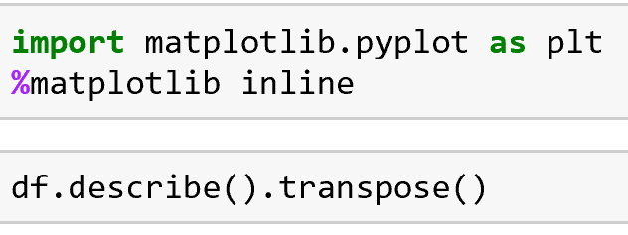
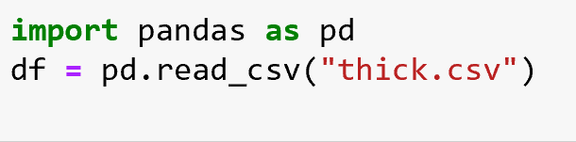
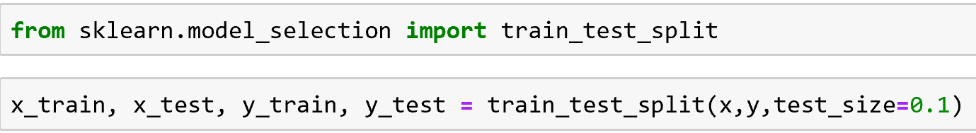
Data from Jupyter

Slide 10
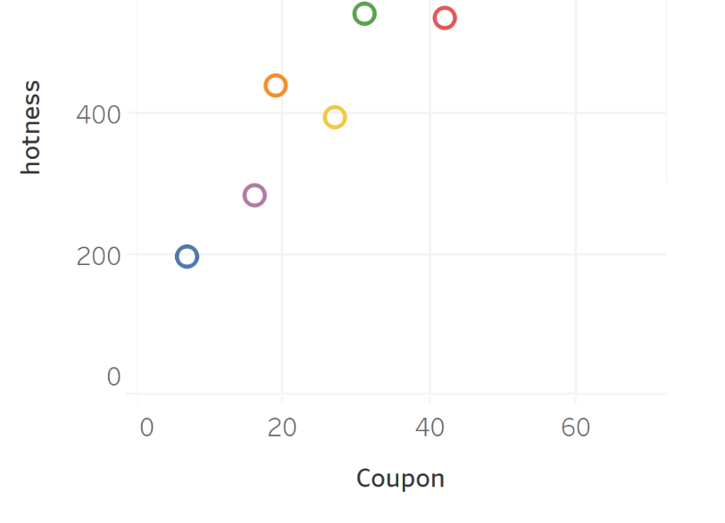
Scatter of Coupon Vs Hotness

Slide 11
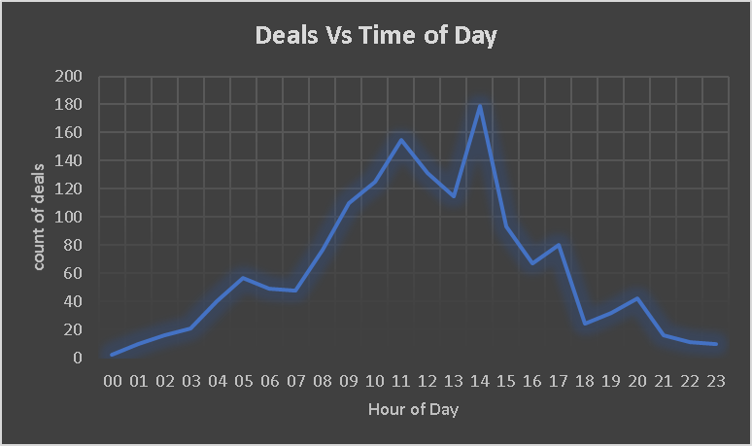
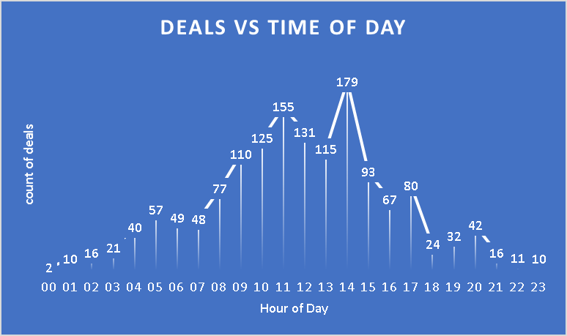
Experiment

Slide 12
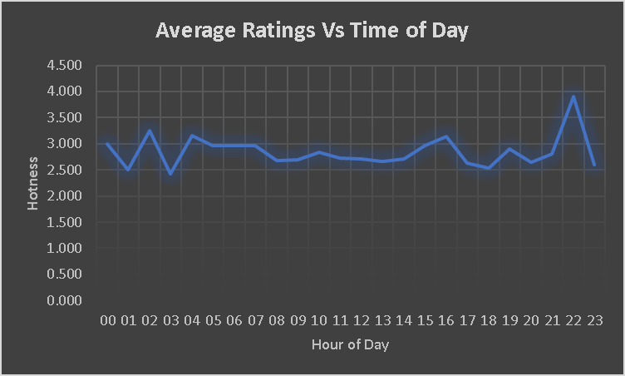
Experiment

Slide 13
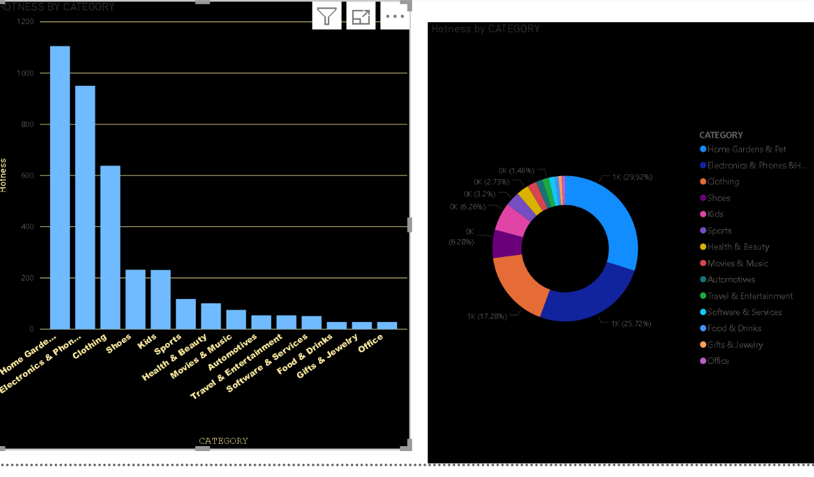
Sector category vs hotness
Home garden show a great chunk of data and having most of the hot ratings

Slide 14
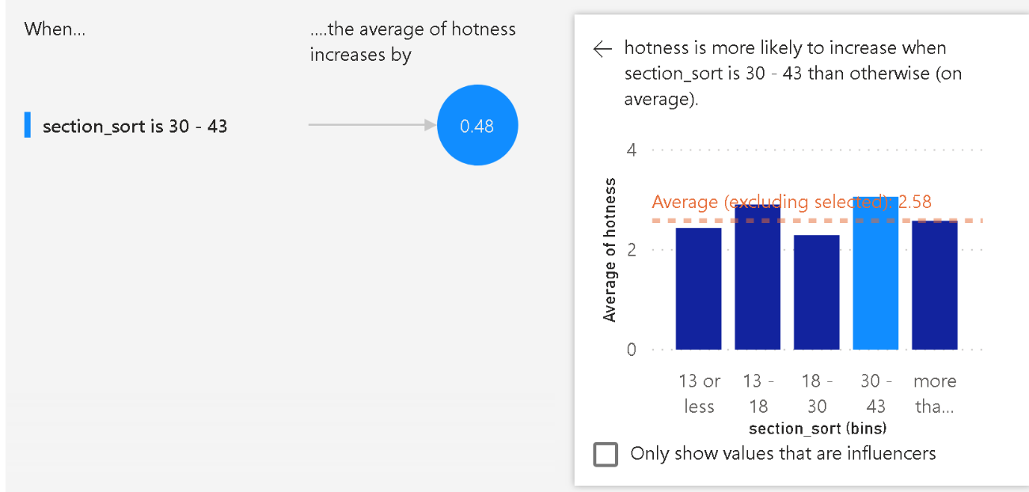
Sector sort vs Hotness

Slide 15
Sector sort, Hotness and % saving
Hotness | Average Discount savings %
1 | 32.95
2 | 35.63
3 | 35.55
4 | 34.82
5 | 46.44

Slide 16
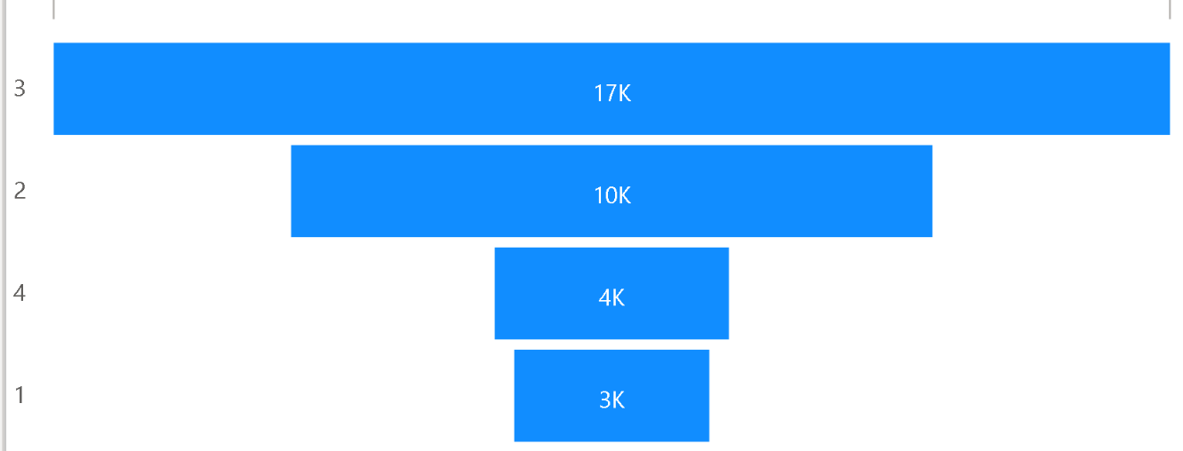
Data size Rep. for various Hotness ratings

Slide 17
Correlation in Analysis
Correlation Coefficients only measure a linear relationship, so even if our calculations show that r=0, we should be careful that a non-linear relationship might exist between the variables.
Secondly, we should not use r to imply a causal relationship between variables, i.e. even if we know that 2 variables x and y are Correlated, the measure does not tell us whether x causes y or y causes x.
Thirdly, there might be cases where a very high correlation might exist between 2 variables, however the relationship is completely illogical.

Slide 18
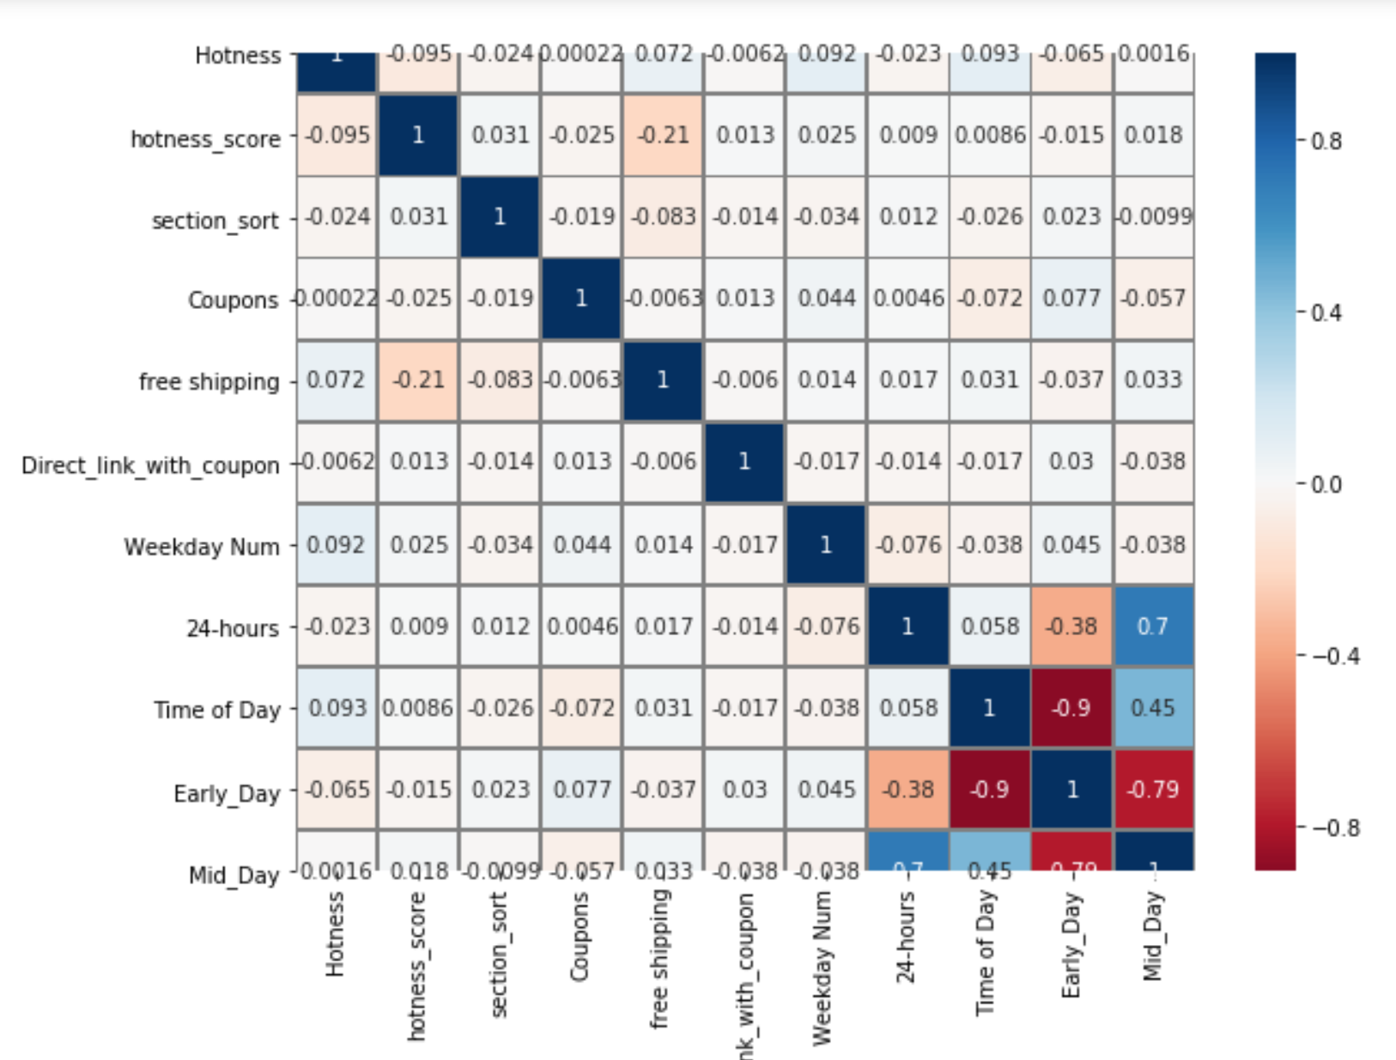
Legend of r matrix
From | to | Interp
 | 1 | Perfect
0.8 | 1 | Very Strong
0.6 | 0.8 | Strong
0.4 | 0.6 | Moderate
0.0 | 0.3 | None to Weak

Slide 19
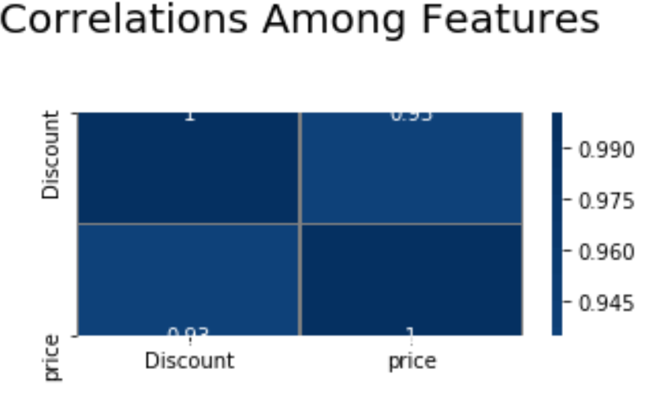

Slide 20
Model
Hotness= 𝛽₀+ 𝛽ₛₜ+ 𝛽ₚₛ + µ

Slide 21
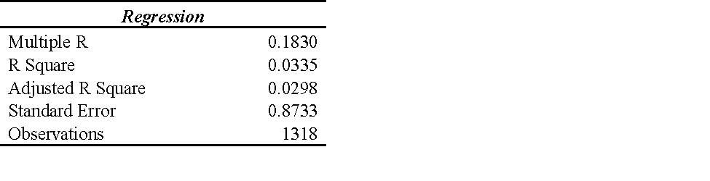
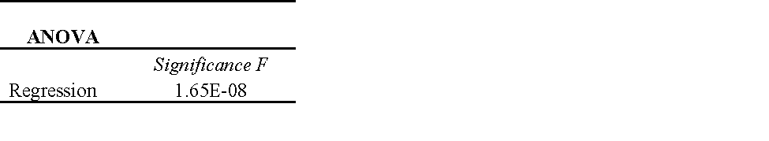
Analysis of Output
The R Squared and the Adjusted R of 3.4% of the variation in hotness is explained by the all of the input variables.
From the Anova summary, the regression significance of the F test is significant. This value is closer to 0, it implies there’s greater probability that the output of the regression was not achieved by chance.

Slide 22
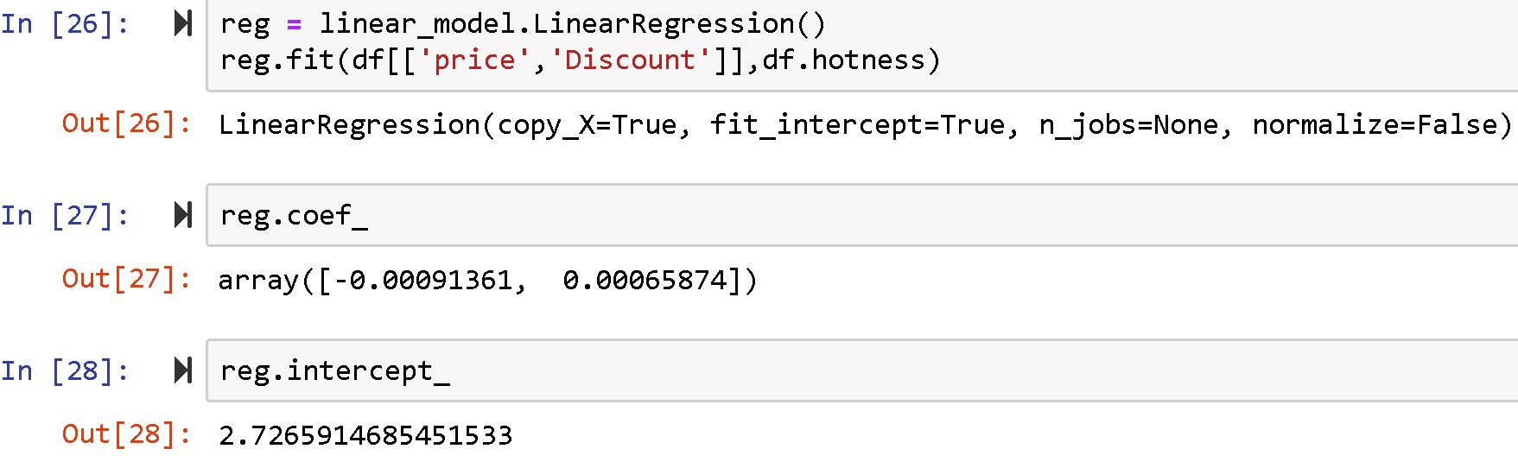
Algorithm
Hotness= 2.726+ 0.00065Discount+ (-0.00091)Price + µ

Slide 23
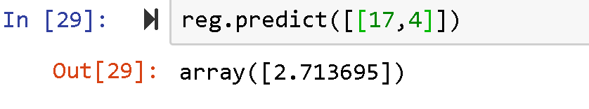
Predicted outcome

Slide 24
Reports & Findings
From the study, I observed from the data and analysis that, a combination of factors could have association with hotness but do not cause hotness ratings for sure.
For instance, price had a zero coefficient but its p value was significant. (Bergmeier et al, 2016) found positive results and others found negative relationships, this paper found an association with hotness but price do not cause popularity rating;
The reasons for this was much evident even from the raw data because;

Slide 25
Most items had high ‘hotness’ however their price columns were blank
Some products had low ‘hotness’ rating however their prices were low and vice versa
This implies customers are indifferent about price when they click into an item online.
This was the case for most of the features which resulted in low adjusted R Square of the regression.
These factors have associations but not a 100% guarantee for causing hotness to either go up or down.
An interesting feature I found was how time of day could affect deals popularity.

Slide 26
Future Research
Data challenges as the website does not provide very detailed information on how ratings were calculated.
how Staff Pick of an item could induce clicks into a deal.
Other qualitative features like display of a product, quality of a brand could impact hotness ratings.

Slide 27
THANK YOU!!

