Slide 1


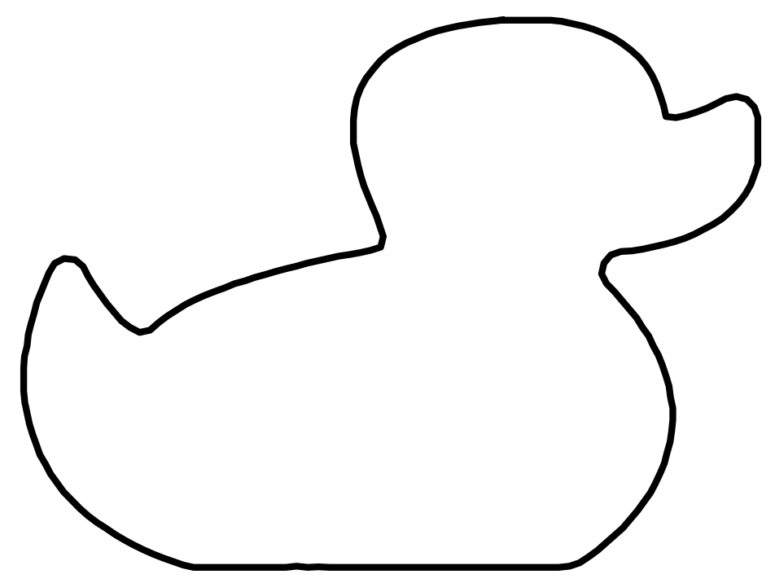
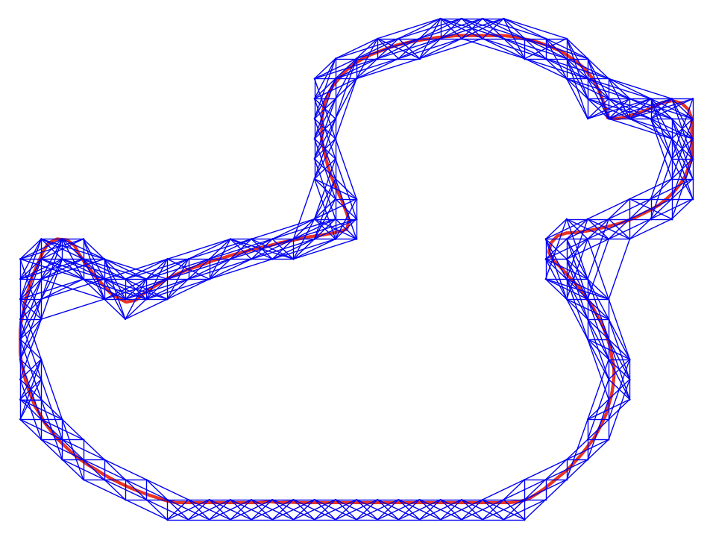
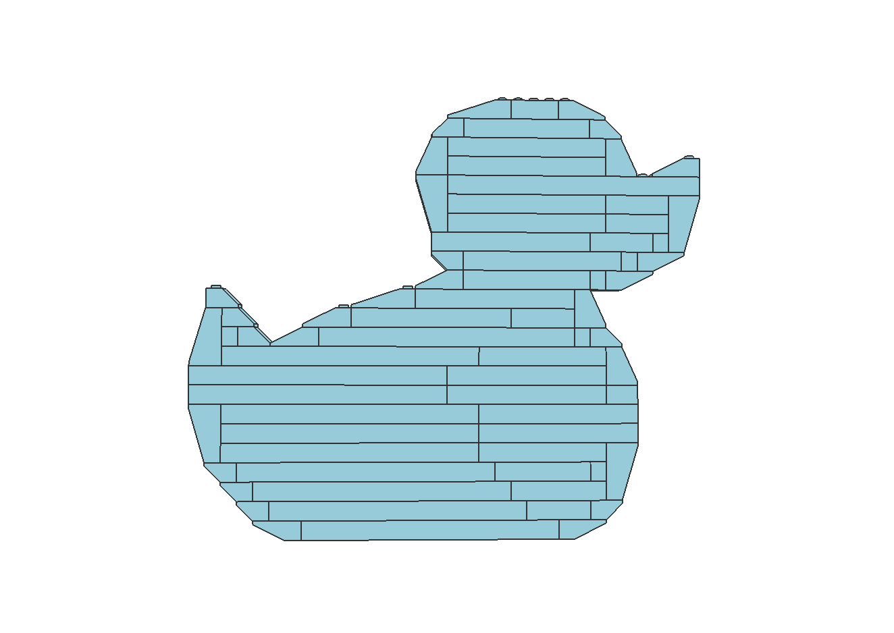
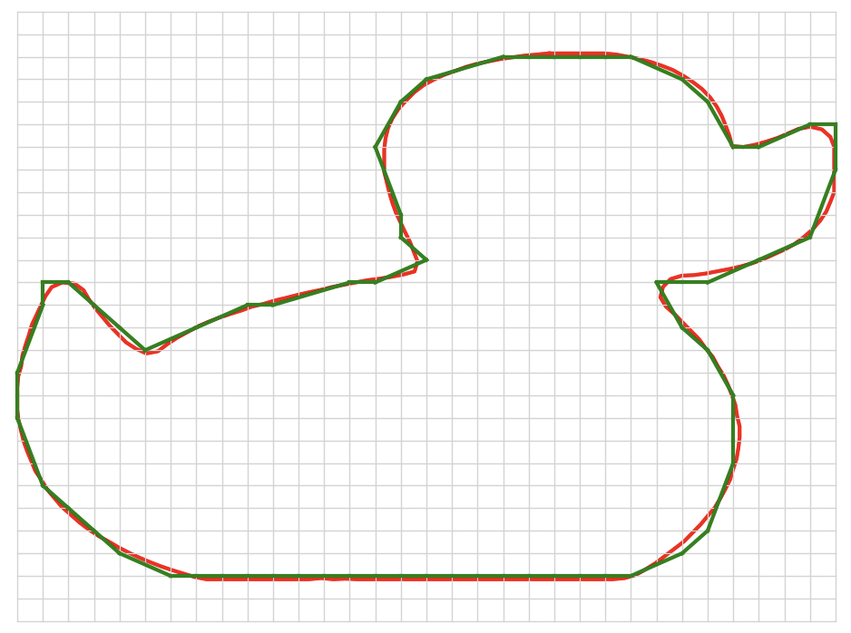
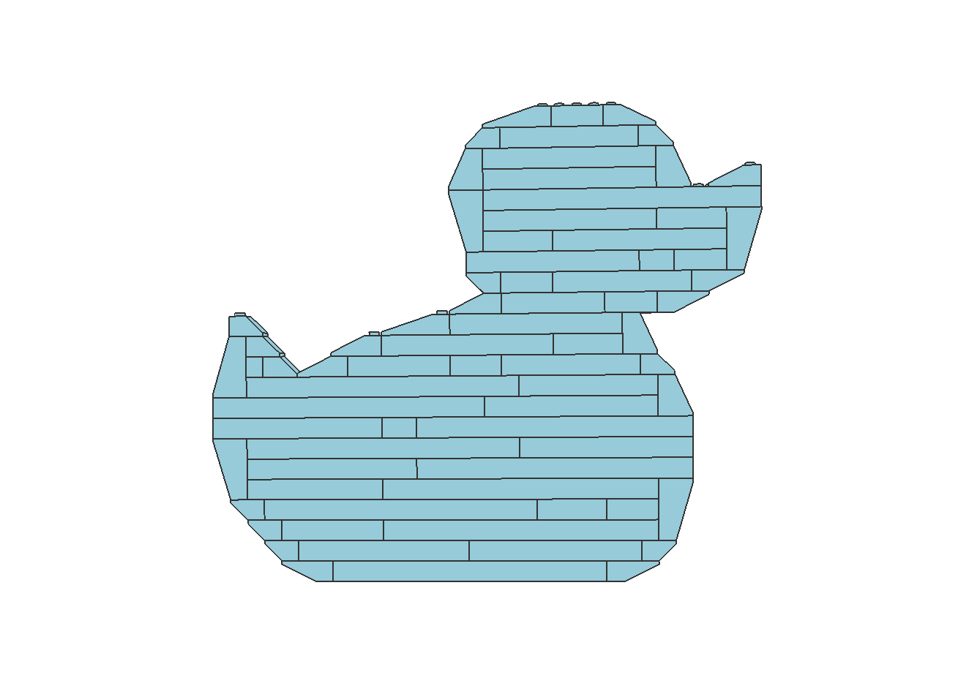
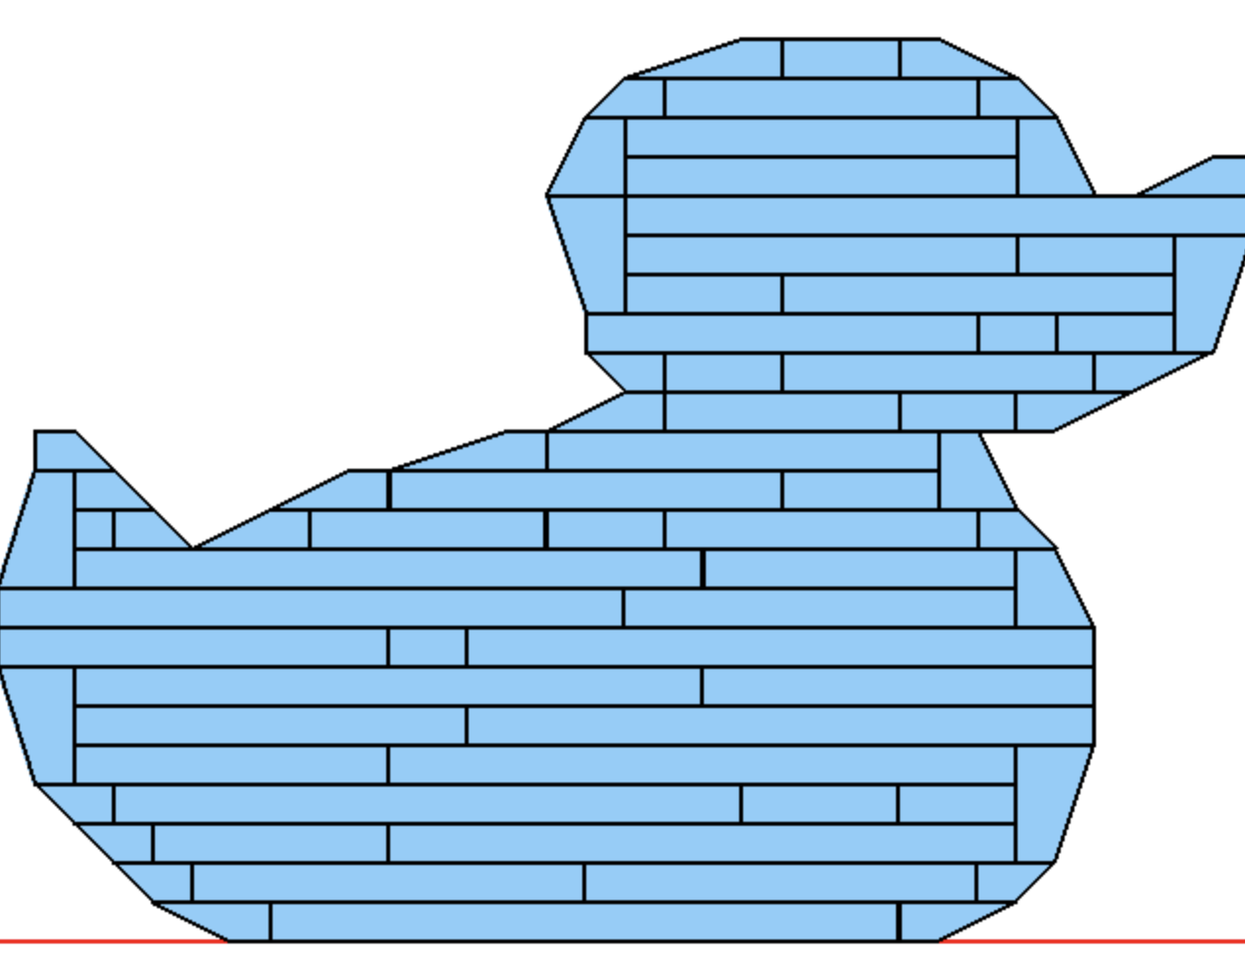
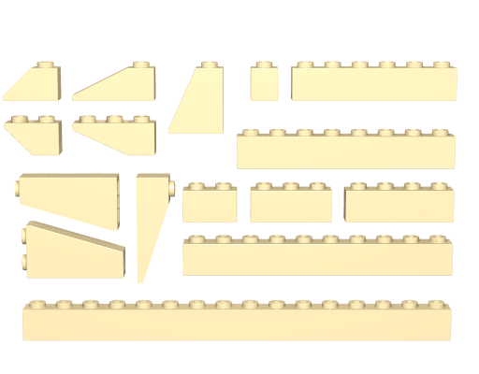
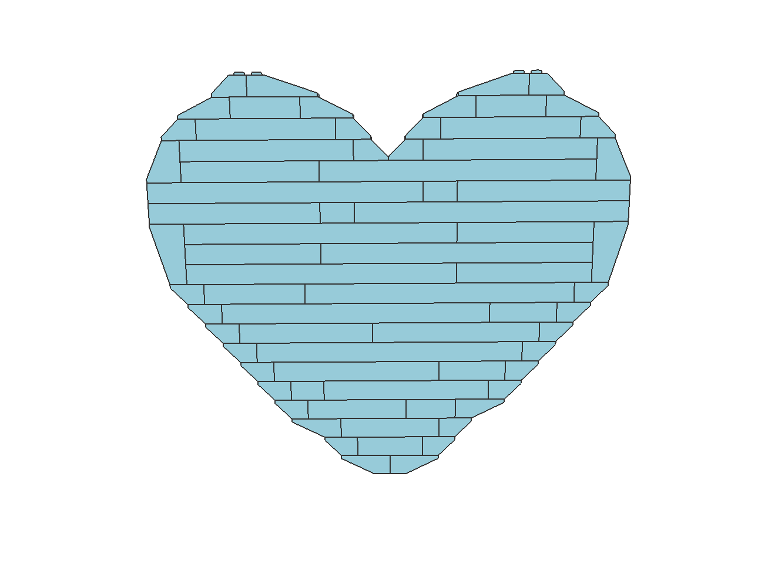
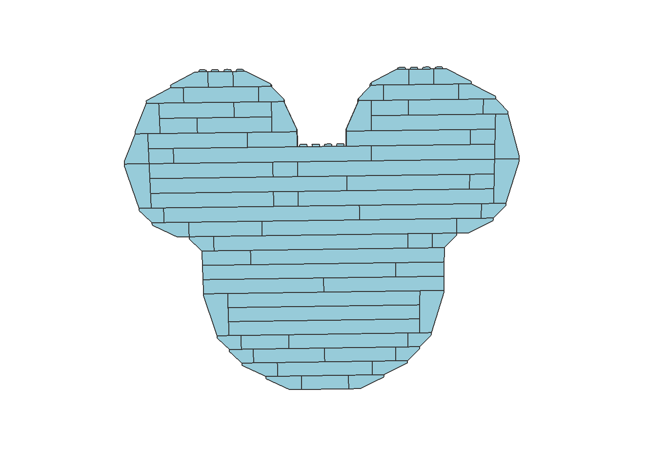
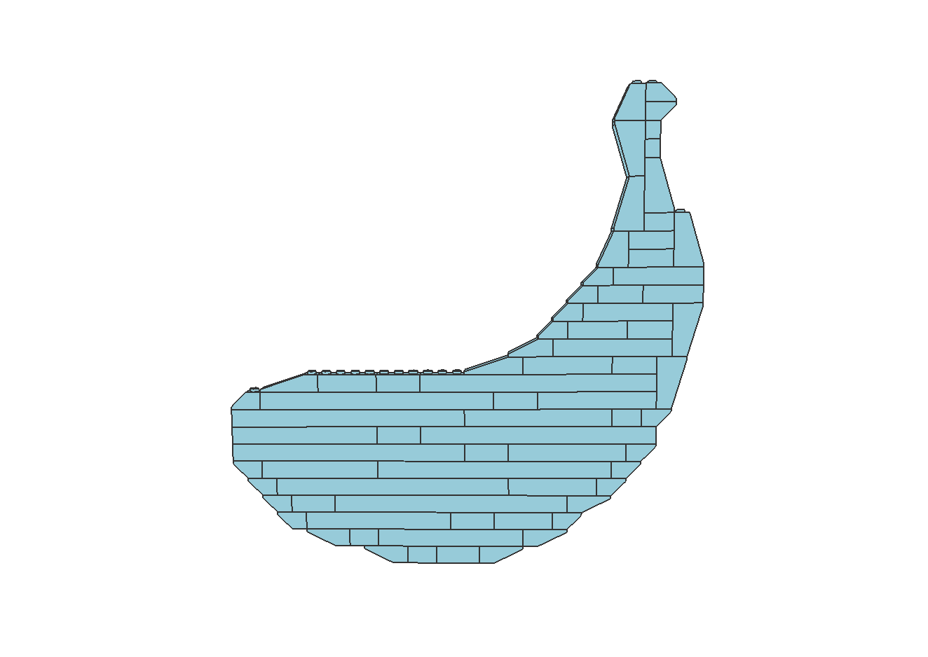
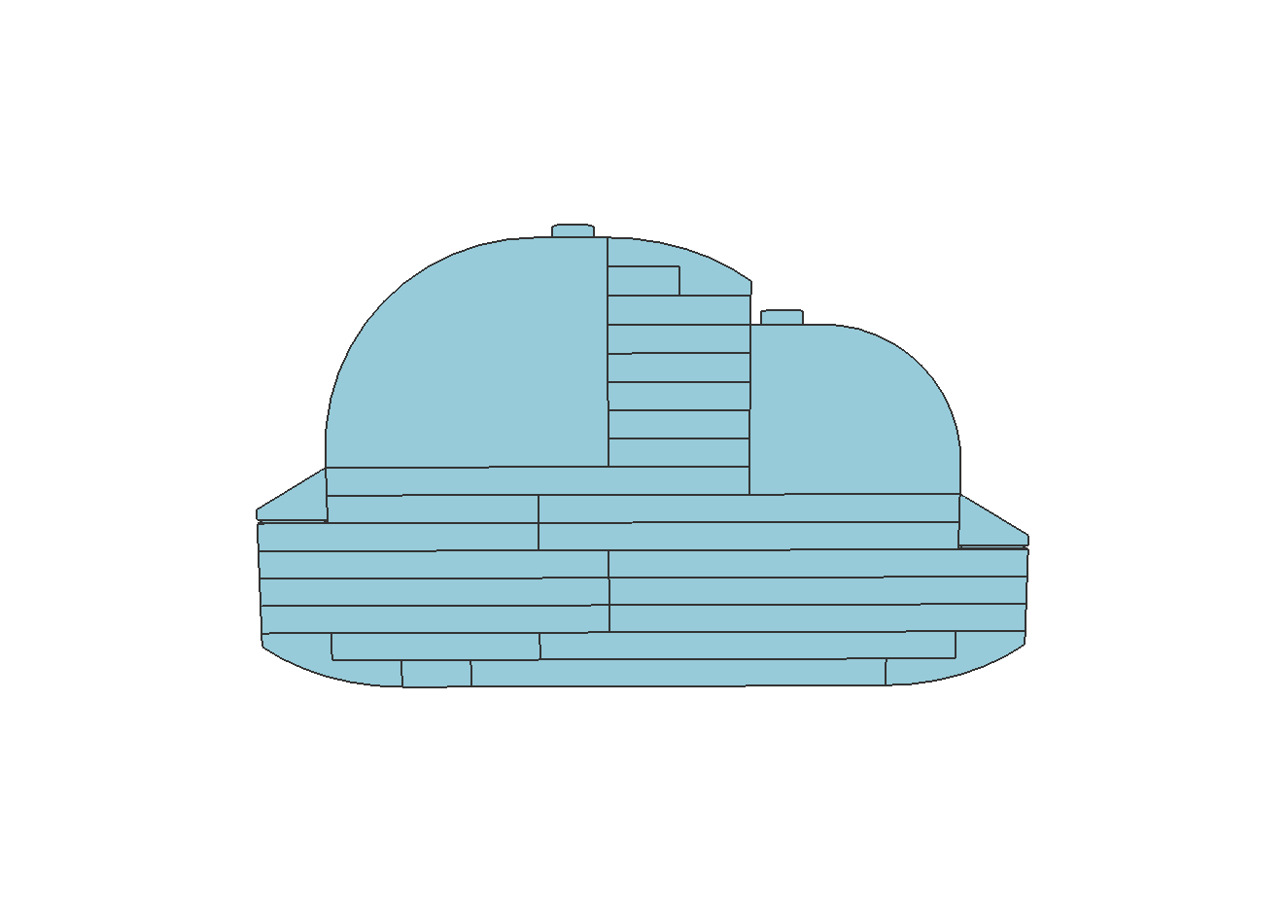
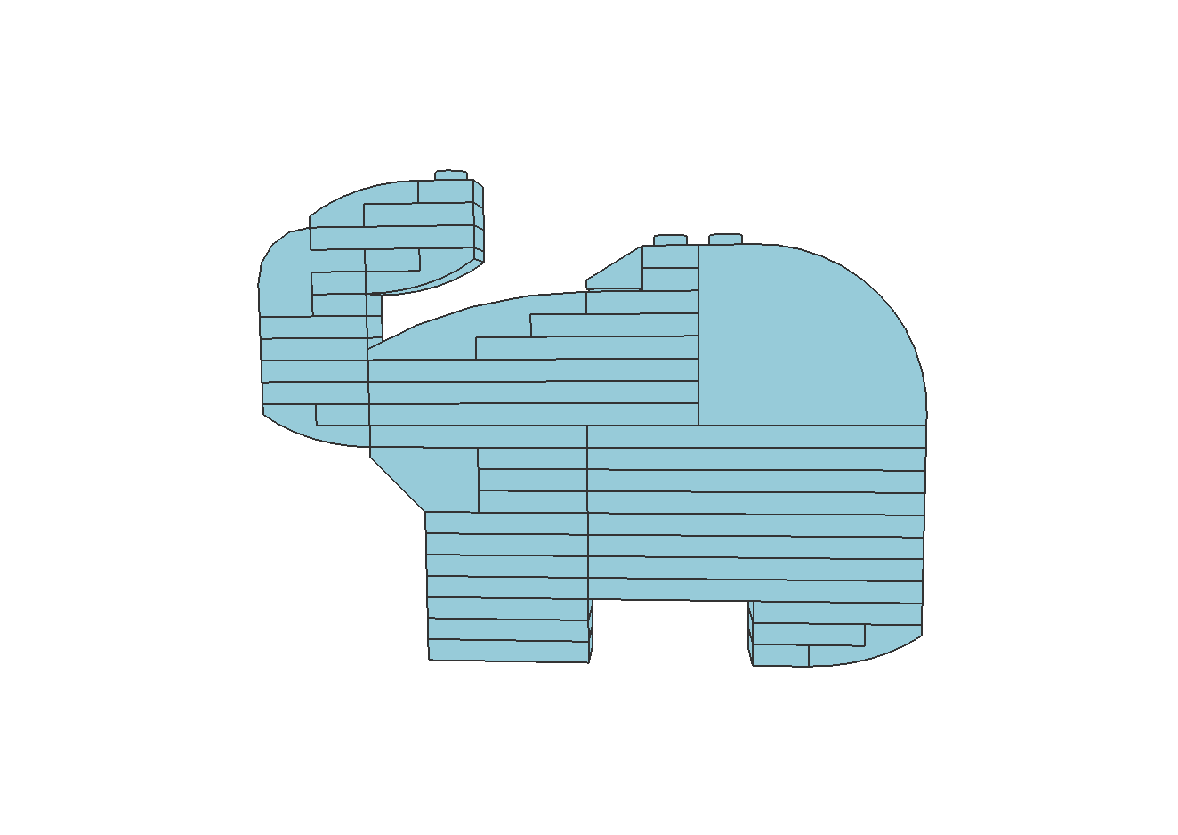
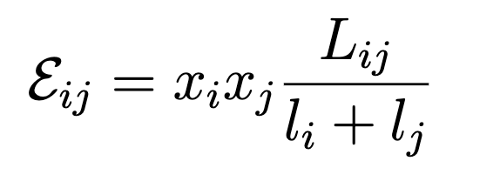
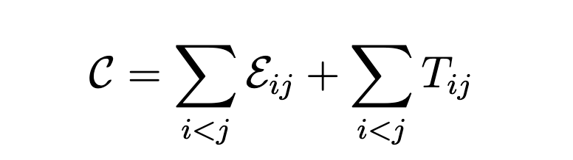
®
Computational LEGO Design
Student: YUAN Shaoxuan Supervisor: Prof. Chi-Wing FU, Philip
Introduction
LEGO model can display many shapes of different objects, which is a great decoration. However, to construct such a model, LEGO designers have to spend significant amount of time and energy. To improve the construction efficiency, we aim to use a computational strategy to generate LEGO models according to 2D shapes. In this project, we will show the construction and optimization method.
input image
candidate edges along the contour
Related Work
In recent years, many work related to LEGO construction have been explored. Zhou et al. [1] show a computational method to create LEGO sketch art. What is more, Luo et al. [2] and Liu et al. [3] present a process to analyse the stabillity of LEGO building. Based on these researches, we will come up a strategy to generate stable LEGO models using selected bricks.
Bad connections
Task Definition & Methods
the model after filling with a greedy algorithm
contour polygon obtained by graph optimization
Task definition: Our aim is to using a set of LEGO bricks to match the shapes in the input images; see figure below.
Methodology: Our method includes two main steps:
Graph creating
Graph optimization
Bricks filling
Connectivity optimization
Stability analysis
Construction
Good connections
Optimization & Analysis
the model after connectivity optimization
physical stability analysis and visualization
Figure: brick set
Optimization Methods
Results & Extension
Graph Optimization: In this step, we follow the strategy of Zhou et al [1]. We use the objective function below to measure the effect of fitting.
Results: Below are some LEGO models generated and optimizated by our method:
W = w_{d} L_{d} + w_{v} L_{v} + w_{s} L_{s}
Connectivity Optimization: We aim to use less bricks to generate more connections. We associate each brick with a binary variable x_{i}. We will consider a structure consisting of two bricks; see left structure below. And we prefer interlaced structure and try to avoid aligned structures; see middle and right structures below.
Extension: Based on previous work, we have enlarged our brick set by adding curved bricks to generate better models. There are some preliminary results; see figure below. In the future, we will consider constructing LEGO models in smaller sizes and multi-orientations.
l_{i}
L_{ij}
Case 1
Case 2
l_{j}
T_{ij} = x_{i} x_{j}
T_{ij} = 2x_{i} x_{j}
Reference
[1] ZHOU, M., GE, J., XU, H., AND FU, C.-W. Computational design of lego sketch art. ACM Transactions on Graphics (TOG) 42, 6 (2023), 1-15.
[2] LUO, S.-J., YUE, Y., HUANG, C.-K., CHUNG, Y.-H., IMAI, S., NISHITA, T., AND CHEN, B.-Y. Legolization: Optimizing lego designs. ACM Transactions on Graphics (TOG) 34, 6 (2015), 1-12.
[3] LIU, R., DENG, K., WANG, Z., AND LIU, C. Stablelego: Stability analysis of block stacking assembly. arXiv preprint arXiv:2402.10711 (2024).

