Slide 1


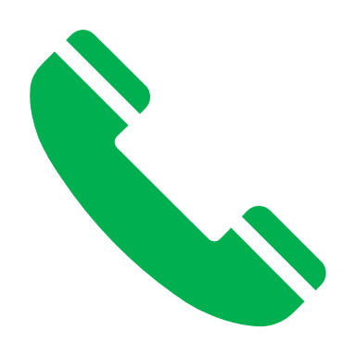

Setup profile
join network
Farmers
Impact leander
Projects
Submit loan request
Agent
Investor can search for project
Legal documents
Investment type
Digital identity
criteria
Investor can call farmer
Reject
Accept
Accept Loan Terms embedded in smart contract
Receive Payment
Send Money
BLOCKCHAIN
Smart Contract

