Slide 1
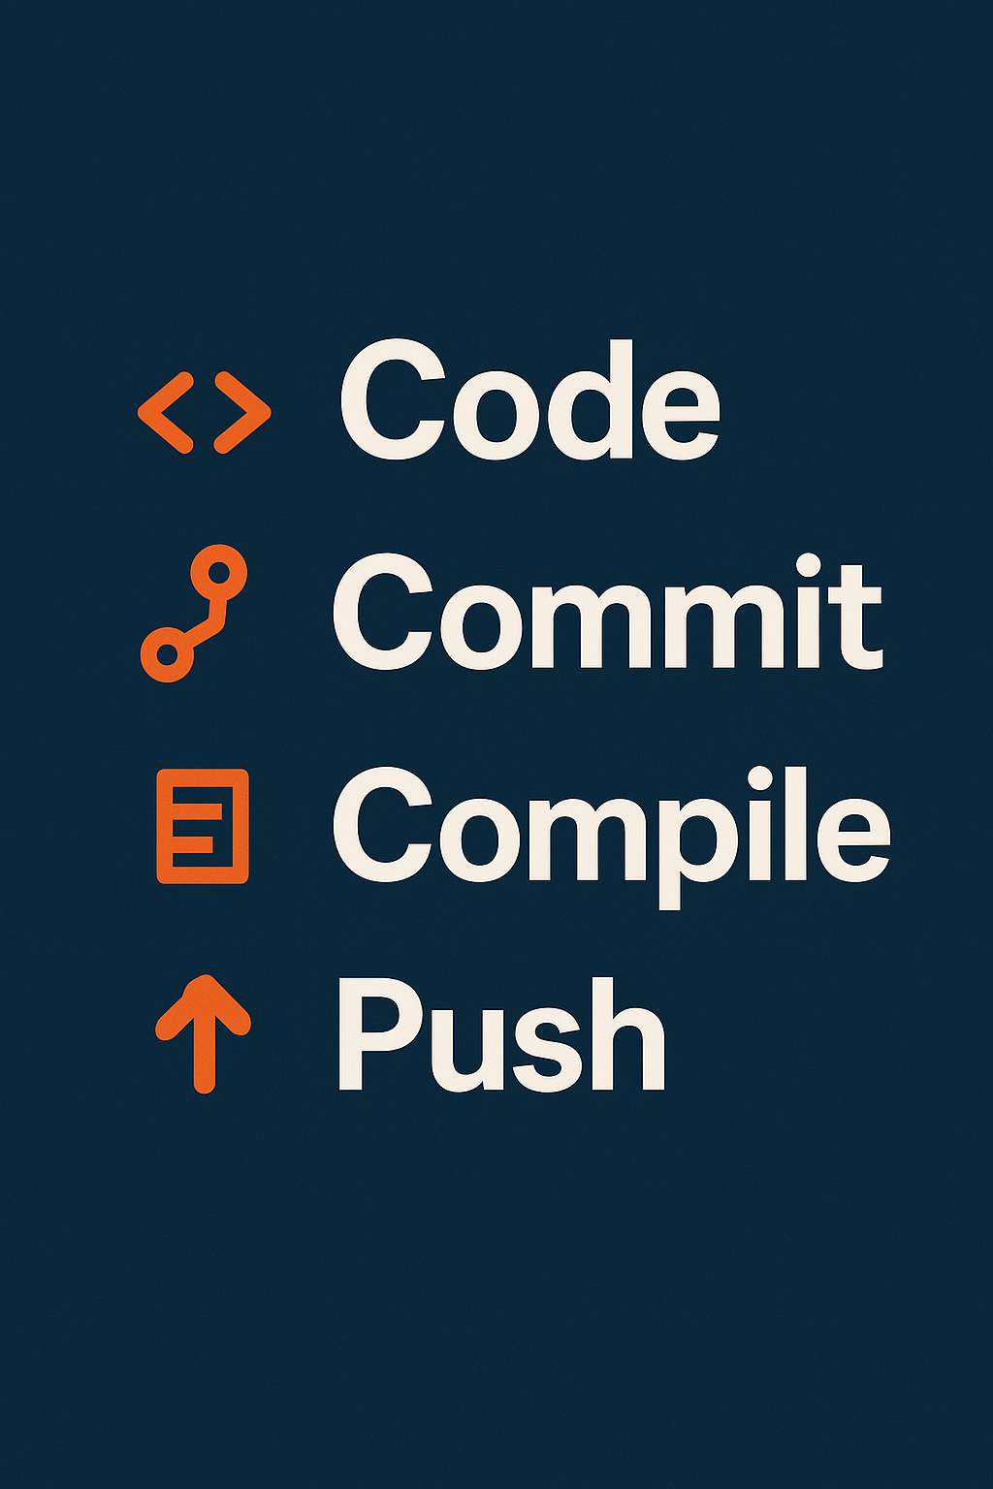
Spotify Track Analytics & Popularity Prediction
Machine Learning + Streamlit
James Barlow
Joshua Tutin
Yulia Shutko

Slide 2
Motivation
Streaming platforms depend on recommender systems.
Artists and producers want to understand what makes a song popular.
Data science can reveal measurable trends in music success.

Slide 3
Business Requirements & Solutions
Understand Key Drivers of Song Popularity
XGBoost ML model with feature importance analysis
2. Classify Songs by Mood and Energy
Automated mood/energy classification system
3. Genre-Level Analysis
Comprehensive genre analytics and visualizations
4. Support Playlist Curation
Data Explorer tab with multi-select filters
5. Data-Driven Music Recommendations
Track Predictor tab (music producer tool)

Slide 4
Dataset Overview
≈114,000 tracks, 125 genres (Kaggle dataset).
Audio features: danceability, energy, valence, loudness, tempo, etc.
Metadata: artist, genre, explicit, duration, release year.
Target: popularity (0–100).

Slide 5
Streamlit App Overview
Interactive tool for exploring features and predicting popularity.
Upload your own dataset or use demo data.
Visualize correlations, model metrics, and predictions in real-time.
Frontend: Streamlit + trained XGBoost backend.

Slide 6
Streamlit App Features
Home: Project overview and instructions.
Data Exploration: Correlations and heatmaps.
Model Insights: Feature importance, results, metrics.
Prediction Tool: Input new song attributes and predict popularity.

Slide 7
EDA &Insights
Popularity & Audio Features
Popularity Distribution is right-skewed: most tracks are low popularity.
Danceability and Valence are normally distributed.
Acousticness, Instrumentalness, Speechiness are skewed toward 0.
Energy is slightly skewed to higher values.
Feature Relationships & Popularity
Energy vs Valence: higher popularity clusters around high energy + valence.
Popularity shows weak correlation with all features.
Strong internal feature correlations: Energy~Loudness, Acousticness~Instrumentalness (negative).
Genre Distribution & Performance
Pop, Hip Hop, Rock dominate track count.
High popularity is not strictly tied to genre frequency.
Genres like K-pop and Latin show high avg. popularity despite lower count.

Slide 8
EDA Key Summary
Popularity: Most tracks are low popularity; few outliers dominate.
Genre: Mainstream genres dominate, but niche genres can be highly popular.
Feature Distributions: Many features are skewed—transformation/scaling needed.
Correlations: Popularity is weakly correlated; multivariate models like XGBoost needed.
Popular Traits: High Energy + High Valence tend to be most popular.

Slide 9
Model Pipeline
Goal: Predict song popularity (regression).
Preprocessing: Scaling, encoding, feature cleaning.
Models tested: Linear Regression, Random Forest, XGBoost.
Metrics: R², RMSE, feature importance.

Slide 10
Model Comparison
Linear Regression → R² = 0.25 (underfits).
Random Forest → R² = 0.36 (better).
XGBoost → R² = 0.39, RMSE = 17.4 (best).
Explains ~39% of variance — moderate predictive power.

Slide 11
Top Predictors (XGBoost)
1. Genre
2. Duration
3. Explicit flag
4. Energy
5. Danceability
Weaker predictors: acousticness, valence, instrumentalness.

Slide 12
Handling Noise
Removed redundant and low-variance features.
Applied correlation checks to drop weak predictors.
Focused on audio + genre combinations.
Improved interpretability without overfitting.

Slide 13
Interpreting R² = 0.39
39% of popularity variance explained by musical features.
61% unexplained — likely social or marketing influences.
Model identifies patterns, not viral or cultural effects.

Slide 14
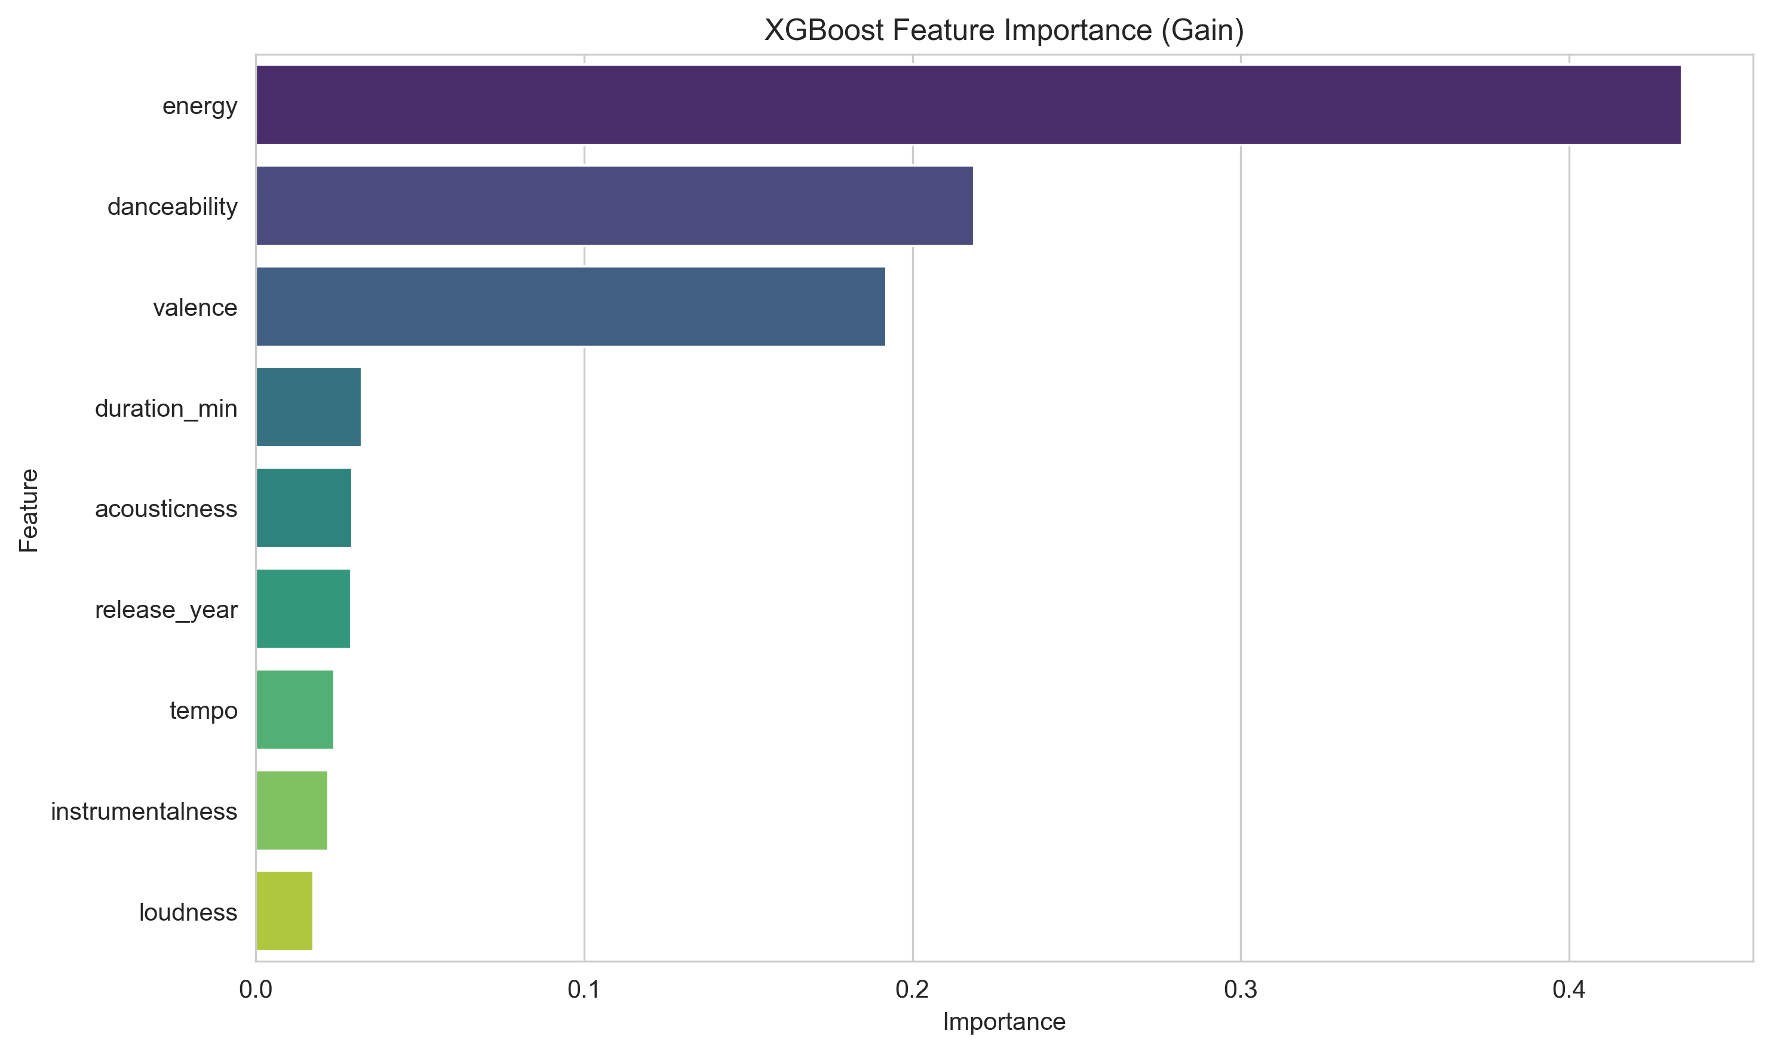
XGBoost Feature Importance

Slide 15
XGBoost: Key Findings & Insights
Achieved R² of 0.8447 on test set [after the hyper parameter tuning, the R squared suggests that the updated model is able to explain more of the variation].
RMSE of 6.02 demonstrates strong predictive accuracy
No significant overfitting observed in learning curves
Residuals follow normal distribution, validating model assumptions
SHAP analysis reveals key drivers of track popularity
Model uses 0 audio features for prediction
Full MLflow experiment tracking enables reproducibility.

Slide 16
Challenges & Learnings
Popularity is influenced by non-musical factors.
Genre encoding and missing metadata posed difficulties.
Learned that genre and energy are most consistent predictors.
Visualization helps bridge ML insights and music understanding.

Slide 17
Future Work
Integrate artist-level data (followers, playlists).
Use deep learning (CNN/RNN) on raw audio.
Add SHAP interpretability visualizations.
Enhance Streamlit for live Spotify API integration.

Slide 18
Final Takeaway
Full ML pipeline: EDA → Model → Visualization → Deployment.
R² = 0.8447 indicates good predictive performance.
Streamlit app makes insights interactive and accessible.
ML helps identify trends but not fully predict human taste.

