Slide 1



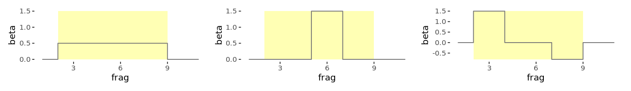
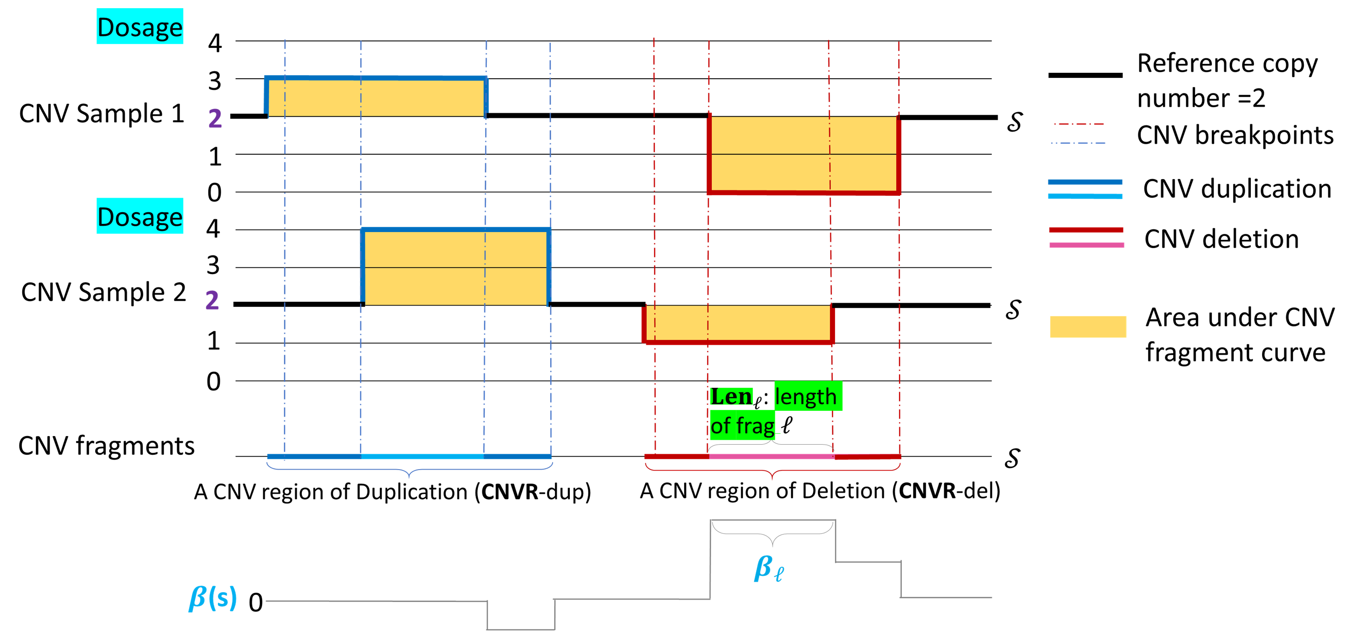
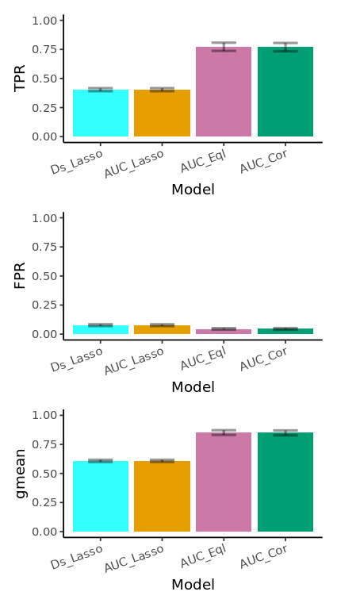
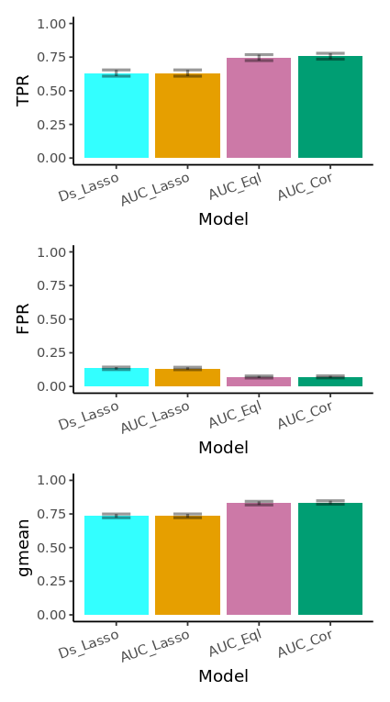
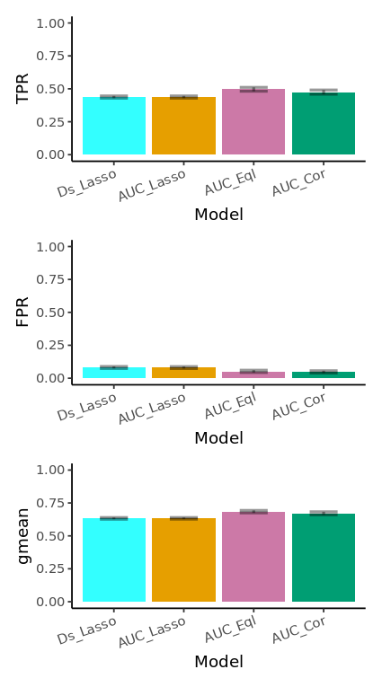
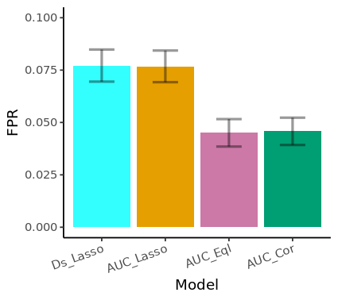
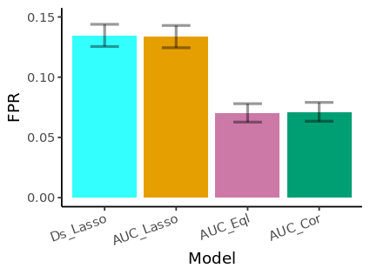
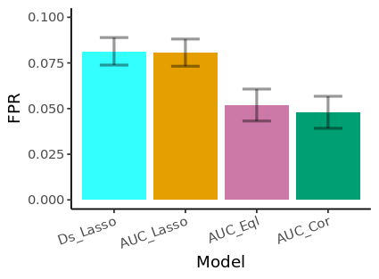
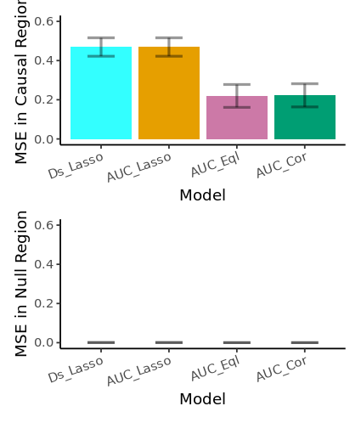
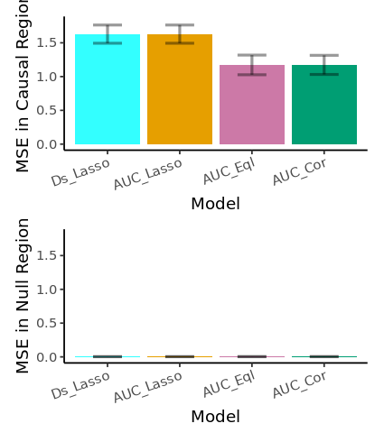
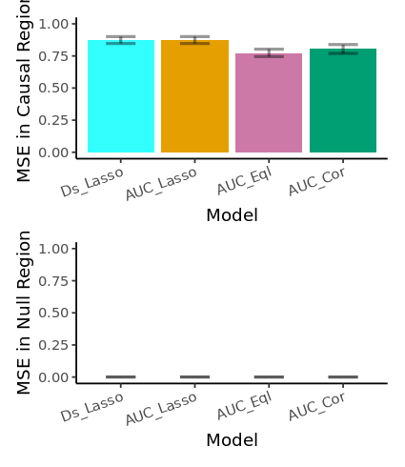
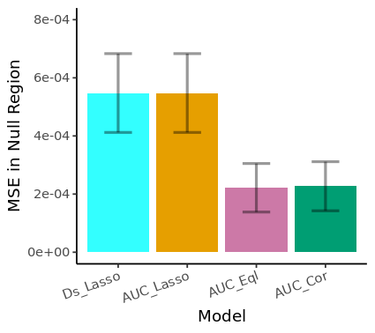
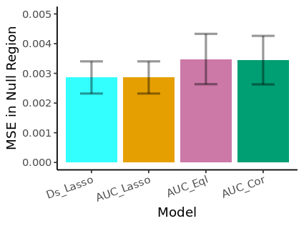
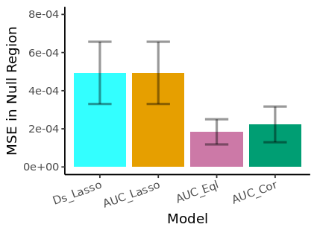
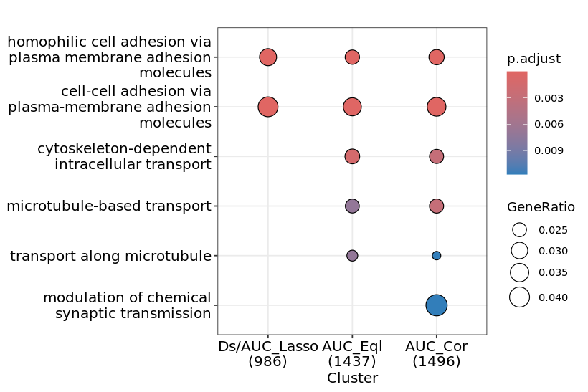


American Society of Human Genetics Annual Meeting 2023
Washington, DC
10/31/2023 - 11/5/2023
Estimating Association Effects of Copy Number Variants Using Penalized Regression with Lasso and Weighted Fusion Penalties
Yaqin Si¹, Wenbin Lu¹, Albert A. Tucci¹, Hui Wang², Yuhuan Cheng¹, Li-San Wang², Gerard Schellenberger², Wan-Ping Lee², Jung-Ying Tzeng¹
1. North Carolina State University, Raleigh, NC, United States. 2. University of Pennsylvania, Philadelphia, PA, United States.
Goal
Simulation and Real Data Analysis
Copy number variants (CNVs) are DNA gains or losses involving at least 50bp.
We propose a statistical method for estimating CNV effects on phenotype.
Properties of the proposed methods:
  Incorporate multiple CNV features (see Figure 1)
    Dosage (duplication vs. deletion, number of extra copies)
    Length
  Assess the joint effect of all CNV events within a genomic region
  Avoid arbitrary CNV region definition
  Allow CNV effects comparable across different studies
Models to compare
Baseline 1: Ds_Lasso (X=|Dosage-2|)
Baseline 2: AUC_Lasso (X=AUC)
Model 1: AUC_Eql (Lasso + Fusion Equal weight)
Model 2: AUC_Cor (Lasso + Fusion Correlation-based weight)
Simulation scenarios and results:
Real data application:
1. All CNV fragments in the same CNVR share the same effect
2. Part of the CNV fragments in the same CNVR share the same effect
3. Part of the CNV fragments in the same CNVR have positive / negative effect
Figure 1: CNV fragments and the effects within CNV duplication and deletion regions
$β_{ℓ}$: effect size of CNV fragment $ℓ$ at genomic position “$s$” with $s∈$ frag $ℓ$
Methods
Proposed Model:
$g\left(μ_{𝒾}\right)=β_{0}+\int_{s}{β\left(s\right)x_{𝒾}^{∗}\left(s\right)ds}=β_{0}+\sum_{frag ℓ}{\int_{s∈frag ℓ}{{β\left(s\right) x}_{𝒾}^{∗}\left(s\right)ds}}$,
where $x_{i}^{∗}\left(s\right)≡\left|{Dosage}_{𝒾s}−2\right|$
reference copy number
subject $i$’s dosage |absolute value| accommodates
at position $s$ duplication and deletion
Assume constant effect within a CNV fragment, i.e., $β\left(s\right)=β_{ℓ}$for $s∈frag ℓ$
$∴\int_{s∈frag ℓ}{β\left(s\right)x_{𝒾}^{∗}\left(s\right)ds}=β_{ℓ}\int_{s∈frag ℓ}{x_{𝒾}^{∗}\left(s\right)ds}≡β_{ℓ}x_{𝒾ℓ}$
where $x_{iℓ}=\int_{s∈frag ℓ}{x_{𝒾}^{∗}\left(s\right)ds}=area under CNV curve \left(AUC\right)=$ ${Len}_{𝒾ℓ}×\left|{Dosage}_{𝒾ℓ}−2\right|$
The proposed model can be simplified as
$g\left(μ_{𝒾}\right)=β_{0}+\sum_{ℓ}{β_{ℓ}x_{ℓi}}$ ← regress trait on $x≡$“length”$×$”dosage”
Figure 2: Simulation results under different effect scenarios
The proposed models show:
Better variable selection performance (higher TPR, lower FPR, and higher G-measure) than the Lasso models.
Better effect size estimation performance (Lower/equivalent MSE in Causal region and Null region) than Lasso models.
Model Fitting:
Proposed to impose two penalty terms:
  Lasso penalty to deal with high dimensionalities and to select phenotype-associated CNVs, i.e., ${\left\|β\right\|}_{1}<a$
  Weighted Fusion penalty to encourage (not force) adjacent CNV fragments to have similar effect size, i.e., $\sum_{ℓ=1}^{L}{w_{ℓ,ℓ+1}{(β_{ℓ+1}−β_{ℓ})}^{2}}<b$
Model interpretation
Recall that $β\left(s\right)=β_{ℓ}$for $s∈frag ℓ$, i.e.,
$β_{ℓ}$is CNV effect size at genomic position “s” with s in fragment $ℓ$
In contrast, in the commonly considered model, $g\left(μ_{𝒾}\right)=α_{0}+\sum_{ ℓ}{α_{ℓ}⋅\text{|}{Dosage}_{𝒾ℓ} \text{ −2}}|,$
$α_{ℓ}$ is the aggregated CNV effect across all positions in fragment $ℓ$ (and hence would depend on the fragment length)
If each study has its own CNV fragment definition, $β_{ℓ}$ of the same genomic position is comparable across different studies but $α_{ℓ}$ is not
Can show that $α_{ℓ}=β_{ℓ}×{Length}_{ℓ}$ (i.e., $\frac{α_{ℓ}}{{length}_{ℓ}}$ is comparable across different studies)
Figure 3: Gene ontology (GO) enrichment analysis for Alzheimer’s Diseases associated genes identified by different models
The proposed models identify additional enriched genes in pathways related to neuron structure and function.
Future work: Apply to other phenotype-CNV association analysis, develop an R package for easy application

