Slide 1
Constrained DAG Structure Learning via Variational Auto Encoder
Group member: Ruohan Liao Yaqin Si Colin Moore
Major: Bioinformatics Bioinformatics Computer Science
ECE 542: Neural Network

Slide 2
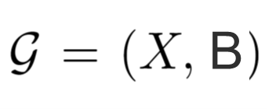

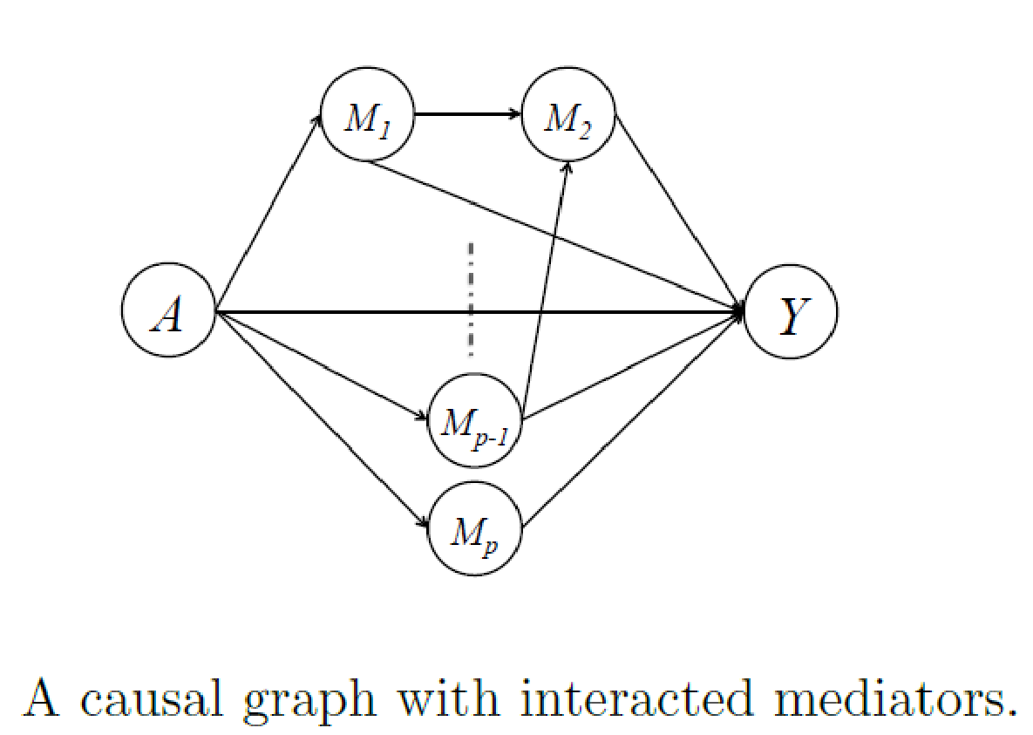
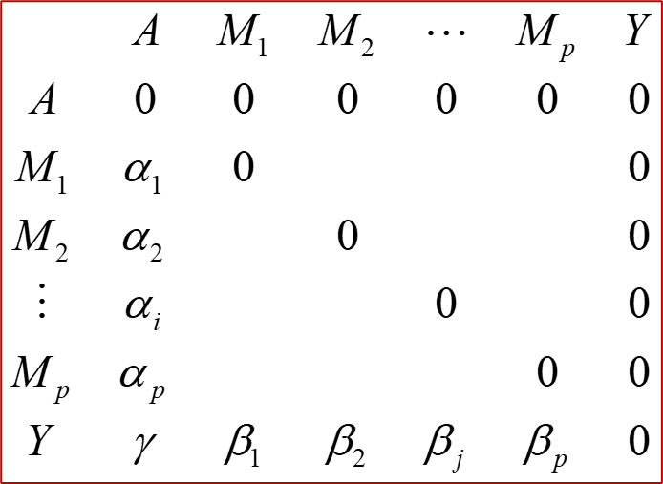
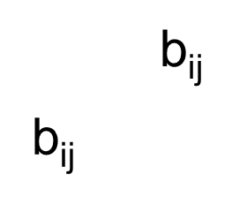
1.Object
A: Exposure
M: Mediators
Y: Outcome
Weighted DAG with weight matrix B.
Figure 1: The illustration of DAGs with different types of mediators.
Left: Network representation Right: Graph weighted matrix representation

Slide 3
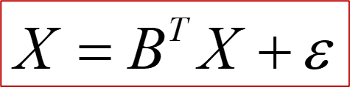
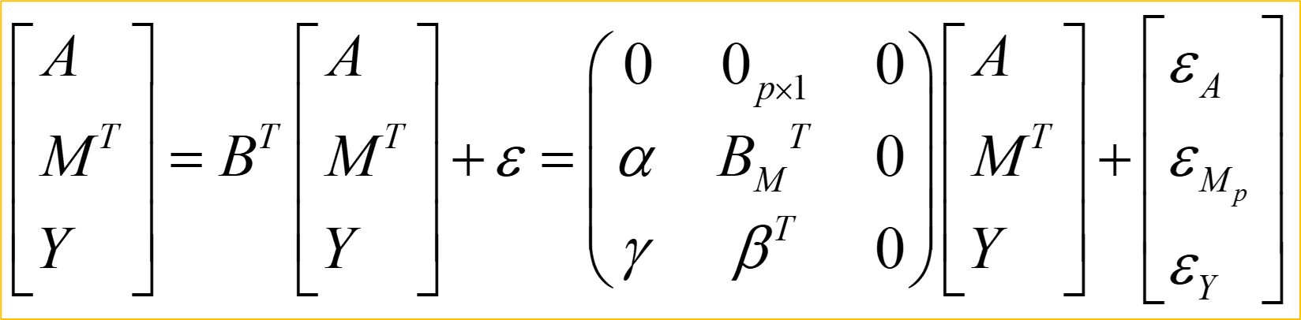

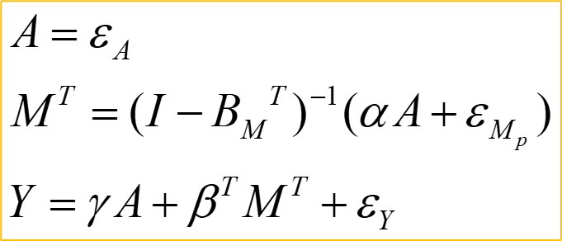
2.Method
2.1 Linear structural equation model(LSEM)
Weighted DAG with weight matrix B.
Notes:
LSEM

Slide 4
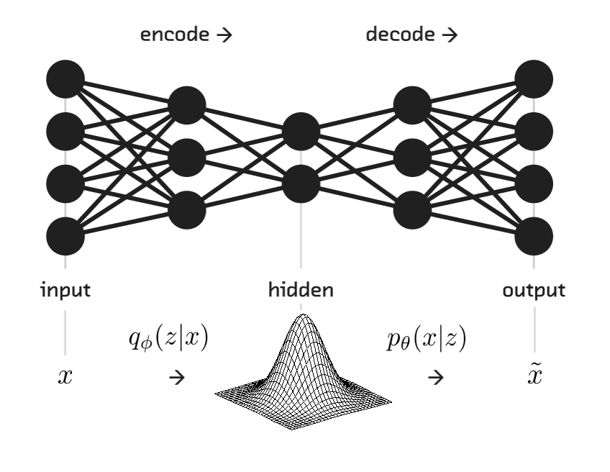
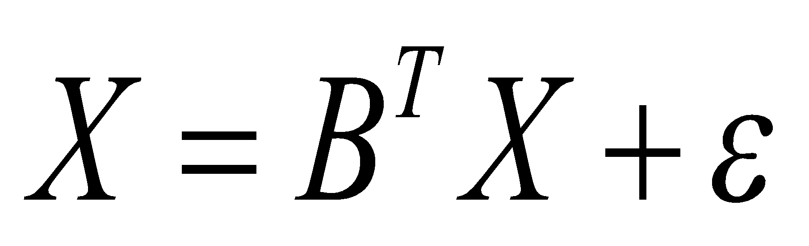
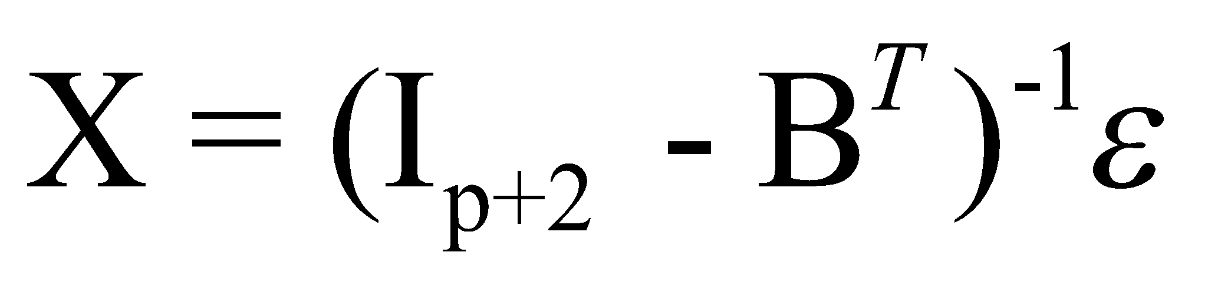
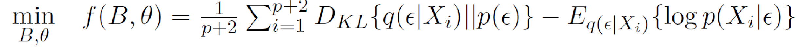
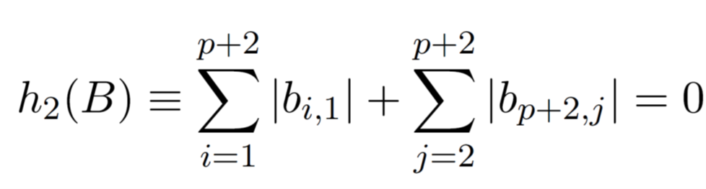
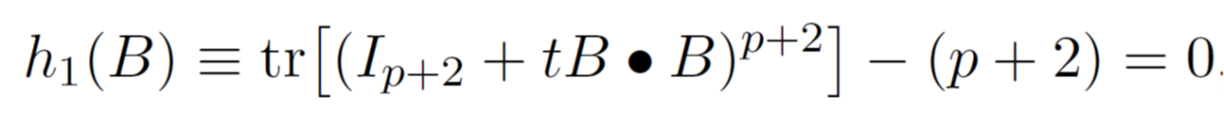
2.2 Constrained structural learning—ANOCE: CVAE algorithm
A type of deep generative model, Variational Autoencoders: VAE
– assume actual data is generated from probability distribution of some latent variable
Random error ε treated as the independent latent variables to generate X
P(੬|X)
P(X|੬)
Figure 2: VAE model
Objective function and penalties:
Evidence Lower Bound (ELBO)
Acyclicity constraint
Topological ordering constraint

Slide 5
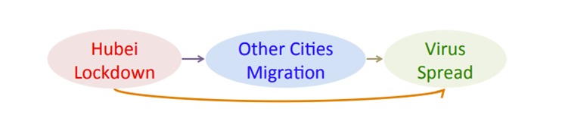
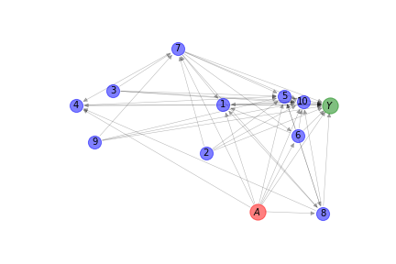
3.Data
Branch 1: .Real Data Set
Branch 2: Simulation Data Set
Generated true DAG with interacted mediators from a random procedure.
Number of mediators p = 10.
Evaluation metrics: TPR, FPR, F1-score, Structural Hamming Distance
Exposure A (1 exposure): Locking Wuhan down on Jan 23rd, 2020
Mediators M (30 mediators): Migration scale of major Chinese cities outside Hubei
Significantly reduced
Outcome Y (1 outcome): Stopping virus spreading
Sample size: 38
A M Y
Figure 3: Real data structure
Figure 4: Simulation data structure
SHD, the smallest number of edge additions, deletions, and reversals to convert the estimated graph into the true DAG
Notes:
•Exposure A: Locking Wuhan down on Jan 23rd, 2020, followed by 12 other cities in Hubei, known as “2020 Hubei lockdowns”;
•Outcome Y : Stopping virus spreading;
•Mediators M: Migration scale of major Chinese cities outside Hubei, significantly reduced due to the lockdown and thus blocked the epidemic spread.;
Specifically, the number of mediators is 30 and sample size is 38 under this scenario.

Slide 6
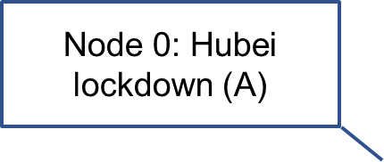
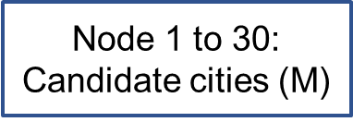
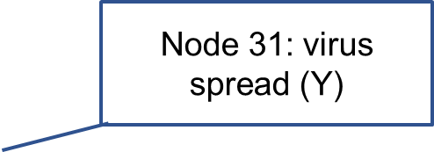
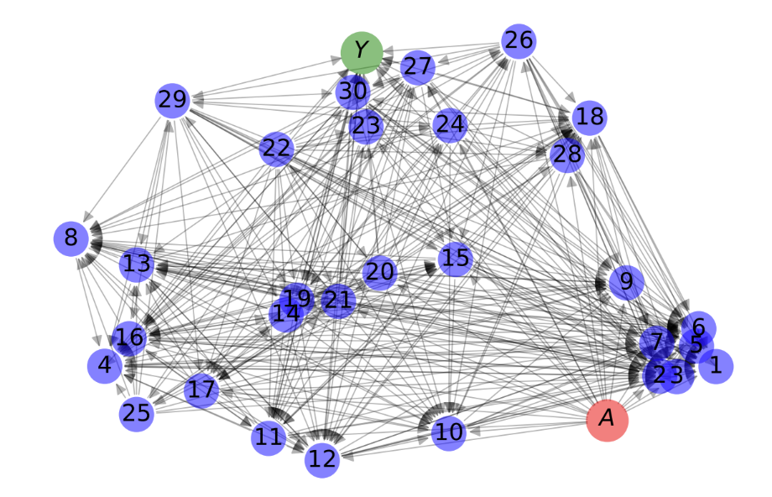
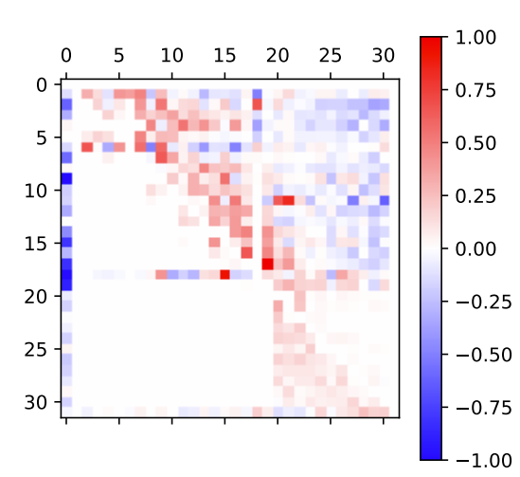
4.Results
Real data: Causal effect of “Wuhan lockdown” on virus spreading
Figure 5: Causal effect of “Wuhan lockdown” on virus spreading
Left : Network representation Right: Graph weighted matrix representation

Slide 7
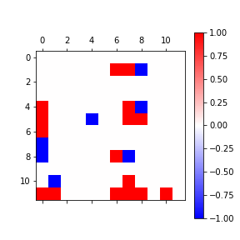
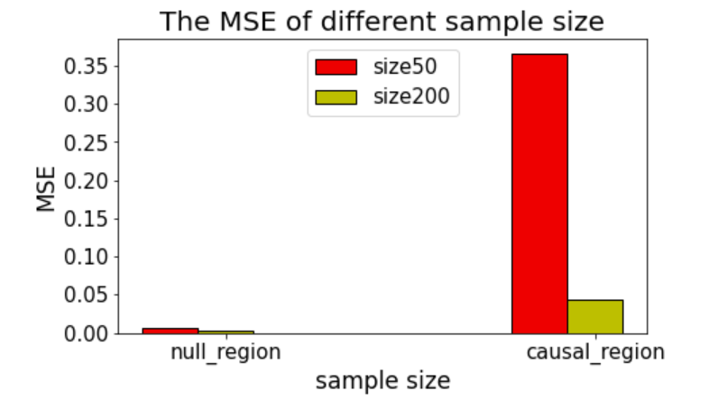
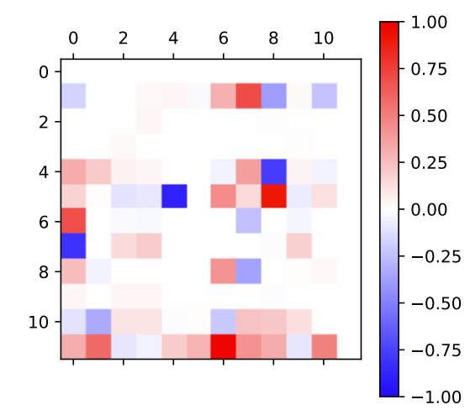
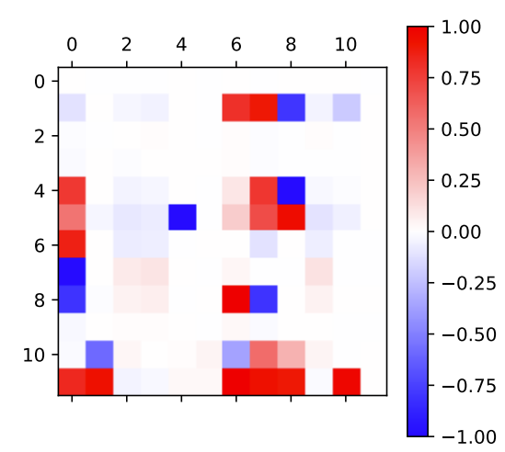
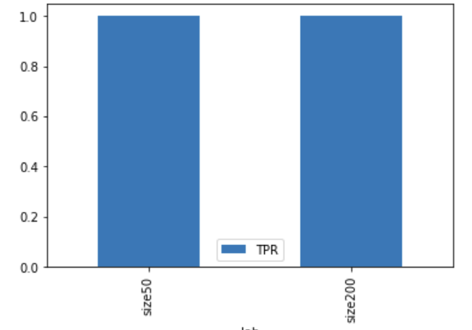
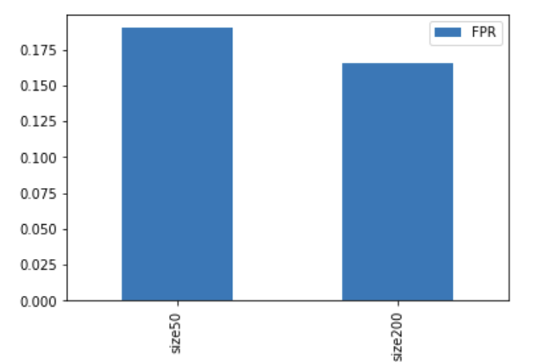
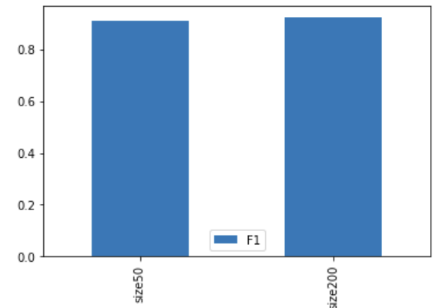
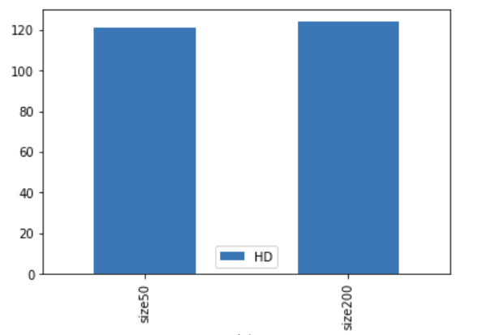
Simulation: Increase Number of Sample Size
True
Sample Size=50
Baseline setting
Sample Size=200
TPR
FPR
F1-score
Structural Hamming distance
SHD, the smallest number of edge additions, deletions, and reversals to convert the estimated graph into the true DAG

Slide 8
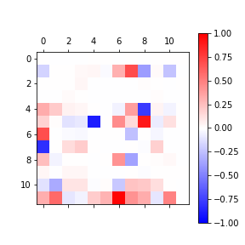
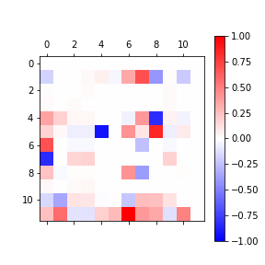
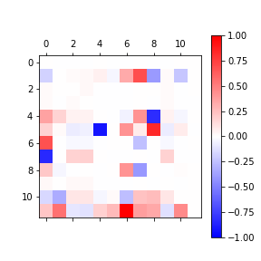
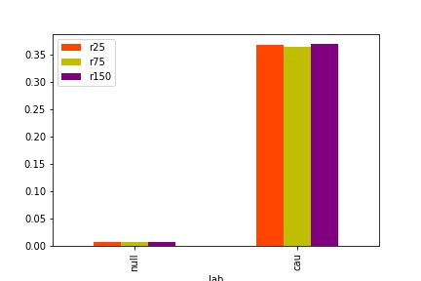
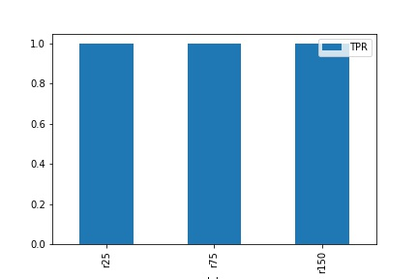
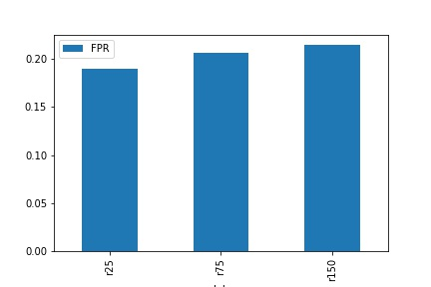
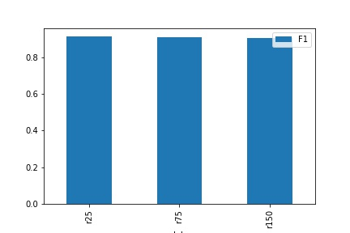

Simulation: random sampling replications
Rep=25
Baseline setting
Rep=75
Rep=150
MSE
TPR
FPR
F1-score
Structural Hamming distance
SHD, the smallest number of edge additions, deletions, and reversals to convert the estimated graph into the true DAG

Slide 9
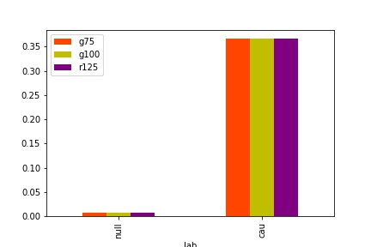

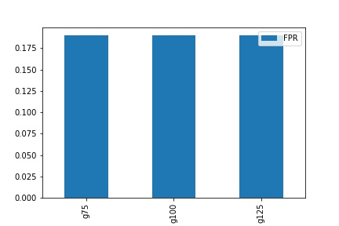
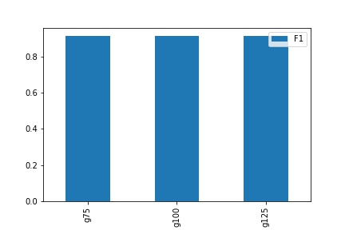
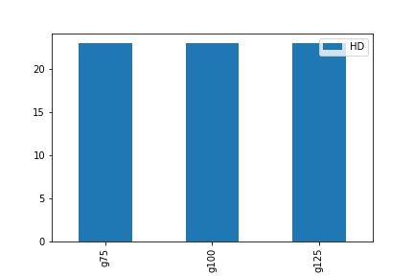
simulation: Learning rate decay
MSE
Learning rate decay 1
Baseline setting
Learning rate decay 0.75
Learning rate decay 1.25
TPR
FPR
F1-score
Structural Hamming distance
SHD, the smallest number of edge additions, deletions, and reversals to convert the estimated graph into the true DAG

Slide 10
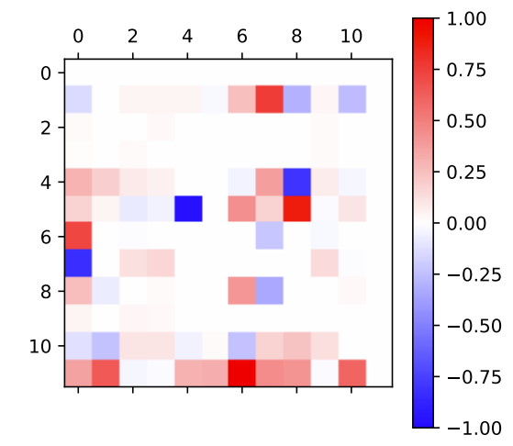
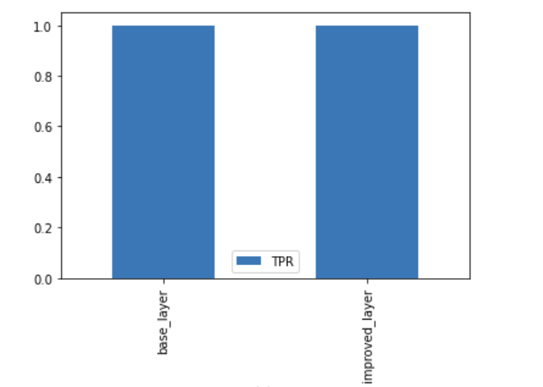
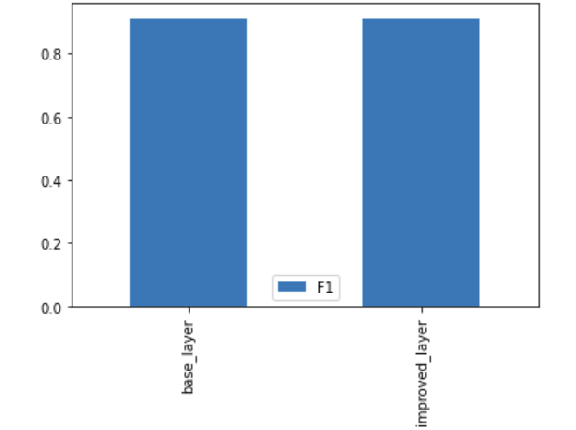
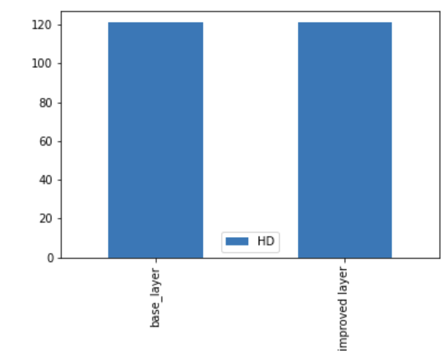
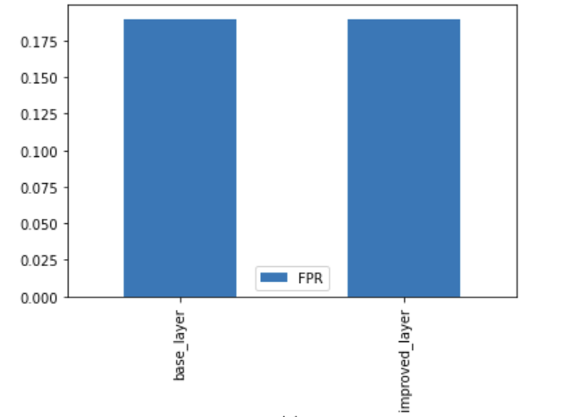
simulation: increase number of hidden layers
True
Baseline Hidden Layer
Improved Hidden Layer
Improvement of Hidden Layer Structure
FPR
TPR
F1
HD

Slide 11
Summary
1. Object
3. Data
3.1 Real Data
3.2 Sim Data
A: Exposure
M: Mediators
Y: Outcome
2. Method
4. Results
P(੬|X)
P(X|੬)

Slide 12
Thank you!

Slide 13
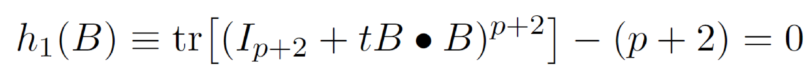
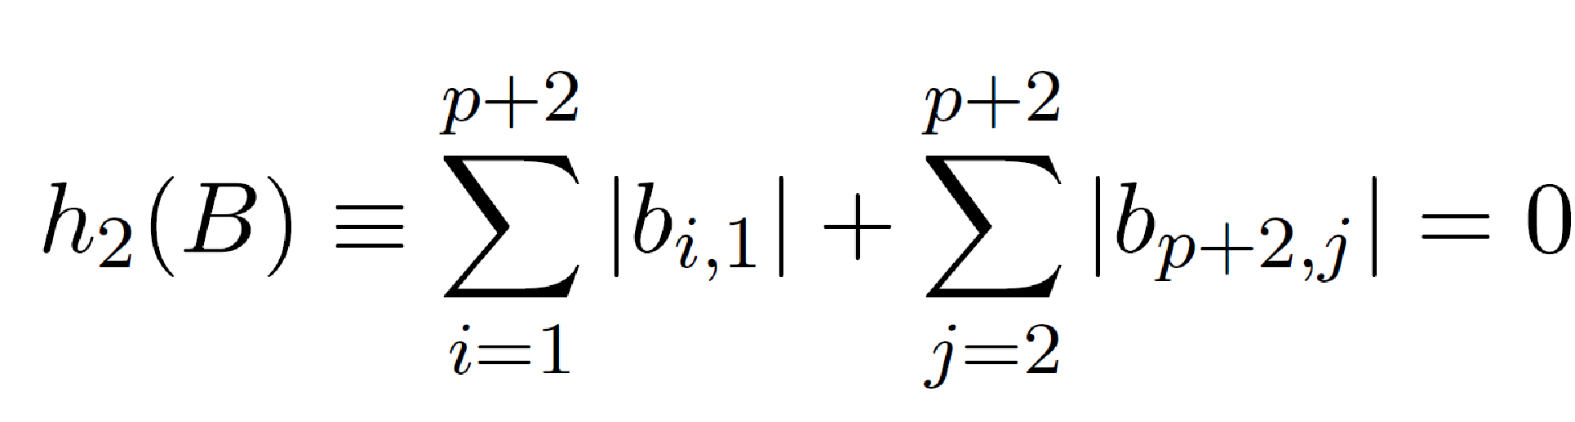
VAE Constraints
Where h1(B) denotes the acyclicity constraint;
And h2(B) denotes the background knowledge: Temporal order A as the first order, Y as the last one;
Loss function based on augmented Lagrangian:
λ1, λ2 Lagrange multiplier; c, d penalty terms

Slide 14
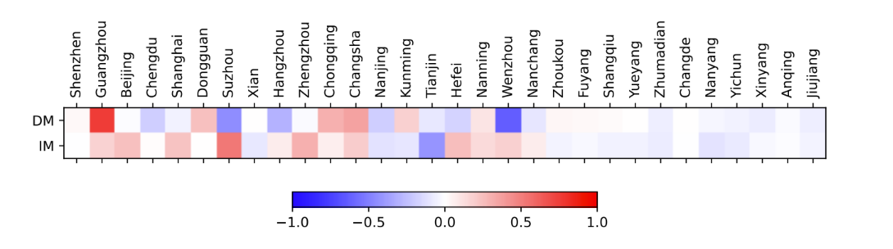
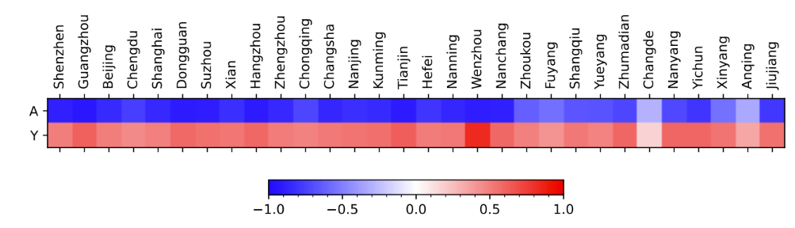
Causal effect decomposition of “Wuhan lockdown” on virus spreading
A, M1, M2, … … M30, Y

Slide 15
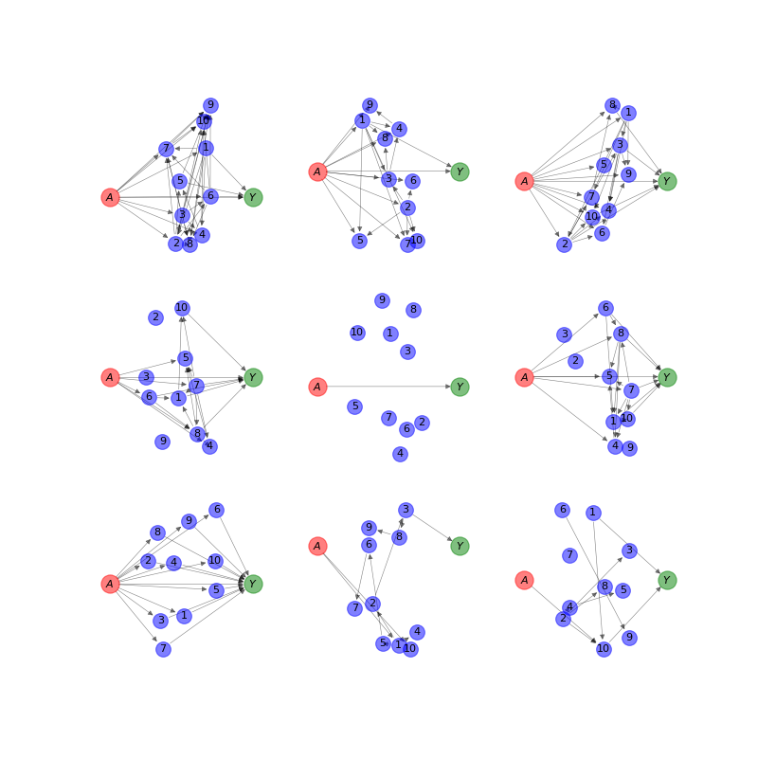
Simulated Dataset
Graphs are each 12 nodes
Varying connection density/sparsity

