Slide 1
CLUSTERING
Insert Instructor Name
Title, Company

Slide 2
LEARNING OBJECTIVES
COMMUNICATING RESULTS
Supervised vs unsupervised algorithms
Understand and apply k-means clustering
Density-based clustering: DBSCAN
Silhouette Metric

Slide 3
OPENING
UNSUPERVISED LEARNING

Slide 4
UNSUPERVISED LEARNING
So far all the algorithms we have used are supervised: each observation (row of data) came with one or more labels, either categorical variables (classes) or measurements (regression)
Unsupervised learning has a different goal: feature discovery
Clustering is a common and fundamental example of unsupervised learning
Clustering algorithms try to find meaningful groups within data

Slide 5
CLUSTERING
CLUSTERING

Slide 6
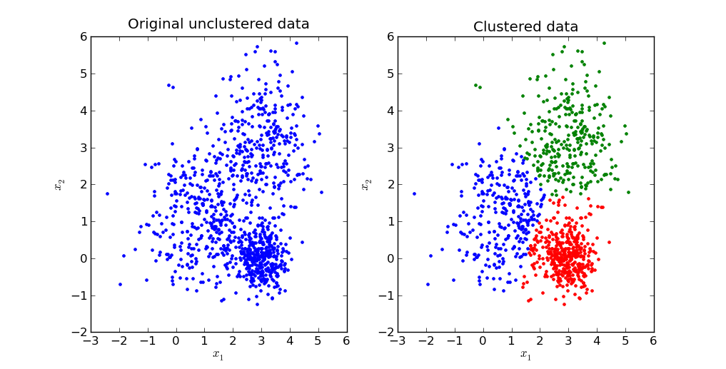
CLUSTERING: Centroids
Source: http://stackoverflow.com/questions/24645068/k-means-clustering-major-understanding-issue

Slide 7

ACTIVITY: KNOWLEDGE CHECK
ANSWER THE FOLLOWING QUESTIONS
Why might data often appear in centered clusters?
EXERCISE
DELIVERABLE
Answers to the above questions

Slide 8
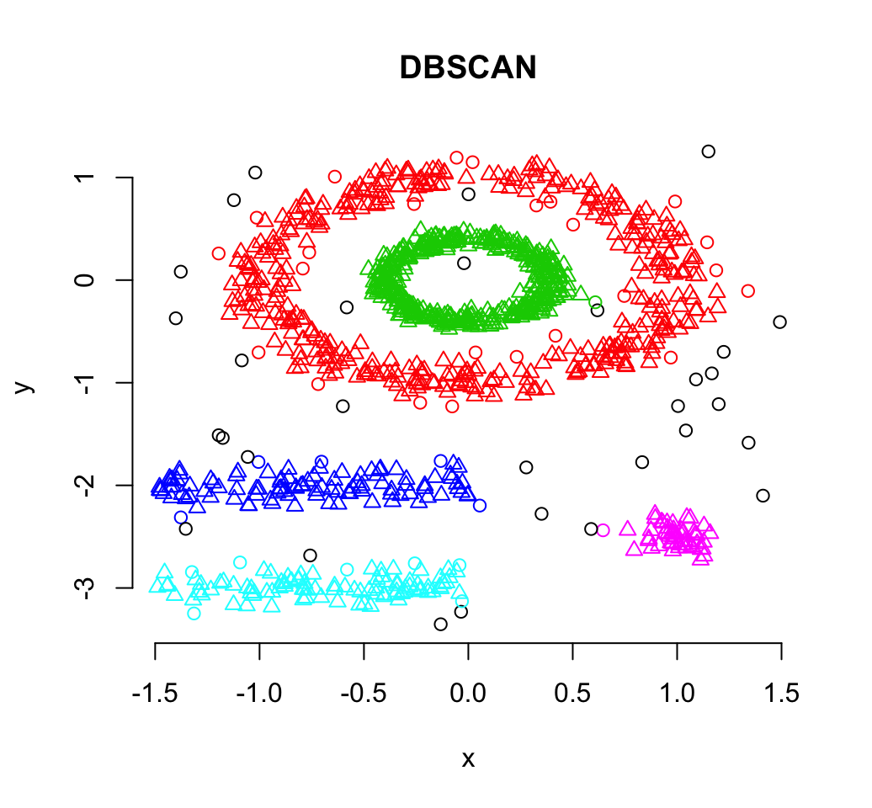
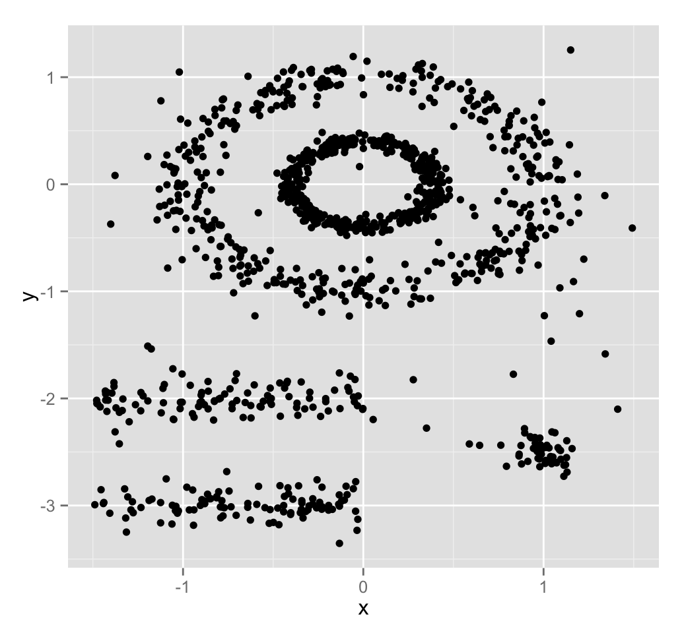
CLUSTERING: Density-Based
Source: http://www.sthda.com/english/wiki/dbscan-density-based-clustering-for-discovering-clusters-in-large-datasets-with-noise-unsupervised-machine-learning

Slide 9
ACTIVITY: KNOWLEDGE CHECK
ANSWER THE FOLLOWING QUESTIONS
Why might data often appear in density-based clusters?
EXERCISE
DELIVERABLE
Answers to the above questions

Slide 10
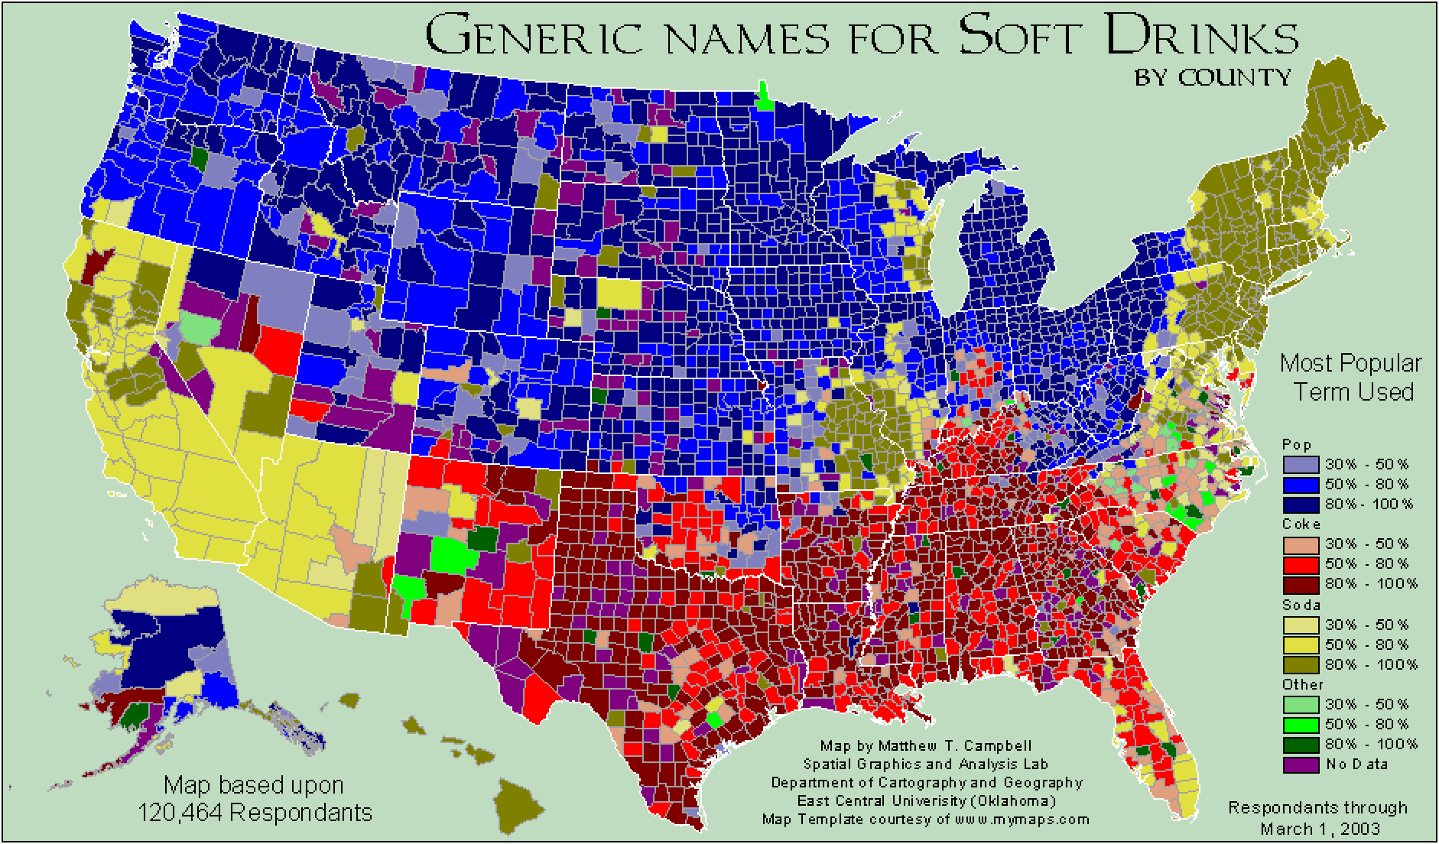
ACTIVITY: KNOWLEDGE CHECK
See also: http://www4.ncsu.edu/~jakatz2/files/dialectposter.png

Slide 11
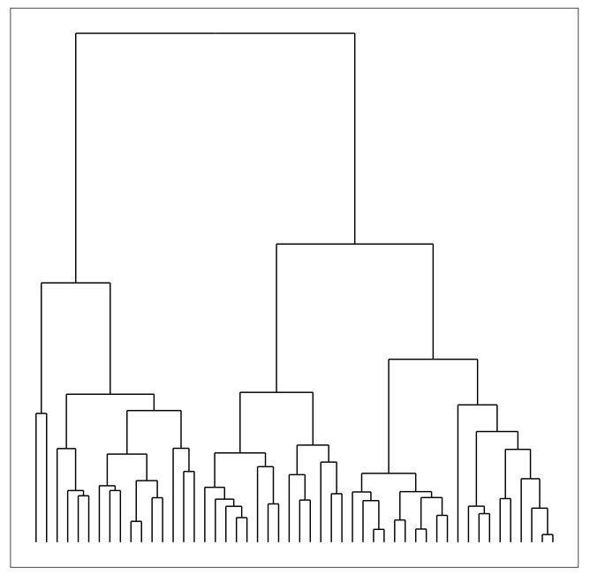
CLUSTERING: Hierarchical
Build hierarchies that form clusters
Based on classification trees (next lesson)

Slide 12
ACTIVITY: KNOWLEDGE CHECK
ANSWER THE FOLLOWING QUESTIONS
How is unsupervised learning different from classification?
EXERCISE
DELIVERABLE
Answers to the above questions

Slide 13
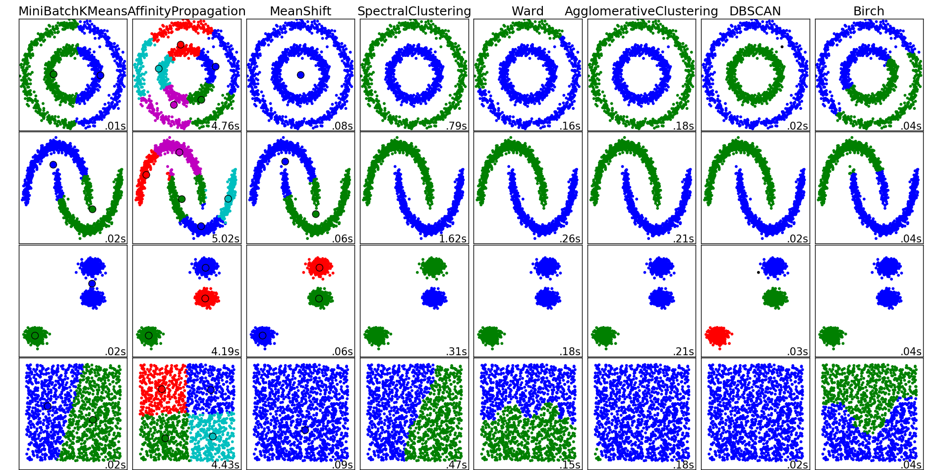
CLUSTERING
There are many clustering algorithms

Slide 14
ACTIVITY: KNOWLEDGE CHECK
ANSWER THE FOLLOWING QUESTIONS
Can you think of a real-world clustering application?
EXERCISE
DELIVERABLE
Answers to the above questions

Slide 15
ACTIVITY: KNOWLEDGE CHECK
ANSWERS
Recommendation Systems e.g. Netflix genres
Medical Imaging: differentiate tissues
Identifying market segments
Discover communities in social networks
Lots of applications for genomic sequences (homologous sequences, genotypes)
Earthquake epicenters
Fraud detection
EXERCISE

Slide 16
CLUSTERING
K-MEANS: CENTRIOD CLUSTERING

Slide 17
K-MEANS CLUSTERING
k-Means clustering is a popular centroid-based clustering algorithm
Basic idea: find k clusters in the data centrally located around various mean points
Awesome Demo

Slide 18
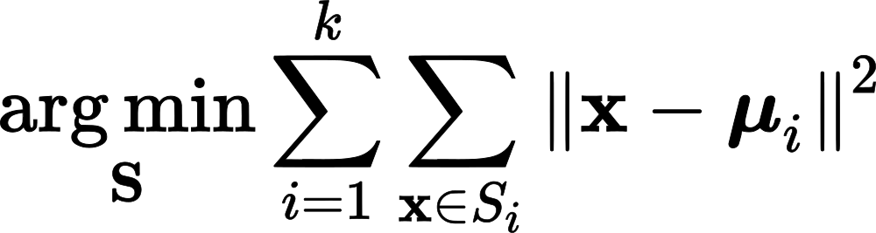
K-MEANS CLUSTERING
k-Means seeks to minimize the sum of squares about the means
Precisely, find k subsets S_1, … S_k of the data with means mu_1, …, mu_k that minimizes:

Slide 19
K-MEANS CLUSTERING
This is a computationally difficult problem to solve so we rely on heuristics
The “standard” heuristic is called “Lloyd’s Algorithm”:
Start with k initial mean values
Data points are then split up into a Voronoi diagram
Each point is assigned to the “closest” mean
Calculate new means based on centroids of points in the cluster
Repeat until clusters do not change

Slide 20
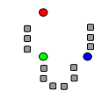
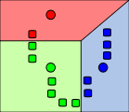
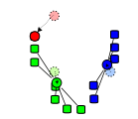
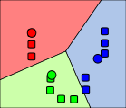
K-MEANS CLUSTERING
Start with initial k mean values
Data points are then split up into a Voronoi diagram
Calculate new means based on centroids

Slide 21
K-MEANS CLUSTERING
from sklearn.cluster import KMeans
est = KMeans(n_clusters=3)
est.fit(X)
labels = est.labels_
Let’s try it out!

Slide 22
ACTIVITY: KNOWLEDGE CHECK
ANSWER THE FOLLOWING QUESTIONS
How do we assign meaning to the clusters we find?
Do clusters always have meaning?
EXERCISE
DELIVERABLE
Answers to the above questions

Slide 23
K-MEANS CLUSTERING
Assumptions are important! k-Means assumes:
k is the correct number of clusters
the data is isotropically distributed (circular/spherical distribution)
the variance is the same for each variable
clusters are roughly the same size
Nice counterexamples / cases where assumptions are not met:
http://varianceexplained.org/r/kmeans-free-lunch/
Scikit-Learn Examples

Slide 24
K-MEANS CLUSTERING
Netflix prize: Predict how users will rate a movie
How might you do this with clustering?
Cluster similar users together and take the average rating for a given movie by users in the cluster (which have rated the movie)
Use the average as the prediction for users that have not yet rated the movie
In other words, fit a model to users in a cluster for each cluster and make predictions per cluster

Slide 25
CLUSTERING
DBSCAN: DENSITY BASED CLUSTERING

Slide 26
DBSCAN CLUSTERING
DBSCAN: Density-based spatial clustering of applications with noise (1996)
Main idea: Group together closely-packed points by identifying
Core points
Reachable points
Outliers (not reachable)
Two parameters:
min_samples
eps

Slide 27
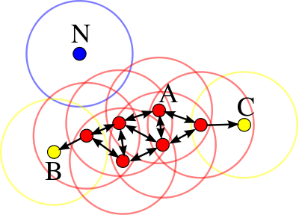
DBSCAN CLUSTERING
Core points: at least min_samples points within eps of the core point
Such points are directly reachable from the core point
Reachable: point q is reachable from p if there is a path of core points from p to q
Outlier: not reachable

Slide 28
DBSCAN CLUSTERING
A cluster is a collection of connected core and reachable points

Slide 29
CLUSTERING: Density-Based
Another example: Page 6
Awesome Demo

Slide 30
ACTIVITY: KNOWLEDGE CHECK
ANSWER THE FOLLOWING QUESTIONS
How does DBSCAN differ from k-means?
EXERCISE
DELIVERABLE
Answers to the above questions

Slide 31
DBSCAN CLUSTERING
from sklearn.cluster import DBSCAN
est = DBSCAN(eps=0.5, min_samples=10)
est.fit(X)
labels = est.labels_
Let’s try it out!

Slide 32
DBSCAN CLUSTERING
DBSCAN advantages:
Can find arbitrarily-shaped clusters
Don’t have to specify number of clusters
Robust to outliers
DBSCAN disadvantages:
Doesn’t work well when clusters are of varying densities
hard to chose parameters that work for all clusters
Can be hard to chose correct parameters regardless

Slide 33
ACTIVITY: CLUSTERING USERS
ANSWER THE FOLLOWING QUESTIONS
How does DBSCAN differ from k-means?
EXERCISE
DELIVERABLE
Answers to the above questions

Slide 34
CLUSTERING
HIERARCHICAL CLUSTERING

Slide 35
CLUSTERING: Hierarchical
Build hierarchies that form clusters
Based on classification trees (next lesson)

Slide 36
HIERARCHICAL CLUSTERING
We’ll discuss the details once we cover decision trees. For now we can black box the model and fit with sklearn
from sklearn.cluster import AgglomerativeClustering
est = AgglomerativeClustering(n_clusters=4)
est.fit(X)
labels = est.labels_
Let’s try it out!

Slide 37
CLUSTERING
CLUSTERING METRICS

Slide 38
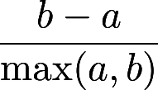
CLUSTERING METRICS
As usual we need a metric to evaluate model fit
For clustering we use a metric called the Silhouette Coefficient
a is the mean distance between a sample and all other points in the cluster
b is the mean distance between a sample and all other points in the nearest cluster
The Silhouette Coefficient is:
Ranges between 1 and -1
Average over all points to judge the cluster algorithm

Slide 39
CLUSTERING METRICS
from sklearn import metrics
from sklearn.cluster import KMeans
kmeans_model = KMeans(n_clusters=3, random_state=1).fit(X)
labels = kmeans_model.labels_
metrics.silhouette_score(X, labels, metric='euclidean')

Slide 40
CLUSTERING METRICS
There are a number of other metrics based on:
Mutual Information
Homogeneity
Adjusted Rand Index (when you know the labels on the training data)

Slide 41
PUTTING IT TOGETHER
CLUSTERING, CLASSIFICATION,
AND REGRESSION

Slide 42
ACTIVITY: KNOWLEDGE CHECK
ANSWER THE FOLLOWING QUESTIONS
How might we combine clustering and classification?
EXERCISE
DELIVERABLE
Answers to the above questions

Slide 43
CLUSTERING, CLASSIFICATION, AND REGRESSION
We can use clustering to discover new features and then use those features for either classification or regression
For classification, we could use e.g. k-NN to classify new points into the discovered clusters
For regression, we could use a dummy variable for the clusters as a variable in our regression

Slide 44
ACTIVITY: CLUSTERING + CLASSIFICATION
EXERCISE
Using the starter code, perform a k-means clustering on the flight delay data
Use the clustering to create a classifier
EXERCISE
DELIVERABLE
A completed notebook

Slide 45
CONCLUSION
TOPIC REVIEW

Slide 46
REVIEW AND NEXT STEPS
Clustering is used to discover features, e.g. segment users or assign labels (such as species)
Clustering may be the goal (user marketing) or a step in a data science pipeline

Slide 47
COURSE
BEFORE NEXT CLASS

Slide 48
UPCOMING
BEFORE NEXT CLASS
Final Project part 2

Slide 49
LESSON
Q & A

Slide 50
LESSON
EXIT TICKET
DON’T FORGET TO FILL OUT YOUR EXIT TICKET

Slide 51
THANKS!
NAME
Body Level One
Body Level Two
Body Level Three
Body Level Four
Body Level Five
Body Level One
Body Level Two
Body Level Three
Body Level Four
Body Level Five
Optional Information:
Email?
Website?
Twitter?

