Slide 1
INTRODUCTION TO REGRESSION ANALYSIS
Jonathan Landesman

Slide 2
LEARNING OBJECTIVES
INTRODUCTION TO REGRESSION ANALYSIS
Define data modeling and simple linear regression
Understand Linear Regression Outputs
Build a model using sklearn and stastmodels
Intepret model findings

Slide 3
INTRODUCTION TO REGRESSION ANALYSIS
PRE-WORK

Slide 4
PRE-WORK REVIEW
Effectively show correlations between an independent variable x and a dependent variable y
Be familiar with the get_dummies function in pandas
Understand the difference between vectors, matrices, Series, and DataFrames
Understand the concepts of outliers and distance.
Be able to interpret p values and confidence intervals

Slide 5
OPENING
INTRODUCTION TO REGRESSION ANALYSIS

Slide 6
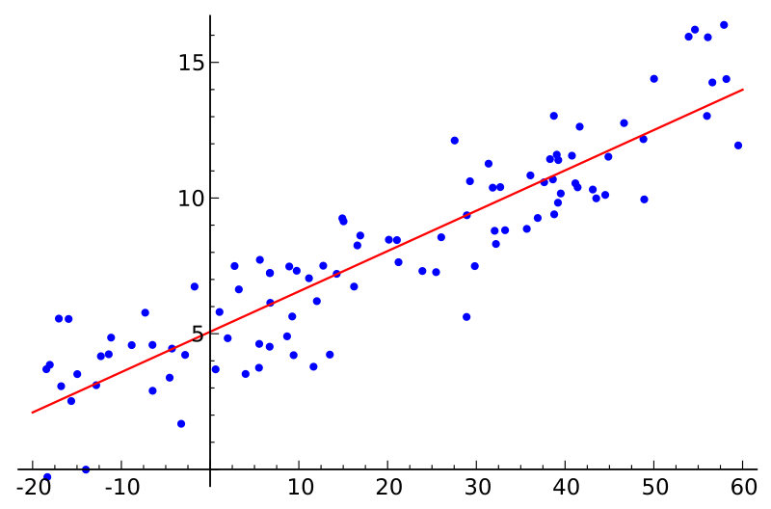
SIMPLE LINEAR REGRESSION
Def: Explanation of a continuous variable given a series of independent variables
The simplest version is just a line of best fit: y = mx + b
Explain the relationship between x and y using the starting point b and the power in explanation m.

Slide 7
Lets make one with simulated data
https://ga.co/2vWklzy

Slide 8
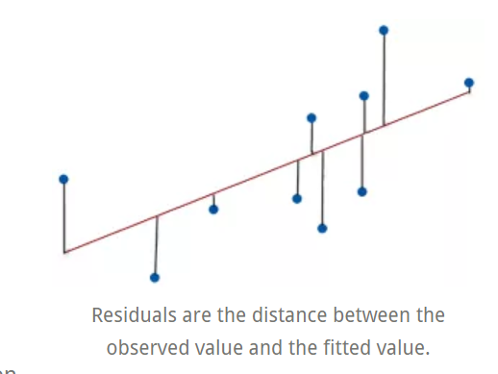
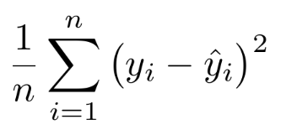
WHY “OLS”? INTRO TO LOSS FUNCTIONS
Derivation Details: https://are.berkeley.edu/courses/EEP118/current/derive_ols.pdf

Slide 9
SIMPLE LINEAR REGRESSION
http://setosa.io/ev/ordinary-least-squares-regression/

Slide 10
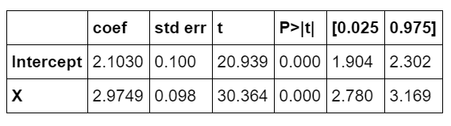
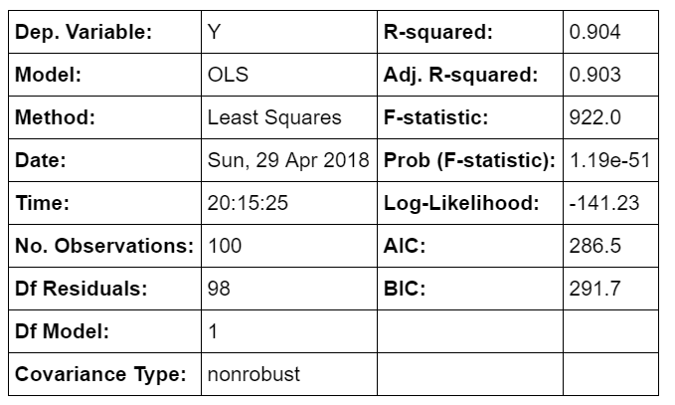
OLS OUTPUTS

Slide 11
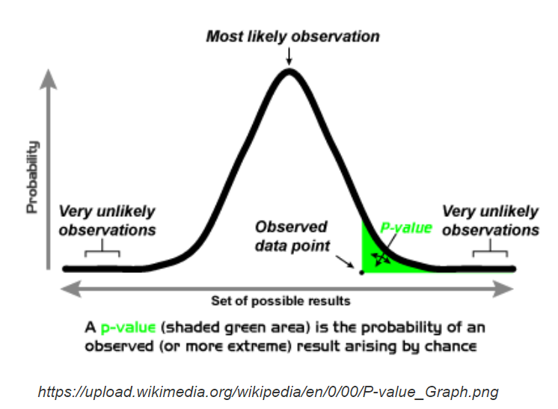
P Values
https://upload.wikimedia.org/wikipedia/en/0/00/P-value_Graph.png

Slide 12
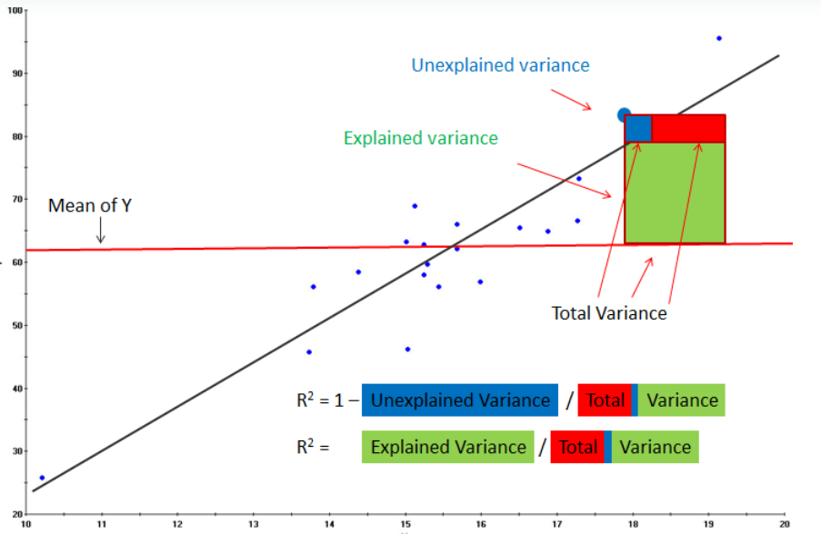
R^2
http://www.rapidinsightinc.com/brushing-r-squared/

Slide 13
INTERPRETATION
Home prices = B0 + B1*square feet + B2*beds +e
Petal_width ~ B0 + B1*petal_length + e

Slide 14
DUMMY VARIABLE INTERPRETATION
prices ~ square feet + number_bedrooms + in_manhattan

Slide 15
CODE
https://ga.co/2r7MwWH

Slide 16
OLS ASSUMPTIONS
The relationship between X and Y is linear. (Non-linearity: Global Financial Crisis)
X affects Y but Y does not affect X! (exogeneity)
No/limited multicolinearity
Homoskedasticity (don’t worry too much about it)

Slide 17
CODE
https://git.generalassemb.ly/DAT-April18/lesson-05/blob/master/code/starter-code/demo-lesson-06-starter-code.ipynb
https://ga.co/2r7MwWH

Slide 18
INTRODUCTION
SIMPLE REGRESSION ANALYSIS IN SKLEARN

Slide 19
SIMPLE LINEAR REGRESSION ANALYSIS IN SKLEARN
Sklearn defines models as objects (in the OOP sense).
You can use the following principles:
All sklearn modeling classes are based on the base estimator. This means all models take a similar form.
All estimators take a matrix X, either sparse or dense.
Supervised estimators also take a vector y (the response).
Estimators can be customized through setting the appropriate parameters.

Slide 20
CLASSES AND OBJECTS IN OBJECT ORIENTED PROGRAMMING
Classes are an abstraction for a complex set of ideas, e.g. human.
Specific instances of classes can be created as objects.
john_smith = human()
Objects have properties. These are attributes or other information.
john_smith.age
john_smith.gender
Object have methods. These are procedures associated with a class/object.
john_smith.breathe()
john_smith.walk()

Slide 21
SIMPLE LINEAR REGRESSION ANALYSIS IN SKLEARN
General format for sklearn model classes and methods
# generate an instance of an estimator class estimator = base_models.AnySKLearnObject() # fit your data estimator.fit(X, y) # score it with the default scoring method (recommended to use the metrics module in the future) estimator.score(X, y) # predict a new set of data estimator.predict(new_X) # transform a new X if changes were made to the original X while fitting estimator.transform(new_X)
LinearRegression() doesn’t have a transform function
With this information, we can build a simple process for linear regression.

Slide 22
SIMPLE LINEAR REGRESSION
However, linear regression uses linear algebra to explain the relationship between multiple x’s and y.
The more sophisticated version: y = beta * X + alpha (+ error)
Explain the relationship between the matrix X and a dependent vector y using a y-intercept alpha and the relative coefficients beta.

Slide 23
GUIDED PRACTICE
USING THE LINEAR REGRESSION OBJECT

Slide 24

ACTIVITY: USING THE LINEAR REGRESSION OBJECT
DIRECTIONS (15 minutes)
EXERCISE
With a partner, generate two more models using the log-transformed data to see how this transform changes the model’s performance.
Use the code on the following slide to complete #1.
DELIVERABLE
Two new models

Slide 25
ACTIVITY: USING THE LINEAR REGRESSION OBJECT
DIRECTIONS (15 minutes)
EXERCISE
X = y = loop = [] for boolean in loop: print 'y-intercept:', boolean lm = linear_model.LinearRegression(fit_intercept=boolean) get_linear_model_metrics(X, y, lm) print
DELIVERABLE
Two new models

Slide 26
INDEPENDENT PRACTICE
BASE LINEAR REGRESSION CLASSES

Slide 27
ACTIVITY: BASE LINEAR REGRESSION CLASSES
DIRECTIONS (20 minutes)
EXERCISE
Experiment with the model evaluation function we have (get_linear_model_metrics) with the following sklearn estimator classes.
linear_model.Lasso()
linear_model.Ridge()
linear_model.ElasticNet()
Note: We’ll cover these new regression techniques in a later class.
DELIVERABLE
New models and evaluation metrics

Slide 28
INTRODUCTION
MULTIPLE REGRESSION ANALYSIS

Slide 29
MULTIPLE REGRESSION ANALYSIS
Simple linear regression with one variable can explain some variance, but using multiple variables can be much more powerful.
We want our multiple variables to be mostly independent to avoid multicollinearity.
Multicollinearity, when two or more variables in a regression are highly correlated, can cause problems with the model.

Slide 30
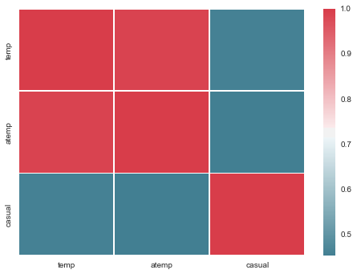
BIKE DATA EXAMPLE
We can look at a correlation matrix of our bike data.
Even if adding correlated variables to the model improves overall variance, it can introduce problems when explaining the output of your model.
What happens if we use a second variable that isn't highly correlated with temperature?

Slide 31
GUIDED PRACTICE
MULTICOLLINEARITY WITH DUMMY VARIABLES

Slide 32
ACTIVITY: MULTICOLLINEARITY WITH DUMMY VARIABLES
DIRECTIONS (15 minutes)
EXERCISE
Load the bike data.
Run through the code on the following slide.
What happens to the coefficients when you include all weather situations instead of just including all except one?
DELIVERABLE
Two models’ output

Slide 33
ACTIVITY: MULTICOLLINEARITY WITH DUMMY VARIABLES
DIRECTIONS (15 minutes)
EXERCISE
lm = linear_model.LinearRegression() weather = pd.get_dummies(bike_data.weathersit) get_linear_model_metrics(weather[[1, 2, 3, 4]], y, lm) print # drop the least significant, weather situation = 4 get_linear_model_metrics(weather[[1, 2, 3]], y, lm)
DELIVERABLE
Two models’ output

Slide 34
GUIDED PRACTICE
COMBINING FEATURES INTO A BETTER MODEL

Slide 35
ACTIVITY: COMBINING FEATURES INTO A BETTER MODEL
DIRECTIONS (15 minutes)
EXERCISE
With a partner, complete the code on the following slide.
Visualize the correlations of all the numerical features built into the dataset.
Add the three significant weather situations into our current model.
Find two more features that are not correlated with the current features, but could be strong indicators for predicting guest riders.
DELIVERABLE
Visualization of correlations, new models

Slide 36
ACTIVITY: COMBINING FEATURES INTO A BETTER MODEL
DIRECTIONS (15 minutes)
EXERCISE
lm = linear_model.LinearRegression() bikemodel_data = bike_data.join() # add in the three weather situations cmap = sns.diverging_palette(220, 10, as_cmap=True) correlations = # what are we getting the correlations of? print correlations print sns.heatmap(correlations, cmap=cmap) columns_to_keep = [] #[which_variables?] final_feature_set = bikemodel_data[columns_to_keep] get_linear_model_metrics(final_feature_set, y, lm)
DELIVERABLE
Visualization of correlations, new models

Slide 37
INDEPENDENT PRACTICE
BUILDING MODELS FOR OTHER Y VARIABLES

Slide 38
ACTIVITY: BUILDING MODELS FOR OTHER Y VARIABLES
DIRECTIONS (25 minutes)
EXERCISE
Build a new model using a new y variable: registered riders.
Pay attention to the following:
the distribution of riders (should we rescale the data?)
checking correlations between the variables and y variable
choosing features to avoid multicollinearity
model complexity vs. explanation of variance
the linear assumption
BONUS
Which variables make sense to dummy?
What features might explain ridership but aren’t included? Can you build these features with the included data and pandas?
DELIVERABLE
A new model and evaluation metrics

Slide 39
CONCLUSION
TOPIC REVIEW

Slide 40
CONCLUSION
You should now be able to answer the following questions:
What is simple linear regression?
What makes multi-variable regressions more useful?
What challenges do they introduce?
How do you dummy a category variable?
How do you avoid a singular matrix?

Slide 41
WEEK 3 : LESSON 6
UPCOMING WORK

Slide 42
Week 4 : Lesson 8
UPCOMING WORK
Project: Final Project, Deliverable 1

Slide 43
INTRODUCTION TO REGRESSION ANALYSIS
Q & A

Slide 44
INTRODUCTION TO REGRESSION ANALYSIS
EXIT TICKET
DON’T FORGET TO FILL OUT YOUR EXIT TICKET!

Slide 45
THANKS!
INSTRUCTOR NAME
Body Level One
Body Level Two
Body Level Three
Body Level Four
Body Level Five
Body Level One
Body Level Two
Body Level Three
Body Level Four
Body Level Five
Optional Information:
Email?
Website?
Twitter?

