Slide 1
DATABASES

Slide 2
LEARNING OBJECTIVES
DATABASES
Understanding of the uses and differences of databases
Accessing databases from Pandas

Slide 3
OPENING
DATABASES

Slide 4
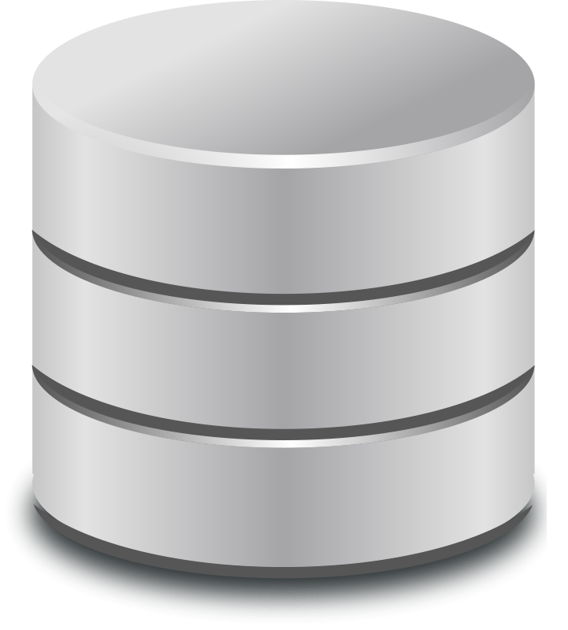
DATABASES
Today’s lesson will be on databases and the SQL query language.
Databases are the standard solution for data storage. They’re far more robust than text and CSV files.
They come in many flavors, but we’ll explore the most common: relational databases.

Slide 5
DATABASES
Relational databases also come in different varieties, but almost all use SQL as a basis for querying (i.e. retrieving) data.
Most analyses typically involve pulling data from a database.

Slide 6
INTRODUCTION
DATABASES

Slide 7
DATABASES
Databases are computer systems that manage the storage and querying of datasets.
They provide a way to organize the data on disk (i.e. hard drive) and efficient methods to retrieve information. Databases allow a user to create rules that ensure proper data management and verification.
Typically, retrieval is performed using a query language, a mini programming language with a few basic operators for data transformation.
The most common query language is SQL (Structured Query Language).

Slide 8
DATABASES
A relational database is based on links between data entities or concepts.
Typically, a relational databases is organized into tables.
Each table should correspond to one entity or concept. Each table is similar to a single CSV file or Pandas dataframe.
For example, consider an application like Twitter. Our two main entities are Users and Tweets. For each of these, we would have a separate table.

Slide 9
DATABASES
For example, the tweets table may have as columns:
tweet_id - the primary key tweet identifier
tweet_text
user_id - a foreign key to the users table
Users Table Schema
user_id | char
user_sign_up_date | date
user_follower_count | int
Tweets Table Schema
tweet_id | int
tweet_text | char
user_id | int

Slide 10
NORMALIZED VS DENORMALIZED DATA
Once we start organizing our data into tables, we start to separate it into normalized and denormalized setups.
Normalized structures have a single table per entity and use many foreign keys or link tables to connect the entities.
Denormalized structures have fewer tables that combine different entities.

Slide 11
NORMALIZED VS DENORMALIZED DATA
With our Twitter example, a normalized structure would place users and tweets in different tables.
Users Table Schema
user_id | char
user_sign_up_date | date
user_follower_count | int
Tweets Table Schema
tweet_id | int
tweet_text | char
user_id | int

Slide 12
NORMALIZED VS DENORMALIZED DATA
A denormalized structure would put them both in one table.
Twitter Table Schema
tweet_id | int
tweet_text | char
user_id | int
user_sign_up_date | date
user_follower_count | int

Slide 13
NORMALIZED VS DENORMALIZED DATA
Denormalized structures:
Duplicates a lot of information
Makes data easy to access since it’s all in one table
Normalized structures:
Save storage space by separating information
Requires joining of table to access information about two different entities, a slow operation

Slide 14
NOSQL OR DOCUMENT DATABASES
“NoSQL” databases are those that don’t rely on a traditional relational table setup and more flexible in their data organization.
Typically they actually do have SQL querying abilities but model their data differently.

Slide 15
NOSQL OR DOCUMENT DATABASES
The following is an example of the storage document for a tweet.
{
"created_at": "Mon Sep 24 03:35:21 +0000 2012",
"id_str": "250075927172759552",
"entities": {
"hashtags": [
{
"text": "freebandnames",
"indices": [
20,
34
]
}
],
"user_mentions": [
]
}
}

Slide 16
NOSQL OR DOCUMENT DATABASES
Relational Structure
NoSQL Data Structure
user_id | user_name | user_hobby_1 | user_hobby_2 | user_age
13123 | robby_g | guitar | cars | 25
18423 | jt1235 | football |  | 31
{
“user_id”: 13123,
“user_name”: “robby_g”,
“user_hobbies”: [“guitar”, “cars”],
“user_age”: 25
}
{
“user_id”: 19423,
“user_name”: “jt1235”,
“user_hobbies”: [“football”],
“user_age”: 31
}

Slide 17
NOSQL OR DOCUMENT DATABASES
They may organize data on an entity level, but often have denormalized and nested data setups.
This nested data layout is often similar to that in JSON documents.
Popular databases include MongoDB and CouchDB.

Slide 18
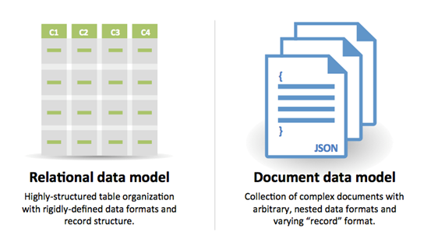
NOSQL OR DOCUMENT DATABASES

Slide 19

ACTIVITY: KNOWLEDGE CHECK
ANSWER THE FOLLOWING QUESTIONS
EXERCISE
Consider a dataset from Uber with the following fields:
In a group, discuss how you would design a relational database to support this data? List the tables you would create, the fields they would contain, and how they would link to other tables.
User ID
User Name
Driver ID
Drive Name
Ride ID
Ride Time
Pickup Latitude
Pickup Longitude
Pickup Location Entity
Dropoff Longitude
Dropoff Latitude
Dropoff Location Entity
Miles
Travel Time
Fare
CC Number
DELIVERABLE
Your database schema design

Slide 20
DEMO
ACCESSING DATABASES FROM PANDAS

Slide 21
ACCESSING DATABASES FROM PANDAS
While databases provide many analytical capabilities, often it’s useful to pull the data back into Python for more flexible programming.
Large, fixed operations would be more efficient in a database, but Pandas allows for interactive processing.
For example, if you just want to aggregate login or sales data to present a report or dashboard, this operation is operating on a large dataset and not often changing.
This would run very efficiently in a database vs connecting to Python.

Slide 22
ACCESSING DATABASES FROM PANDAS
However, if we want to investigate the login or sales data further and ask more interactive questions, then using Python would come in very handy.
import pandas as pd from pandas.io import sql
Pandas can be used to connect to most relational databases.

Slide 23
ACCESSING DATABASES FROM PANDAS
In this demonstration, we will create and connect to a SQLite database. SQLite creates portable relational databases saved in a single file.
These databases are stored in a very efficient manner and allow fast querying, making them ideal for small databases or databases that need to be moved across machines.
Additionally, SQLite databases can be created with the setup of MySQL or Postgres databases.

Slide 24
CONCLUSION
TOPIC REVIEW

Slide 25
CONCLUSION
While this was a brief introduction, databases are often at the core of any data analysis. Most analysis starts with retrieving data from a database.
SQL is a key language that any data scientist should understand.
SELECT: Used in every query to define the resulting columns
WHERE: Filters rows based on a given condition
GROUP BY: Groups rows for aggregation
JOIN: Combines two tables based upon a given condition

Slide 26
CONCLUSION
Pandas can be used to access data from databases as well. The result of the queries will end up in a Pandas dataframe.
There is much more to learn about query optimization if one dives further!

Slide 27
LESSON
EXIT TICKET
DON’T FORGET TO FILL OUT YOUR EXIT TICKET

