Slide 1
WELCOME TO
DATA SCIENCE
Jonathan Landesman

Slide 2
LEARNING OBJECTIVES
WELCOME TO DATA SCIENCE
Describe the roles and components of a successful learning environment
Define data science and the data science workflow
Apply the data science workflow to meet your classmates
Setup your development environment and review python basics

Slide 3
DATA SCIENCE
PRE-WORK

Slide 4
PRE-WORK REVIEW
Define basic data types used in object-oriented programming
Recall the Python syntax for lists, dictionaries, and functions
Create files and navigate directories using the command line interface

Slide 5
DATA SCIENCE
WELCOME TO GA!

Slide 6
WELCOME TO GA!
General Assembly is a global community of individuals empowered to pursue the work we love.
General Assembly’s mission is to build our community by transforming millions of thinkers into creators.

Slide 7

FEEDBACK/SUPPORT
Access to EIRs: office hours, in class support
Exit Tickets
Mid-Course Feedback
End of Course Feedback

Slide 8

GA GRADUATION REQUIREMENTS

Slide 9

FOREVER AND EVER

Slide 10
INTRODUCTION
WHAT IS DATA SCIENCE?

Slide 11
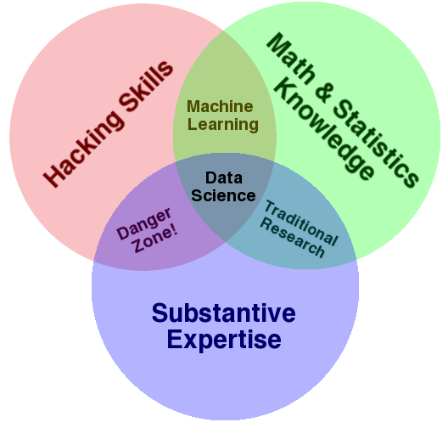
WHAT IS DATA SCIENCE?
A set of tools and techniques for data
Interdisciplinary problem-solving
Application of scientific techniques to
practical problems

Slide 12





WHO USES DATA SCIENCE?

Slide 13
WHO USES DATA SCIENCE?
Can you think of others?

Slide 14




WHAT ARE THE ROLES IN DATA SCIENCE?
Computer scientist
Statistical Analyst
Data Engineer
Research Scientist

Slide 15
WHAT ARE THE ROLES IN DATA SCIENCE?
Data Science involves a variety of skill sets, not just one.
Business
ML / Big Data
Applied Math
Programming
Statistics
Product Development Domain Knowledge Data Collection Data Storytelling
Structured Data Unstructured Data Graph Data Distributed Data Parallel Processing
Algorithm Design Linear Algebra Matrix Calculations Model Optimization Dimensionality Reduction
Data Acquisition Data Cleaning Object-Oriented Programming Database Administration Data Engineering Natural Language Processing
Spatial Statistics Temporal Statistics Descriptive Statistics Data Visualization Feature Selection Multi-Armed Bandit Study Design Model Evaluation

Slide 16
QUIZ
DATA SCIENCE BASELINE

Slide 17

ACTIVITY: DATA SCIENCE BASELINE QUIZ
DIRECTIONS (5-10 minutes)
EXERCISE
Form groups of three.
Answer the following questions.
True or False: Gender (coded male=0, female=1) is a continuous variable.
According to the table on the next slide, BMI is the _____
Outcome
Predictor
Covariate
Draw a normal distribution
True or False: Linear regression is an unsupervised learning algorithm.
What is a hypothesis test?

Slide 18
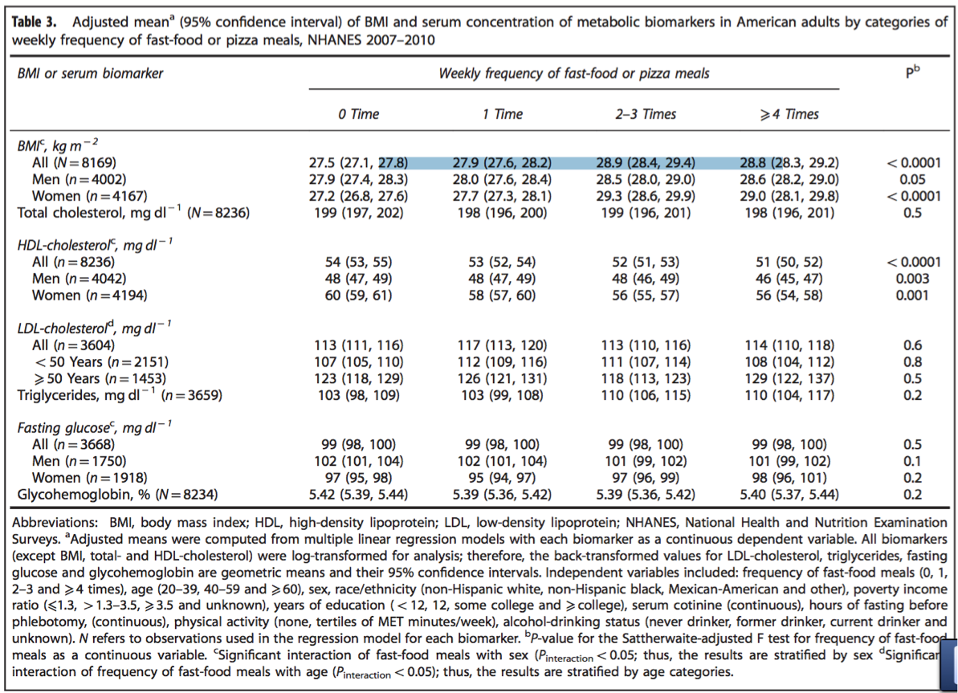
ACTIVITY: DATA SCIENCE BASELINE QUIZ
EXERCISE

Slide 19
INTRODUCTION
THE DATA SCIENCE WORKFLOW

Slide 20
OVERVIEW OF THE DATA SCIENCE WORKFLOW
A methodology for doing Data Science
Similar to the scientific method
Helps produce reliable and reproducible results
Reliable: Accurate findings
Reproducible: Others can follow your steps and get the same results

Slide 21
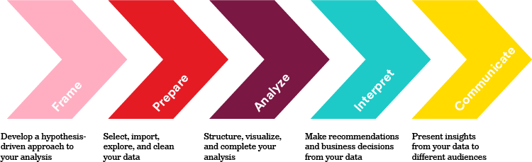
OVERVIEW OF THE DATA SCIENCE WORKFLOW

Slide 22
FRAME
Identify the business/product objectives.
Identify and hypothesize goals and criteria for success.
Create a set of questions to help you identify the correct data set
Example: Real Estate Company predicting the best properties to buy and resell
Notes:
We work for a real estate company interested in using data science to determine the best properties to buy and resell. Specifically, your company would like to identify the characteristics of residential houses that estimate their sale price and the cost-effectiveness of doing renovations.
Identify the Business/Product Objectives
The customer tells us their business goals are to accurately predict prices for houses (so that they can sell them for as large a profit as possible) and to identify which kinds of features in the housing market would be more likely to lead to foreclosure and other abnormal sales (which could represent more profitable sales for the company).
Identify and Hypothesize Goals and Criteria for Success
Ultimately, the customer wants us to:
Deliver a presentation to the real estate team.
Write a business report discussing results, procedures used, and rationales.
Build an API that provides estimated returns.
Create a Set of Questions to Help You Identify the Correct Data Set
Can you think of questions that would help this customer deliver on their business goals?
What sort of features or columns would you want to see in the data?

Slide 23
Prepare
Variable | Description | Var Type
Square Footage | Floating Point | Continuous
Street Type | 1 - Gravel, 2 - Paved | Categorical
Neighborhood | String, e.g., 'Dumbo' | Categorical
# Bedrooms | Integer | Discrete
Notes:
Common considerations when preparing our data include:
Ensuring data is clearly defined and structured
Check and clean data formatting as needed - outliers, Nan’s data types, negative values, etc
Instructor Note: During the Preparing process, guide students toward the following steps:
Reading any documentation provided with the data (e.g., the data dictionary above).
Performing exploratory surface analysis via filtering, sorting, and simple visualizations.
Describing the data structure and the information being collected.
Exploring variables and data types via SELECT statements.
Assessing preliminary outliers and trends.
Verifying the quality of the data (feedback loop -> 1).
Sampling the data and determining sampling methodology.
Iterating and exploring outliers and null values via SELECT statements.
Assessing qualitative versus quantitative data.
Formatting and cleaning data in Python (e.g., dates, number signs, formatting).
Defining how to appropriately address missing values (cleaning).
Categorizing, manipulating, slicing, formating, and integrating data.
Formatting and combining different data points, separate columns, etc.
Determining most appropriate methods for aggregating, cleaning, etc.
Creating the necessary derived columns from the data (new data).

Slide 24
Analyze and Model
Variable | Mean or Frequency (%)
Square Footage | 2201.3
Street Type - Gravel | 8%
Street Type - Paved | 92%
Number of Bedrooms | 1.8
Practice via the Ames dataset: https://git.generalassemb.ly/jlandesman/april_2018/blob/master/lessons/lesson-01/assets/dataset/ames_data_documentation.txt
Notes:
What sort of questions do these types of statistics allow us to answer? Why would we do this?
Check for understanding: Lets pause here and go over a data set and guess at what types of analysis we might want to
Divide into groups and look at the Ames dataset

Slide 25
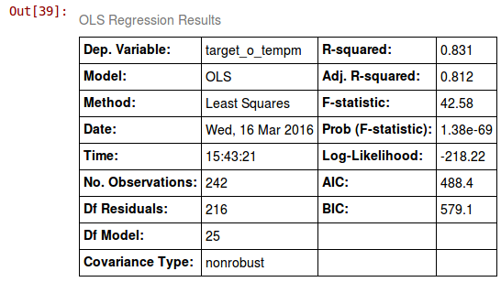
Interpret
Notes:
What sort of questions do these types of statistics allow us to answer? Why would we do this?
Check for understanding: Lets pause here and go over a data set and guess at what types of analysis we might want to
Divide into groups and look at the Ames dataset
Did you reject or fail to reject your hypotheses?
What does this mean for your project?
What does this mean for your client?
Were your questions answered?
Which ones?
What do you need to do to answer the ones that weren't?
Do your findings support any business recommendations, actions, or decisions?
Is there further supportive analysis?
How do your data support these recommendations?

Slide 26
Communicate
https://projects.fivethirtyeight.com/sandy-311/
Notes:
What sort of questions do these types of statistics allow us to answer? Why would we do this?
Check for understanding: Lets pause here and go over a data set and guess at what types of analysis we might want to
Divide into groups and look at the Ames dataset

Slide 27
Example: Trump Tweets: IPhone or Android?
http://varianceexplained.org/r/trump-tweets/

Slide 28
GUIDED PRACTICE
DATA SCIENCE WORK FLOW

Slide 29
ACTIVITY: DATA SCIENCE WORKFLOW
DIRECTIONS
EXERCISE
Divide into 4 groups, each located at a whiteboard.
FRAME: Each group should develop 1 research question they would like to know about their classmates. Create a hypothesis to your question. Don’t share your question yet! (5 minutes)
PREPARE: Rotate from group to group to collect data for your hypothesis. Have other students write or tally their answers on the whiteboard. (10 minutes)
COMMUNICATE: Communicate the results of your analysis to the class. (10 minutes)
Create a narrative to summarize your findings.
Provide a basic visualization for easy comprehension.
Choose one student to present for the group.
DELIVERABLE
Presentation of the results

Slide 30
DEMO
ENVIRONMENT SETUP

Slide 31
DEV ENVIRONMENT SETUP
Brief intro of tools
Environment setup
Create a Github account
Install Python 3.6 and Anaconda
Practice Python syntax, Terminal commands, and Pandas
iPython Notebook test and Python review

Slide 32
DEV ENVIRONMENT SETUP
Test your new setup using the lesson 1 starter code available at /lessons/lesson-1/code/starter-code/lesson1-starter-code.ipynb in the Github repo
Ask your classmates and instructor for help if you have problems!

Slide 33
CONCLUSION
REVIEW

Slide 34
CONCLUSION
You should now be able to answer the following questions:
What is Data Science?
What is the Data Science workflow?
How can you have a successful learning experience at GA?

Slide 35
DATA SCIENCE
BEFORE NEXT CLASS

Slide 36
DUE DATE
BEFORE NEXT CLASS
Project: Begin work on Project 1

Slide 37
WELCOME TO DATA SCIENCE
Q & A

Slide 38
WELCOME TO DATA SCIENCE
EXIT TICKET
DON’T FORGET TO FILL OUT YOUR EXIT TICKET

