Slide 1



SMART INDIA HACKATHON 2026
TITLE PAGE
Problem Statement ID – SIH26032
Problem Statement Title :- Long farmer wait times & procurement status uncertainty
Theme- Smart Automation
PS Category- Software
Team ID- SIH2026-APP-7729
Team Name- KisanSetu AI

Slide 2
KisanSetu
AI
END-TO-END WORKFLOW
SYSTEM FLOW
One Digital Bridge for Every Mandi
Farmer
Login / Register
Slot
AI-ranked booking
Token
Digital queue
Users
Farmer / Officer / Admin
• Smart Slot Booking: Farmers select centre, crop and time; the engine ranks less-congested options.
• Digital Token: A token replaces physical queue uncertainty and can be tracked remotely.
• Live Queue: WebSockets synchronize farmer and officer screens with current token status.
• Digital Procurement: Officer grading, procurement records and receipts stay in one workflow.
• Payment Visibility: Farmers can track procurement and payment status without repeated visits.
Application
Next.js Web App
Centre
Live call + grading
Procurement
Receipt + record
Payment
Status tracking
API & Real-Time
FastAPI REST + WebSocket
Smart Operations
Smart Engine + Queue
Login → ranked slot → token → live queue → grading → procurement → payment
Data Layer
PostgreSQL / Supabase
Insights
Notifications + Analytics
Classic layered system architecture
2
@SIH Idea submission - KisanSetu AI

Slide 3
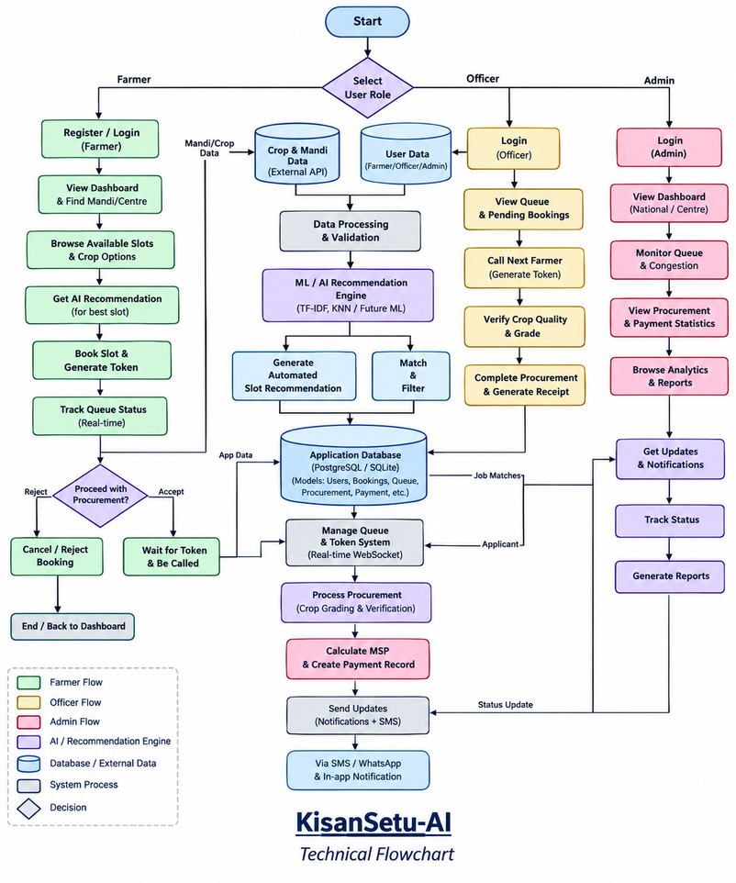
KisanSetu
AI
TECHNICAL APPROACH
System Design Explanation
• Frontend: Next.js 16, TypeScript and Tailwind CSS.
• Backend: FastAPI, Python 3.13, async SQLAlchemy 2.0 and Pydantic v2.
• Real-time layer: WebSockets for queue position, token calls and alerts.
• AI / Smart Engine: Explainable wait-time and congestion scoring ranks open slots.
• Data layer: PostgreSQL / Supabase for production, SQLite for local development.
• Security: JWT-based role access for Farmer, Officer and Admin.
• Deployment: Docker Compose with a Vercel-hosted frontend.
@SIH Idea submission - KisanSetu AI
3

Slide 4
KisanSetu
AI
FEASIBILITY AND VIABILITY
FEASIBILITY
CHALLENGES AND SOLUTIONS
Technical Feasibility
Long queues & uncertainty
Congestion varies by centre
Network interruptions
Scaling across mandis
• Open-source stack: FastAPI, Next.js, PostgreSQL and WebSockets reduce implementation cost.
• Modular backend: Async SQLAlchemy and separate routers/services keep the system maintainable.
• Real-time queue: WebSockets support live token updates without page refresh.
• Explainable engine: Wait-time and congestion scoring works without a large training dataset.
• Deployment: Docker Compose and a Vercel frontend provide a reproducible demo path.
Use slot booking + live digital tokens to reduce unnecessary waiting.
Rank slots using queue length, processing time and active counters.
Keep the core workflow lightweight and support local development.
Pilot selected centres, integrate centre data, then expand state-wise.
@SIH Idea submission - KisanSetu AI
4

Slide 5
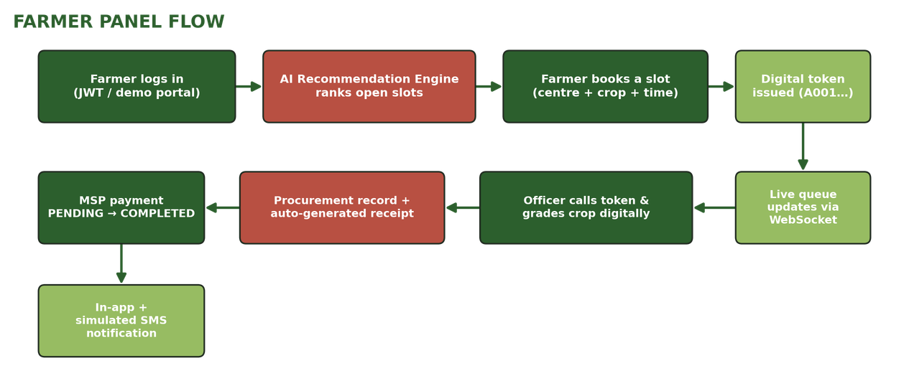
KisanSetu
AI
IMPACT AND BENEFITS
Impact on Farmers & Centres
KisanSetu Workflow Preview
• Less wasted time: Farmers reserve before travel and follow their token remotely.
• Higher predictability: Live queue status and notifications reduce uncertainty.
• Faster operations: Structured token flow helps officers process farmers in sequence.
• Payment visibility: Procurement and payment status remain traceable.
• Better planning: Queue data supports staffing and capacity decisions.
Digital workflow: login → ranked slot → token → live queue → grading → procurement → payment.
SOCIAL
ECONOMIC
GOVERNANCE
PROJECTED / TARGET INDICATORS
Fewer repeat trips and clearer queue expectations.
Better throughput and payment visibility.
Digital records and queue analytics improve traceability.
7,000+
23%
Lakhs
Target mandis
Estimated wait cut
Farmers reached
@SIH Idea submission - KisanSetu AI
5

Slide 6
KisanSetu
AI
RESEARCH AND REFERENCES
Research-backed references used to frame the problem, workflow and technology choices.
1. Smart India Hackathon
5. Department of Consumer Affairs
Official SIH portal and problem-statement process.
Government source on agricultural commodity procurement through agencies.
https://www.sih.gov.in/
https://consumeraffairs.gov.in/
2. e-NAM / National Agriculture Market
6. KisanSetu AI Repository
Government platform for APMC integration, market information and online payments.
Project source code, architecture, API design, seed data and tests.
https://enam.gov.in/
https://github.com/YTxFSGAMERz/KisanSetu-AI
3. FCI Annual Report 2024–25
7. KisanSetu AI Demo
Procurement at MSP and payment to farmers through bank accounts.
Live deployment used for project demonstration.
https://fci.gov.in/fci-storage/storage/app/uploads/693a5c5db48ed1765432413.pdf
https://kisansetu-sih.vercel.app/
4. FCI Procurement Action Plan
Procurement-centre operations, quality checks and MSP communication.
https://fci.gov.in/admin/storage/ckeditor/Action_plan_RMS_2023-24_1705061814.pdf
@SIH Idea submission - KisanSetu AI
6

