Slide 1
Computer Organization
Prof. Chwan-Chia Wu, Ph.D.
Dept. of Electrical Engineering
National Taiwan University of Science and Technology
22 P

Slide 2
Textbook:
William Stallings,
Computer Organization and Architecture
8th Edition or later version

Slide 3
Course Contents
Introduction
Computer Evolution and Performance
System Buses
Internal Memory
External Memory
Input/Output
Operating System
Computer Arithmetic
Instruction Sets
CPU Structure and Function
Reduced Instruction Set Computers (RISCs)
Control Unit Operation
Microprogrammed Control

Slide 4
Chapter 1
Introduction

Slide 5
What is Computer?
A computer is a programmable machine designed to automatically carry out a sequence of arithmetic or logical operations. The particular sequence of operations can be changed readily, allowing the computer to solve more than one kind of problem.
An important class of computer operations on some computing platforms is the accepting of input from human operators and the output of results formatted for human consumption. The interface between the computer and the human operator is known as the user interface.

Slide 6
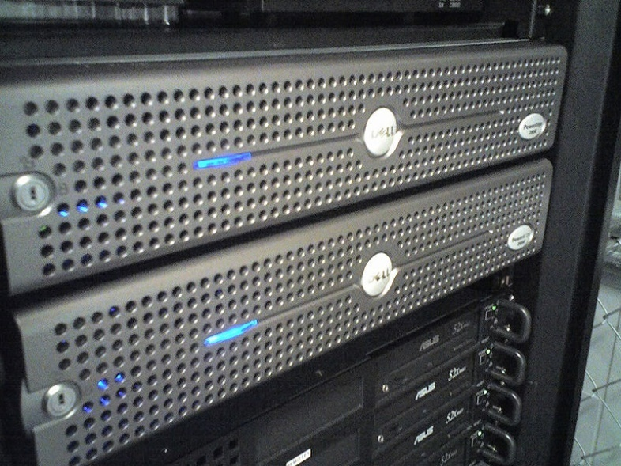
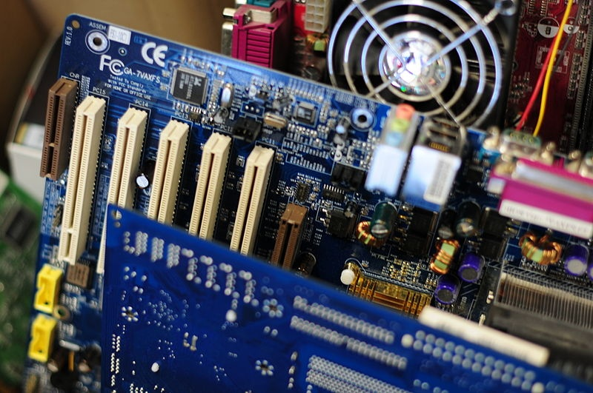
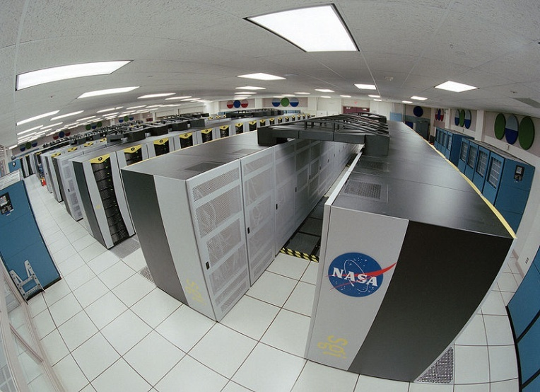
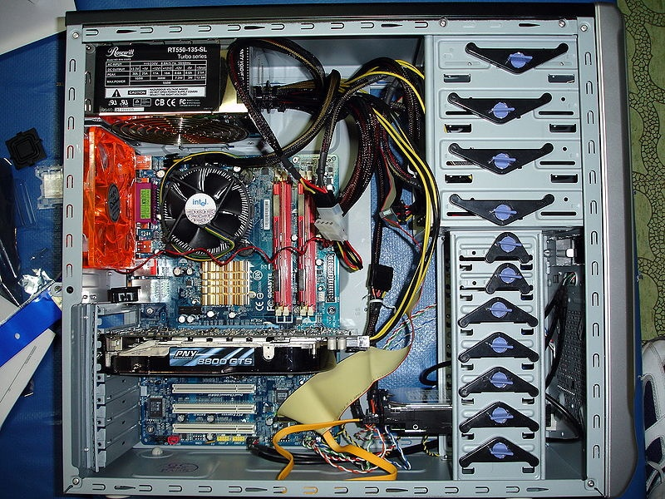
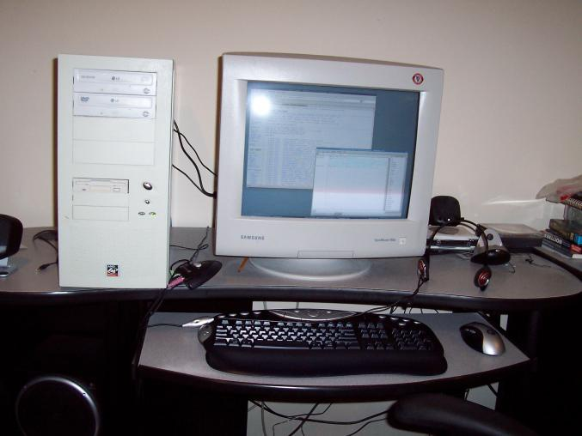

Slide 7
Architecture & Organization 1
Architecture is those attributes visible to the programmer
  Instruction set, number of bits used for data representation, I/O mechanisms, addressing techniques.
  e.g. Is there a multiply instruction?
Organization is how features are implemented
  Control signals, interfaces, memory technology.
  e.g. Is there a hardware multiply unit or is it done by repeated addition?

Slide 8
Architecture & Organization 2
Computer Organization - refers to the operational
units and their interconnections that realize the
architectural specifications.
Computer Architecture - refers to those attributes
of a system visible to a programmer, or put
another way, those attributes that have a direct
impact on the logical execution of a program.

Slide 9
Architecture & Organization 3
All Intel x86 family share the same basic architecture
The IBM System/370 family share the same basic architecture
This gives code compatibility
  At least backwards
Organization differs between different versions

Slide 10
Structure & Function
When designing a computer, the designer need only
deal with a particular level of the system at a time.
At each level, the designer is concerned with
structure and function
Structure is the way in which components relate to each other
Function is the operation of individual components as part of the structure

Slide 11
Function
All computer functions are:
  Data processing
  Data storage
  Data movement
  Control

Slide 12

Functional view

Slide 13
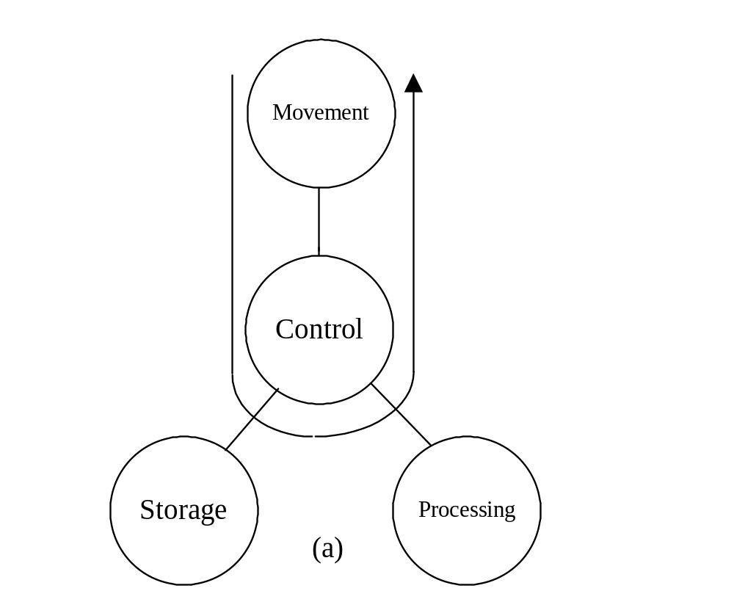
Operations (1) Data movement

Slide 14
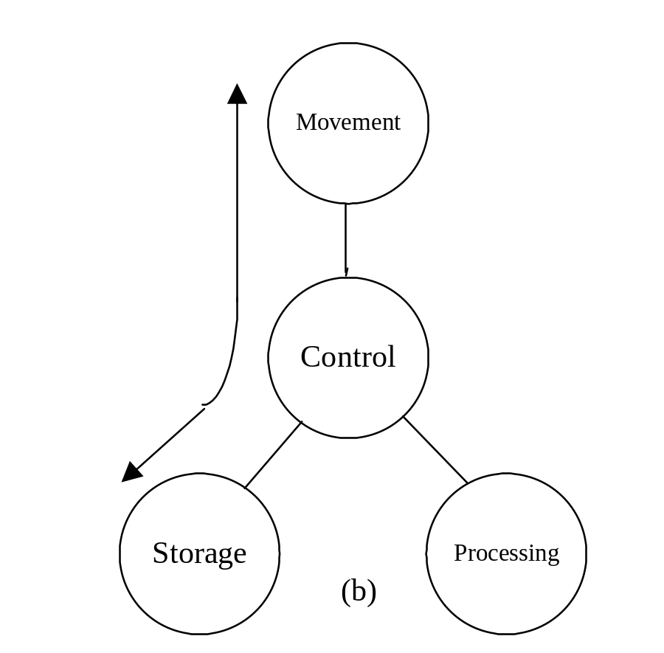
Operations (2) Storage

Slide 15
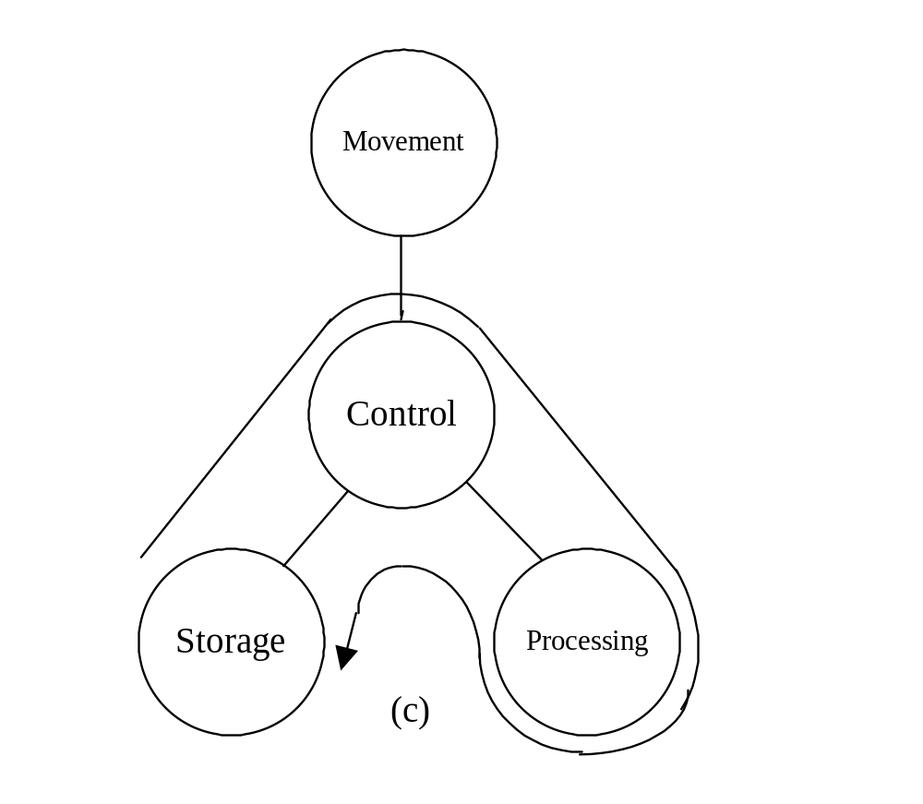
Operation (3) Processing from/to storage

Slide 16
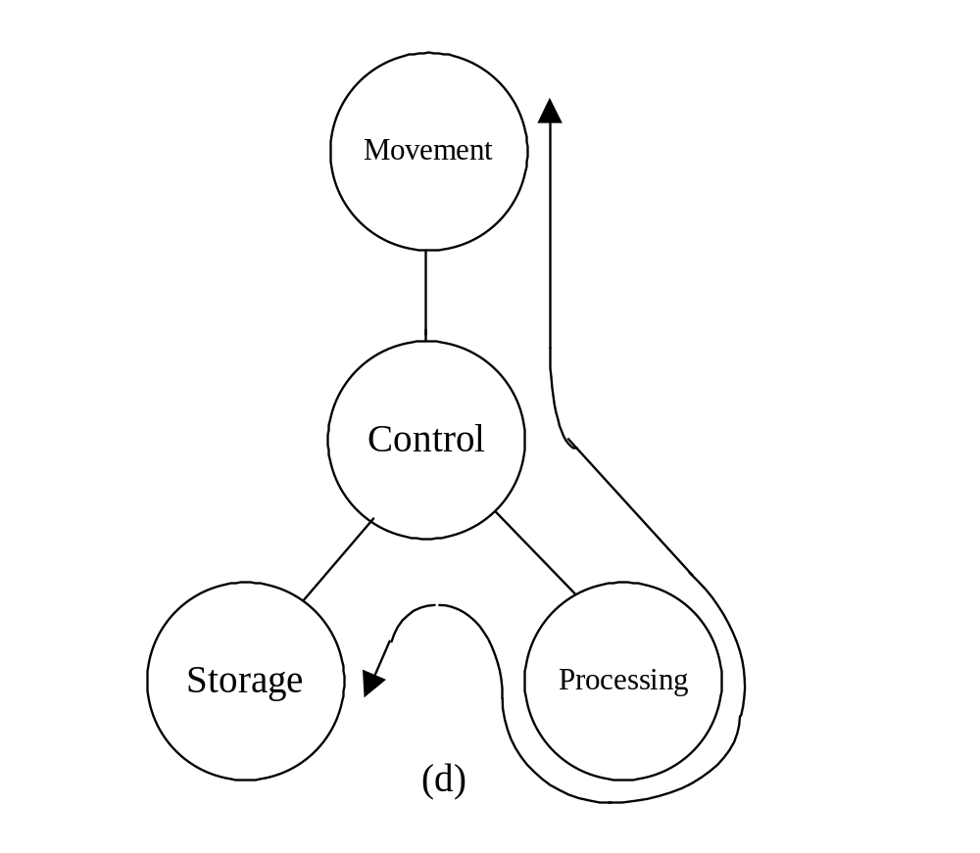
Operation (4)
Processing from storage to I/O

Slide 17
Structure - Top Level
Peripherals
Computer
Central
Processing
Unit
Main
Memory
Computer
Systems
Interconnection
Input
Output
Communication
lines

Slide 18
Structure - The CPU
CPU
Computer
Arithmetic
and
Login Unit
I/O
Registers
System
Bus
CPU
Internal CPU
Interconnection
Memory
Control
Unit

Slide 19
Structure - The Control Unit
Control Unit
CPU
ALU
Sequencing
Login
Internal
Bus
Control
Unit
Control Unit
Registers and
Decoders
Registers
Control
Memory

Slide 20
Outline of this Course (1)
Computer Evolution and Performance
Computer Interconnection Structures
Cache Memory
Internal Memory
External Memory
Input/Output

Slide 21
Outline of this Course (2)
Operating System
Computer Arithmetic
Instruction Set - Characteristics
Instruction Set - Addressing Modes
CPU Structure and Function
Control Unit Operation
Microprogrammed Control

Slide 22
Q & A

