Slide 1
GLOBAL IMAGE REGISTRATION AND VIDEO COLOR CORRECTION IN PRESENCE OF ILLUMINATION VARIATIONS
Universit´ e Paris-Est, Laboratoire d’Informatique Gaspard Monge bd Blaise Pascal, Cit´ e DESCARTES, BP 99, 93162 Noisy le Grand CEDEX, France
Sublab Production, 52 Avenue Pierre Semard, 94200 Ivry-sur-Seine, France
圖像資訊系統期末報告
學號：M10407505
姓名：賴冠宏

Slide 2
Outline
Abstract
Introduction
Analysis Of Flickering
Image Registration Using SIFT Descriptors
Color Correction Method
Result And Discussion
Conclusion

Slide 3
Abstract
In high-speed video imaging acquisition, artificial lighting can cause non-uniform luminosity and chroma variation between frames, which is linked to the interaction between the frequency of the lighting power source and of the video acquisition.-----This problem is commonly dubbed “flicker”
This paper introduces a rigid registration method using point descriptors that is robust to illumination variations, and followed by a Least Square adjustment approach for stabilizing brightness variations in image sequences.
Our results demonstrate the efficacy of our method at correcting global brightness fluctuations in image sequences while maintaining image quality and without introducing artifacts.

Slide 4
Introduction
Most of these works consider grey-level sequences and none specifically deals with periodic flicker.
In our context, we consider in addition the problem of high speed video acquisition – with frame rate up to 2000 fps – under artificial lighting, which features specific characteristics.
In particular our problem exhibits approximate periodicity, and depending on the light source, both smooth and non-smooth variations. So we need to provide more adapted solutions.
To solve this particular flicker problem, we must solve both the registration and the light correction problems; this requires in particular taking the motion into consideration.

Slide 5
Analysis Of Flickering
In old videos or film image sequences, flicker is defined as unnatural temporal fluctuations in perceived image intensity that do not originate from the original scene, and it is due to variations in shutter time.
This type of artifact present global, sudden and random variations of luminance and contrast between consecutive frames of a sequence.
In high speed video imaging, Flicker is a periodic intensity and chroma variation due to the interaction between lighting and acquisition frequencies.
Flicker is proportionally linked to the camera frame rate, so its effects become more obvious with increasing acquisition frequency.
Normally, each pixel value on a frame corresponds to the integration of a lighting function.

Slide 6
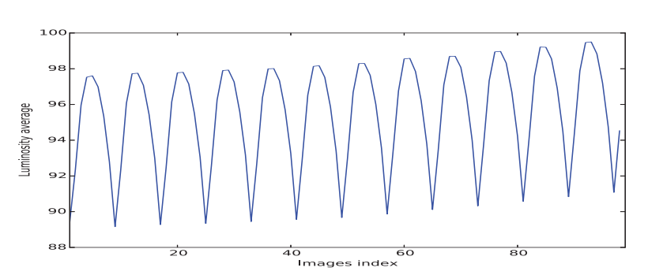
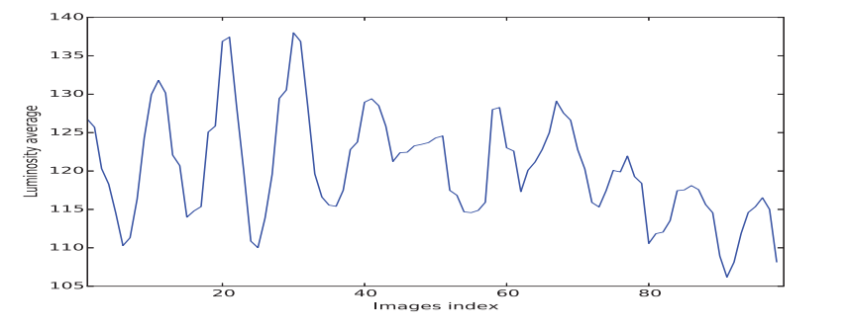
Analysis Of Flickering
At usual video rates (25 frames per second), these variations are integrated over a long enough time interval, therefore, the intensity / chroma variations are usually not perceptible.
In contrast, in high speed video imaging, the integration of the lighting function is performed over a very short interval which implies that intensity variations are no longer negligible.
(a) Flicker in archived videos
(b) Flicker in high speed imaging videos
Fig. 1. Difference between flickering in archived and high speed videos.

Slide 7
Image Registration Using SIFT Descriptors
Most videos contain background and object motion, and so matching pixels between frames must be performed.
To perform image registration, we need to obtain the corresponding geometric transformations between two frames.
We use the SIFT keypoints descriptors to register each subsequent frame to its reference image in the same flicker period.
The SIFT algorithm generates a number of keypoints, which are invariant to image translation, rotation and scale, and so yields matches between two images even in the presence of illumination variations.
The management of these matches allows us to estimate better geometrical transformations.

Slide 8
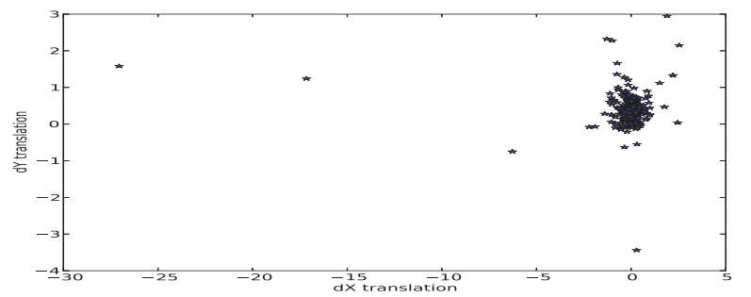
Image Registration Using SIFT Descriptors
3.1. Image matching
Fig 2 shows vertical plotted against horizontal translations in order to check whether or not there are bad matches estimated.
We can see that most points are centered in a narrow range, but some keypoints seem to undergo a larger translations than the others.
Fig. 2. dY=f(dX)

Slide 9

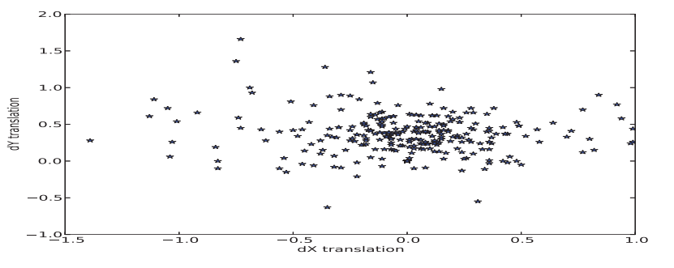
Image Registration Using SIFT Descriptors
3.1. Image matching
Fig. 3. dY=f(dX) with euclidean distance

Slide 10

Image Registration Using SIFT Descriptors
3.2. Application of the transformation matrix
Now we have enough information to form the geometric transformation matrix between each image its corresponding reference, and it takes the following form:
The inversion of this matrix shifts geometrically the image i to the reference image
Once the transformation matrix between the reference and each current frame has been found, it is applied to each.

Slide 11
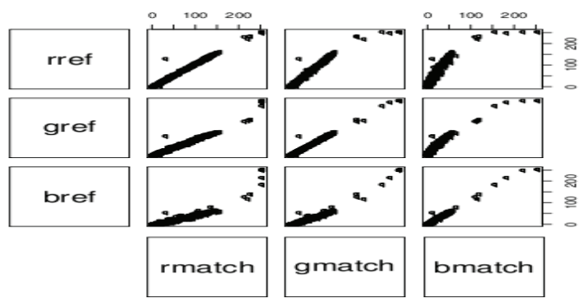
Color Correction Method
4.1. Assumptions
In order to check our assumption regarding the influence of periodic flicker on illumination, we acquired a sequence affected with periodic flicker due to a single source and no motion.
Fig. 4. Cross-channel correlation between a flicker-affected frame and a reference image.

Slide 12

Color Correction Method
we propose to use a linear model to compensate flicker in the affected frames, this model is represented by a square matrix Mt of size 3X3.
In the case of a single light source illuminating the scene, we observe a single flicker effect in image sequences.
model the illumination variation by a single matrix Mt for all pixels in the frame.

Slide 13

Color Correction Method
4.2. Flicker parameters estimation
There is no need to consider all the points in the image.
we associate a vector Vref =[Rref, Gref, Bref] in the reference image to a vector Vreg =[Rreg, Greg, Breg] in the registered image.
for a given frame f (t), the optimal transform matrix that minimizes the following energy function:
For each frame, 9 scalar parameters for the color correction have to be estimated. For minimizing the energy function J, we use the standard least square method:

Slide 14
Color Correction Method
4.3. Flicker compensation
Once the optimal color transform between the reference and the current frame warped to the reference has been found, it is applied onto the original one.
This yields a flicker-compensated frame.
Reproducing the same procedure for each frame yields a flicker-compensated sequence.

Slide 15
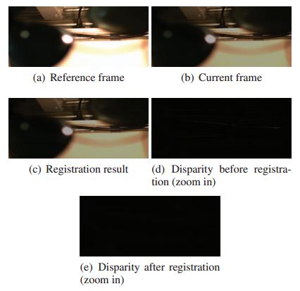
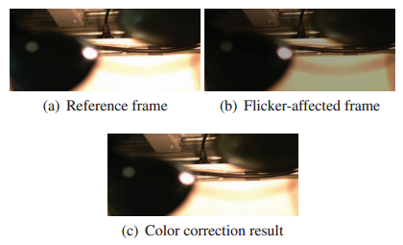
Result And Discussion
The registration method was tested on a real sequence, the disparity images before and after registration shows that the global motion is well estimated.
Our color correction model was tested on a synthetic flicker sequence produced from a flicker-free, naturally lit video and also on a real, studio-lit video affected with global flicker and motion.
Fig. 6. Image sequence with periodic flicker from studio lighting.
Fig. 5. Image sequence with periodic flicker from studio lighting.

Slide 16
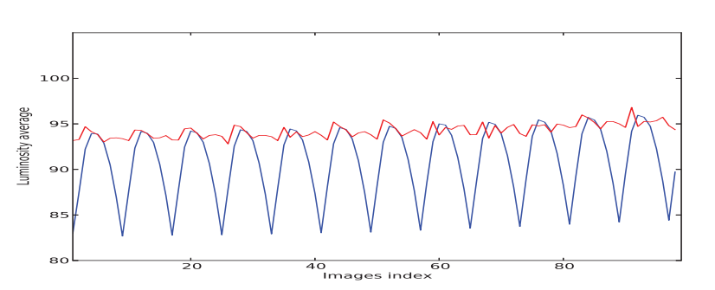
Result And Discussion
The luminosity variation graph (Figure 7) shows that brightness levels are well restored in the color-corrected video.
Fig. 7. Luminosity fluctuation and restoration in a real sequence

Slide 17
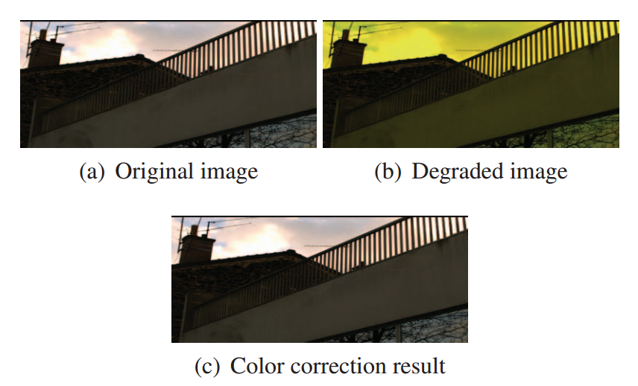
Result And Discussion
A restoration example on a sequence with artificial flicker.
Fig. 8. Sequence with global motion and artificial flicker

Slide 18
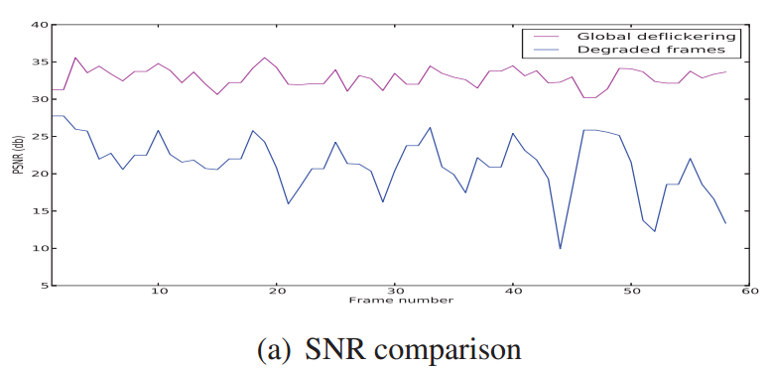
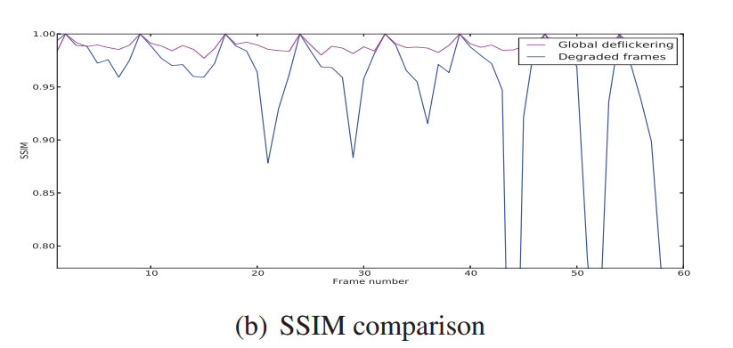
Result And Discussion
The PSNR average increases from 21 to 32dB after color correction.
SSIM index is very close to 1 after restoration.
Fig. 9. Artificial flicker: similarity measures

Slide 19
Conclusion
we have proposed a new method for flicker reduction.
Uses keypoint matching for image registration followed by a least-square linear color correction step.
Demonstrated the effectiveness of our method on real sequences affected with flicker from studio lights, and on video sequences degraded with an artificial flicker.
Restoration method works well in the presence of single light source and global motion
In future work, develop a method allowing joint color matrix estimation and motion estimation, and to deal with videos affected with flicker featuring multiple light sources and complex motion.

Slide 20
Thanks for your attention

