Slide 1

PROJ 309-SD · SOFTWARE DEVELOPMENT CAPSTONE · FALL 2026
Non-Negotiable Project Requirements
Every project must demonstrate all six of these pillars. They are graded — and they are mandatory.
Olusola Akinbode · SAIT · School of Advanced Digital Technology

Slide 2
AT A GLANCE
Six Requirements. Every Project. No Exceptions.
01 Microservices Over Monolith
02 Cloud & Cloud-Native
Architect independent, separately deployable services.
Live on public cloud. Containerized. CI/CD enforced.
03 Security by Design
04 Requirements & Full Scope
Auth, encryption, RBAC.
Deliver what was approved. Every feature. Tested.
05 AI Workflows Integrated
06 Project Mgmt & Participation
Functional AI as a core product feature — not a stub.
Agile process. Every member visible and accountable.

Slide 3
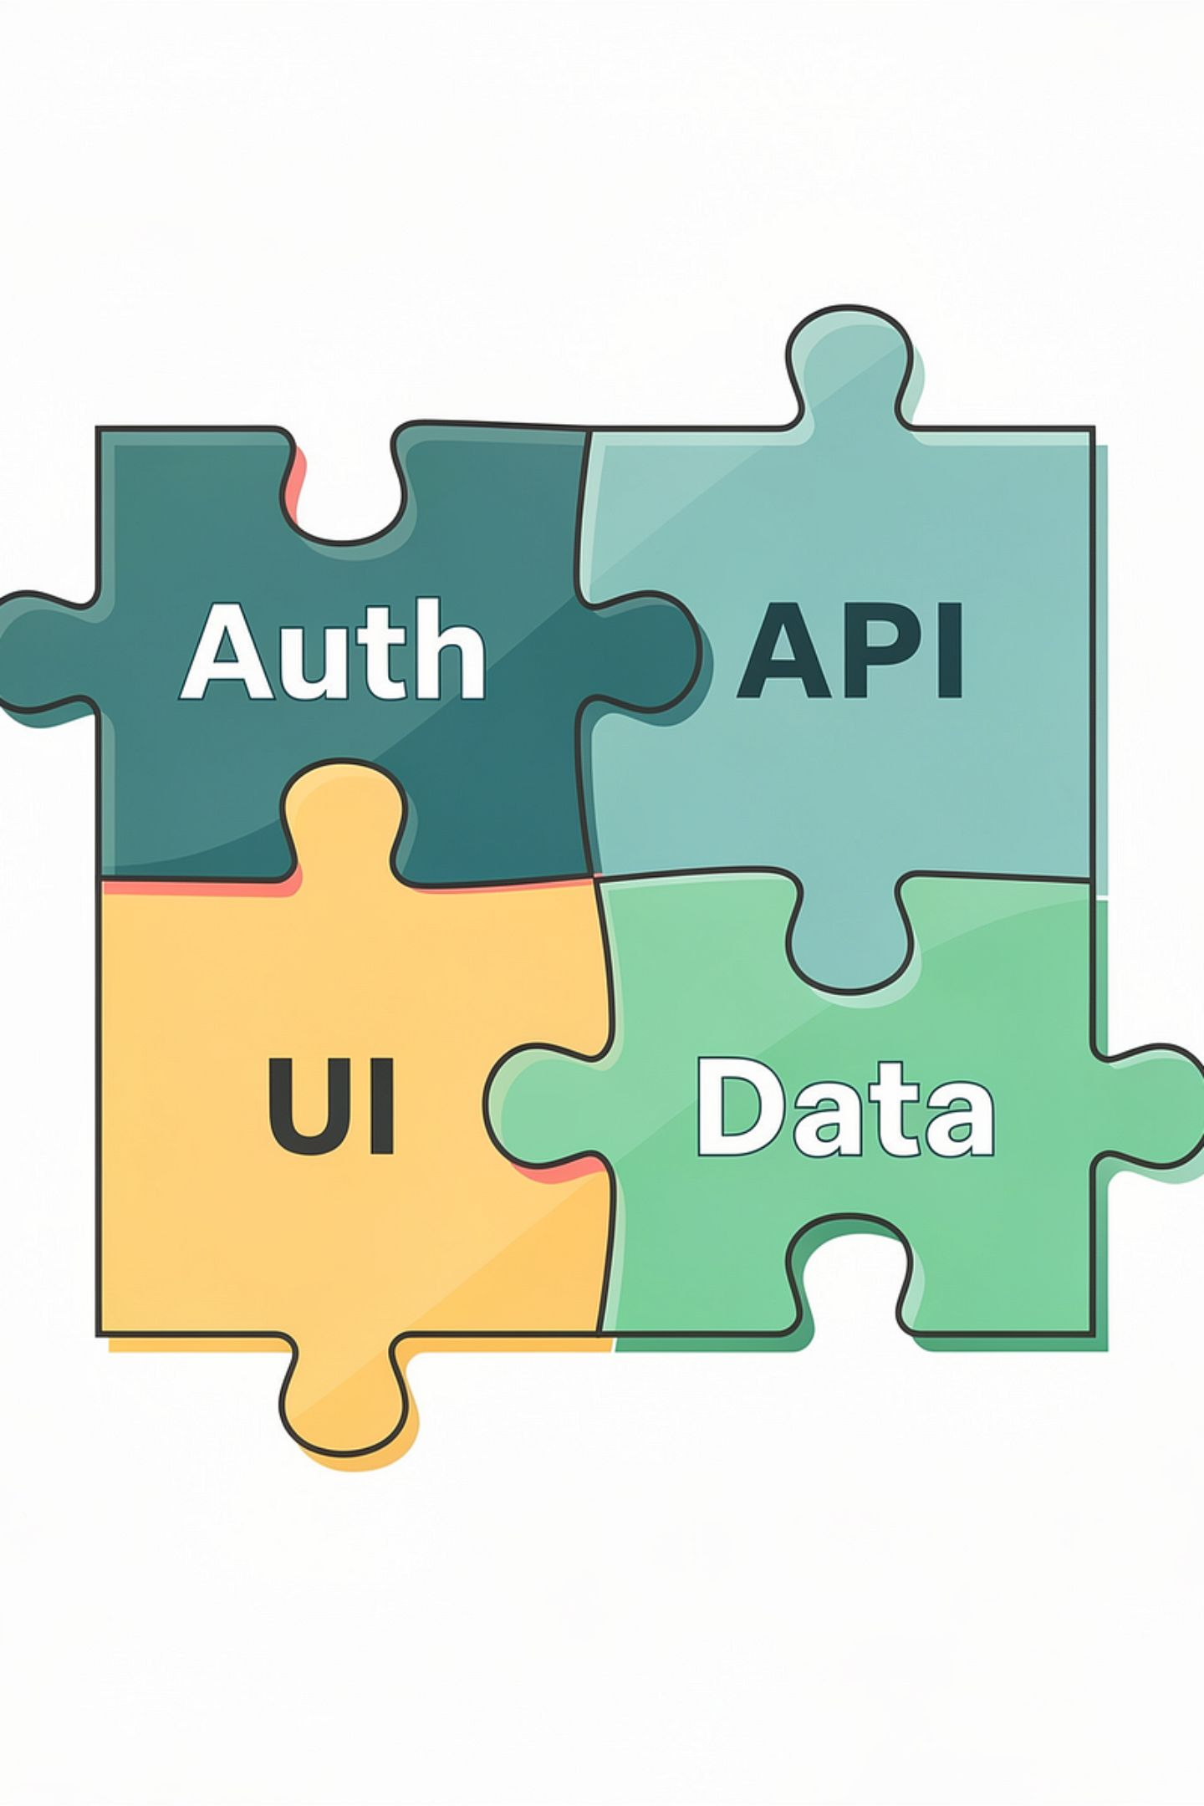




REQUIREMENT 01
Microservices Over Monolith
Architect for independence and scale.
Separate Deployable Services
API Gateway or Service Mesh
Each domain — auth, data, UI, AI — must be its own independently deployable service.
Use an API Gateway or service mesh to manage and route all inter-service traffic.
Architectural Diagram Required
API-Driven Communication
A clear diagram showing service boundaries is mandatory — not optional documentation.
Services communicate via REST APIs or message queues. Direct coupling is not permitted.
Sprint 1 review: Architecture diagram & justification required. No monolith will be approved.
Own Repo & Pipeline
Each microservice requires its own repository, CI/CD pipeline, and designated ownership.

Slide 4
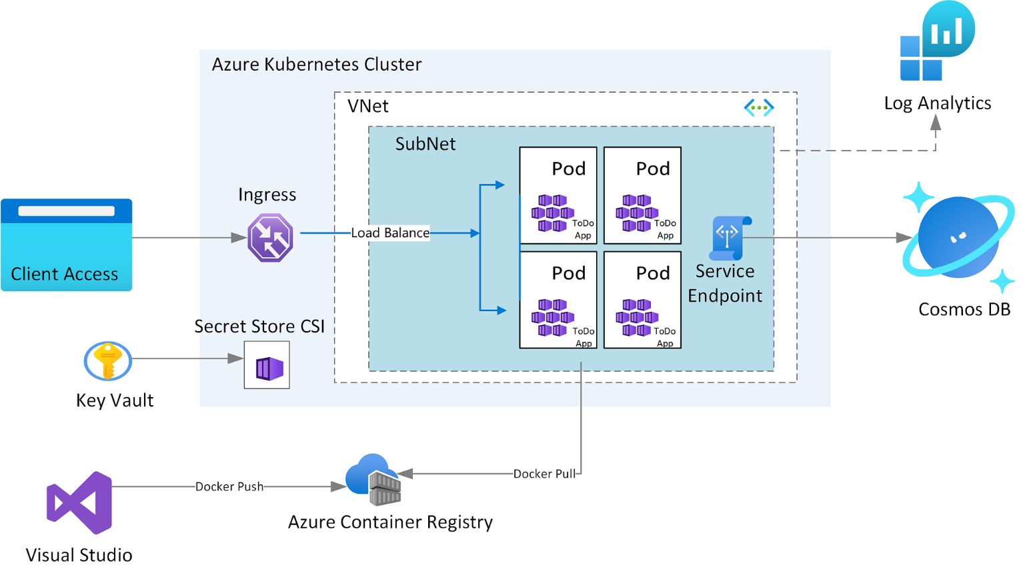
REQUIREMENT 02
Cloud & Cloud-Native Design
Built for the cloud — not just deployed to it.
1
Live Cloud Deployment
Project must be deployed and running on a public cloud platform. Azure is preferred.
2
Containerization
Docker for packaging; Kubernetes or Azure Container Apps for orchestration.
3
Infrastructure as Code
Use Bicep, Terraform, or ARM templates. Manual provisioning is not acceptable.
4
CI/CD Pipeline
Automated pipeline required end-to-end. No manual deployments to production — ever.
All sprint demos must run live on cloud. Local-only demos will not be accepted.

Slide 5





REQUIREMENT 03
Security by Design
Security is not an afterthought — it is architecture.
Authentication & Authorization
Encryption Everywhere
OAuth 2.0, JWT, or Azure AD only. No homebrew authentication solutions permitted.
HTTPS/TLS for all data in transit. Data at rest must be encrypted without exception.
No Hardcoded Credentials
RBAC Implementation
Use Azure Key Vault, environment secrets, or managed identities for all sensitive config.
Role-based access control must be implemented across all user-facing features and endpoints.
Security checklist reviewed at Sprint 2 & 3. Exposed credentials = automatic sprint failure.

Slide 6
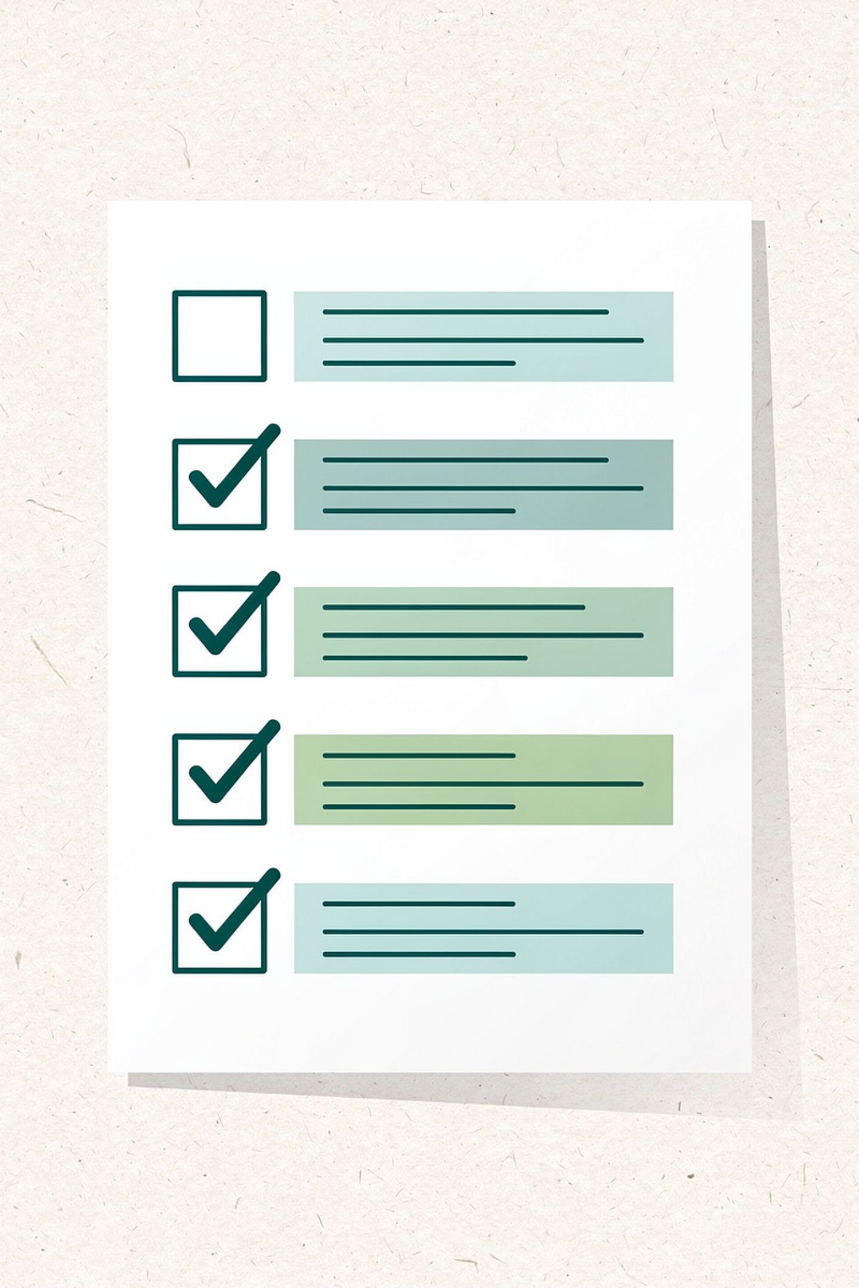

REQUIREMENT 04
Requirements & Full Scope Delivery
What was promised must be delivered.
Full Feature Implementation
Every feature from the approved scope must be implemented and demonstrated. No exceptions.
Traceable Requirements
Each feature must map to a user story or acceptance criterion. Traceability is graded.
Scope Changes Require Approval
Silent scope reduction is not permitted. Any change requires written instructor sign-off.
Client Validation & Testing
The client must validate delivery. Critical paths require unit and integration test coverage.
Full scope verified at Sprint 3 and Final Showcase. Partial delivery = partial grade.

Slide 7

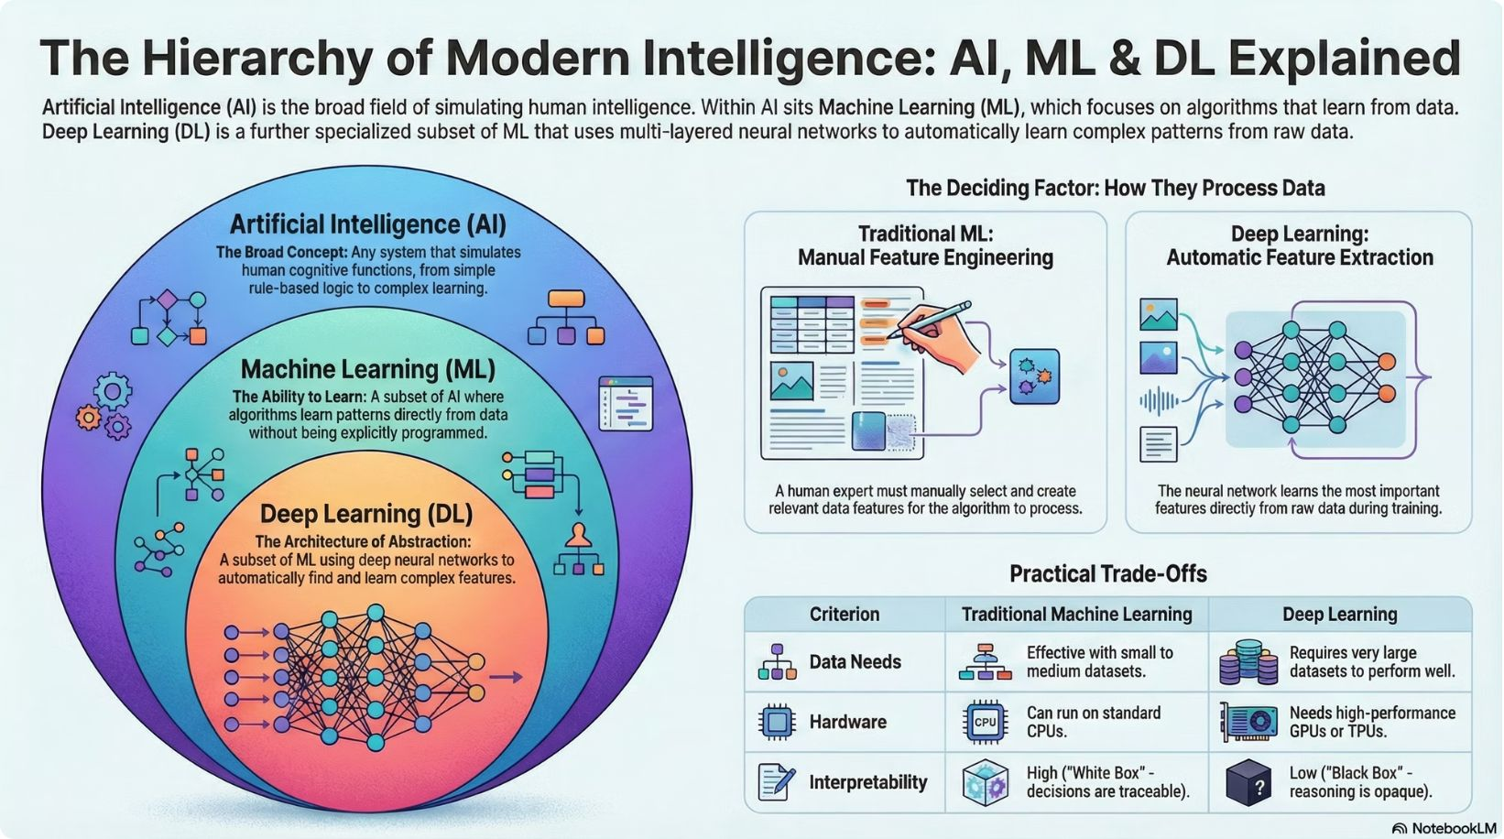

REQUIREMENT 05
AI Workflows Integrated
AI must be functional — not decorative.
Core Feature — Not a Stub
AI must be a working, central part of the product. Placeholder implementations will not pass.
Accepted Integrations
RAG pipelines, NLP classification, recommendation engines, intelligent search, or generative responses.
Production-Grade Services
Use Azure OpenAI, HuggingFace endpoints, or equivalent. Toy models are not sufficient.
Documented End-to-End
Live AI demo required at Sprint 2+. Must work with real inputs — no scripted demos.
Document model choices, prompts, data flow, and fallback strategies in your project artifacts.

Slide 8

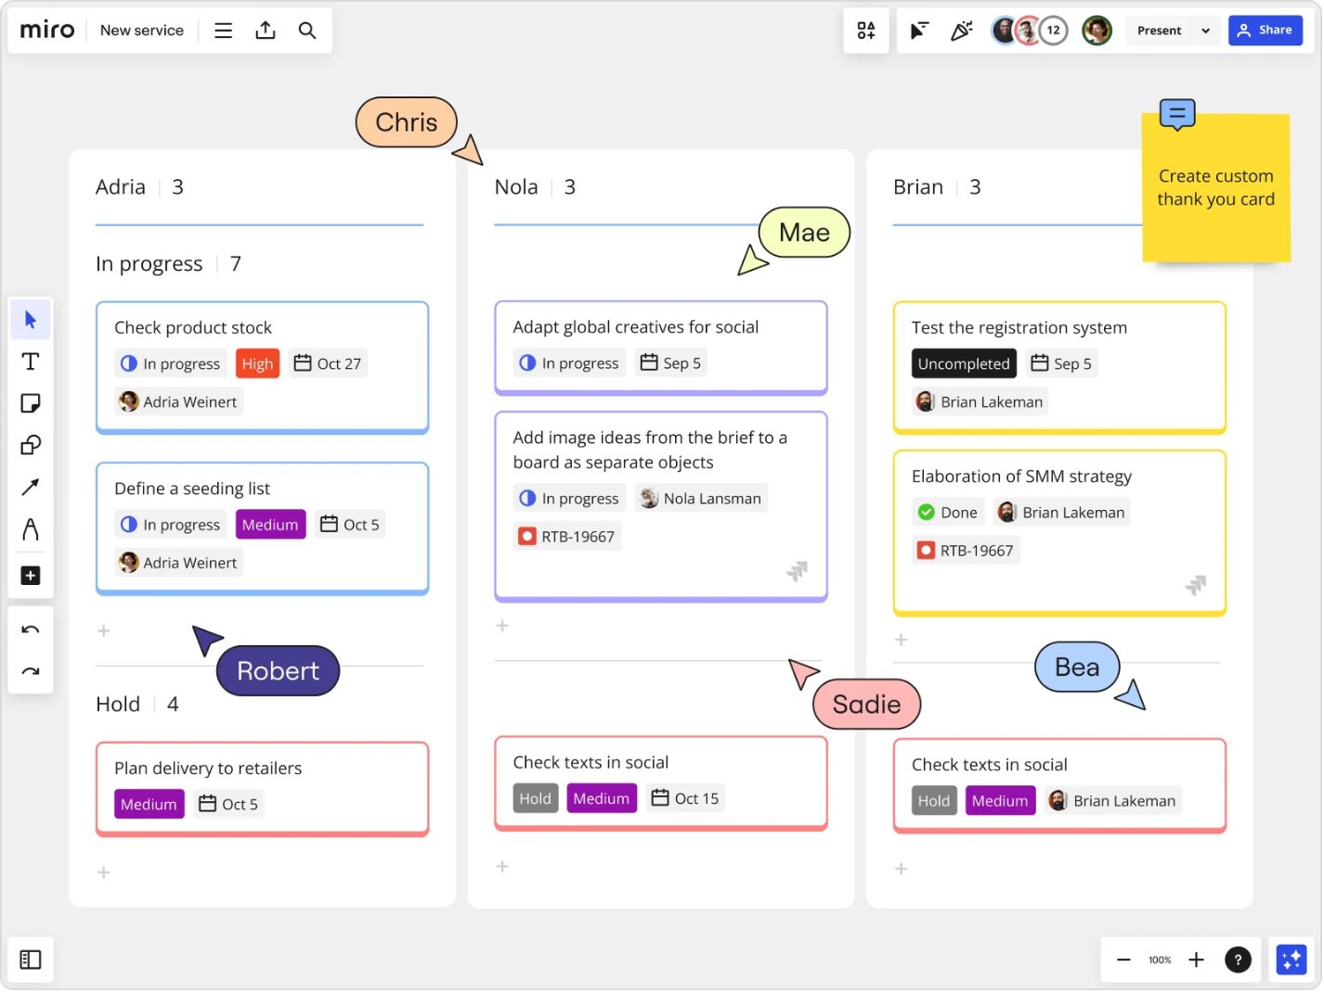
REQUIREMENT 06
Project Management & Team Participation
Everyone contributes. Everyone is accountable.
Agile Methodology Required
Scrum or Kanban with sprint planning, standups, and retrospectives — fully documented.
Every Member Must Present
All three sprint technical reviews require every team member to present. No silent members.
Weekly Progress Reports
A 1–2 paragraph progress report is submitted at the end of every 3-hour class session.
Client Meetings Documented
Weekly or biweekly client meetings are required. Notes and action items must be on record.
Individual Grades
Your individual grade reflects your participation, contributions, and peer assessment results.

