Slide 1

LeNet网络
主讲人：司庆龙
北方民族大学计算机科学与工程学院

Slide 2
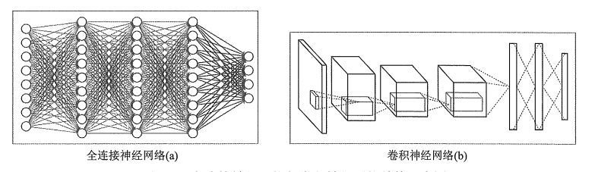
卷积网络-Mnist手写数字分类
2层的全连接网络： 96.4%正确率
优化后的全连接网络： 98.2%正确率
使用卷积神经网络，效果如何？

Slide 3
卷积神经网络结构
一个最基本的卷积神经网络主要有：
输入层：输入图像的像素矩阵，[height, width, channels]
卷积层：对上层输入进行卷积操作，获得更加抽象的特征
池化层：在卷积特征上进行池化采样，进一步缩小特征维度，从而减小整个网络中参数数目
全连接层：全连接层一般在多轮的卷积和池化之后，给出最后的分类结果。
Softmax层：对于分类任务，一般会添加一个softmax层来得到各个类别归一化之后的概率

Slide 4
卷积神经网络结构
对于Mnist分类，使用
Convolution
Pooling
Convolution
Pooling
Fully connected
Fully connected
2 convolutions 2 fc neural network

Slide 5
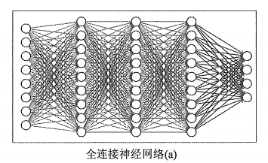
Model definition
1 | 0 | 1
0 | 1 | 0
1 | 0 | 1
Filter 1
定义几个辅助函数
def conv_layer(input, in_channel, out_channel): # 定义卷积层 w = tf.Variable(tf.truncated_normal([5, 5, in_channel, out_channel], stddev=0.1)) b = tf.Variable(tf.constant(0.1, shape=[out_channel])) conv = tf.nn.conv2d(input, w, strides=[1, 1, 1, 1], padding="SAME") act = tf.nn.relu(conv + b) return act def fc_layer(input, size_in, size_out): # 定义全连接层 w = tf.Variable(tf.truncated_normal([size_in, size_out], stddev=0.1)) b = tf.Variable(tf.constant(0.1, shape=[size_out])) fc = tf.matmul(input, w) + b return fc

Slide 6
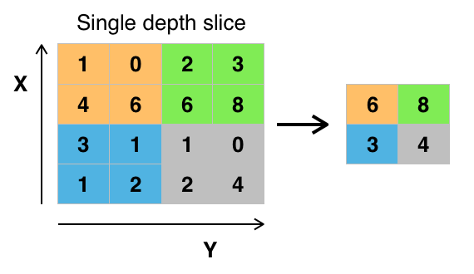
Bulid model
def inputs(): # 定义输入 x = tf.placeholder(tf.float32, shape=[None, 784], name="x") y = tf.placeholder(tf.float32, shape=[None, 10], name="labels") return x, y
# image.shape:[batch_size,28,28,1]
def inference(image): # conv1 conv1 = conv_layer(image,1, 32) # conv1.shape:[batch_size,28,28,32) conv1_pool = tf.nn.max_pool(conv1,ksize=[1,2,2,1],strides=[1,2,2,1], padding="SAME") # conv1_pool.shape: [batch_size,14,14,32] # conv2 conv2= conv_layer(conv1_pool, 32, 64) # conv2.shape:[batch_size,14,14,64] conv2_pool = tf.nn.max_pool(conv2,ksize=[1,2,2,1],strides=[1,2,2,1], padding="SAME") # conv1_pool.shape: [batch_size,7,7,64] conv_flaten = tf.reshape(conv2_pool, shape=[-1, 7*7*64]) # fc1 fc1 = tf.nn.relu(fc_layer(conv_flaten, 7*7*64, 1024)) return fc_layer(fc1, 1024, 10)

Slide 7
Loss & Train
def loss(y_pred, y_real): # 定义损失函数, 这里使用softmax_cross_entropy_with_logits, 首先在对inference输出 # 添加一个softmax层归一化概率，然后计算inference的误差 cross_entropy=tf.nn.softmax_cross_entropy_with_logits(logits=y_pred, labels=y_real) loss = tf.reduce_mean(cross_entropy) return loss def accuracy(y_pred, y_real): correct_prediction = tf.equal(tf.argmax(y_pred, 1), tf.argmax(y_real, 1)) acc= tf.reduce_mean(tf.cast(correct_prediction, tf.float32)) return acc def train_optimizer(loss): train_step = tf.train.AdamOptimizer(learning_rate).minimize(loss) return train_step
0 ,0.1,…,0.8 ,0
0.1,0.7,…, 0 ,0.1
8
1
y_pred
1
0
Acc:0.5
y_real
0,0,0,0,0,0,0,0,1,0
1,0,0,0,0,0,0,0,0,0
8
0

Slide 8
完整流程
x, y = inputs() x_image = tf.reshape(x, [-1, 28, 28, 1]) global_step = tf.Variable(0, trainable=False) logits = inference(x_image) # 定义模型 losses = loss(y_pred=logits, y_real=y) train_step = train_optimizer(losses, global_step=global_step) acc = accuracy(y_pred=logits, y_real=y) with tf.Session() as sess: sess.run(tf.global_variables_initializer()) for i in range(TRAINING_STEPS): xs, ys = mnist.train.next_batch(BATCH_SIZE) _, loss_value, step = sess.run([train_step, losses, global_step], feed_dict={x: xs, y: ys}) if i % 200 ==0: print("After %d training step(s), loss on training batch is %g." % (step, loss_value)) if i % 1000 == 0: valid_acc = sess.run(acc, feed_dict={x: mnist.validation.images,
y: mnist.validation.labels}) print("After %d training step(s), accuracy on validation is %g." % (step, valid_acc)) test_acc = sess.run(acc, feed_dict={x:mnist.test.images, y:mnist.test.labels}) print("After %d training step(s), accuracy on test is %g." % (TRAINING_STEPS, test_acc))

Slide 9
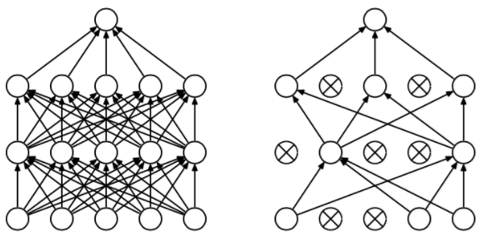
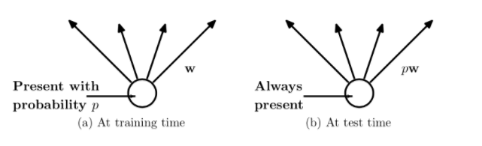
Dropout - 解决过拟合问题
dropout是指在深度学习网络的训练过程中，对于神经网络单元，按照一定的概率将其暂时从网络中丢弃。对于随机梯度下降来说，由于是随机丢弃，故而每一个mini-batch都在训练不同的网络。
Dropout：0.5

Slide 10
Dropout - 解决过拟合问题
在第一层fc层后面添加dropout层（dropout一般用于全连接层）
def inference(input, keep_prob): # conv1 conv1 = conv_layer(input,1, 32) conv1_pool = tf.nn.max_pool(conv1, ksize=[1,2,2,1], strides=[1,2,2,1], padding="SAME") # conv2 conv2= conv_layer(conv1_pool, 32, 64) conv2_pool = tf.nn.max_pool(conv2, ksize=[1,2,2,1], strides=[1,2,2,1], padding="SAME") conv_flaten = tf.reshape(conv2_pool, shape=[-1, 7*7*64]) # fc1 fc1 = tf.nn.relu(fc_layer(conv_flaten, 7*7*64, 1024)) fc1 = tf.nn.dropout(fc1, keep_prob=keep_prob) return fc_layer(fc1, 1024, 10)
定义输入的部分添加keep_prob概率输入
keep_prob= tf.placeholder(tf.float32, name="keep_prob")

Slide 11
Dropout - 解决过拟合问题
训练的时候keep_prob设置为0.5 测试时设置为1.0
for i in range(TRAINING_STEPS): xs, ys = mnist.train.next_batch(BATCH_SIZE) _,loss_value,step = sess.run([train_step, xent, global_step],
feed_dict={x: xs, y: ys,keep_prob:0.5}) if i % 500 ==0: print("After %d training step(s), loss on training batch is
%g." % (step, loss_value)) if i % 1000 == 0: valid_acc = sess.run(accuracy,
feed_dict={x: mnist.validation.images,
y: mnist.validation.labels,
keep_prob:1.}) print("After %d training step(s), accuracy on validation is
%g." % (step, acc)) test_acc = sess.run(accuracy, feed_dict={x:mnist.test.images,
y:mnist.test.labels, keep_prob:1.}) print("After %d training step(s), accuracy on test is %g." %
(TRAINING_STEPS, test_acc))

Slide 12
训练参数
learning_rate: 0.001
TRAINING_STEPS :10000
BATCH_SIZE: 64
Conv1_filters: 32
Conv2_filters: 64
fc1: 1024
fc2: 10
10000次迭代后，在测试集上能达到99.2的准确率

Slide 13
Thank you!

