Slide 1
My name is:YUCHENXI
I am come from China

Slide 2
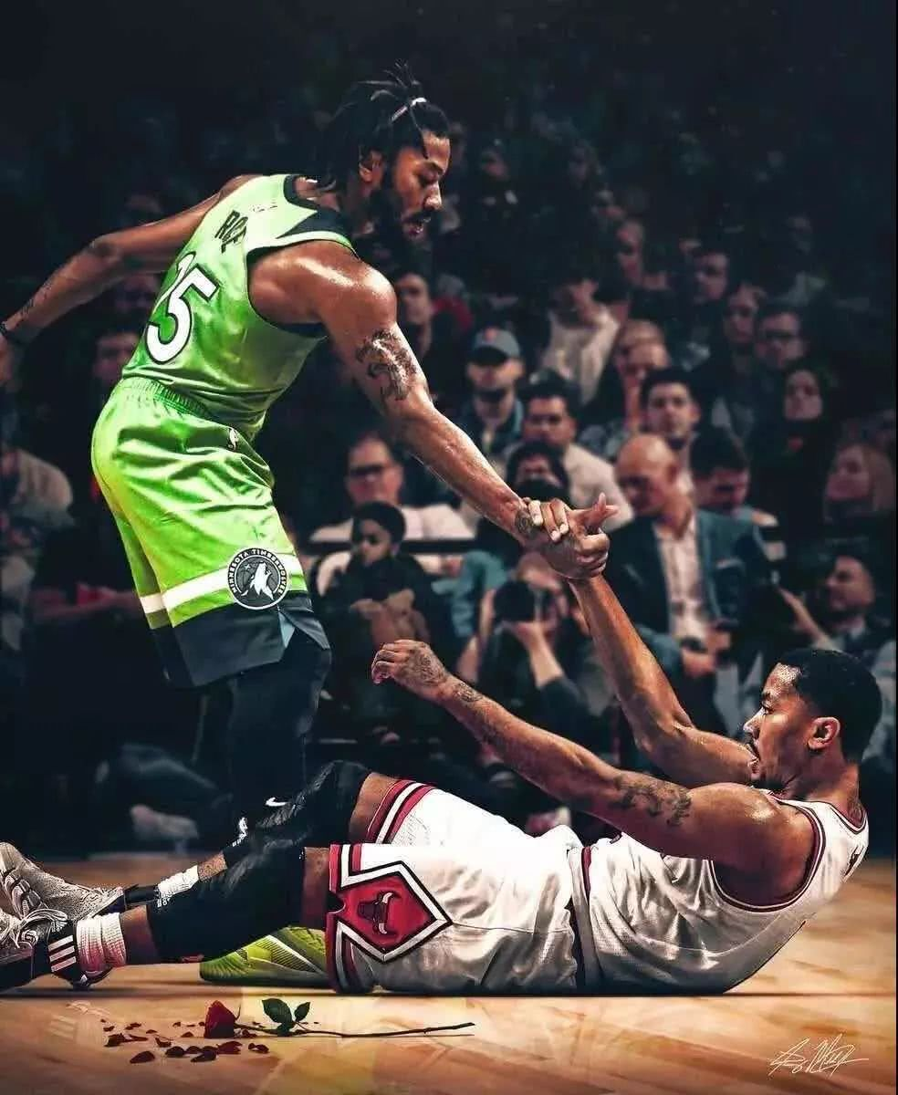
My hobbies:
Basketball:

Slide 3
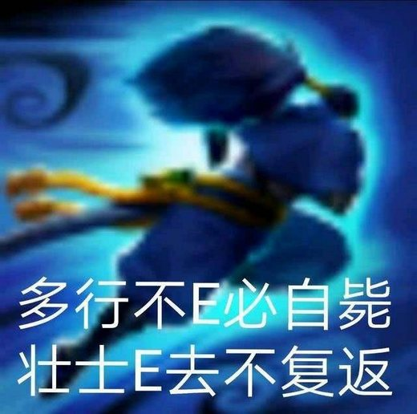
Game:
LOL

Slide 4
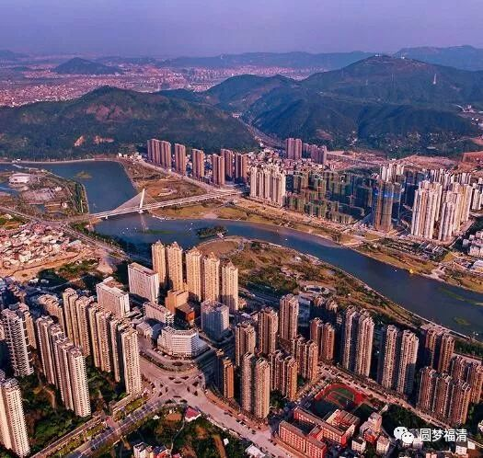
My hometown:

