Slide 1
Cardiovascular Disease
ALY6020 Predictive Analytics
Instructor: Justin Rodgers
Group 1: Kailun Chen, Chenyuan Wang, Zhenwu Yang, Tian Yue
Date: May 14, 2019

Slide 2
CONTEXT
Introduction
Methods
Results
Conclusion
Appendix

Slide 3
Introduction
Background:
The etiology of heart disease is arteriosclerosis, hypertension, virus infection, respiratory disease, and other causes.
The patient's heart disease can be tested based on blood pressure, cholesterol levels, and bad habits.
Research Question:
Can we fit models in R studio to predict whether patients have a high probability of heart diseases?
Hypotheses:
According to the binary datasets, the researchers could fit tree models or random forests to solve the research question.

Slide 4
Methods
Methods:
Decision Tree models : C5.0 Tree model / Boosted Tree model / Cost Matrix Tree Model
Random Forests: Tune using Caret Evaluation
Dataset:
The dataset is mainly based on factual information; Results of medical examination and information given by the patient.

Slide 5
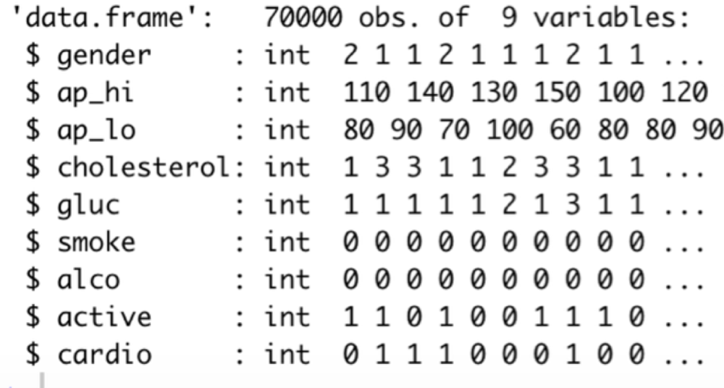
Methods
Variables:
Gender: 1 - women, 2 - men
Hi: Systolic blood pressure
Lo: Diastolic blood pressure
Cholesterol: 1-normal, 2-above normal, 3-well above normal
Glucose: 1-normal, 2-above normal, 3-well above normal
Smoke: whether patient smokes or not
Alcohol: Binary feature
Active: Binary feature
Cardio: Target variable

Slide 6
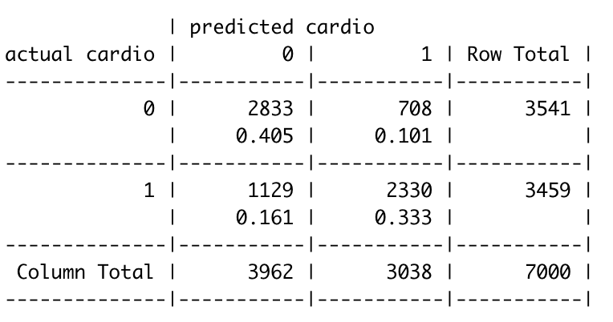
Results: Tree Model
Accuracy rate of model
(2833+2330)/7000 = 0.7375714
Predicted Cardio rate
2330/3459 = 0.6736051

Slide 7

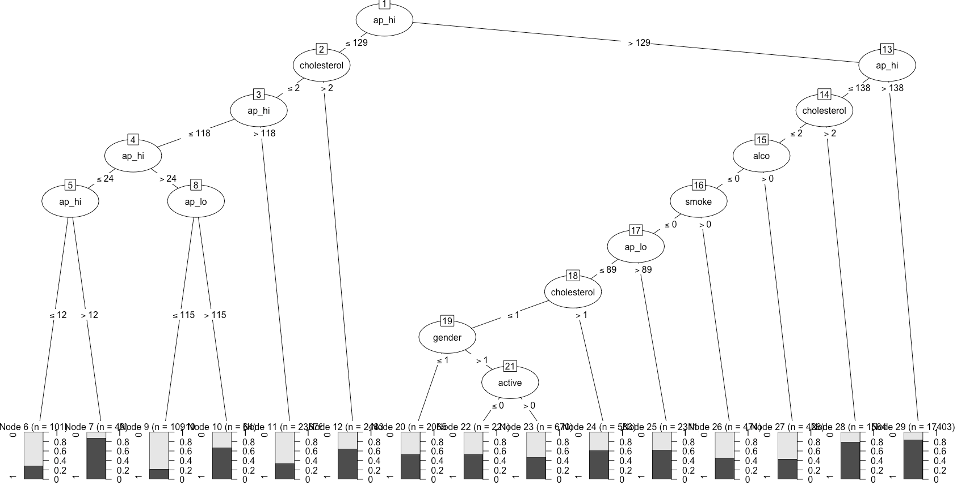

Slide 8
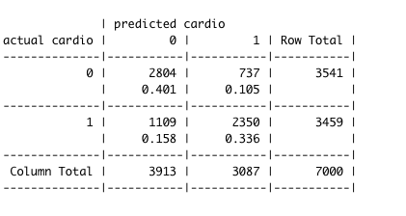
Results: Boosted Tree Model (Trials = 10)
Accuracy rate of model
(2804+2350)/7000 = 0.7362857
Predicted Cardio rate
2350/3459 = 0.6793871

Slide 9
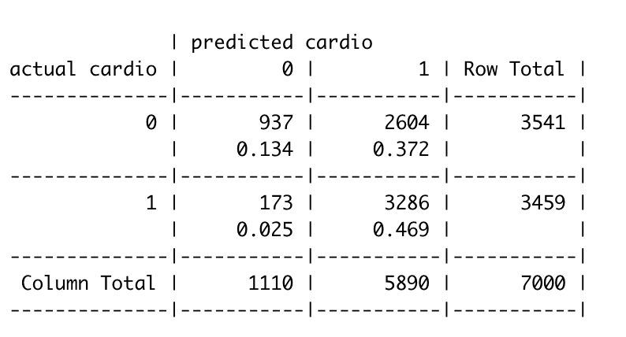
Results: Cost Matrix Tree Model (0-1-3-0)
Accuracy rate of model
(937+3286)/7000 = 0. 6032857
Predicted Cardio rate
3286/3459 = 0.9499855

Slide 10
Total Tree model -Results
Model | Accuracy rate of model | Cardio rate
Decision tree model | 73.76% | 67.36%
Boosted model | 73.63% | 67.94%
Cost matrix model | 60.33% | 94%

Slide 11
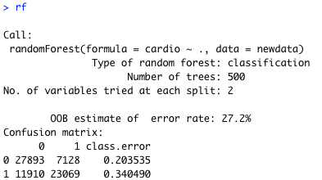
Results: Random Forest

Slide 12
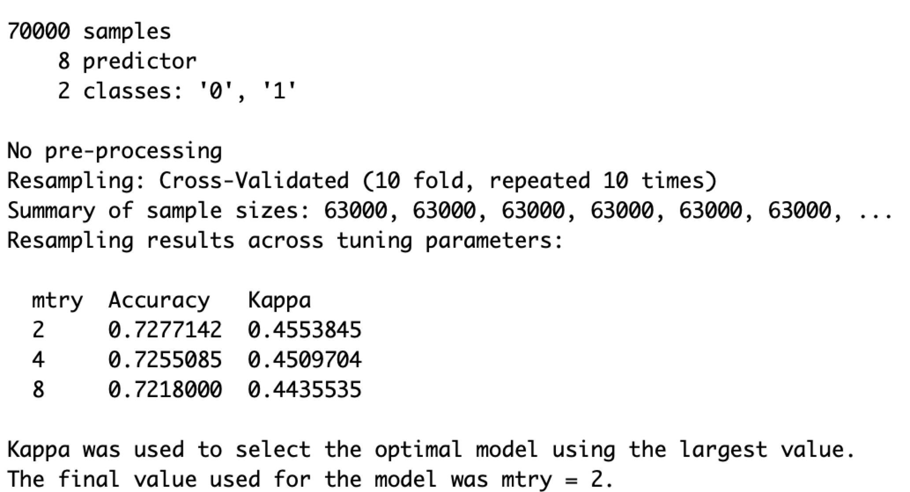
Evaluation: Tune using Caret

Slide 13
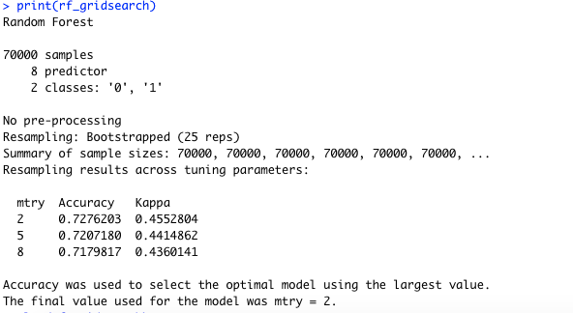
Evaluation: Grid Search

Slide 14
Conclusion
For the decision tree models, the cost matrix model has the highest accuracy rate of predicting cardio diseases.
For the random forest, after using the tune algorithm of the Caret packages in R, when the “mtry” is 2, we got the highest accuracy (0.728)and kappa value(0.455).

Slide 15
Q & A

Slide 16
Appendix - Dataset citation
Ulianova, S. (2019, January 20). Cardiovascular Disease dataset. Retrieved May 14, 2019, from https://www.kaggle.com/sulianova/cardiovascular-disease-dataset

Slide 17
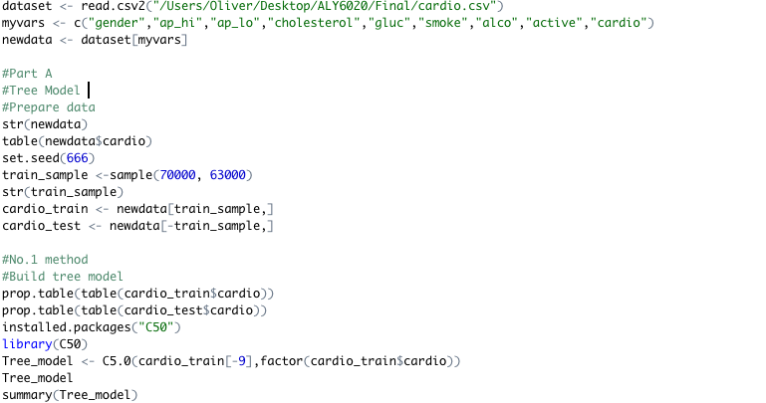
Appendix - R coding

Slide 18
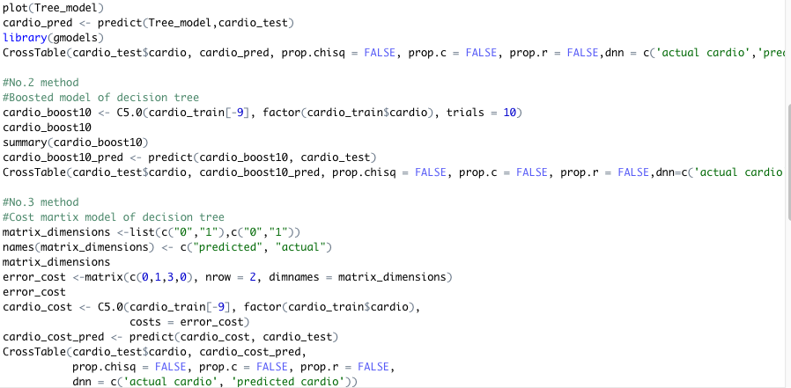
Appendix - R coding

Slide 19
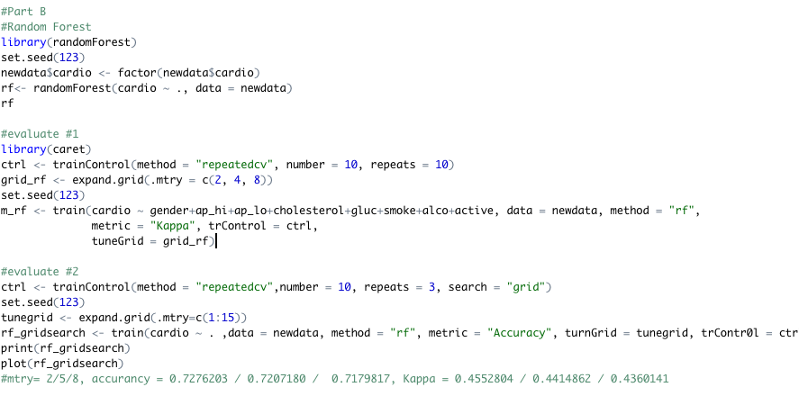
Appendix - R coding

Slide 20
Thank You~

