Slide 1

WellPoint Clinic Appointment Booking System
Seminar 3: Execution, Testing & Modification
Group 17 · Preet Tanna · Yug Sharma · Aarav Sathvara · Dhruv Suthar · Parth Shah
Guide: H. V. Katpara · R.C. Technical Institute, Ahmedabad · Diploma in Computer Engineering – GTU

Slide 2
Project Progression
From Planning to Working Prototype
01
02
Planning & Requirements Analysis
Database Design & ER Modeling
03
04
Django Backend Development
Frontend Implementation
05
06
System Integration
Testing & Validation
07
08
Issue Identification & Modifications
Working Prototype Completion

Slide 3

Module Implementation: Role-Based Architecture
Five Core User Roles
Patient
Doctor
Clinic
Search doctors, book appointments, manage records, submit reviews
View appointments, manage availability, update records, issue prescriptions
Manage clinic information, oversee operations and clinic-related workflows
Clinic Staff
Administrator
Verify patient details, manage confirmations, assist operations
System-wide management, user verification, data integrity, reporting
Core Workflow: Patient → Doctor Search → Doctor Profile → Clinic & Availability → Appointment Booking → Doctor Dashboard → Patient Records & Prescriptions

Slide 4



Technology Stack & Development Environment
Frontend Layer
HTML5, CSS3, JavaScript · Bootstrap Framework
Backend Layer
Python 3 · Django Web Framework · Django ORM
Database
SQLite (Development & Testing) · MySQL (Planned for Production)
Development Tools
VS Code · Git & GitHub

Slide 5

Testing Methodology
Testing Approaches Implemented
Testing Tools & Frameworks
Functional Testing
Django Test Framework
django.test.Client
Verify core features work as designed
Request & workflow testing
Role-Based Testing
Validate access control for each user role
Browser & UI Testing
Python Automation Scripts
Negative Testing
Django ORM & DB Inspection
Test invalid inputs and edge cases
Authorization Testing
Ensure proper permission enforcement
Database Integrity Testing
Verify data relationships and constraints
Regression Testing
Confirm modifications don't break existing functionality

Slide 6
Test Results & Verification
Key Testing Areas — All Passed ✓
Testing / Verification Screenshot
Patient Booking Workflow
[ INSERT TESTING / VERIFICATION SCREENSHOT HERE ] Django test runner output or browser verification result
End-to-end booking flow validated successfully
Duplicate / Double-Booking Prevention
Conflict detection logic confirmed operational
Role-Based Access Control
Permission boundaries enforced across all five roles
Review & Rating Validation
Rating scale and submission rules verified
Database Relationship Integrity
All relational constraints passed inspection
Regression Verification
Post-modification functionality confirmed stable

Slide 7
Issues Identified & Modifications
Missing Patient Profile
Booking Validation Error
Login Account-Status Mismatch
Added profile validation before appointment submission
Implemented comprehensive input validation and error messaging
Fixed account status verification in authentication flow
Availability Slot Handling
Doctor Title Duplication
Appointment/Payment Status
Corrected slot assignment and conflict detection logic
Removed duplicate entries in doctor profile display
Clarified status labels and workflow indicators
Incorrect Currency Symbol
Booking Page Layout
Review Rating Validation
Standardized currency formatting across the system
Improved responsive design and form layout
Enhanced validation for rating scale and review submission

Slide 8
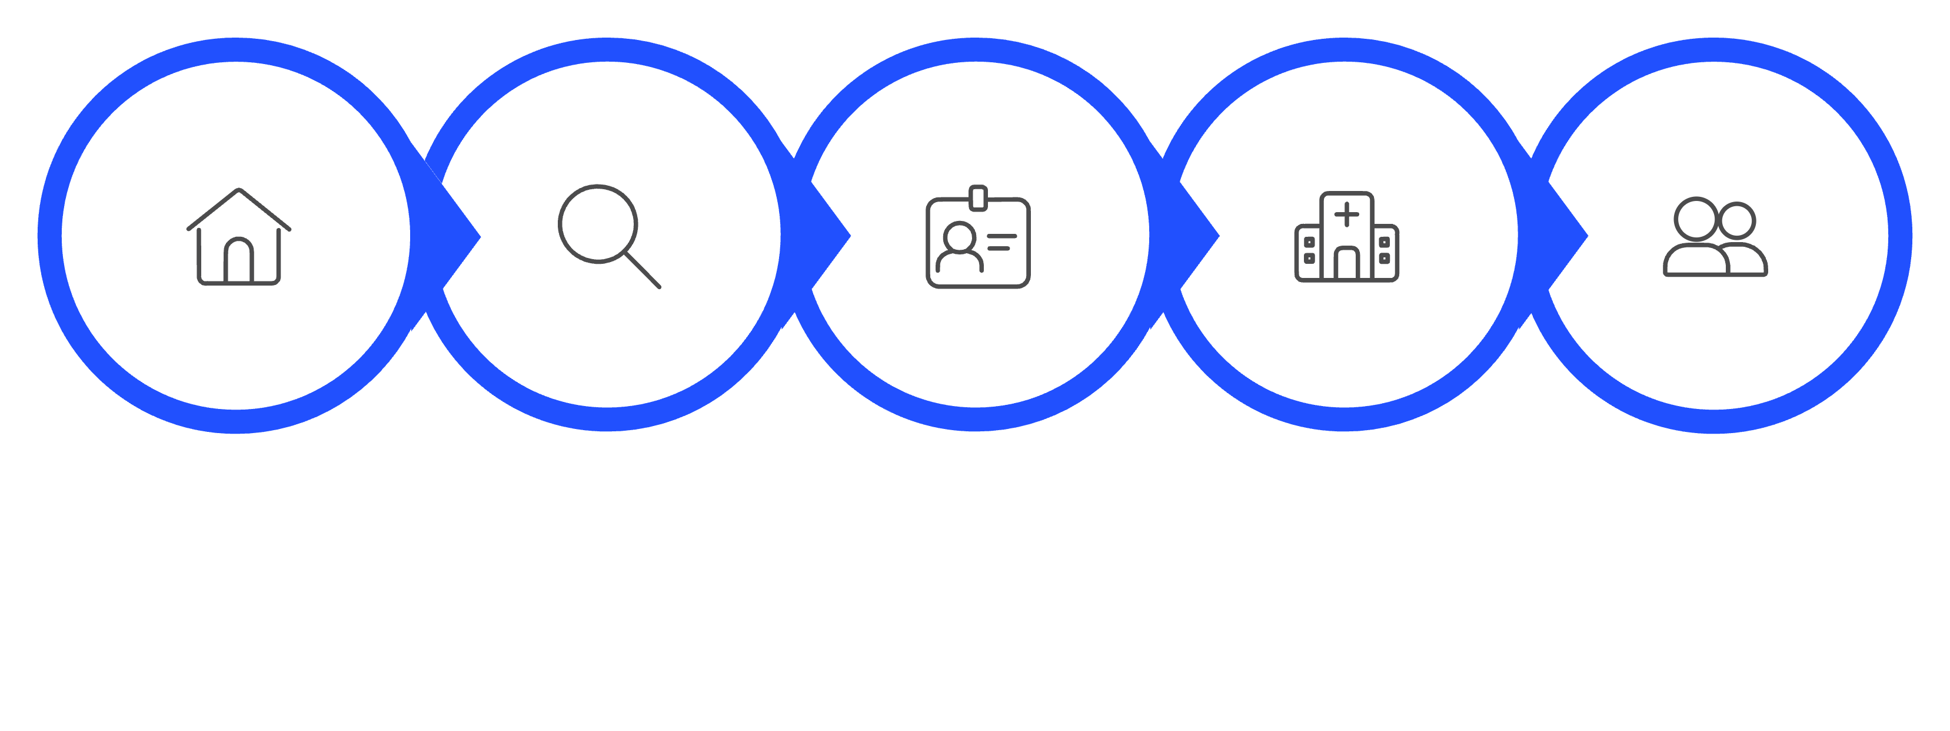
Current Working Prototype — User Journey
Home
Find Doctor
Doctor Profile
Select Clinic
Patient Type
Implemented Features: Doctor search & filtering by specialty, clinic & availability · Profile viewing with qualifications & reviews · Date/time selection, rescheduling & cancellation · Patient records & prescription management · Review & rating submission · Admin verification & user management
[ INSERT REAL BOOKING WORKFLOW SCREENSHOT HERE ] Full booking flow — from homepage to appointment confirmation

Slide 9
Prototype Screens — Patient Side
Patient Interface & Dashboard
Homepage / Find Doctors
Patient Dashboard
[ INSERT HOMEPAGE / FIND DOCTORS SCREENSHOT HERE ] Search, filter, and browse available doctors
[ INSERT PATIENT DASHBOARD SCREENSHOT HERE ] Appointments, records, and prescription management

Slide 10
Prototype Screens — Doctor & Admin Side
Doctor & Administrator Interfaces
Doctor Dashboard
Admin Dashboard
[ INSERT DOCTOR DASHBOARD SCREENSHOT HERE ] Appointments, availability, and patient records
[ INSERT ADMIN DASHBOARD SCREENSHOT HERE ] User verification, system management, and reporting

