Slide 1
Computer Networks and Internets
《计算机网络与因特网》课件
林坤辉

Slide 2
PART III Packet Transmission
Chapter 13（1）
LAN Technologies
and Network Topology
局域网技术与网络拓扑

Slide 3
13.2 Direct Point-to-Point Communication
直接点对点通信
Each communication channel(e.g., a leased data circuit) connected exactly two computers, and was available to those computers exclusively.
Known as a point-to-point network(点对点网络) or mesh network（网状网络）.

Slide 4
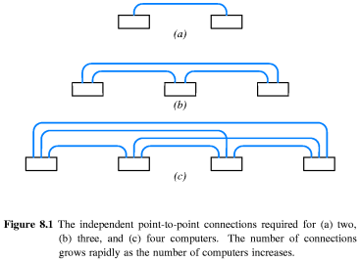

Slide 5
Three useful properties:
First, each connection is installed independently, appropriate hardware can be used.
Second, they have exclusive access, the connected computers can decide exactly how to send data across the connection.
Third, because only two computers have access to the channel, it is easy to enforce security and privacy.

Slide 6
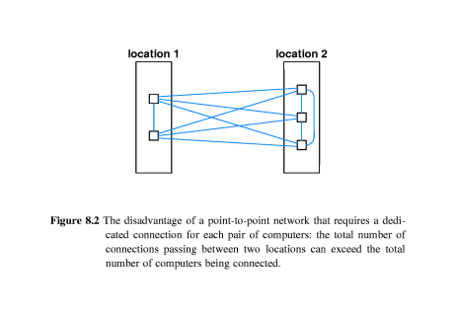

Slide 7
Disadvantage:
The total number of connections grows more rapidly than the total number of computers.
The number of connections needed for N computers is proportional to the square of N:
Direct connections required=(N²-N)/2
The expense is especially high because many connections follow the same physical path.

Slide 8
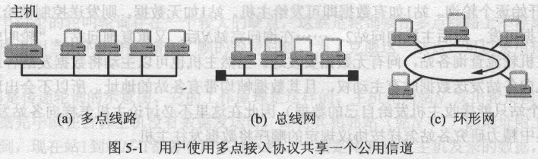
13.3 Shared Communication Channels
共享通信信道

Slide 9
Each LAN consists of a single shared medium, usually a cable, to which many computers attach.
The computers take turns using the medium to send packets.
Networks that allow multiple computers to share a communication medium are used for local communication. Point-to-point connections are used for long-distance networks and a few other special cases.

Slide 10
If sharing reduces cost, why are shared networks used only for local communication?
the computers attached to a shared network must coordinate use of the network.
Because coordination requires communication and the time required to communication depends on distance.

Slide 11
13.4 Significance of LANs and Locality of Reference局域网的重要性与访问的局部性
Because LAN technologies are both inexpensive and widely available.
The locality of reference principle: computer communication follows two distinct patterns.
First, a computer is more likely to communicate with computers that are physically nearby than with computers that are far away.
Second, a computer is more likely to communicate with the same set of computers repeatedly.

Slide 12

13.5 LAN Topologies
局域网拓扑结构
Because many LAN technologies have been invented, it is important to know how specific technologies are similar and how they differ.
To help understand similarities, each network is classified into a category according to its topology or general shape.

Slide 13
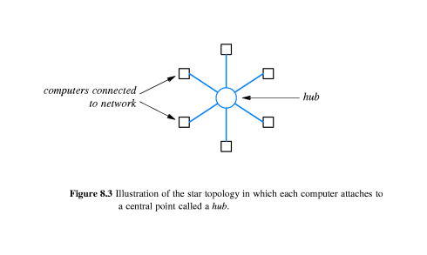
13.5.1 Star Topology
A network uses a star topology if all computers attach to a central point.

Slide 14
Star networks seldom have a symmetric shape in which the hub is located an equal distance from all computers.
星型结构
  一个中心节点
  一组计算机通过中心节点实现信息传输
  各节点和中心节点之间通过点到点的链路进行连接

Slide 15
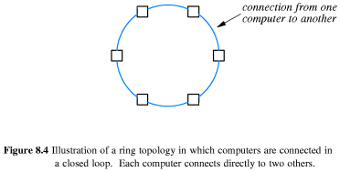
13.5.2 Ring Topology
A network that uses a ring topology arranges for computers to be connected in a closed loop.

Slide 16
A cable connects the first computer to a second computer, another cable connects the second computer to a third, and so on, until a cable connects the final computer back to the first.
The computers and connections in a ring network need not be arranged in a circle.
The name ring arises because one can imagine the computers and the cables connecting them arranged in a circle.

Slide 17
环型结构
  各节点通过通信介质连成一个封闭的环形
  两个邻接的节点之间通过点到点连接
  非邻接节点之间通信要经过路径上的其它节点

Slide 18
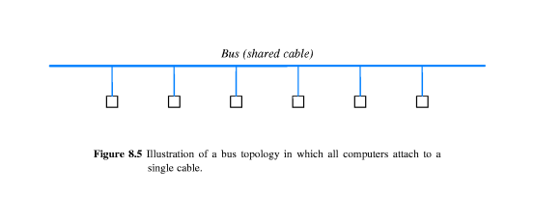
13.5.3 Bus Topology
A network that uses a bus topology usually consists of a single,long cable to which computers attach.

Slide 19
Any computer attached to a bus can send a signal down the cable, and all computers receive the signal.
The computers attached to a bus network must coordinate to ensure that only one computer sends a signal at any time or chaos results.
总线型结构
  网络中所有的站点共享一条数据通道
  任何节点只需发送一个数据包到总线中，其它节点会接收，从而完成数据通信

Slide 20
13.5.4 The Reason For Multiple Topology
Each topology has advantages and disadvantages.
Star topology
Ring topology
Bus topology

Slide 21
Star topology
优势
  容易在网络中增加新的站点
  一个节点断掉不会影响其它节点
  数据的安全性和优先级容易控制
  易实现网络监控
不足
  中心节点的故障会引起整个网络瘫痪

Slide 22
Ring topology
优势
  结构简单，容易安装
  容易监控通/断情况
  节省资源
不足
  容量有限
  网络建成后，难以增加新的站点
  一个节点产生异常情况，会影响其它节点通信

Slide 23
Bus topology
优势
  安装简单方便
  需要铺设的电缆最短，成本低
  某个站点的故障一般不会影响整个网络
不足
  介质的故障会导致网络瘫痪
  线网安全性低
  监控比较困难
  增加新站点也不如星型网容易

Slide 24
13.6 Example Bus Network: Ethernet
13.6.1 History of The Ethernet
以太网是由Xerox公司在70年代早期发明的。
以太网的标准: 现在由IEEE制订并维护
带宽容量
  传统以太网：10M bps
  快速以太网：100M bps
  千兆以太网： 1000M bps 或 1G bps

Slide 25
以太网和IEEE 802.3
以太网发展历史
  IEEE 802.3 标准 （1985）
  IEEE 802.3u Fast Ethernet 标准（1995）
  IEEE 802.3z Gigabit Ethernet 标准（1998）
  IEEE 802.3ab Gigabit Ethernet 标准（1999）

Slide 26
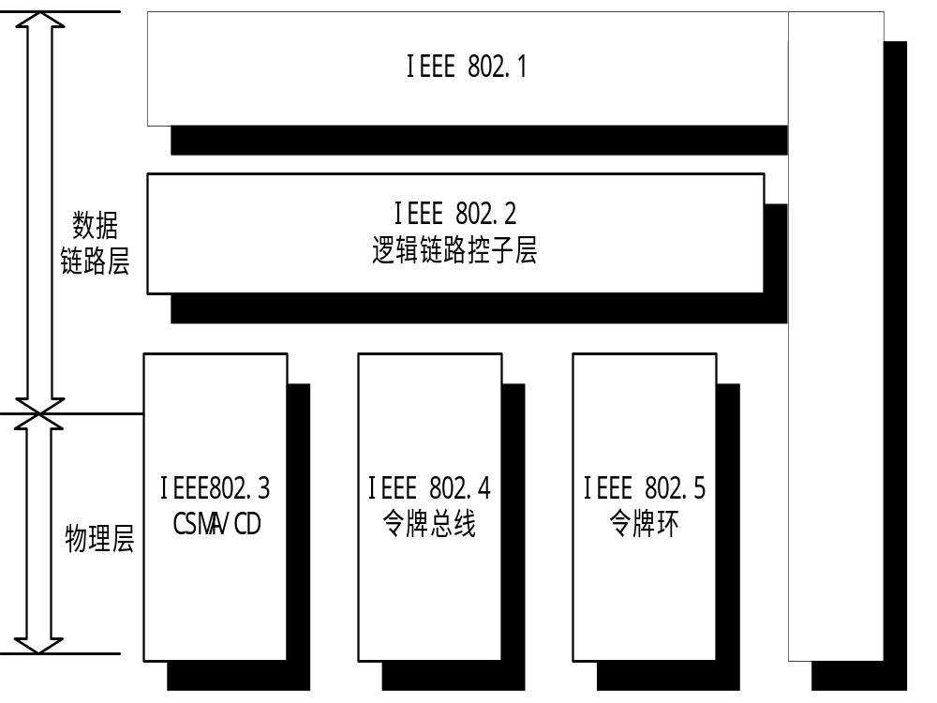

Slide 27
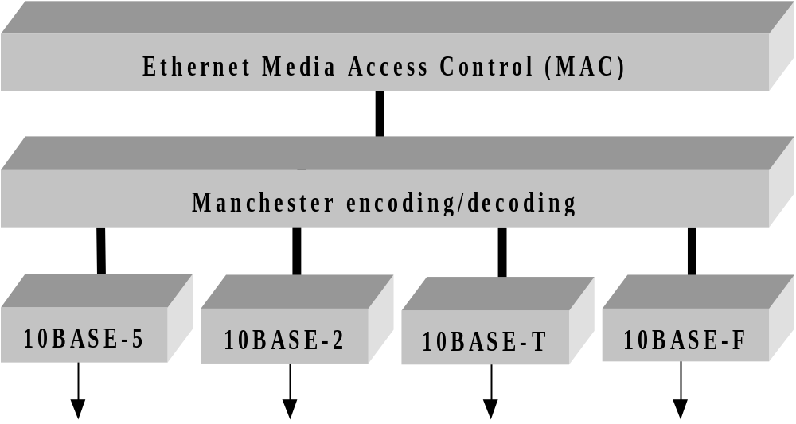
IEEE802.3的组成示意图

Slide 28
8.6.2 Ethernet Transmission And Manchester Encoding
Manchester(曼彻斯特) Encoding uses rising and falling edges to encode data.
The sender transmits a falling edge to encode a 0 and a rising edge to encode a 1.
The hardware is said to be edge triggered(触发), and the change are known as rising or falling edge.

Slide 29
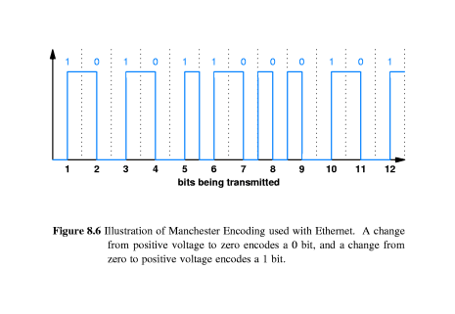
The Ethernet standard specifies that frames are sent using the Manchester(曼彻斯特) Encoding.

Slide 30
To make sense(检测) of the incoming signal, a receiver must know exactly when each time slot(时间间隙、时隙) begins and ends.
The Manchester Encoding uses a preamble(前同步) to allow such synchronization.
The preamble consists of sixty-four alternating 1’s and 0’s sent before the frame.

Slide 31
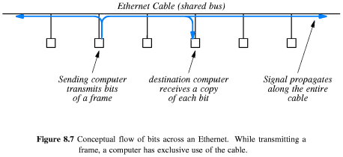
13.6.3 Sharing on An Ethernet
A sender transmits a signal, which propagates(传播) from the sender toward both ends of the shared cable.

Slide 32
Multiple computers share a single transmission medium.
Multiple frames are not being sent at the same time.
While one computer transmits a frame to another, all other computers must wait.

Slide 33
13.7 Carrier Sense on Multi-Access Networks(CSMA)
During frame transmission, a sender transmits electrical signals used to encode bits.
When no computer is sending a frame, the ether(以太) does not contain electrical signals.
To determine whether the cable is currently being used, a computer can check for a carrier.

Slide 34
Checking for a carrier wave is called carrier sense(载波侦听).
The idea of using the presence of a signal to determine when to transmit is called carrier sense multiple access(CSMA载波侦听多路访问)

Slide 35
13.8 Collision Detection and Backoff With CSMA/CD
When the signals transmitted by two computers reach the same point on the cable, they interfere with each other.
The interference between two signals is called a collision(冲突).
Monitoring a cable during transmission is known as collision detect(CD冲突检测).
The Ethernet mechanism is known as Carrier Sense Multiple Access with Collision Detect(CSMA/CD)

Slide 36
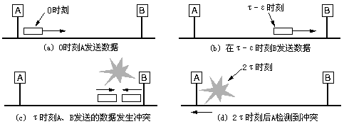
在时刻τ处发生冲突，B站将检测到回收的能量大于发出的能量，因此知道发生了冲突，于是放弃发送，并产生一个48比特的噪声帧以警告其他站。大约在2 τ时，A看到了噪声帧，知道了冲突，放弃发送。

Slide 37
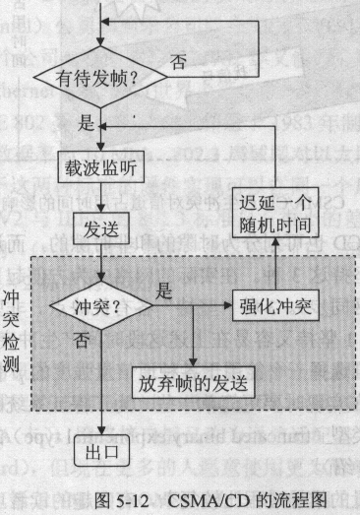

Slide 38
After a collision occurs, a computer must wait for the cable to become idle again before transmitting a frame.
To avoid multiple collisions, Ethernet requires each computer to delay after a collision before attempting to retransmit.
Doubling the range of the random delay after each collision is known as binary exponential backoff(二进制指数后退算法：一般地，第i次冲突后，等待时隙数就从0到2^{i}-1中随机选出）

Slide 39
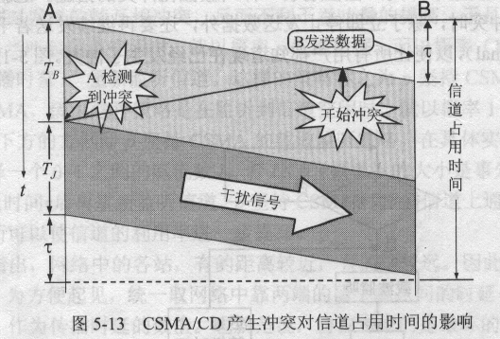
总线争用期：T_{B}+T_{J}+ τ

Slide 40
以太网工作原理特点
小结：
采用曼彻斯特编码格式
  载波形式：直方波
  通过载波中心的波形变化表示信号值：电压上升表示“1”，下降表示“0”
是一种分组交换网，每个主机有一个全球唯一的物理地址
通过CSMA/CD技术实现局域网总线上的数据监听和冲突检测
需要通过网桥或交换机实现对网络的分段，以减少主机增多时冲突发生次数

Slide 41
CSMA/CD特点
载波侦听多路访问
  站点传送数据时，首先侦听信道是否空闲
  空闲则发送，非空闲则等待，重新侦听
  侦听等待的时间
    始终侦听，直到没有冲突，开始发送
    冲突后，等待一个随机时间，再重新开始侦听
    如果不冲突，按照一个特定概率p决定当前是否发送
冲突检测
  多个站点同时侦听到空闲，发送数据时进行冲突检测
  检测到冲突，立刻停止，等待一定的时间后，再重新开始CSMA/CD过程

Slide 42
8.9 802.11 Wireless LANs And CSMA/CA
IEEE standard 802.11 defines wireless LANs that operate at 11Mbps using a frequency in the 2.4 GHz range.
A standard known as bluetooth specifies a wireless LAN technology designed for short distances.
Wireless LAN hardware uses antennas to broadcast RF signals through the air, which other computers receive.

Slide 43
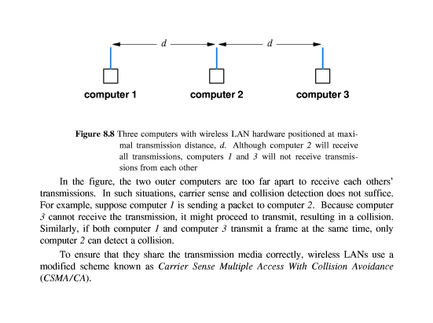

Slide 44
Wireless LANs use a modified scheme known as Carrier Sense Multiple Access With Collision Avoidance(CSMA/CA载波侦听多路访问/冲突避免)
The CSMA/CA triggers a brief transmission from the intended receiver before transmitting a packet.
Collisions of control messages can occur.
The sending stations apply random backoff before resending the control messages.

Slide 45
无线局域网技术特点
基本技术特点
  通过一台PC机器加上一块无线网络接口卡构成将多个无线的接入站聚合到有线的网络上
  采用了新的协议CSMA/CA进行冲突避免
    只有当客户端收到网络上返回的ACK信号后才确认送出的数据已经正确到达目的
  两个节点通过中间节点进行数据通信，要由中间节点通过控制命令进行统一调度控制，增加了额外的网络负担

Slide 46
13.10 Another Example Bus Network: LocalTalk
LocalTalk is invented by Apple computer Corporation.
The technology is designed for use with Apple’s personal computers.
LocalTalk network is a bus topology, attached computers use a version of CSMA/CA when accessing the medium. A computer sends a small control message to reserve the bus.

Slide 47
LocalTalk特点
Apple公司的总线网
应用了CSMA/CA技术处理介质访问冲突
成本低，安装简单，适合苹果机的局域网
带宽受限（230.4kbps），距离受限，不适合其它品牌设备互联

Slide 48
13.11 Example Ring Network: IBM Token Ring
A LAN using ring topology connects computers in a loop.
An access mechanism known as token passing(令牌传递).
The networks using token passing are known as token passing ring networks, or token ring.

Slide 49
When a computer needs to send data , the computer must wait for permission before it can access the network.
A token ring transmission does not rely on CSMA/CD, the token ring hardware coordinates among all connected computers to ensure that permission is passed to each computer in turn.
The coordination uses a special ,reserved message called a token(令牌)， it is a bit pattern that differs from normal data frame.

Slide 50
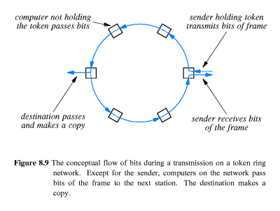

Slide 51
IBM 令牌环网特点
单向环网，相邻节点是点到点连接
环中接口采用三种工作方式之一
  拷贝：普通的环中节点
  传输：和其它环的邻接节点
  恢复：恢复已经丢失的令牌的节点
对令牌集中管理，避免了冲突的发生
单点出现故障，可造成环网瘫痪

Slide 52
13.12 Another Example Ring Network: FDDI
Fiber Distributed Data Interconnect(FDDI光纤分布数据互连) is a token ring technology that can transmit data at a rate of 100 million bits per second.
FDDI uses optical fiber to interconnect computers.
An FDDI network contains two complete rings.

Slide 53
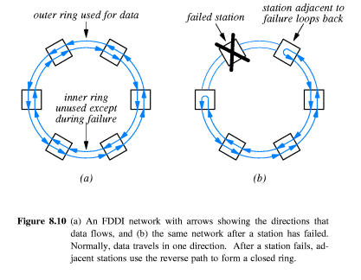

Slide 54
An FDDI network is called self-healing(自恢复) because the hardware can detect a catastrophic(灾难的) failure and recover automatically. To do so, FDDI uses a pair of counter rotating rings(反旋转环). One ring is used to transmit data. When a failure occurs that breaks the ring,stations adjacent to the failure automatically reconfigure, using the second ring to bypass(旁路) the failure.

Slide 55
FDDI特点
双向环网，保证了单点故障对网络的影响，具有自愈合能力
是一个开放式网络，网桥连接的两个局域网可以基于同一种标准，也可以基于两种不同类型的标准
转发速度快，传输速率较高（100Mbps）
成本较高

Slide 56
13.13 Example Star Network: ATM
ATM(Asynchronous Transfer Mode异步传输模式)
The basic element of an ATM network is an electronic switch(电子交换机) to which several computers can connect.
An ATM network is a star topology.
An ATM switch operates at a speed of 155Mbps or faster.
An ATM switch usually uses optical fiber.

Slide 57
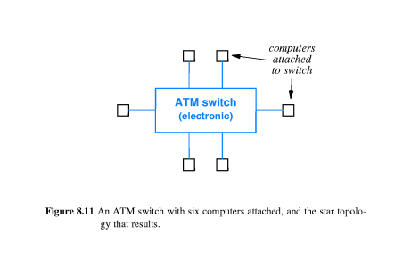

Slide 58
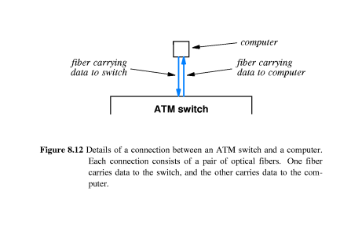

Slide 59
ATM特点
通过ATM交换机进行互连，典型的星型结构
异步传输模式，两条传输线缆
数据包分组发送
速度快（155Mbps）
成本相对较高

Slide 60
作业
局域网有哪几种拓扑结构，各有什么特点？分别举出一种有代表性的网络。
简述以太网的工作原理。
习题：13.6, 13.7

