Slide 1
Computer Networks and Internets
《计算机网络与因特网》课件
林坤辉

Slide 2
PART III Packet Transmission
Chapter 13（2）
Hardware Addressing
and Frame Type Identification
硬件编址与帧类型标识

Slide 3

13.1 Introduction
Physically,any signal sent across a shared network reaches all attached stations.
At a given station,the network interface hardware detects the electrical signal and extracts a copy of the frame.
Communication does not usually involve all stations. Instead,most communication occurs because an application program on one computer sends data directly to an application program on another.

Slide 4
13.2 Specifying A Recipient指定接收方
Most LAN technologies use an addressing scheme to provide direct communication.
Each station on the LAN is assigned a unique numeric value called a physical address(物理地址),hardware address(硬件地址),or media access address(MAC).
A frame sent across a LAN contains the address of the sending computer,called a source address,and the address of the intended recipient,called the destination address.

Slide 5
13.3 How LAN Hardware Uses Addresses To Filter Packets
局域网硬件如何使用地址过滤包
The LAN hardware in a computer as completely separate from the computer’s CPU and memory.
The LAN interface hardware handles all the details of sending and receiving frame on the shared medium without using the computer’s CPU.

Slide 6
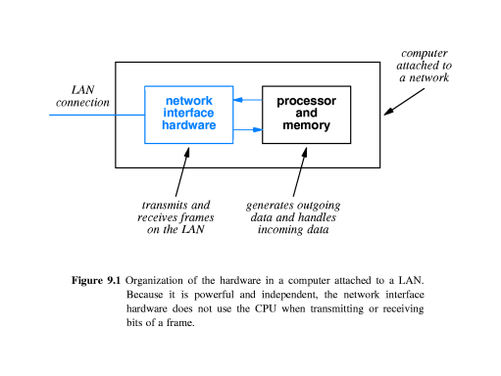

Slide 7
The LAN interface hardware uses physical addressing to prevent the computer from receiving all packets that travel across the LAN.
Once it has captured a complete frame, the interface hardware compares the destination address in the frame to the station’s physical address.

Slide 8
网卡的任务：
    检测帧是否存在
    有效性检验
    判断是否接收
  CPU的任务
    判断是否传给上层处理
分层处理的目的：减少CPU的负荷
数据包过滤是通信接收方的动作
通过检测数据的标识，对符合接收条件的：
    复制帧
    中断CPU，将复制后的帧交给CPU
    继续等待下一个帧
  对不符合接收条件的：放弃接收，继续等待下一个帧

Slide 9
13.4 Format of A Physical Address
Physical Address
  必须是所在局域网内的唯一标识
  局域网内要对物理地址提供检索的功能
Three broad categories:
Static address（静态地址）
    出厂前由生产厂家一次性配置完成
    全球唯一硬件标识，不会出现地址冲突
    一次生成，永久使用
    地址较长，查询慢

Slide 10
Configurable address （可配置地址）
    系统出厂后，用户动态分配，保持局域网内唯一
    地址短，查询快
    地址可以永久有效，也可以随需求改变
Dynamic address （动态地址）
    每当系统启动的时候动态分配，局域网内唯一
    地址短，查询快
    有可能出现地址冲突
    地址动态改变，不利于地址映射表的维护

Slide 11
13.5 Broadcasting 广播
Broadcasting was originally applied to radio and television transmission.
The network designers define a special,reserved address known as a broadcast address(广播地址).
The hardware interface on a computer is built to recognize the special broadcast address as well as the station’s physical address.

Slide 12
当一台计算机需要向多台计算机广播信息时，若使用单播技术，必须向每一台计算机分别发送数据，将造成网络负载的成倍增长。
采用广播实现方式，发送方按照一个广播地址向共享介质发送数据帧，网上所有设备的网卡分别进行数据帧的拷贝，并交给CPU处理。需要接收数据帧的设备由CPU完成向上层的传递，不需要数据帧的设备由CPU丢弃该数据帧
  通过广播，实现了一对多的数据通信，比单点传输方式减少了负载，但所有计算机CPU都要决定接收还是丢弃数据帧，这样增加了无关设备的CPU负载。

Slide 13
13.6 Multicasting 组播
Broadcasting is extremely inefficient.
When a frame arrives,the network interface hardware places the contents in memory,interrupts(中断) the CPU,and allows system software to determine whether the frame should be ignored.
Discarding frame involves using the CPU to make a decision.

Slide 14
A restricted form of broadcasting known as multicasting.
A network interface does not automatically forward multicast frame to the CPU.
The interface hardware must be programmed with specification of which multicast frame to accept and which to reject.
The interface hardware makes the decision and only accepts those frames that match the specification.

Slide 15
13.7 Multicast Addressing 组播编址
When the computer boots,the interface is programmed to recognize only the computer’s address and broadcast address.
If an application on the computer wishes to receive multicast frame, the application must inform the network interface which multicast address to use.
The interface adds the address to the set it will recognize, and begins accepting frame sent to that address.

Slide 16
13.8 Identifying Packet Contents 标识包的内容
A receiver cannot use data in the packet to determine what the packet contains.
To inform the receiver about its contents,each frame contains additional information that specifies the type of the contents.
Two methods are used to identify the contents of a frame.

Slide 17
Explicit frame type(显式帧类型)：
The network hardware designers specify how type information is included in the frame.
The bits of a frame used to identify the contents are called the frame type field(帧类型域), and the frame is called self-identifying(自标识).

Slide 18
Implicit frame type(隐式帧类型)：
The network hardware does not include a type field in each frame.
The sender and receiver must agree on the contents of a frame or agree to use part of the data portion of the frame as a type field.

Slide 19
13.9 Frame Headers and Frame Format 帧头部和帧格式
Each LAN technology defines a frame format.
Most technologies define a frame to consist of two parts, a frame header(帧头部), followed by a larger payload(有效载荷) or data area.
a frame header has a fixed size and location.
The data area of a frame does not have a fixed size.

Slide 20
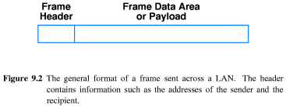

Slide 21
13.10 An Example Frame Format
帧格式实例
An Ethernet frame begins with a header that contains three fields.
The 64-bit preamble contains alternating 1s and 0s
The first two fields of the header contain physical addresses(48-bit static addressing scheme).
The third field of the header consists of a 16-bit Ethernet frame type.

Slide 22
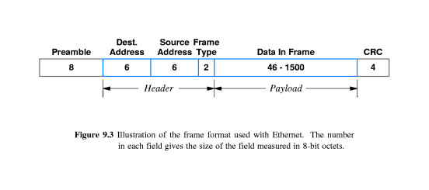
The Digital-Intel-Xerox(DIX) Ethernet standard specifies the value that can be used in the header fields and their meanings. For example:
The address with all 48 bits set to 1 is reserved for broadcast, other addresses that start with a 1 bit are used for multicast.

Slide 23
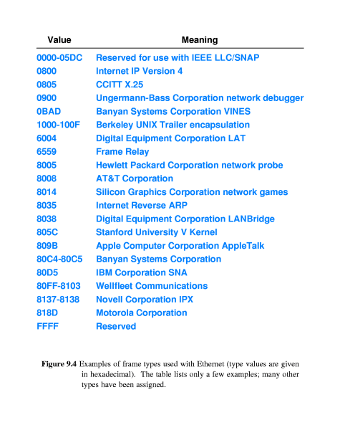

Slide 24
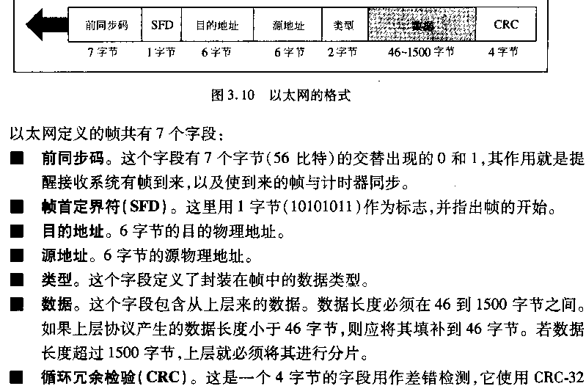

Slide 25
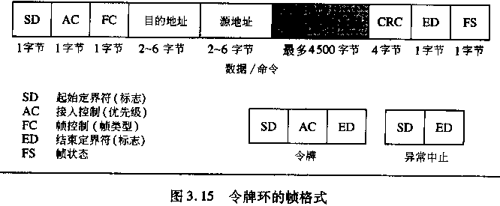
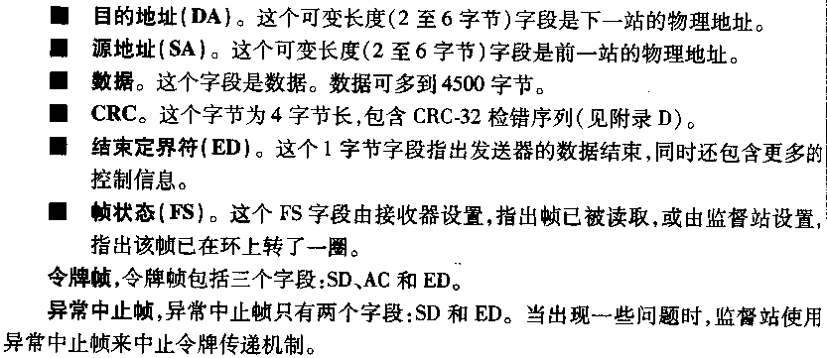

Slide 26
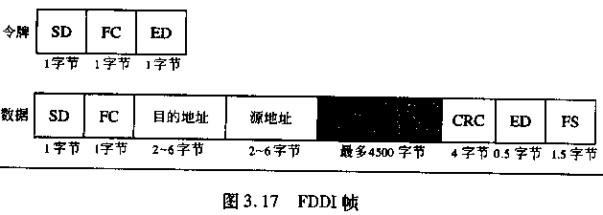
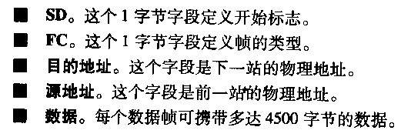

Slide 27
13.11 Using Networks That Do Not Have Self-Identifying frame
无自标识帧的网络的使用
Some network technologies do not include a type field in the frame header.
How can computers connected to such networks know the type of data in each frame?
There are two possible approaches

Slide 28
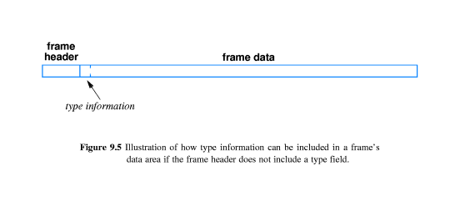
Before any data is sent, the sender and receiver agree to use a single format for data.
Before any data is sent, the sender and receiver agree to use the first few octets of the data field to store type information

Slide 29
可用的标识方式
  1）把传送的数据看作有效数据，发送和接收者通 过其它协议约定传输的数据类型标识
  2）有效数据开始部分作为数据类型标识
应用层进行数据标识的问题
  类型标识值可能被重复使用，很难保持全局唯一
全球唯一的标识的建立：IEEE802.2的LLC/SNAP
  在帧的有效数据头附加一个唯一标识
逻辑链路层控制(LLC)：3bytes
子网连接点：SNAP
  组织唯一标识(OUI)：3bytes，标准组织的编号
  组织内部唯一类型标识：2bytes

Slide 30
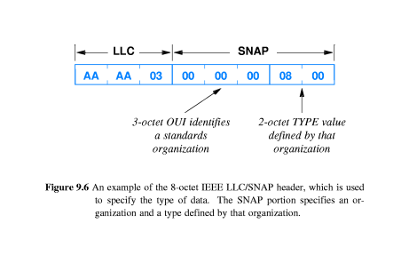
Part of IEEE’s 802.2 standard, the specification is known as a Logical Link Control (LLC)逻辑链路控制 Subnetwork Attachment Point (SNAP) 子网连接点。

Slide 31
13.12 Network Analyzers, Physical Addresses,Frame Type 网络分析器、物理地址和帧类型
A network analyzer or network monitor is a device that can be configured to count or display frame as they pass across a shared network.

Slide 32
To read packets,analyzer software places the computer’s network interface hardware into promiscuous mode(混合模式).
An analyzer obtains a copy of each frame, then uses header fields such as the physical source address,physical destination address, or type information to determine how to process the frame.

Slide 33
作业
简述广播和多播的技术原理和特点。
简单描述以太网的帧格式。
习题：13.2, 13.4

