Slide 1
Computer Networks and Internets
《计算机网络与因特网》课件
林坤辉

Slide 2
PART II Data Transmission
Chapter 10 Long-Distance
Communication
(Carriers, Modulation, and Modems)
远程通信
(载波，调制和调制解调器)

Slide 3

10.1 Introduction
Computers use binary digits(bits位串) to represent data.
Transmitting data across a network from one computer to another means sending bits through the underlying transmission medium.
Communication systems use electric current, radio waves, or light to transfer information .

Slide 4
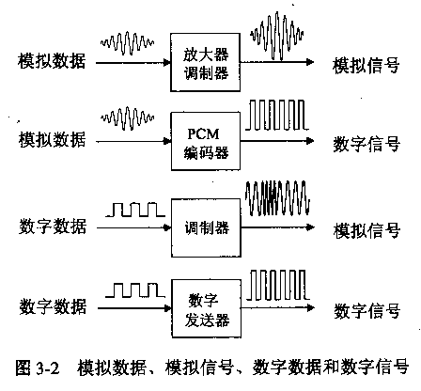

Slide 5
10.2 Sending Signals Across Long Distances
An electric current cannot be propagated(传播) an arbitrary distance over copper wire because the current becomes weaker as it travels.
Engineers term the problem signal loss (信号损耗).
Such loss occurs because resistance in the wire causes small amounts of the electrical energy to be converted to heat.

Slide 6
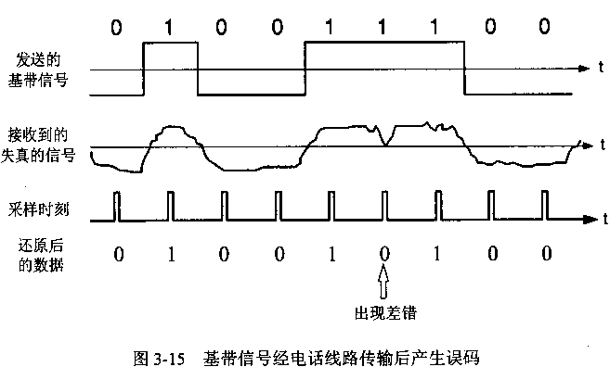

Slide 7
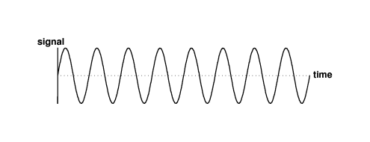
A continuous oscillating(振荡) signal will propagate farther than other signals.
Instead of transmitting an electric current that only changes when the value of a bit changes, long distance communication systems send a continuously oscillating signal,usually a sine wave(正弦波), called a carrier(载波).

Slide 8
The carrier oscillates continuously, even when no data is being sent.
To send data, a transmitter modifies the carrier slightly. Such modification are called modulation(调制).
The transmitter generates a continuously oscillating carrier signal, which it modulates according to the data being sent.

Slide 9
The receiver on a long-distance communication link must be configured to recognize the carrier that the sender uses.
The receiver monitors the incoming carrier, detects modulation , reconstructs the original data, and discards the carrier.

Slide 10

Network technologies use a variety of modulation techniques, including：
amplitude modulation (AM调幅),
frequency modulation (FM调频),
phase shift modulation (PM调相).

Slide 11
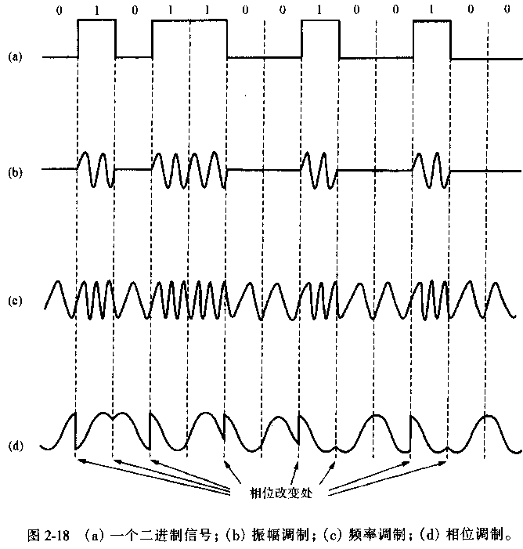

Slide 12
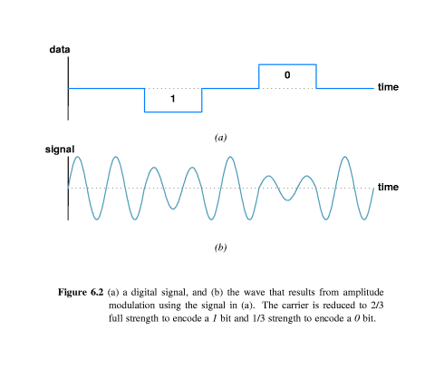

Slide 13
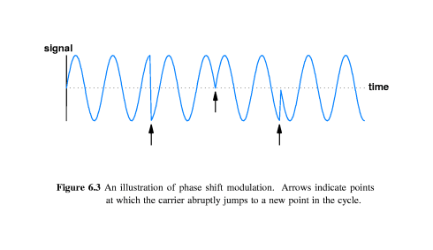

Slide 14
10.3 Modem Hardware Used For Modulation And Demodulation
A hardware circuit that accepts a sequence of data bits and applies modulation to a carrier wave according to the bits is called a modulator(调制器).
A hardware circuit that accepts a modulated carrier wave and recreates the sequence of data bits that was used to modulate the carrier is called a demodulator(解调器).

Slide 15
Transmission of data across a long distance requires a modulator at one end of the transmission line and a demodulator at the other.
Most network systems are full duplex, each location needs both a modulator and a demodulator.
manufactures combine both circuits into a single device called a modem(调制解调器).

Slide 16
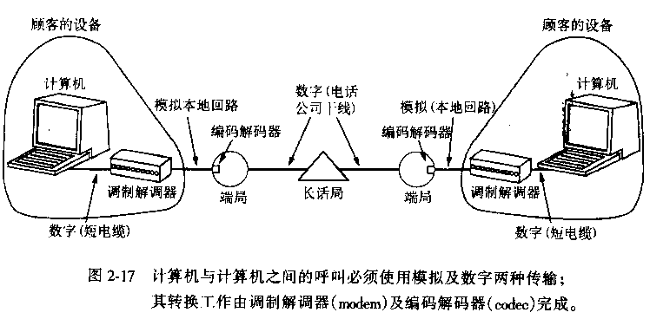

Slide 17
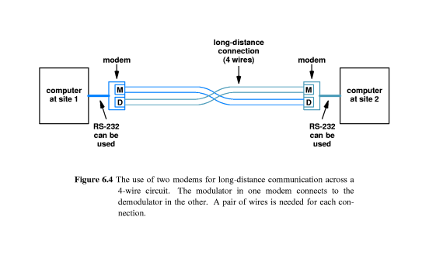

Slide 18
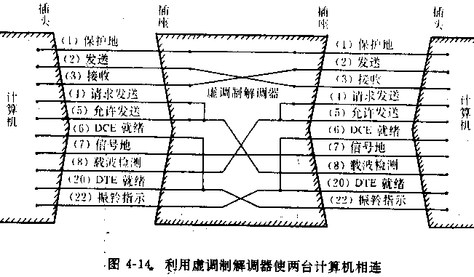

Slide 19
10.4 Leased Analog Data Circuits
租用模拟数据线路
When the circuit connects two location at a single site,the company can install the necessary wires itself. Private companies cannot install circuits across long distance.
The necessary wiring can be obtained from a telephone company. Telephone companies allow companies to lease a circuit between any two locations.

Slide 20
Once a connection has been leased from the phone company,a modem must be installed at each end before communication is possible.
After that, the leased line is available to send data.
Advantage: data can be sent at any time.
Disadvantage: the limited connectivity and cost.

Slide 21
10.5 Optical, Radio Frequency, and Dialup Modems
In addition to dedicated wires,modems are also used with other media, including RF transmission, glass fibers, and conventional telephone connections.
A dialup modem contains circuitry that mimics a telephone----the modem can simulate lifting the handset, dialing, or hanging up the phone.

Slide 22
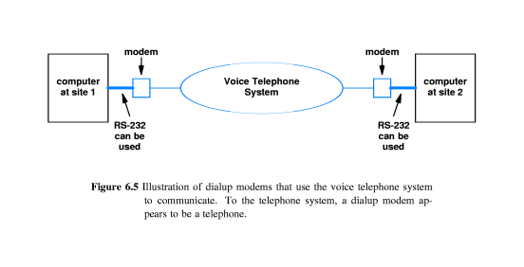

Slide 23
10.6 Carrier Frequency And Multiplexing
载波频率和多路复用
Each television station is assigned a channel number on which it broadcasts a signal.
A channel number is merely shorthand for the frequency at which the station’s carrier oscillates.
The signal for one channel does not interfere with the signal for another.

Slide 24
Computer networks use the principle of separate channels to permit multiple communication to share a single,physical connection.
Each sender transmits a signal using a particular carrier frequency.
Multiple carriers can pass over the same wire at the same time without interference.

Slide 25
Frequency division multiplexing(FDM频分多路复用)：multiple carrier frequencies to allow independent signal to travel through a medium.
FDM allows multiple pairs of senders and receivers to communication over a shared medium simultaneously. The carrier used by each pairs operates at a unique frequency that does not interfere with the others.

Slide 26
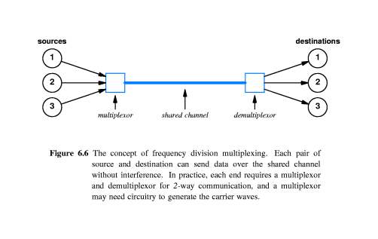

Slide 27
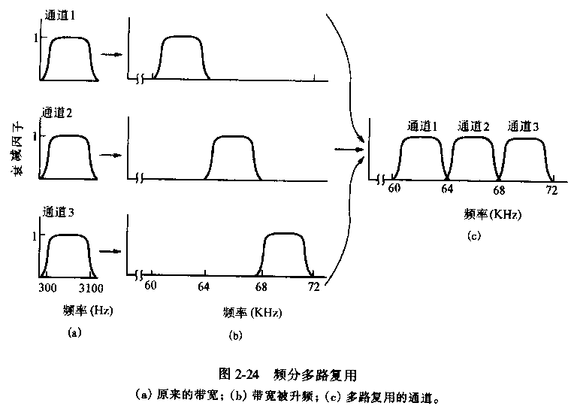

Slide 28
10.7 Baseband and Broadband technology
基带和宽带技术
The primary motivation for using Frequency division multiplexing(FDM) arises from the desire for high throughput(吞吐量).
To achieve higher throughput, the underlying hardware uses a larger part of the electromagnetic spectrum(频谱)(i.e., a larger bandwidth)

Slide 29
The term broadband(宽带) technology is used to characterize such technologies.
Any technology that uses a small part of the electromagnetic spectrum and sends only one signal at a time over the medium, is known as a baseband(基带) technology.

Slide 30
简单说，所谓基带信号就是将数字信号1或0直接用两种不同的电压来表示，然后送到线路上去传输。
宽带信号是将基带信号进行调制后形成的频分复用模拟信号。
基带信号进行调制后，其频谱被移到较高的频率处，每一路基带信号的频谱被移到不同的频段，因此合在一起不会互相干扰。
因此，一条电缆中可以同时传送多路的数字信号，从而提高了线路的利用率。

Slide 31
10.8 Wave Division Multiplexing
波分多路复用
Technically, optical FDM is known as Wave Division Multiplexing(WDM).
WDM operates by sending multiple light waves across a single optical fiber.
At the receiving end , an optical prism is used to separate the frequencies.

Slide 32
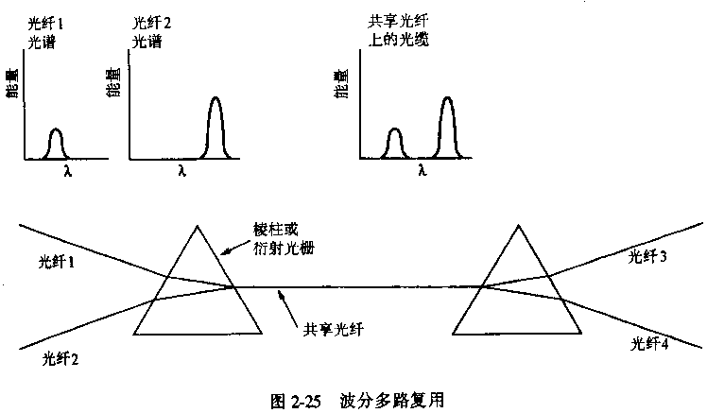

Slide 33
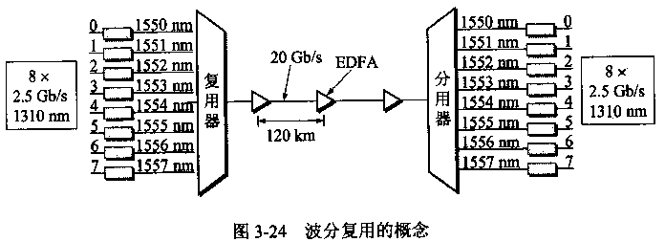
EDAF:光纤放大器，直接对光信号进行放大。

Slide 34
由于光载波的频率很高，因此习惯上用波长表示光载波。
现在可以在一根光纤上复用80路或更多路数的光载波信号，即密集波分复用DWDM（dense wavelength division multiplexing）

Slide 35
10.9 Spread Spectrum 扩散频谱
A transmitter sends the same signal on a set of carrier frequencies.
A receiver is configured to check all carrier frequencies and to use whichever is working at present.
Some modems select a set of carrier frequencies and use them simultaneously. if interference damages one or more of the carriers ,the modem can extract the data from the others.

Slide 36
10.10 Time Division Multiplexing
时分多路复用
Time Division Multiplexing(TDM).
There are two types of TDM:
Synchronous Time Division Multiplexing(STDM同步时分多路复用).
Statistical Multiplexing(统计多路复用).

Slide 37
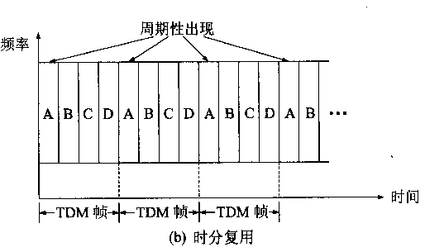

Slide 38
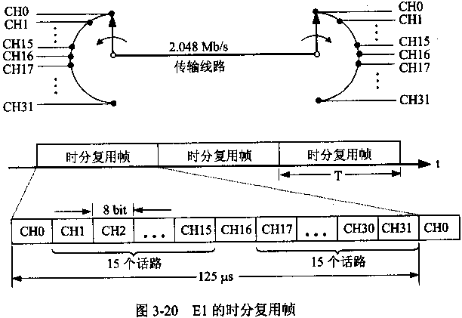

Slide 39
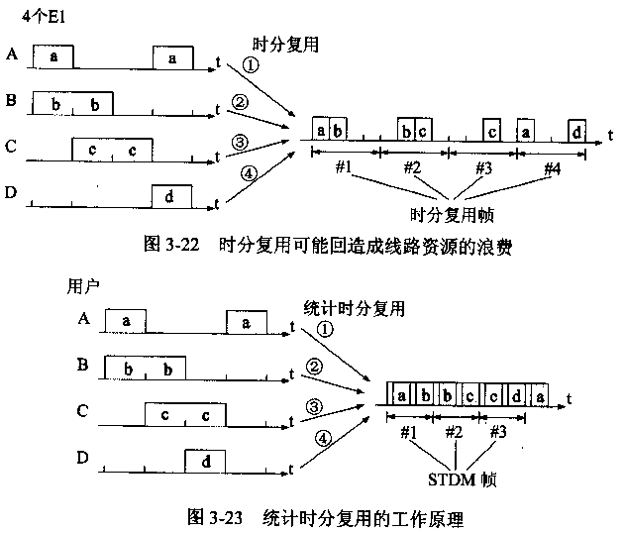

Slide 40
作业
什么是调制与解调？调制与解调有哪些基本方法？
载波复用技术有哪几种？各有什么特点？
习题：10.1, 10.2, 10.7

