Slide 1
Computer Networks and Internets
《计算机网络与因特网》课件
林坤辉

Slide 2
PART II Packet Transmission
Chapter 12 Long-Distance Digital Connection Technologies
远程数字连接技术

Slide 3

12.2 Digital Telephony数字电话
The motivation for studying digital communication.
Digital communication avoids the problem of noise.
The digital version of an analog audio signal is called digital audio.
The process of converting an analog signal to digital form is called digitization(数字化).

Slide 4
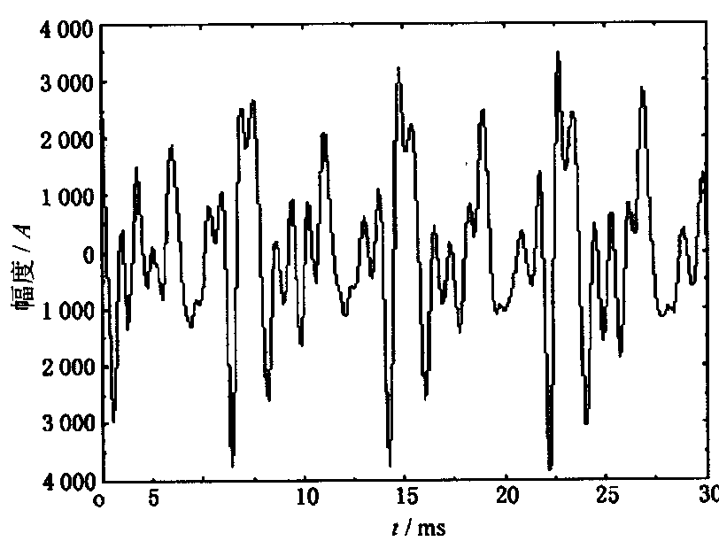
声波举例

Slide 5
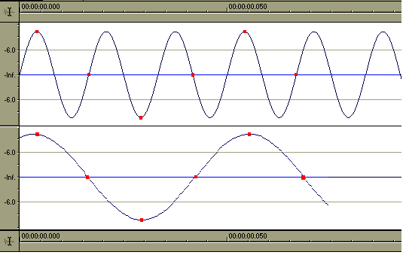
Sampling Rate(采样频率)

Slide 6
Nyquist’s sampling theorem(采样定理) states that if a continuous signal is sampled at a rate greater than twice the highest significant frequency, the original signal can be reconstructed from the samples(样本).
The tradeoff is between accuracy and data size.
Pulse Code Modulation(PCM).
PCM samples a signal once every 125 μ seconds(微秒) and converts each sample into a integer between 0 and 255.

Slide 7
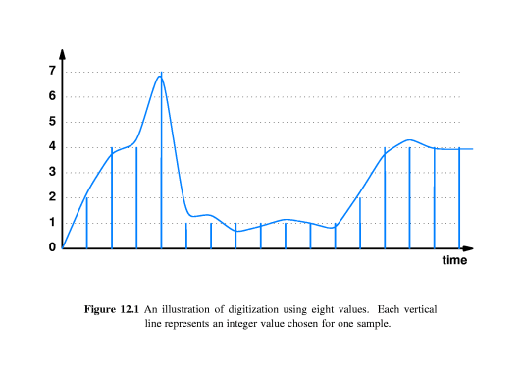

Slide 8
12.3 Synchronous Communication 同步通信
The facilities used for digitized voice differ from the system used for data.
Voice systems use synchronous or clocked technology.
Most data networks use asynchronous technology.

Slide 9
A synchronous network consists of a system designed to move data at a precise rate.
The telephone system is carefully designed to transmit additional information along with the digitized data and to ensure continuous transmission.
Receiving equipment uses the additional information to synchronize its clock and ensure that data leaves the network at exactly the same rate as it entered.

Slide 10
12.4 Digital Circuits and DSU/CSUs
Digital circuits leased from common carriers.
The standards for telephone system digital circuits differ from those used in the computer industry.
DSU: Data Service Unit
CSU: Channel Service Unit.

Slide 11
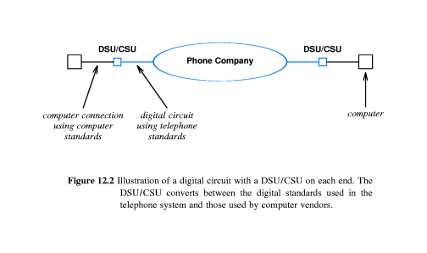

Slide 12
12.5 Telephone Standards
In the U.S., standards for digital telephone circuits : T-series standards.
Japan adopted a modified version of the T-series standards.
Europe chose a slightly different scheme (E-series standards).

Slide 13
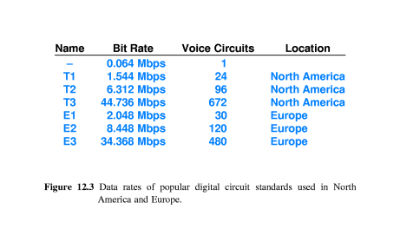

Slide 14
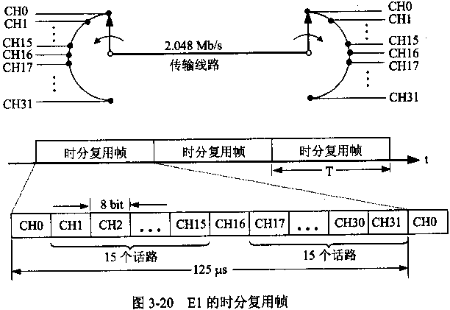

Slide 15
12.6 DS Terminology and Data Rates
A single voice channel requires 64kbps.
T1 standard was chosen to allow the circuit to carry 24 independent voice calls(plus a small amount of overhead).
T-standards define the underlying carrier system.
DS standards(digital signal level) specify how to multiplex multiple phone calls onto a single connection.
(DS-n 表示一个标准，而T-n表示符合一定标准的电路)

Slide 16
12.7 Lower Capacity Circuits
Many companies do not need the capacity of a T1 circuit(1.544Mbps).
One of the most popular fractional T1 capacities is 56kbps.

Slide 17
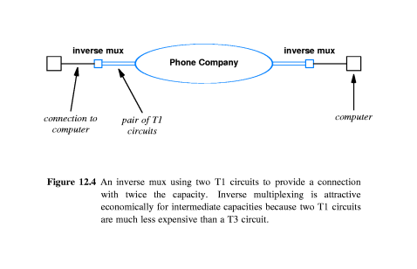
12.8 Intermediate Capacity Digital Circuits

Slide 18
12.9 Highest Capacity Circuits
Trunk 干线.
High-capacity digital circuit.
STS(synchronous transport signal).

Slide 19
12.10 Optical Carrier Standards 光纤传输标准
OC(optical carrier).
The OC standards refer to the optical signals that propagate across the fiber.

Slide 20
12.12 Synchronous Optical NETwork(SONET) 同步光纤网
The phone companies have defined a broad set of standards for digital transmission.
In North America, the standards use term synchronous optical network(SONET) .
In Europe, they are known as the synchronous digital hierarchy(SDH).

Slide 21
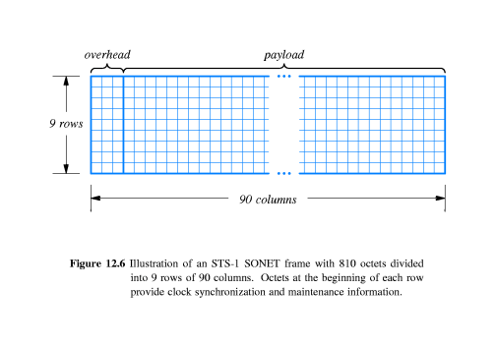

Slide 22
12.13 The Local Subscriber Loop 本地用户回路
Local loop or local subscriber line.
To refer to the connection between the phone company central office and an individual subscribers’s residence or place of business.
To refer to the connections from a network provider to individual subscribers.

Slide 23
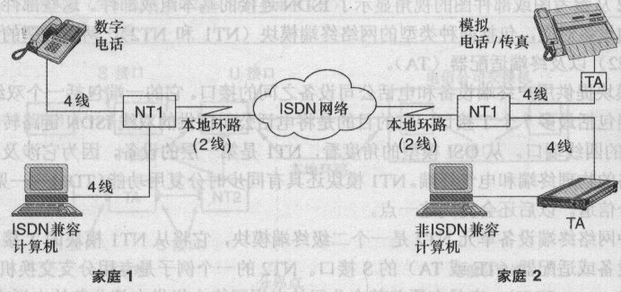
12.14 ISDN

Slide 24
Integrated Services Digital Network (ISDN综合业务数字网).
The 2B+D channels are known as the ISDN Basic Rate Interface(BRI)。
2B+D (B: 64Kbps, D: 16Kbps).
The two B channels are intended to carry digitized voice,data,or compressed video.
The D channel is intended as a control channel.

Slide 25
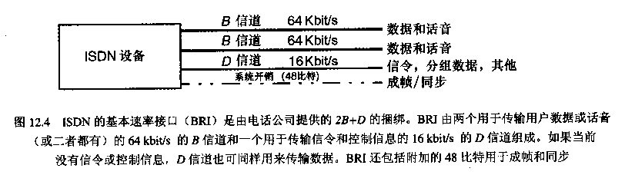

Slide 26
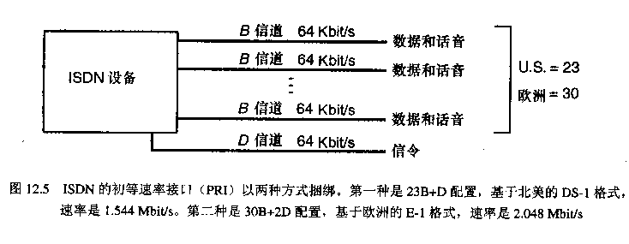

Slide 27
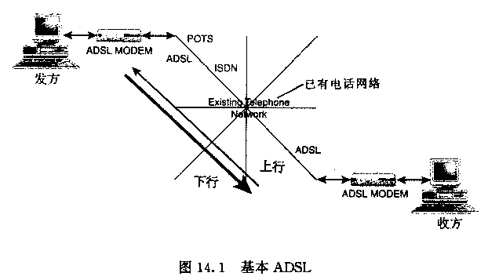
12.15 Asymmetric Digital Subscriber Line Technology
不对称数字用户线技术
ADSL is a local loop technology.

Slide 28
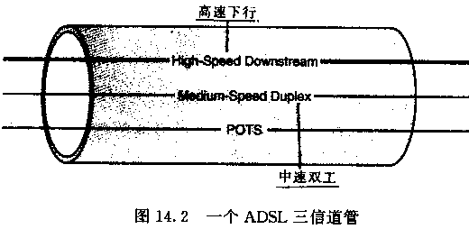
Dividing the bandwidth into 286 separate frequencies, 255 frequencies used for downstream data transmission and 31 used for upstream data transmission, with 2 taken for control information.
ADSL is adaptive.

Slide 29
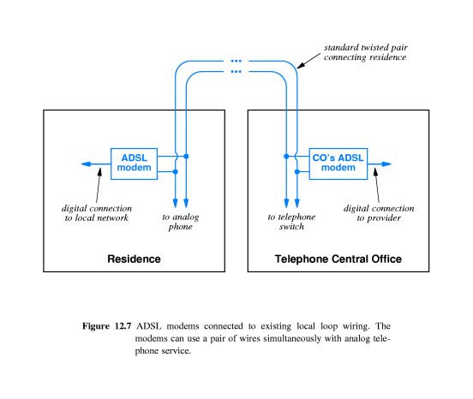

Slide 30
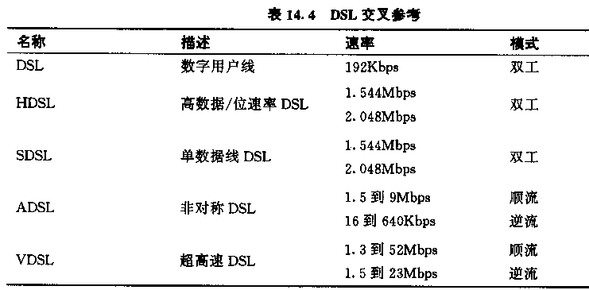
12.16 Other DSL Technologies

Slide 31
12.17 Cable Modem Technology
电缆调制解调技术
12.18 Upstream Communication
上行通信
12.19 Hybrid Fiber Coax
混合光纤电缆
12.20 Fiber To The Curb
光纤到街道

Slide 32
作业
简述广域网有哪些通信标准和数据传输方法？

