Slide 1
Computer Networks and Internets
《计算机网络与因特网》课件
林坤辉

Slide 2
PART II Data Transmission
Chapter 7 Transmission Media
传输介质

Slide 3
7.1 Introduction
At the lowest level,all computer communication involves encoding(编码) data in a form of energy,and sending the energy across a transmission medium(传输媒体).
For example, electric current(电流) can be used to transfer data across a wire(导线), or radio waves(无线电波) can be used to carry data though the air.

Slide 4

7.2 Copper Wires 铜缆
Because wire is inexpensive and easy to install;
Because wire is low resistance(电阻) ;
The type of wiring(布线) used for computer networks is chosen to minimize interference(干扰).
To minimize interference, networks use one of two basic wiring types:
(1) twisted pair(双绞线)
(2) coaxial cable(同轴电缆)

Slide 5
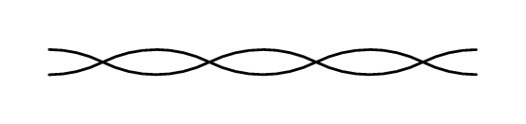
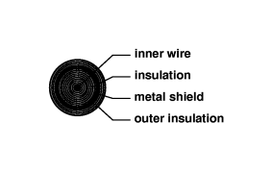
twisted pair
coaxial cable

Slide 6
双绞线
补充
双绞线既能传输模拟信号又能传输数字信号；
双绞线的通信距离一般为几到几十公里，距离太长，信号会衰减，需要用中继器进行整形和放大。
双绞线还分为屏蔽双绞线STP(Shielded Twisted Pair)和非屏蔽双绞线UTP(Unshielded Twisted Pair)

Slide 7
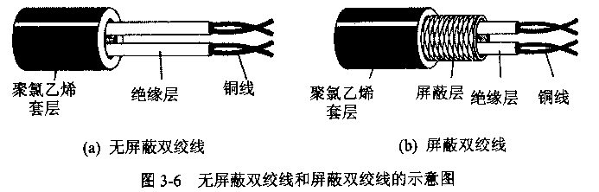

Slide 8
非屏蔽双绞线UTP有6个类别，对计算机网络常用的是3类线（Category 3）和5类线（ Category 5）
双绞线用于10MB和100MB以太网的标准分别是10BASE-T和100BASE-T
10BASE-T使用两对无屏蔽双绞线，一对发送数据，另一对接收数据，最大网段长度100m。
千兆以太网的标准还在制定中，目前通常使用6类双绞线。

Slide 9
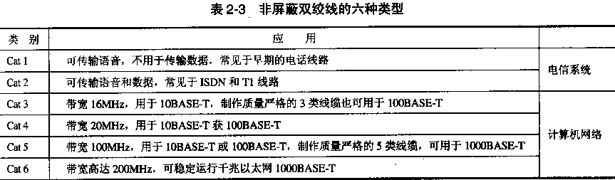

Slide 10
同轴电缆
补充
按特性阻抗不同，将同轴电缆分为两类：50Ω同轴电缆和75 Ω同轴电缆。
50Ω同轴电缆又称为基带同轴电缆（baseband coaxial cable）。以10Mb/s传输基带信号的距离可达1km.
75Ω同轴电缆又称为宽带同轴电缆（broadband coaxial cable）

Slide 11
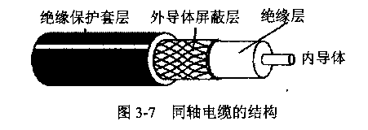

Slide 12
基带同轴电缆用于10MB以太网的标准有：10Base2和10Base5,10Base2的最大网段长度185m,10Base5的最大网段长度500m。
宽带同轴电缆通常用于传输有线电视的模拟信号，频率可高达500MHz以上，传输距离可达100km.
宽带系统可用频分方式分为多个信道，每个有线电视通常占6MHz的带宽，每个信道可用于模拟电视、CD质量声音(1.4Mb/s)或3Mb/s的数字比特流。使用电缆调制(cable modem)技术,电视和数据可在一条电缆上混合传输。

Slide 13
7.3 Glass Fibers 玻璃纤维
Computer network also use flexible(柔软的) glass fibers(玻璃纤维) to transmit data. known as an optical fiber(光纤),the medium uses light to transport data;
A transmitter at one end of a fiber uses a light emitting diode (LED发光二极管) or a laser(激光器) to send pulses(脉冲) of light down the fiber；
A receiver at the other end uses a light sensitive(光敏) transistor(晶体管) to detect(检测) the pulses.

Slide 14
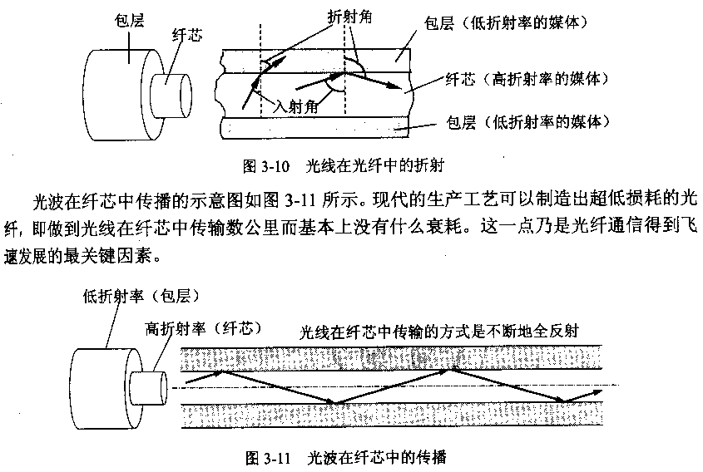

Slide 15
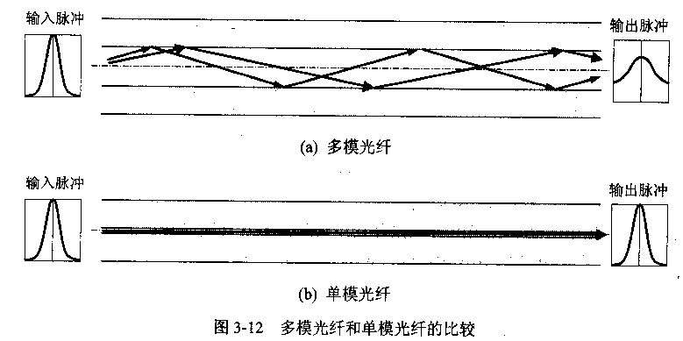
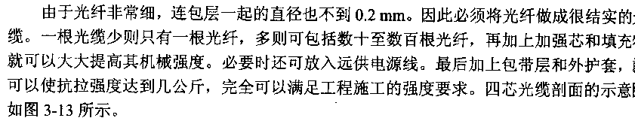

Slide 16
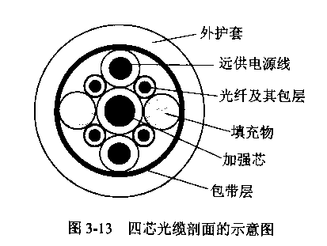
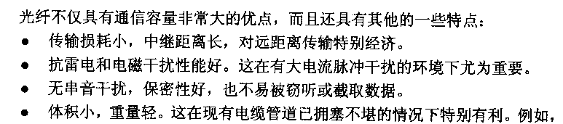

Slide 17
单模光纤（single-mode fiber）
  使用激光源
  中继距离100公里
  内芯直径较小: 直径为8～10μm/125 μm
多模光纤（multi-mode fiber）
  使用普通发光二极管作为光源
  中继距离2公里
  内芯直径稍大: 直径为62.5μm/125μm

Slide 18
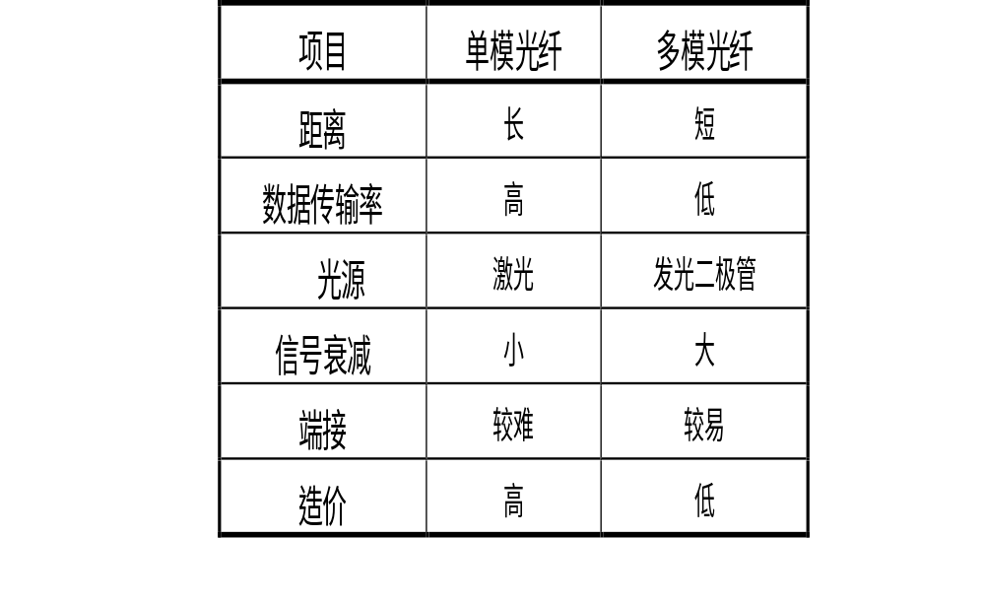
单模光纤与多模光纤的比较

Slide 19
光纤
补充
特点：
  有较宽的频带，电磁绝缘性能好，无干扰，传输数据稳定，信号衰减少,抗腐蚀。
  窃听不敏感（安全、可靠）
  不易弯曲，质地较脆，易损坏
  损坏不易定位
  单向传输
  光纤接口价格昂贵
  工艺复杂、安装技术复杂

Slide 20
7.4 Radio 无线电波
Electromagnetic radiation can be used to transmit computer data;
A network that uses electromagnetic radio waves is said to operate at radio frequency(射频),and the transmissions are referred to RF transmissions;
Each participating computer attaches to an antenna(天线),which can both transmit and receive RF

Slide 21
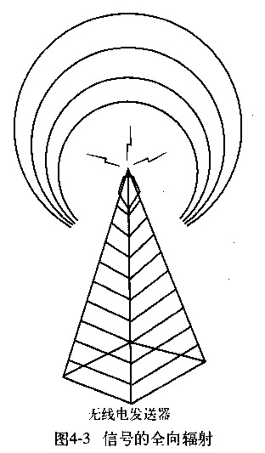
无线电
补充
构成：
  无线电发射装置，接收装置，空气
特点：
  广泛应用于广播电视系统
  传输部分不需要物理介质

Slide 22
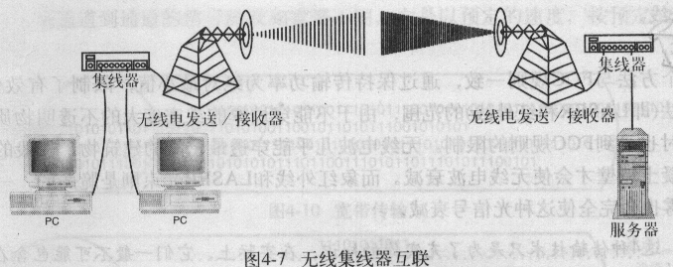
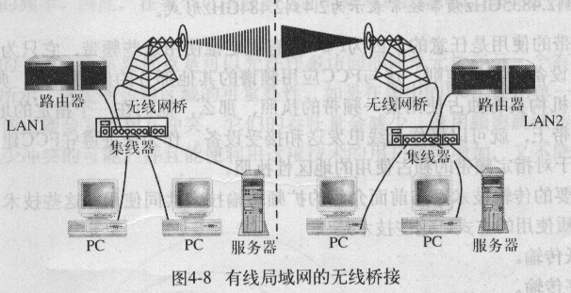

Slide 23
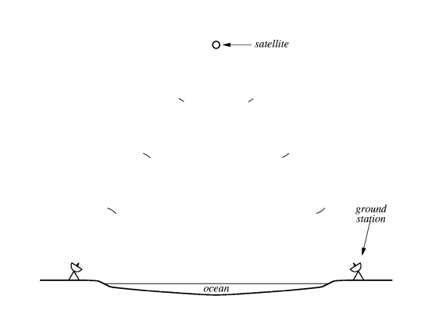
7.5 Satellites 卫星
Radio transmissions do not bend around the surface of the earth;
RF technology can be combined with satellites to provide communication across longer distances;

Slide 24
7.6 Geosynchronous Satellites
地球同步卫星
Because a geosynchronous satellite is placed in an orbit that is exactly synchronized with the rotation of the earth;
The distance required for geosynchronous orbit is 35,785 kilometers,Engineers sometimes refer to the distance as high earth orbit(高地球轨道)

Slide 25
7.7 Low Earth Orbit Satellites
低地球轨道卫星
Low Earth Orbit means that they orbit a few hundred miles above the earth(typically 200 to 400 miles)
Their period of rotation is faster than the rotation of the earth

Slide 26
7.8 Low Earth Orbit Satellite Arrays 低地球轨道卫星阵列
A communication company launch a set of satellites into low earth orbits.
Although a given satellite orbits quickly,the set of orbits is chosen so that each point on the ground has at least one satellite overhead at any time.

Slide 27
卫星传送
补充
构成：
  无线电发射装置，接收装置
  人造卫星转发装置
特点：
  同步轨道卫星的覆盖面广，可以和地球同步运转作业，但是为了避免干扰，个数受限
  近地轨道卫星个数可以扩充业务量，但是覆盖面窄，需要同步运行或者卫星群组和地球协同运转。

Slide 28
7.9 Microwave 微波
Although microwaves are merely a higher frequency version of radio waves,they behave differently
instead of broadcasting in all directions,a microwaves transmission can be aimed in a single direction.
Microwaves transmission can carry more information than RF transmission.
Microwaves cannot penetrate metal structures.

Slide 29
7.10 Infrared 红外线
Infrared is limited to a small area(e.g., a single room),
the transmitter be pointed toward the receiver
构成：
  红外线发射、接收装置
特点：
  成本低，不需要天线，使用方便
  直线传输，具有方向性，必须无障碍传输。
  传输距离很短，限近距离使用。

Slide 30
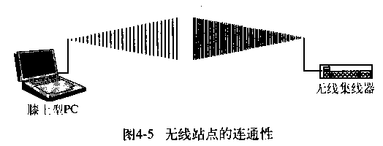
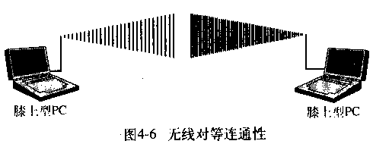

Slide 31
7.11 Light From A Laser 激光
A beam of light can be used to carry data through the air.
The transmitter at one location sends its beam of light directly to the receiver at the other.
The transmitter uses a laser(激光器) to generate the beam of light .
A laser beam will stay focused over a long distance.
特点：数据传输率高，正确率高，信号衰减小, 成本高.

Slide 32
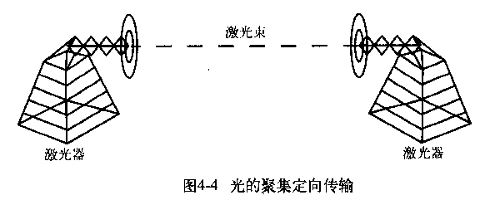

Slide 33
小结：
数据必须编码成能通过传输介质传输的格式.
这些格式必须随着传输介质而变化，因为每种介质都有其自身的物理特性.
数据编码的技术有许多种，但它们都使用电磁波来进行编码和数据传输.
电磁波是能量的物理形式，可通过电磁波谱来描述.
随着频率的增加，对数据编码的能力也增加.
高频比低频有更多的状态改变，而状态的改变可用来进行编码。

Slide 34
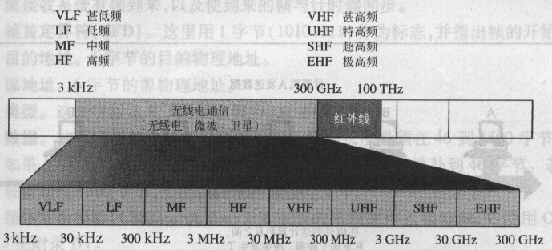

Slide 35
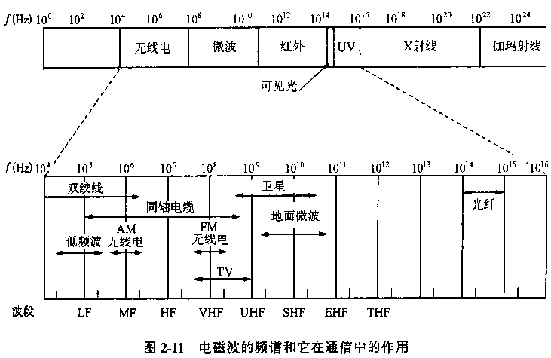

Slide 36
作业
课本7.2 、7.3、 7.4 题

