Slide 1
Computer Networks and Internets
《计算机网络与因特网》课件
林坤辉

Slide 2
PART II Data Transmission
Chapter 9 Local Asynchronous
Communication
(RS-232)
局域异步通信

Slide 3

9.1 Introduction
Computers use binary digits(bits位串) to represent data.
Transmitting data across a network from one computer to another means sending bits through the underlying transmission medium.
Communication systems use electric current, radio waves, or light to transfer information .

Slide 4
9.2 The Need For Asynchronous Communication
A communication is called asynchronous if a sender and receiver do not need to coordinate before data can be transmitted
A sender can wait arbitrarily(任意地) long between transmissions and can transmit whenever data becomes ready.
The receiver must be ready to accept data whenever it arrives.

Slide 5
In a more technical sense, communication hardware is classified as asynchronous if the electrical signal the transmitter sends does not contain information that the receiver can use to determine where individual bits begin and end.
The receiving hardware must be build to accept and interpret(解释) the signal the sending hardware generates.

Slide 6
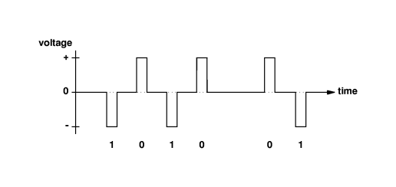
9.3 Using Electric Current To Send Bits
Negative voltage might be used to represent a 1 ,and positive voltage to represent a 0.

Slide 7
位(Bit)与电压
补充
位是数据通信的基本数据单元
位的取值范围
  {0,1}
通信数据的基本编码方式
  用不同的电压表示不同的位值。例如：0: [3v, 15v]; 1: [-15v, -3v]
  波形图：通信过程的电压曲线

Slide 8
同步通信和异步通信(1)
补充
同步(synchronous)通信
  数据发送方生成的数据中包含了有效数据的位置信息
  数据接收方根据有效数据的位置信息提取相应的有效数据
  通信的双方在开始通信之前必须完成协调工作，即必须进行同步处理
  数据基本单元保持顺序传输，对空数据必需填充对应的空单元

Slide 9
同步通信和异步通信(2)
补充
异步通信
  数据发送方不需要包含有效数据的位置信息
  数据接收方对接收的信息能够直接提取有效数据
  通信的双方不需要事先进行任何同步工作。

Slide 10
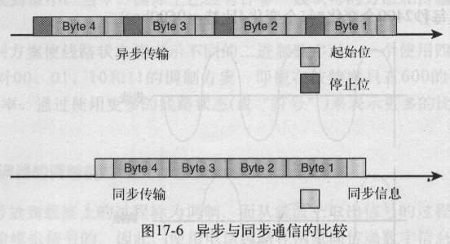

Slide 11
9.4 Standards For Communication
How long should the sender hold a voltage on the wire for a single bit?
What is the maximum rate at which hardware can change the voltage?
How can a customer know that transmitting hardware purchased from one vendor will work correctly with receiving hardware purchased from another vendor?
Is there a way to send more data in the same amount of time?
Notes:
e

Slide 12
RS-232
To ensure that communication hardware build different vendor will interoperate(互操作),the specification(规格) for communication systems are standardized.
One particular standard produced by the EIA(Electronic Industries Association).
EIA standard RS-232-C, which is commonly abbreviated RS-232.

Slide 13
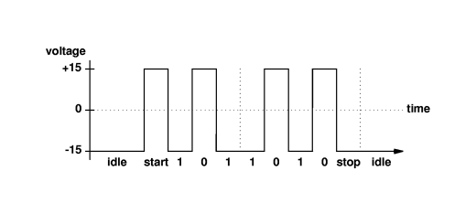
RS-232 is a popular standard used for serial(串行), asynchronous communication over short distances between a computer and a modem or ASCII terminal. RS-232 precedes each character with a start bit,follows each character with an idle period at least one bit long(stop bit),and sends each bit in exactly the same length of time.

Slide 14
RS-232通信标准
补充
电子工业协会（ EIA ）
RS-232异步串行通信接口
  对数据按照位进行序列化发送和接收
  发送方和接收方不需要进行同步操作
  数据值仅有0和1两种形式，不出现“空”状态
  7位作为一个发送单元
  对应每个数据单元，增加一个“0”作为开始位，“1”作为结束位
  接收方接收到有效数据开始位后，严格按照时间片顺序完成数据接收，直到接收完结束位为止

Slide 15
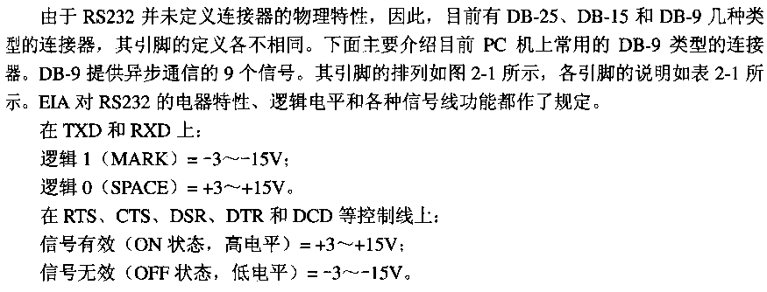

Slide 16
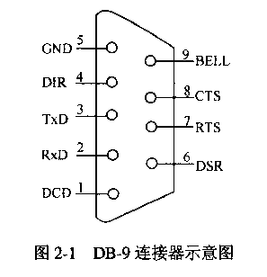

Slide 17
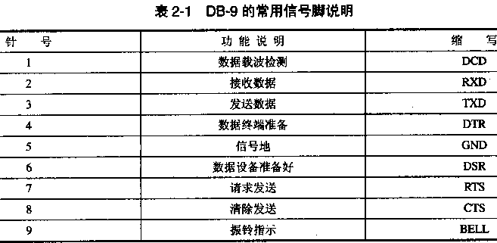

Slide 18
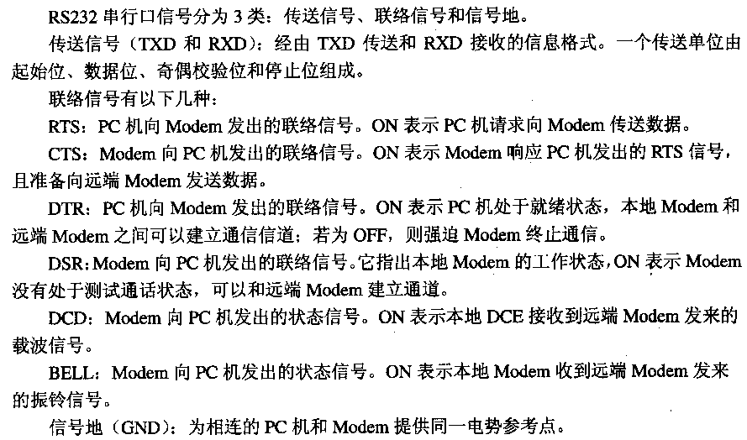

Slide 19
9.5 Baud Rate 波特率
Framing 帧对齐
Errors 差错
Technically,transmission hardware is rate in baud,the number of changes in the signal per second that the hardware generates.
For the simple RS-232 scheme presented,the baud rate is exactly equal to the number of bits per second.

Slide 20
If the sending and receiving hardware are not configured to use the same baud rate,errors will occur because the receiver`s timer will not wait an appropriate length of time for each bit.
To detect errors,a receiver measures the voltage for each bit multiple times and compares the measurements. If the voltages do not all agree or if the stop bit does not occur exactly at the time expected,the receiver reports an error. Such errors are called framing errors.
Notes:
e

Slide 21
补充
Baud是波特，是码元传输速率的单位，1波特为每秒传送1个码元。
  波特率：传输硬件介质中信号变化的速率，
  接口传输（发送/接收）位的速率，码元传输速率也称为调制速率，波形速率或符号速率。单位：bps(bits per second)
  波特与比特是两个不同的概念，比特是信息量的单位。
  若1个码元只携带1bit的信息量，则“比特/秒”和“波特”在数量上是相等的。

Slide 22
波特率和传输中断的实现
补充
传输中断的实现
  发送方在发送完有效数据开始位后，发送“0”信息，超过有效数据结束位
  接收方接收到有效数据开始位后，严格按照时间接收数据，当有效数据结束位时间片到，仍然是“0”，接收方认为数据错误，产生中断信号

Slide 23
9.6 Full Duplex全双工
Asynchronous 异步Communication 通信
Simultaneous transfer in two direction is known as full duplex(全双工) transmission.
transfer in single direction is known as half duplex(半双工) transmission or simplex(单工) transmission.

Slide 24
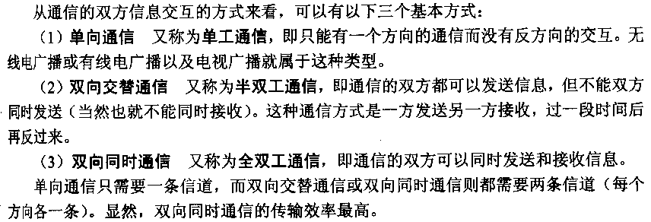

Slide 25
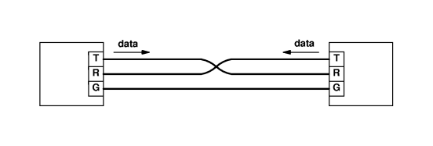
The minimal wiring required for full duplex RS-232 communication
The ground wire connects directly from the ground on one device to the ground on the other, the other two wires cross: the wire connected to the transmitter on one device connects to the receiver on the other.

Slide 26
Technically, the two types of connectors are associated with Data Communication Equipment(DCE数据通信设备) and Data Terminal Equipment(DTE).
A cable that connects a computer to a modem has a wire from pin 2 to pin 2 and a wire from pin 3 to pin 3.
A cable used to connect two computers(i.e., two DCE devices) must have a wire from pin 2 to pin 3 and a wire from pin 3 to pin 2. The exchange is often called a 2-3swap(2-3交换)

Slide 27
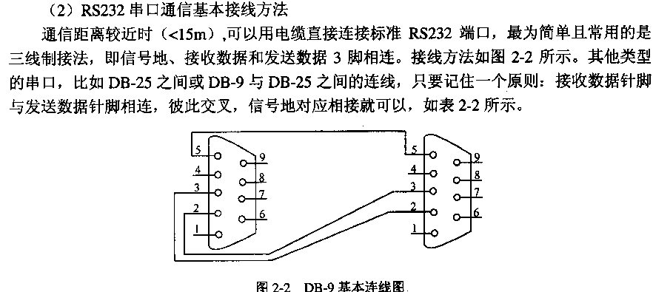

Slide 28
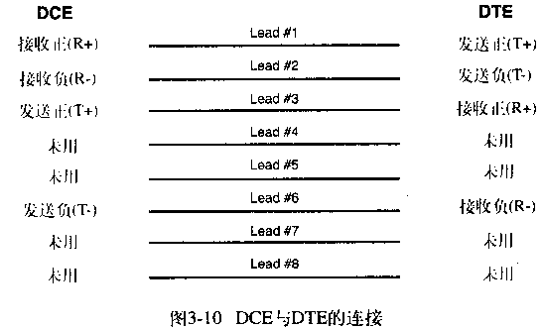
以10Mbps 以太网的RJ-45接口为例：
（在UTP上以100Mbps或更高的信号速度运行的局域网将使用全部4对线。）

Slide 29
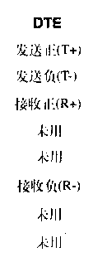
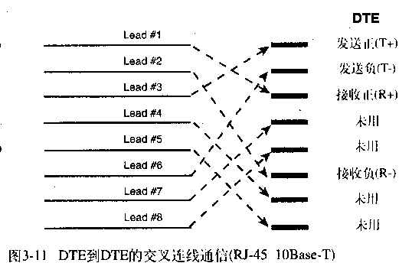


Slide 30
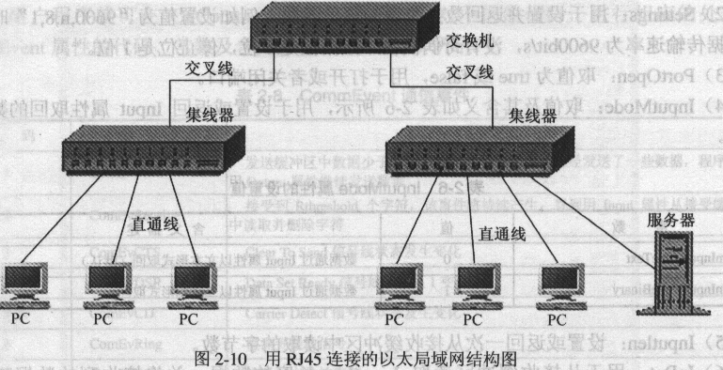

Slide 31
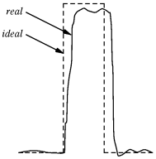
9.7 Limitations of Real Hardware实际硬件的限制
How fast can hardware transmit bits across a wire?

Slide 32
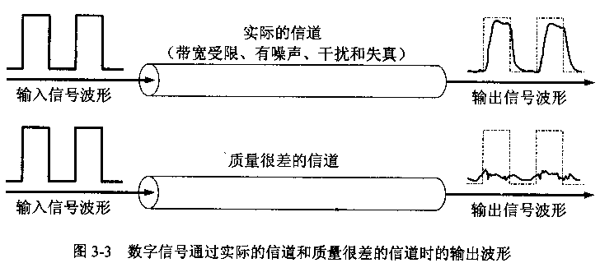

Slide 33
No electronic device can produce an exact voltage or change from one voltage to another instantly.
No wire conducts electricity perfectly.
As electric current travels down the wire,the signal loses energy.
As a result, it takes a small time for the voltage to rise or fall,and the signal received is not perfect.

Slide 34
RS-232 recognizes that real hardware is imperfect.
The standard does not specify that a receiver should measure the voltage exactly at the beginning of bit.
The standard recommends taking samples during the middle of the time allocated to the bit.

Slide 35
9.8 Hardware Bandwidth and the Transmission of Bits
硬件带宽与位串的传输
How fast can hardware transmit bits across a wire?
Real hardware cannot change voltages instantly.
Each transmission system has a limited bandwidth,which is the maximum rate that the hardware can change a signal.

Slide 36
Bandwidth is measured in cycles per second or Hertz(Hz).
Because bandwidth limitations arise from the physical properties of matter and energy,every physical transmission system has a finite bandwidth.
Nyquist’s(奈奎斯特) theorem defines relationship between hardware bandwidth and the theoretical maximum rate at which data can be sent.

Slide 37
For a transmission scheme like RS-232 that uses two values of voltage to encode data , Nyquist’s theorem states that the maximum data rate in bits per second that can be achieved over a transmission system of bandwidth B is 2B.
If the transmission system uses K possible values of voltage instead of two, Nyquist’s theorem states that the maximum data rate in bits per second, D, is: D=2Blog₂K

Slide 38
补充
带宽
  本来的意思是指某个信号具有的频带宽度。
  一个特定信号通常是由许多不同的频率成分组成的。因此，一个信号的带宽是指该信号的各种不同频率成分所占据的频率范围。
  对于数字信道，“带宽”是指在信道上能够传送的数字信号的速率，即数据率或比特率，单位是b/s或bps。
  因为带宽代表数字信号的发送速率，因此，带宽有时也称为吞吐量。

Slide 39
9.9 The Effect of Noise on Communication
Shannon(香农) extended Nyquist’s work to specify the maximum data rate could be achieved over a transmission system that introduce noise.
Shannon’s theorem: C=Blog₂(1+S/N)
Where C is the effective limit on the channel capacity in bits per second, B is the hardware bandwidth, S is the average signal power, and N is the average noise power.

Slide 40
S/N is known as the signal-to-noise ratio(信噪比),
Which is measured in deibels(分贝dB):
10log₁₀S/N

Slide 41
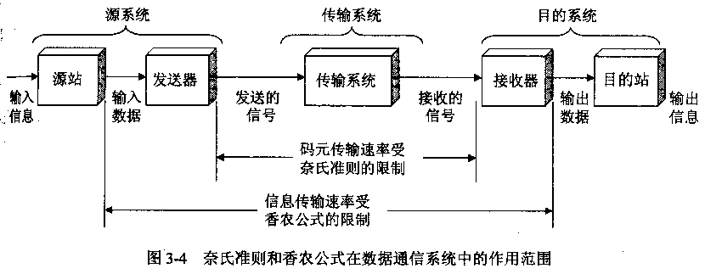

Slide 42
9.10 Significance For Data Networking
Nyquist’s theorem encourages engineers to explore ways to encode bits on a signal because a clever encoding allows more bits to be transmitted per unit time.
Shannon’s theorem informs engineers that no amount of clever encoding can overcome the laws of physics that place a fundamental limit on the number of bits per second that can be transmitted in a real communication system.

Slide 43
作业
什么是RS-232？RS-232有什么特点？
课本9.2 、9.3、 9.6 、9.10题

