Slide 1
Computer Networks and Internets
《计算机网络与因特网》课件
林坤辉

Slide 2
PART IV Internetworking
Chapter 22（1）
IP Datagrams and Datagram Forwarding
I P数据报和数据报转发

Slide 3

22.2 Connectionles Service
无连接服务
Connection-oriented service.
Connectionless service.

Slide 4
22.3 Virtual Packet虚拟包
To overcome heterogeneity, internet protocol software defines an internet packet format that is independent of the underlying hardware.
The result is a universal , virtual packet.

Slide 5
The underlying hardware does not understand or recognize the internet packet format.
Each host or router in a internet contains protocol software that understands internet packets.

Slide 6
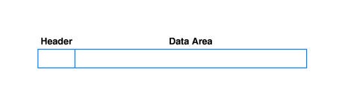
22.4 The IP Datagram IP数据报
TCP/IP protocol use the name IP datagram to refer to an internet packet.
In IPv4, a datagram can contain as little as a single octet of data or at most 64K octets, including the header.

Slide 7
IP报文格式(1)
IP报文的基本格式
  IP报头
  有效数据
IP报文
IP报头
IP有效数据

Slide 8
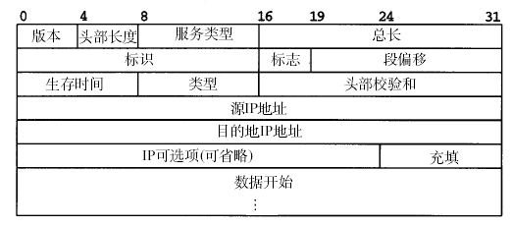
The IP Datagram Header Format

Slide 9
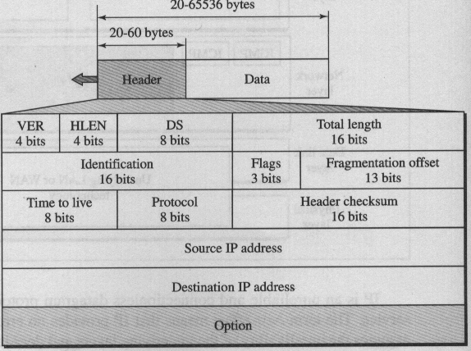

Slide 10
IP报文格式(2)
IP报文头格式的组成（基本长度：20B）
  版本号：4bits
  报头长度：4bits
  服务类型：8bits
  总长度：16bits
  标识：16bits
  IP分片标志：3bits
  片偏移：13bits

Slide 11
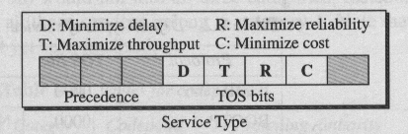
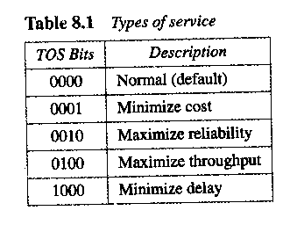

Slide 12
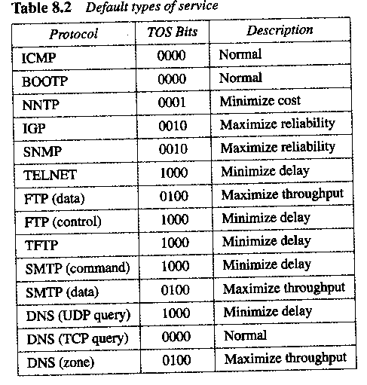

Slide 13
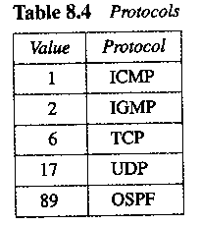
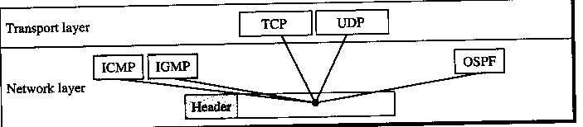

Slide 14
IP报文格式(3)
IP报文头格式的组成（续）
  TTL（生存时间） ：8bits
  协议类型：8bits
  报头校验和：16bits
  源IP地址：32bits
  目标IP地址：32bits
  选项内容：（可变长度）
  填充部分：（根据选项部分改变）

Slide 15
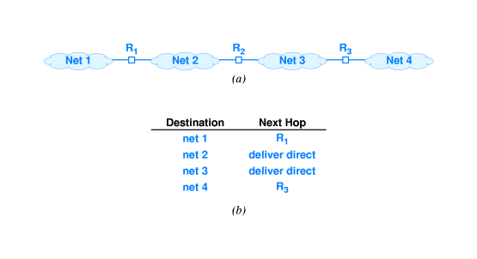
22.5 Forwarding An IP Datagram
Routing table (R2路由表)

Slide 16
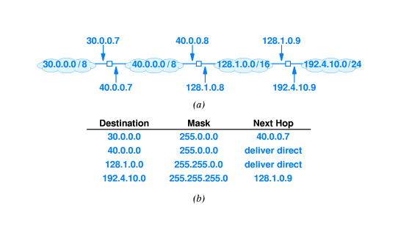
20.6 IP Address and Router Table Entries

Slide 17

基于IP传输的路由表特征(2)
路由表的组成
  目标网络号
  目标网络子网掩码
  下一跳
    直接传送标志
    交换设备所在的子网IP地址

Slide 18
22.7 The Mask Field and Datagram Forwarding
The process of using a routing table to select a next hop for a given datagram is called routing(路由) or forwarding(转发).
The mask field in a routing table entry is used to extract the network part of an address during lookup.

Slide 19
IP子网掩码与数据转发
通过子网掩码进行计算的路由表匹配
  获得IP报文的目标IP地址D
  用D顺序逐条匹配路由表各个条目T1,T2,T3…
    如果(D & T(m)i )等于T(d)i, 则下一跳为T(n)i
    D：目标端地址
    T(d)i：路由表中第i条目标子网网络号
    T(m)i：路由表中第i条目标子网掩码
    T(n)i：路由表中第i条下一跳IP地址

Slide 20
22.8 Destination and Next-Hop Addresses
The destination address in a datagram header always refer to the ultimate destination:
When a router forwards the datagram to another router,the address of the next hop does not appear in the datagram header.

Slide 21
22.9 Best-Effort Delivery
IP is designed to opaerate over all types of network hardware,
The underlying hardware may misbehave.
IP datagrams may be lost, duplicated, delayed, delivered out of order,or delivered with corrupted data.
Higer layers of protocol software are required to handle each of these errors.

Slide 22
作业
给出下面图形的路由器设备的路由表，格式参考书图例22.3
10.0.0.2
C1
C2
10.0.0.3
C6
30.0.0.2
10.0.0.1
30.0.0.1
30.0.0.3
10.0.0.4
R1
R2
R4
N1
N3
10.0.0.0/8
20.0.0.1
30.0.0.0/8
N2
20.0.0.0/8
20.0.0.3
C3
40.0.0.0/8
20.0.0.2
N4
40.0.0.5
20.0.0.4
C4
40.0.0.1
R5
R3
20.0.0.5
C5
C7
C8
C9
40.0.0.2
40.0.0.3
40.0.0.4

