Slide 1
Computer Networks and Internets
《计算机网络与因特网》课件
林坤辉

Slide 2
PART IV Internetworking
Chapter 23 （1）
Binding Protocol
Addresses (ARP)
(地址解析协议)

Slide 3

23.1 Introduction
IP addressing scheme used to assign high-level protocol addresses to hosts and routers.
IP addresses are virtual.
Neither local nor wide area network hardware understands IP addressing.
A frame transmitted across a physical network must contain the hardware address of the destination.

Slide 4
23.2 Protocol Addresses and Packet Delivery协议地址和包传递
Software in each host or router uses the protocol destination address to select a next hop for the packet.
The protocol address of the next hop must be translated to an equivalent hardware address before a packet can be sent.

Slide 5
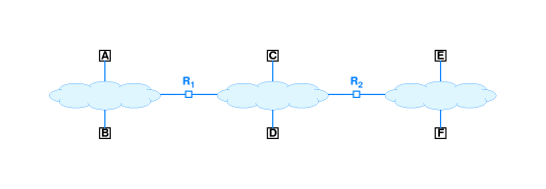
23.3 Address Resolution地址解析
Translation from a computer’s protocol address to an equivalent hardware address is known as address resolution.
Address resolution is local to a network.
A computer never resolves the address of a computer on a remote network.

Slide 6
23.4 Address Resolution Techniques地址解析技术
Table lookup(查表）
Close-form computation(相近形式计算)
Message exchange(消息交换)

Slide 7
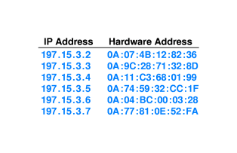
23.5 Address Resolution With Table Lookup 查表法地址解析

Slide 8
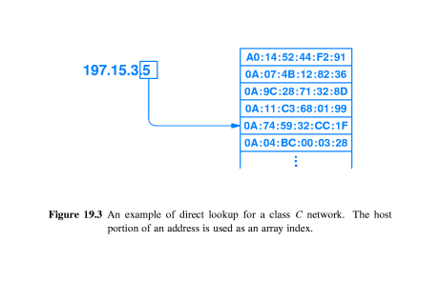

Slide 9
23.7 Address Resolution With Message Exchange
消息交换法地址解析
One computer sends a message that requests an address binding,
Another computer sends a reply that contains the requested information.
One or more servers are assigned the task of answering address resolution requests .
A computer broadcasts a request, if an incoming request matches a computer’s address,the computer responds.

Slide 10
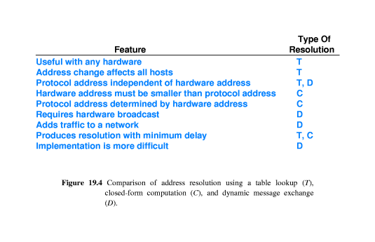

Slide 11
23.8 Address Resolution Protocol
地址解析协议
TCP/IP protocol suite includes an ARP
The ARP standard defines two basic message types:
A request and a response.

Slide 12
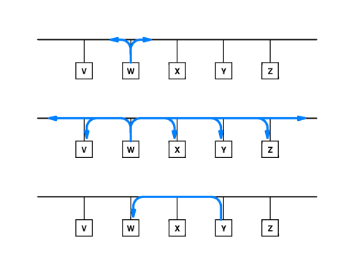
23.9 ARP Message Delivery
ARP消息传递

Slide 13
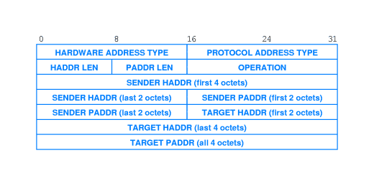
23.10 ARP Message Format

Slide 14
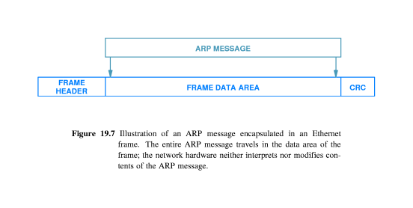
23.11 Sending An ARP Message

Slide 15
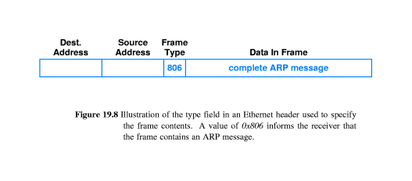
23.12 Identifying ARP Frames

Slide 16
23.13 Caching ARP Responses
To reduce network traffic, ARP software extracts and saves the information from a response so it can be used for subsequent packets.

Slide 17
23.14 Processing An Incoming ARP Message
To replace the previously stored binding.
To examine the OPERATION field.
If the message is a request,?.
If the message is a response,?
Address resolution software hides the details of physical addressing,
Allowing software in higher layers to use protocol addressing.

Slide 18
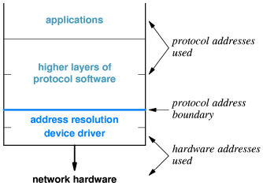
23.15 Layering,Address Resolution,Protocol Address

Slide 19
作业
简述2种地址解析的方法的原理。
简述ARP发送和接收端的操作过程。

