Slide 1
IMUPoser: Full-Body Pose Estimation using IMUs in Phones,Watches,andEarbuds
2023/10/30
Song Zetao

Slide 2
Why this article?
IMU sensors in consumer devices (phones, watches, earbuds) have promising applications for future.
Cross-disciplinary research (computer vision, sensor technology, human-computer interaction).
Real-world applications in VR, AR, sports, fitness, and healthcare.
Addressing challenges in multi-sensor pose estimation.

Slide 3
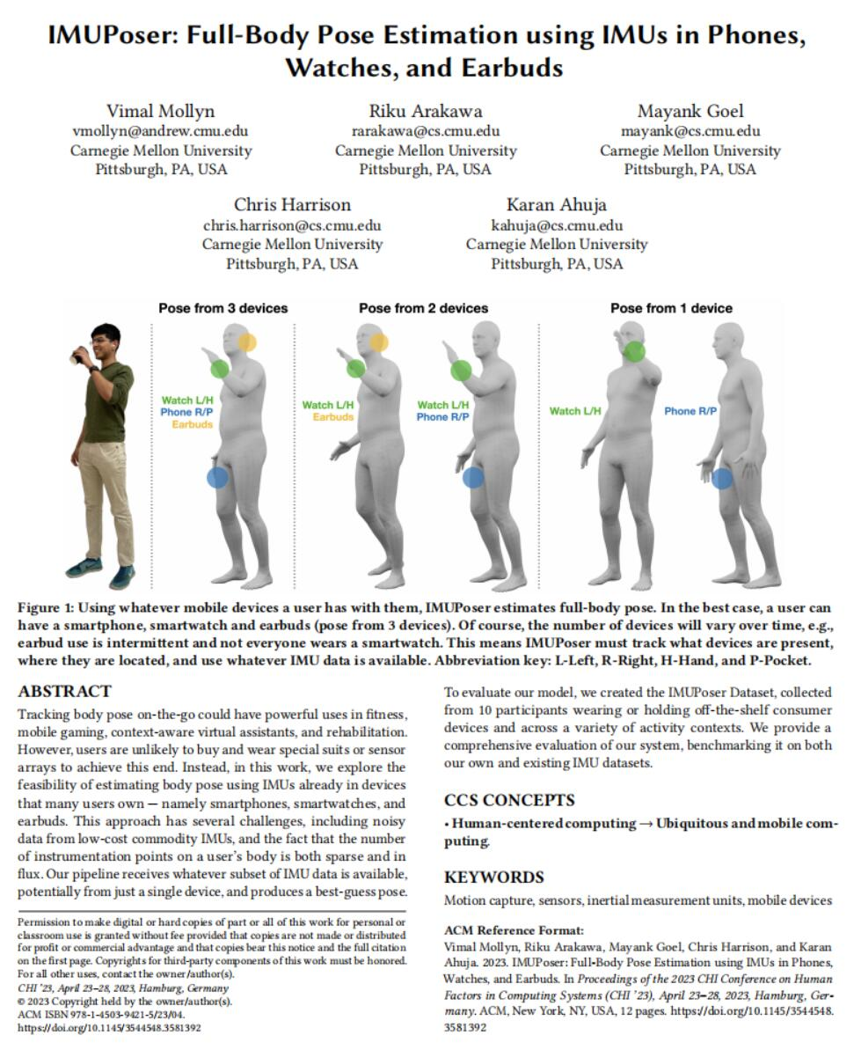
Basic Information
Year of publication: 2023
Journal: CHI 2023
Keywords: Motion capture, Sensors,
Mobile devices
Study design: Applied Research

Slide 4
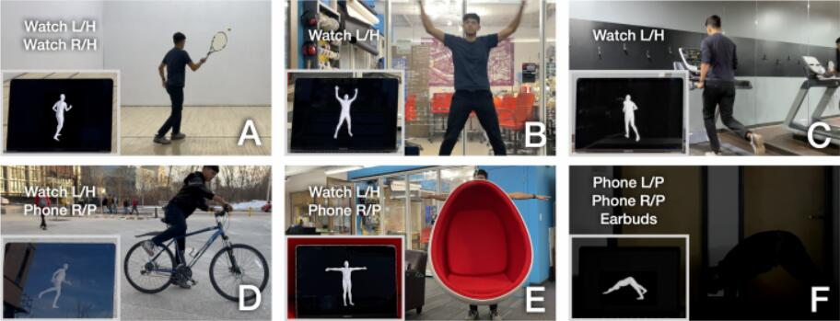
Brief introduction
This research explores the feasibility of tracking body pose using IMUs in common devices.
It addresses challenges such as noisy data from low-cost IMUs and the sparse and changing number of sensors on the user's body.
The applications of this technology include fitness, mobile gaming, virtual assistants, and rehabilitation.

Slide 5
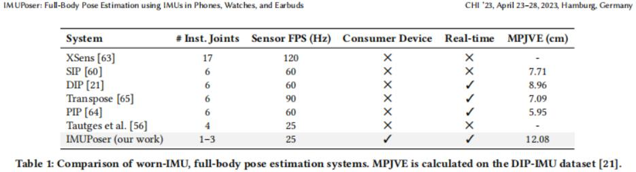
RELATED WORK
Body Capture using External Sensors
Body Capture with non-IMU Worn Sensors
Body Pose Estimation using Worn IMUs

Slide 6
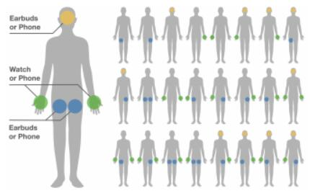
POSSIBLE DEVICE COMBINATIONS
Consumer devices like smartphones, smartwatches, and earbuds can be carried in various ways on the body.
This results in 72 possible device-location combinations, but a few unusual combinations are excluded, leaving 68 arrangements.
Some combinations provide similar IMU data due to device positions, and the focus is on 24 distinct body location combinations enabled by the 68 possible device positions.

Slide 7
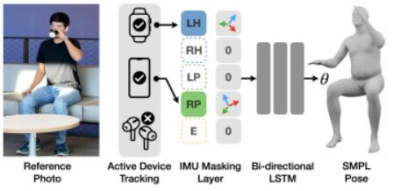
IMPLEMENTATION
Model（输入5个IMU的信息，用双向的LSTM训练模型）
IMU Dataset Synthesis
Training
Joint Rotation Refinement

Slide 8
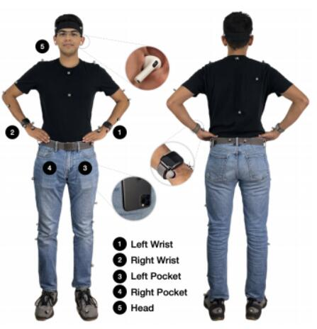
EVALUATION
DIP-IMU Dataset
IMUPoser Dataset
(1).Data Collection Apparatus
(2).Device Calibration
(3).Data Collection Procedure
Evaluation Protocol

Slide 9
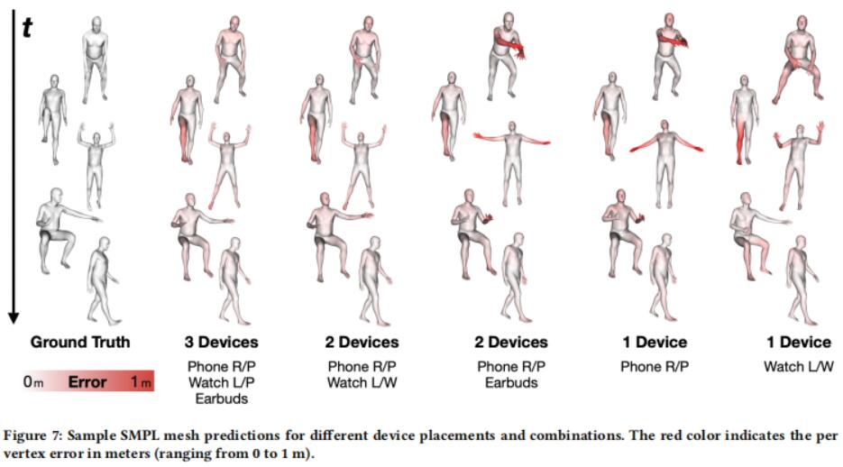
RESULTS
Accuracy Across Device-Location Combinations

Slide 10
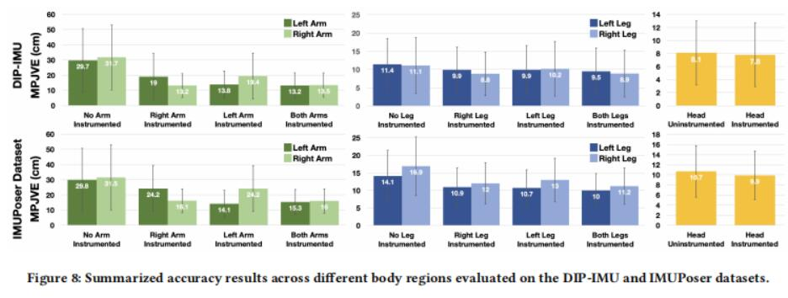
RESULTS
Accuracy Across Body Regions
Comparison to Prior Work

Slide 11
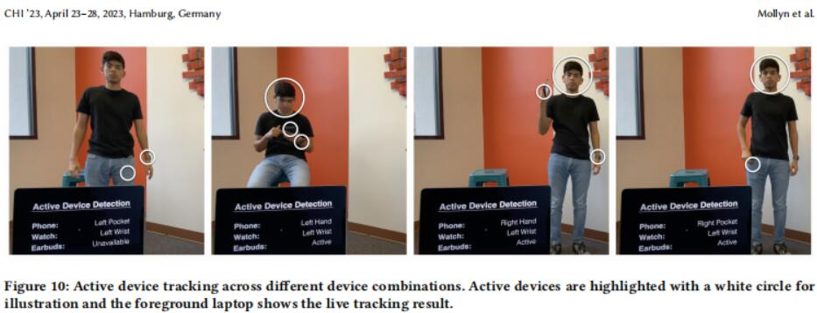
REAL-TIME IMPLEMENTATION

Slide 12
CONCLUSION
In this paper, we presented IMUPoser – a system for real-time, full-body pose estimation using IMUs present in consumer devices such as phones,smartwatches and earbuds. Our system must automatically track devices that are available and where they are currently located on the body, and use streaming IMU data to estimate pose.Our evaluations show that IMUPoser can contend with the noisy signals of consumer IMUs and produce natural and temporally coherent pose estimates with as little as one device. This opens up new and interesting whole-body applications with no additional user instrumentation.

Slide 13
Thanks!

