Slide 1
Gene Expression Pipeline
Lei Yu
July/2023

Slide 2
File Formats

Slide 3
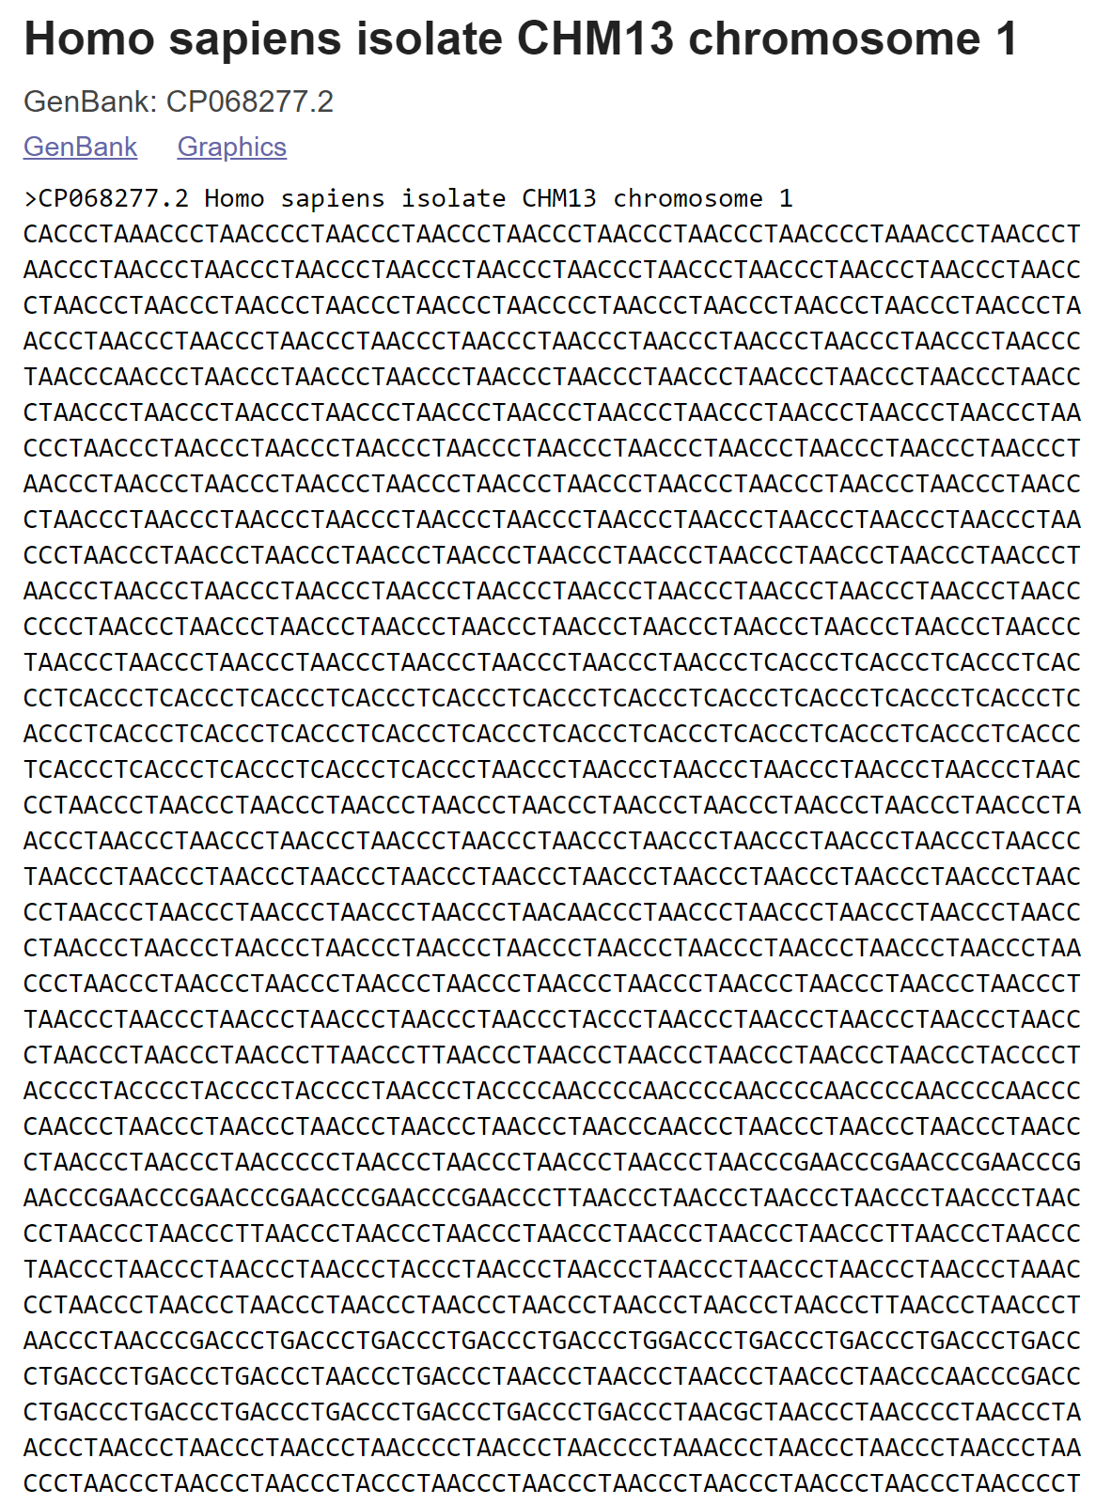

File formats: Fasta
Fasta format is a simple way of representing nucleotide or amino acid sequences of nucleic acids and proteins.
This is a very basic format with two minimum lines.
First line referred as comment line starts with ‘>’ and gives basic information about sequence.

Slide 4
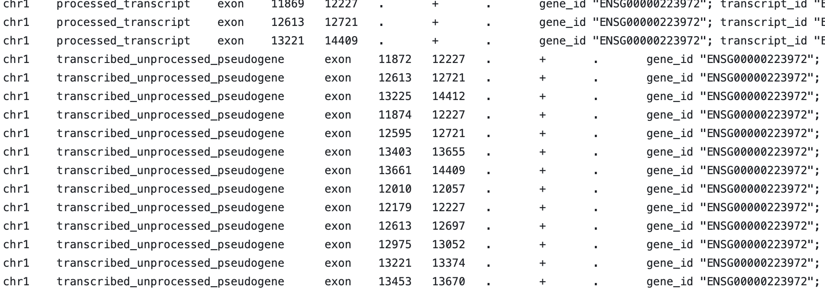
File formats: GTF
The Gene transfer format (GTF) is a file format used to hold information about gene structure.
It is a tab-delimited text format based on the general feature format (GFF), but contains some additional conventions specific to gene information.

Slide 5
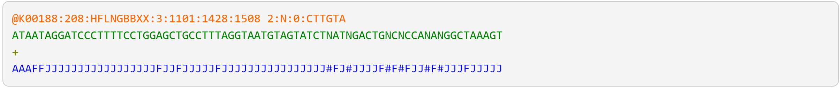
File formats: Fastq
Fastq format was developed by Sanger institute in order to group together sequence and its quality scores (Q: phred quality score). In fastq files each entry is associated with 4 lines.
Line 1 begins with a ‘@‘ character and is a sequence identifier and an optional description.
Line 2 Sequence in standard one letter code.
Line 3 begins with a ‘+‘ character and is optionally followed by the same sequence identifier (and any additional description) again.
Line 4 encodes the quality values for the sequence in Line 2, and must contain the same number of symbols as letters in the sequence.

Slide 6
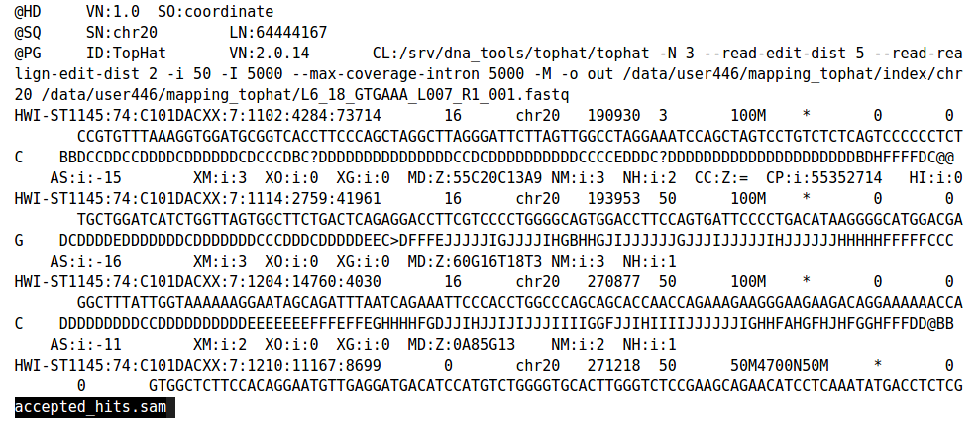
File formats: Sam
SAM stands for Sequence Alignment/Map format. It is a TAB-delimited text format consisting of a header section, which is optional, and an alignment section. If present, the header must be prior to the alignments. Header lines start with ‘@’, while alignment lines do not.
File formats: Bam
A BAM (Binary Alignment/Map) file is the compressed binary version of the Sequence Alignment/Map (SAM), a compact and indexable representation of nucleotide sequence alignments. The data between SAM and BAM is exactly same. Being Binary BAM files are small in size and ideal to store alignment files. Require samtools to view the file.

Slide 7
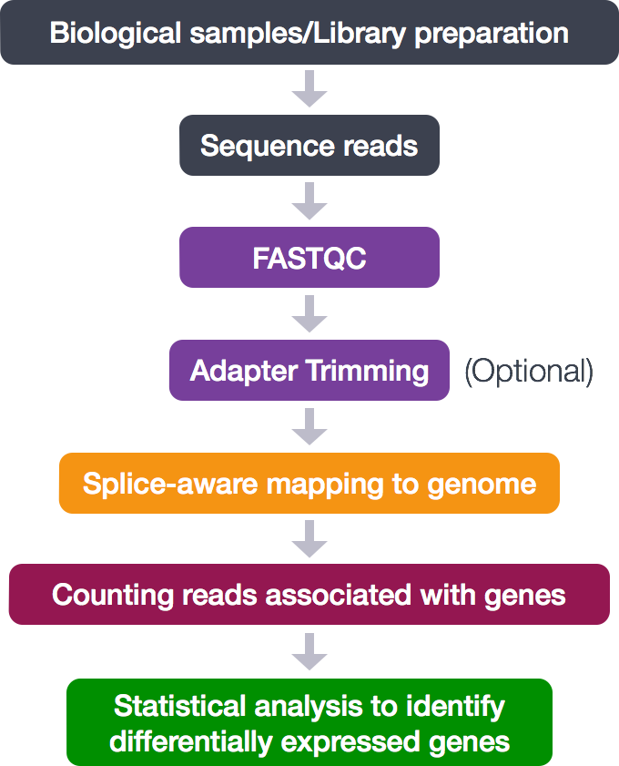
RNA sequencing pipeline
Alignment based method: STAR
Pseudo alignment approach: kallisto
https://pachterlab.github.io/kallisto/
Step_1_fastqc.sh
Optional_step_1_trim_tream_reads.sh
Step_2_alignment.sh
Step_3_count_gene_expression_R.sh
https://hbctraining.github.io/Intro-to-rnaseq-hpc-O2/lessons/03_alignment.html

Slide 8
Run Pipeline

Slide 9
Run Pipeline by Steps
Sample_A:
fastq
bam
count
Sample_B:
fastq
bam
count
Count matrix
Sample_C:
fastq
bam
count

Slide 10
Run Pipeline by Sample
Sample_A:
fastq
bam
count
Sample_B:
fastq
bam
count
Count matrix
Sample_C:
fastq
bam
count

Slide 11
Submit a Job

Slide 12

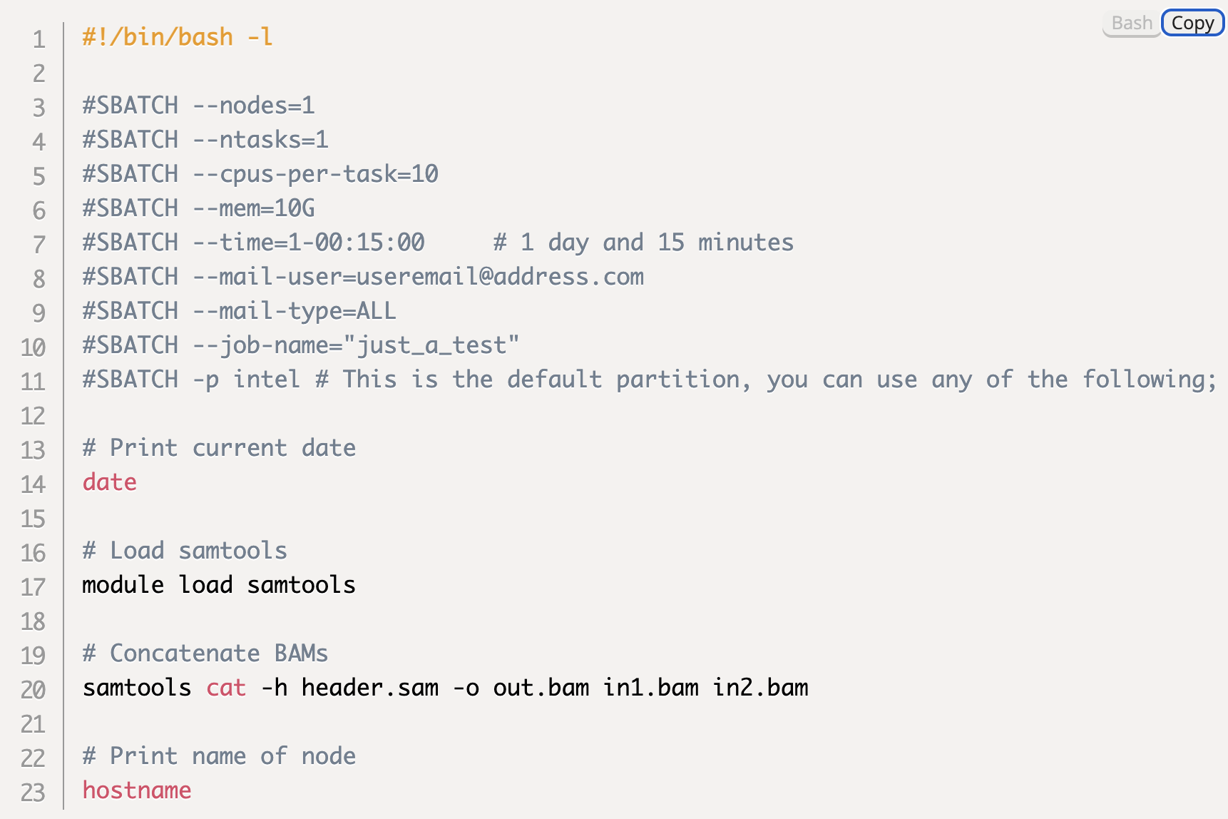

Slurm
Slurm is an open source, fault-tolerant, and highly scalable cluster management and job scheduling system for large and small Linux clusters.
Example of an SBATCH script

