Slide 1

Guardian
12781961 Yilun Chen
13000359 Cheng Zhu
12446542 Mingjie Yuan

Slide 2
01
Introduction
02
Service Group
03
Main Functions
04
Application Display
05
Conclusion

Slide 3
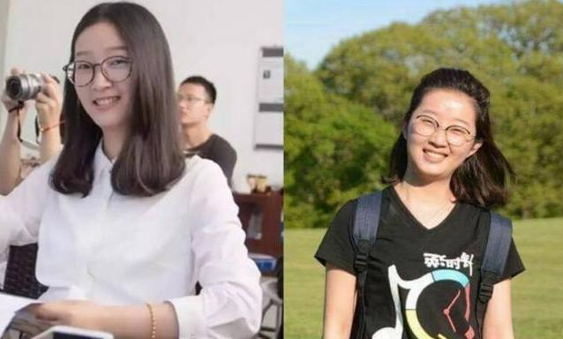
Service
Group
Main
Functions
App
Display
Introduction
Conclusion
Question
Name :Yingyi Zhang
Event: Disappeared 11
months ago.
Situation: Still not be found.

Slide 4
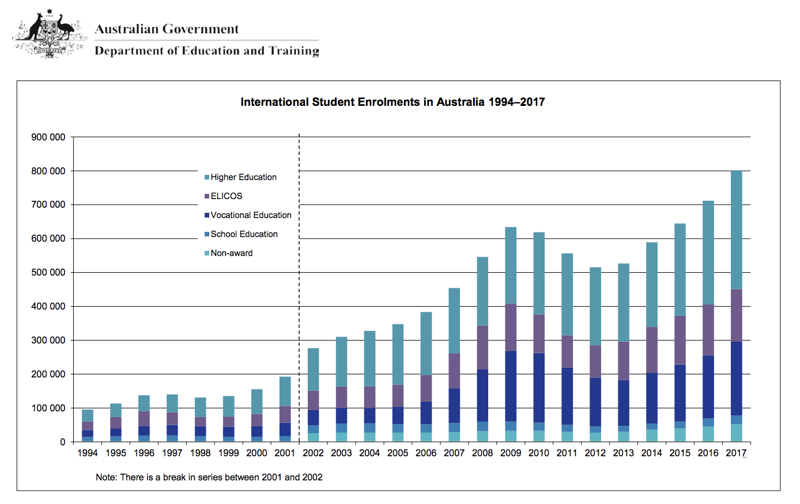
Service
Group
Main
Functions
App
Display
Introduction
Conclusion

Slide 5
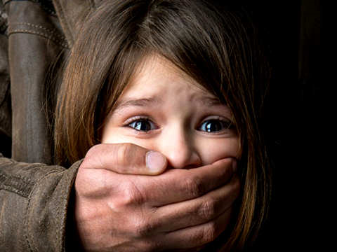
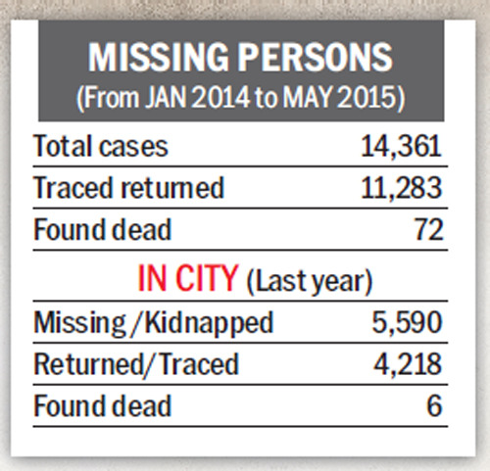
Service
Group
Main
Functions
App
Display
Introduction
Conclusion
Phenomenon
China:10000 Children
27 children and women go missing in Karnataka every day

Slide 6
Service
Group
Main
Functions
App
Display
Introduction
Conclusion
Solution?
Guardian Application

Slide 7
Service
Group
Main
Functions
App
Display
Introduction
Conclusion
Vulnerable groups:
Oversea students
Female who feel unsafe
Children

Slide 8
Introduction
Service
Group
Main
Functions
App
Display
Conclusion
Emergency light
Set time guarding
One tap SOS
Functions
Fake phone-call

Slide 9
Service
Group
Main
Functions
APP
Display
Introduction
Conclusion

Slide 10
Service
Group
Main
Functions
App
Display
Introduction
Conclusion
The Guardian is intelligent, advanced and effective
The Guardian cannot eliminate the crime
The Guardian can provide more info for police
01
02
03

Slide 11
Thank You

