Slide 1

bataa.
Learn by doing.
bataa.app is your AI mentor that learns from real tutorials and can control your computer with you.
It sits on your screen as a friendly mascot, shows you exactly where to click, explains what everything does and why it matters, answers your questions, and guides you step by step while you actually practice the skill.
Mobile practice · Desktop guidance · AI when the question appears
Pitch deck | September 2026
Notes:
Opening: People do not fail because content is unavailable. They stall at the moment they need to act. Bataa keeps the next action close. Visual source: public/hero.webp from the Bataa project.

Slide 2

bataa
THE GAP
02
Learning support disappears when the learner is ready to act
The hardest moment often comes after the video ends.
“I know what I want to learn.
I just do not know what to click next.”
The learner is alone when the question appears: late at night, between classes, or inside unfamiliar software.
Problem framing · user-provided brief
Notes:
Framing based on the user-provided problem statement. The quoted sentence is a synthesized articulation, not a verbatim interview quote.

Slide 3
bataa
DISCOVERY
03
We heard the same friction in three moments
Qualitative discovery at Horus University. Synthesized from conversations, not verbatim quotes.
Three moments, one pattern
OBSERVED
HORUS UNIVERSITY
1
02:00 AM
“I can’t ask an instructor at 2 a.m.”
Support stops when the question starts.
2
TOO BASIC TO ASK
Anxiety turns a small blocker into a stall.
PARAPHRASED STUDENT SIGNAL
3
TOO EXPENSIVE / TOO CROWDED
The question arrives after the lesson.
Existing options miss the moment of practice.
PRODUCT IMPLICATION
Make the next step available, private, and easy to try.
Evidence status: observed. Horus University conversations.
Notes:
Evidence label: OBSERVED. Source: user-provided description of early qualitative conversations at Horus University. The large sentence is a paraphrased student signal, not a verbatim quote. Do not add a participant count until the team verifies it. The three moments are synthesized themes: instructor availability, anxiety about asking basic questions, and price or crowding in existing course options.

Slide 4
bataa
INSIGHT
04
The missing layer is contextual guidance
Bataa helps at the exact moment the learner has to make a move.
CONTENT ONLY
BATAA
Watch → pause → search → stall
→
Try → get feedback → keep moving
The learner has to translate theory into the next action alone.
The next step appears beside the work, in plain English.
Product insight · contextual help at the moment of action
Notes:
Narrative bridge: Bataa is not another content library. It is the guidance layer between intention and action.

Slide 5
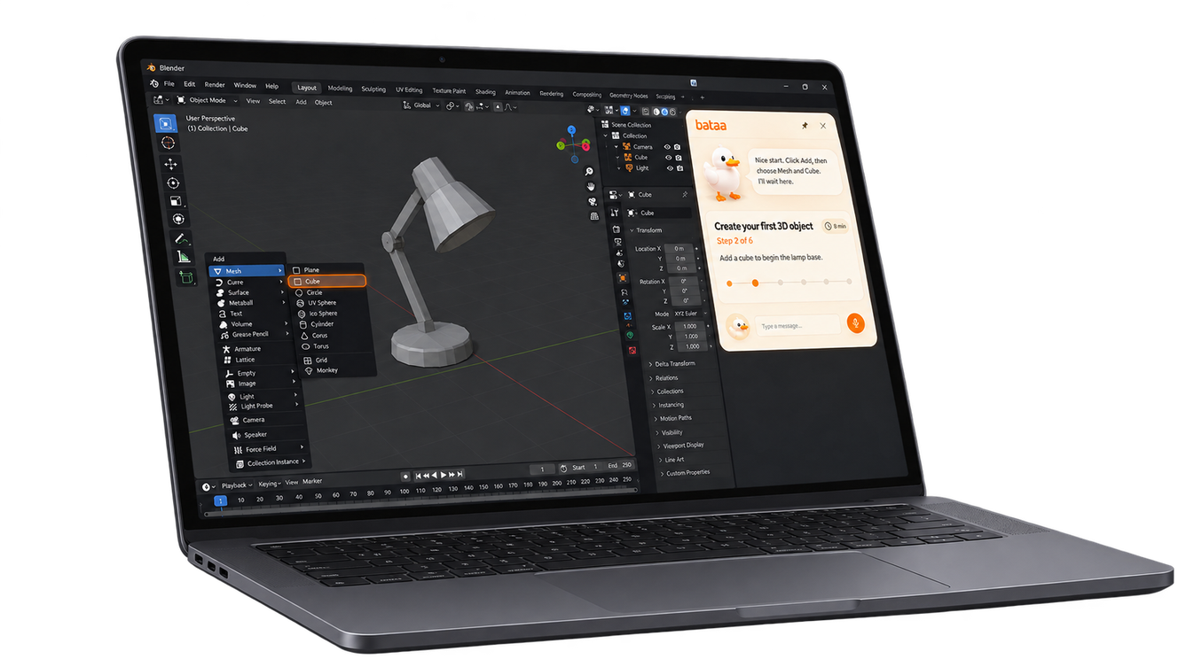
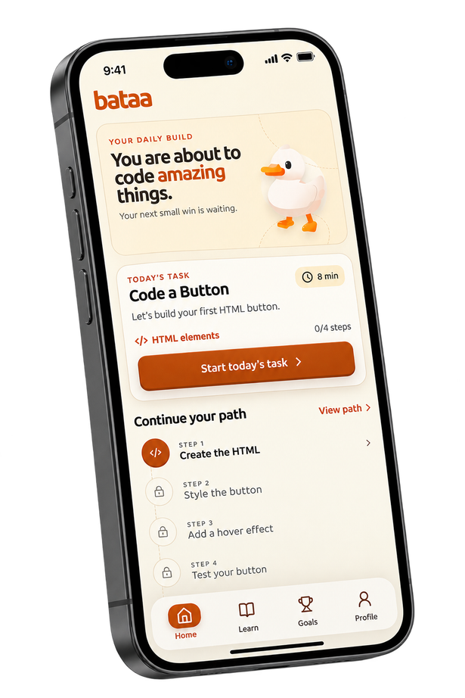
bataa
PRODUCT
05
One product, two moments
The same learning loop follows the learner from a spare minute to the tool where the work happens.
MOBILE
Keep momentum anywhere
Short daily tasks make progress possible in transit, between classes, or at home.
DESKTOP
Guide inside the tool
Notes:
Visual sources: Bataa mobile capture from the running app (lesson-1.png) and public/guided-project-ai.webp. The desktop agent interaction should be demonstrated live or with a short clip when available.

Slide 6
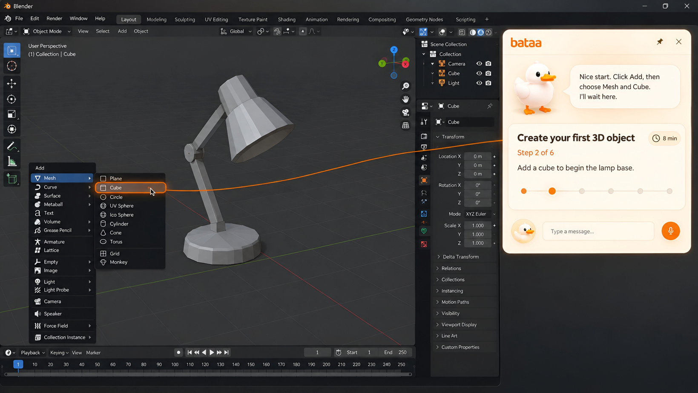
bataa
DESKTOP GUIDANCE
07
Desktop guidance meets the learner where work happens
For 3D, code, and other tools, Bataa can point to the next action instead of describing it from a distance.
01
Notice
Understand what the learner is trying to do
02
Point
Highlight the exact control or line to inspect
03
Try
Let the learner perform the action and see the result
Desktop product visual · guided-project-ai.webp and ai-assisted-coding.webp
Notes:
Visual sources: public/ai-assisted-coding.webp and public/guided-project-ai.webp. Evidence status: DEMONSTRATED for the guidance concept. State clearly that autonomous cursor control and broad software coverage remain pilot scope unless already shipped.

Slide 7
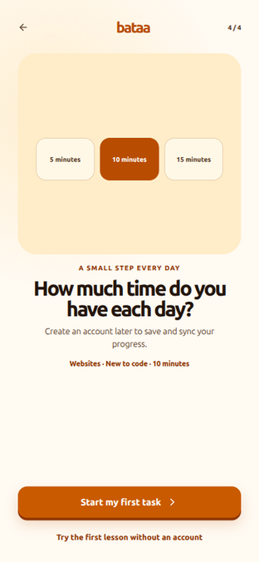


bataa
MOBILE PRACTICE
07
Mobile turns spare minutes into practice
A daily task can fit into the time a learner already has.
1
8–10 min
A small session with a clear finish line
2
User friendly
The first days use three-choice recognition
3
One real skill
Every step maps to a usable web concept
Demonstrated · beginner-friendly lesson flow
Notes:
Visual sources: running Bataa app captures from the project. The “no typing needed” design is demonstrated in the first lesson step, which offers three choices.

Slide 8
bataa
SKILL JOURNEY
08
A skill compounds one small day at a time
Illustrative 3D-modeling journey: the learner starts with a gesture, then builds a real artifact.
The product promise is a path, not a single lesson.
1
2
3
DAY 1
DAY 7
DAY 30
Find the tool
Shape a scene
Finish an artifact
Recognize the viewport, select an object, make one change.
Combine small actions into a simple modeled composition.
Use the same guided loop to complete a portfolio-ready piece.
Product narrative · example journey, not a measured outcome
Notes:
This is an illustrative journey for explaining the product loop. Do not present the day-30 outcome as a measured result until a real course and pilot validate it.

Slide 9
bataa
LEARNING LOOP
09
Bataa closes the gap between attempt and understanding
Each turn makes the next turn easier.
2
Try
3
Get feedback
4
Repeat
The learner acts
Context, not a lecture
Correct the next detail
1
Choose
5
Build confidence
One clear goal
A skill that stays
THE LOOP
The product keeps the learner moving without taking the work away from them.
Editable diagram · product hypothesis to validate in pilot
Notes:
This editable diagram expresses the intended learning loop. Validate it with pilot metrics such as task completion, time-to-first-success, hint usage, and return rate.

Slide 10






bataa
POSITIONING
10
Bataa sits between content and the moment of action
Bataa combines daily practice with help inside the work.
A positioning hypothesis, not a claim that competitors lack AI.
GUIDANCE IN CONTEXT
HIGH
Bataa
iSchool
Yanfaa / Nafham
Khan Academy
DAILY PRACTICE
LOW
Notes:
This is a qualitative positioning hypothesis based on the user-provided competitor list. Verify the exact local platform names and current features before presenting. Do not claim that competitors do not use AI without research.

Slide 11
bataa
BUSINESS MODEL
11
Start with one clear revenue engine
Paid learning first. Optional AI usage and platform licensing expand the model later.
LAUNCH PRIORITY
OPTIONAL
LATER
Course purchase
AI tokens
Platform fees
Learners pay for a structured path that turns practice into a finished skill.
Extra attempts, deeper explanations, or advanced model usage.
Commission from creator and institution courses.
Keep the first story simple: one learner pays for one useful outcome.
Business model · planned streams, launch priority shown
Notes:
Business model is based on the user-provided brief. Course purchases are the launch priority; token packs and platform fees are expansion paths unless already implemented and tested commercially.

Slide 12
bataa
PLATFORM EXPANSION
12
The same learning engine can serve creators and institutions
Bataa can become the infrastructure behind guided practice, not only a destination app.
LEARNERS
BATAA ENGINE
Buy, practice, and finish the skill
CREATORS + INSTITUTIONS
Guided tasks, feedback, progress, AI context
Publish a course or training path
IDE / PRODUCT API
Bring the tutor into another workflow
PLANNED EXPANSION
Commission on course sales plus API licensing for organizations and tools.
Platform architecture · future revenue paths
Notes:
This diagram reflects planned expansion from the user-provided business model: institution and creator courses with commission, plus an API/base URL offering. Label as planned until commercially validated.

Slide 13
bataa
TEAM
13
The team built the core surfaces
The product is split across the places where the learner meets Bataa.
1
Abdelrahman Mohsen
2
Yousef Mohamed
3
Mostafa Kamal
DESKTOP APP
Web/Mobile app developer
Web app assistant developer
Builds the guided workspace where the AI can meet the learner inside real software.
Builds the daily lesson loop for small, approachable practice sessions.
Shapes the public story, visual identity, and first touchpoint for Bataa.
Team roles · supplied in the Bataa brief
Notes:
Team names and roles are taken from the user-provided brief. Add concrete proof points, links, or advisor details if available before presenting.

Slide 14
bataa
16
NEXT MILESTONE
14
The next milestone is a real pilot.
Prove that one doable action can become a habit and a finished skill.
→
01
Beginner mobile path
Ship the first week of simple daily tasks
→
02
Desktop agent pilot
Guide one real workflow with safe user control
03
Partner pilots
Test a creator course and an institutional path
Bataa gives every learner a next step.
Close with a specific pilot ask · replace with contact details before presenting
Notes:
Close: ask for pilot partners, not a generic “thank you.” Replace the ask and roadmap with dates, owners, and contact details when confirmed.

Slide 15




bataa
STAY CONNECTED
15
FOLLOW THE BUILD
Follow us on social
Keep building
with Bataa
Find Bataa on every platform
TIKTOK
@bataa_app
Follow product updates, new lessons, and the next Bataa launch.
INSTAGRAM
@bataa_app
FACEBOOK
Bataa
START HERE
→
LINKEDIN
bataa.app
bataaap
Official verified channels · Follow Bataa on TikTok, Instagram, Facebook, and LinkedIn
Notes:
Website: bataa.app, supplied by the user. Social platforms requested by the user: TikTok, Instagram, Facebook, and LinkedIn. Account handles and profile URLs were not provided, so this slide labels each account as “Bataa” without inventing links. Verify and add the live handles before publishing. Logo sources: Simple Icons via jsDelivr (TikTok, Instagram, and Facebook from Simple Icons 14.15; LinkedIn from Simple Icons 13.0).

Slide 16
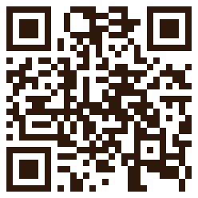
bataa
JUDGES WALKTHROUGH & Q&A
16
▶ VIDEO DEMO & FAQ
What Judges Will Learn in the Video
See Bataa in action —
all questions answered fast.
Every evaluation topic addressed with live proof & clear metrics
SURFACES
Live Dual-Surface Product Demo
Watch both daily mobile bite-sized coding tasks and the desktop contextual AI agent work seamlessly together.
01
We recorded an official video walkthrough demonstrating the live product experience and directly answering every competition judge question in minutes.
MOAT
Physical Guidance vs. Passive Chatbots
See why generic AI chats fail learners, and how Bataa points on-screen and verifies actual learner actions.
02
▶ YOUTUBE WALKTHROUGH
youtu.be/4Lz5fNhs49g
FAQ
Key Evaluator & Judge Questions Answered
Direct answers on learner retention, desktop sandbox safety, revenue roadmap, and Horus University pilot data.
03
⚡ Fast-paced: direct answers in minutes
📱 Live mobile web dev practice in action
🤖 Contextual desktop AI tutor demonstrated
🎯 Direct answers to judges' evaluation criteria
TRACTION
Roadmap & Validated Pilot Pipeline
Proof of demand from university students and our path to institutional and creator partnership rollouts.
SCAN OR CLICK
Watch video instantly
04
Judge evaluation resource · Video Link: https://youtu.be/4Lz5fNhs49g · All competition questions answered fast

