Slide 1
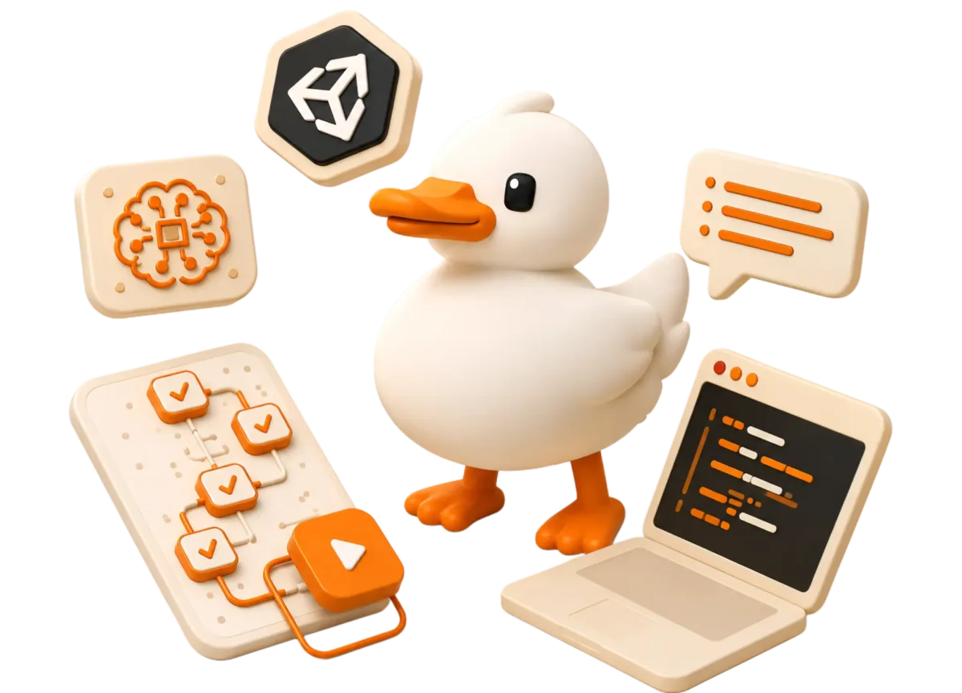
bataa
PRODUCT STORY
Learn by doing.
A learning companion that gives people one doable next step, wherever they are.
Mobile practice · Desktop guidance · AI when the question appears
Pitch deck | September 2026
Notes:
Opening: People do not fail because content is unavailable. They stall at the moment they need to act. Bataa keeps the next action close. Visual source: public/hero.webp from the Bataa project.

Slide 2
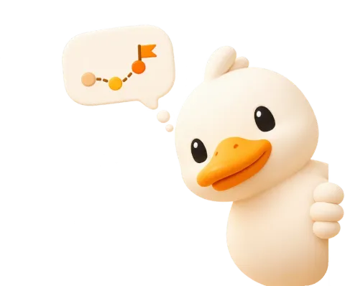
bataa
THE GAP
02
Learning support disappears when the learner is ready to act
The hardest moment often comes after the video ends.
“I know what I want to learn. I just do not know what to click next.”
The learner is alone when the question appears: late at night, between classes, or inside unfamiliar software.
THE STALL
Content is available. Context is missing.
Problem framing · user-provided brief
Notes:
Framing based on the user-provided problem statement. The quoted sentence is a synthesized articulation, not a verbatim interview quote.

Slide 3
bataa
DISCOVERY
03
The campus signal
Early conversations at Horus University pointed to the same friction from different angles.
Students do not only need more content. They need a safe next step.
AVAILABILITY
ANXIETY
ACCESS
Instructor support stops when the learner’s question starts.
Some learners avoid asking because the question feels too basic or too late.
Courses can feel expensive, crowded, or disconnected from the moment of practice.
OBSERVED
Qualitative themes from campus conversations. Add the verified participant count before presenting.
Evidence status: observed · Horus University conversations
Notes:
Evidence label: OBSERVED. Source: user-provided description of early qualitative conversations at Horus University. Do not add a participant count until the team verifies it. These are synthesized themes, not verbatim quotes.

Slide 4
bataa
INSIGHT
04
The missing layer is contextual guidance
Bataa helps at the exact moment the learner has to make a move.
CONTENT ONLY
BATAA
Watch → pause → search → stall
→
Try → get feedback → keep moving
The learner has to translate theory into the next action alone.
The next step appears beside the work, in plain English.
Product insight · contextual help at the moment of action
Notes:
Narrative bridge: Bataa is not another content library. It is the guidance layer between intention and action.

Slide 5
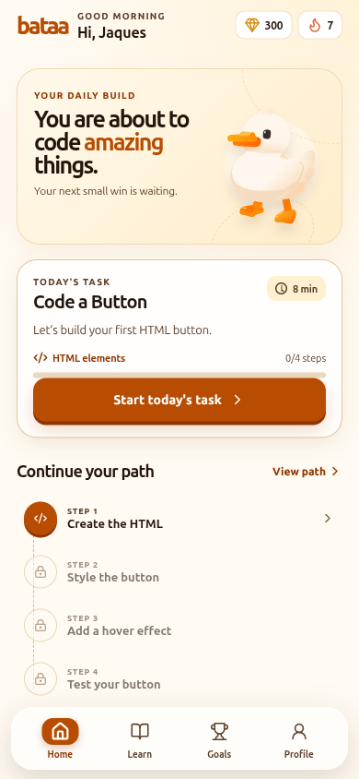
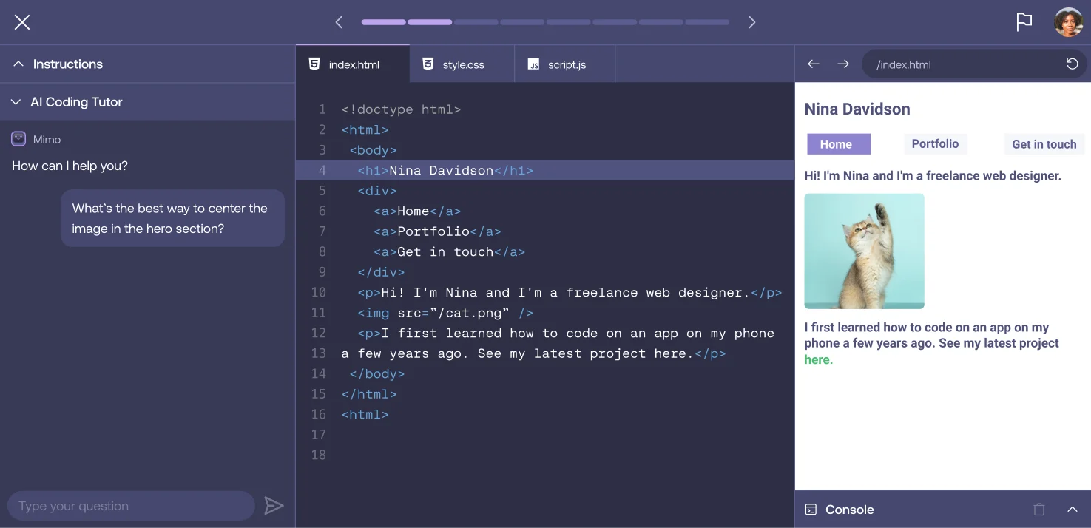
bataa
PRODUCT
05
One product, two moments
The same learning loop follows the learner from a spare minute to the tool where the work happens.
MOBILE
Keep momentum anywhere
Short daily tasks make progress possible in transit, between classes, or at home.
DESKTOP
Guide inside the tool
Demonstrated surfaces · mobile and desktop product visuals
Notes:
Visual sources: Bataa mobile capture from the running app (lesson-1.png) and public/guided-project-ai.webp. The desktop agent interaction should be demonstrated live or with a short clip when available.

Slide 6
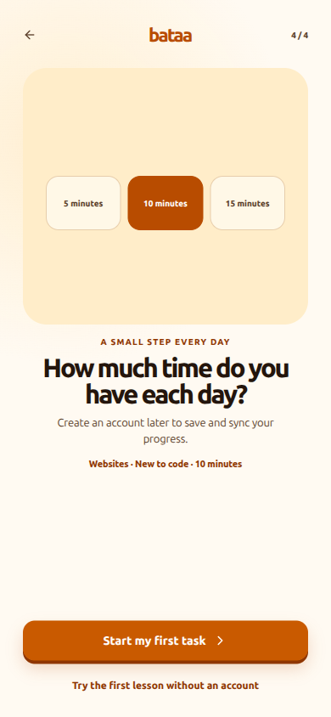

bataa
MOBILE PRACTICE
06
Mobile turns spare minutes into practice
A daily task can fit into the time a learner already has.
1
8–10 min
A small session with a clear finish line
2
No typing needed
The first days use three-choice recognition
3
One real skill
Every step maps to a usable web concept
Demonstrated · beginner-friendly lesson flow
Notes:
Visual sources: running Bataa app captures from the project. The “no typing needed” design is demonstrated in the first lesson step, which offers three choices.

Slide 7
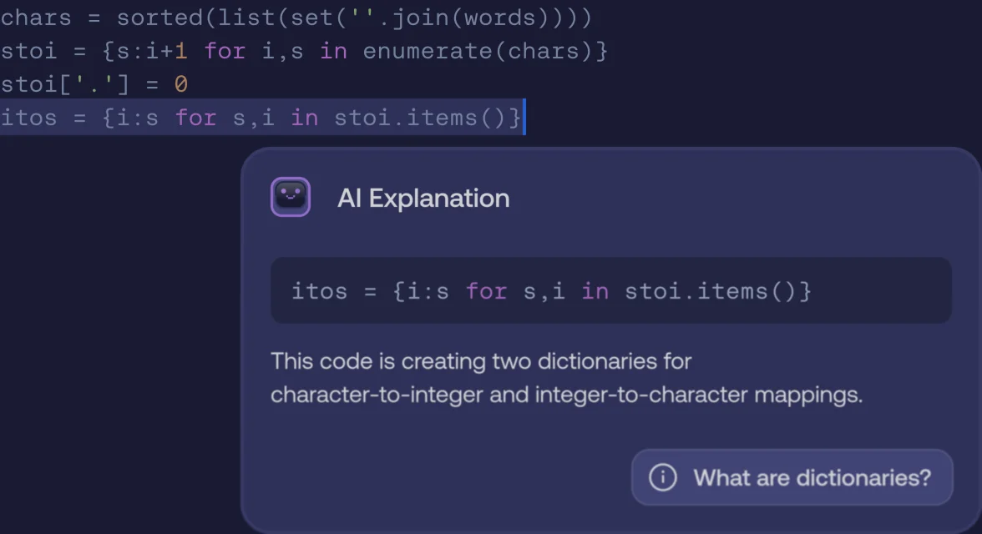
bataa
DESKTOP GUIDANCE
07
Desktop guidance meets the learner where work happens
For 3D, code, and other tools, Bataa can point to the next action instead of describing it from a distance.
01
Notice
Understand what the learner is trying to do
02
Point
Highlight the exact control or line to inspect
03
Try
Let the learner perform the action and see the result
DEMONSTRATED
Autonomous control and deeper integrations are pilot work, not a promise of the current build.
Desktop product visual · guided-project-ai.webp and ai-assisted-coding.webp
Notes:
Visual sources: public/ai-assisted-coding.webp and public/guided-project-ai.webp. Evidence status: DEMONSTRATED for the guidance concept. State clearly that autonomous cursor control and broad software coverage remain pilot scope unless already shipped.

Slide 8
bataa
SKILL JOURNEY
08
A skill compounds one small day at a time
Illustrative 3D-modeling journey: the learner starts with a gesture, then builds a real artifact.
The product promise is a path, not a single lesson.
1
2
3
DAY 1
DAY 7
DAY 30
Find the tool
Shape a scene
Finish an artifact
Recognize the viewport, select an object, make one change.
Combine small actions into a simple modeled composition.
Use the same guided loop to complete a portfolio-ready piece.
ILLUSTRATIVE
Replace with a real Bataa skill path and learner artifact before the final pitch.
Product narrative · example journey, not a measured outcome
Notes:
This is an illustrative journey for explaining the product loop. Do not present the day-30 outcome as a measured result until a real course and pilot validate it.

Slide 9
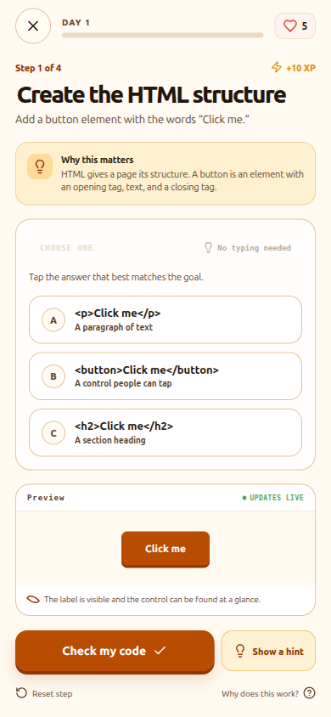
bataa
BEGINNER DESIGN
09
The first three days should feel approachable
Recognition first. Typed code comes after the learner understands what the code is doing.
DAY 1
Choose the right HTML element
DAY 2
Match CSS properties to a visual result
DAY 3
Predict what a hover state will do
The learner gets a win before they get a keyboard-heavy challenge.
Demonstrated · first lesson uses three-choice recognition
Notes:
Visual source: running Bataa app capture lesson-step-1.png. This design directly addresses beginner anxiety and keyboard friction from the user brief.

Slide 10
bataa
LEARNING LOOP
10
Bataa closes the gap between attempt and understanding
Each turn makes the next turn easier.
2
Try
3
Get feedback
The learner acts
Context, not a lecture
1
Choose
4
Repeat
One clear goal
Correct the next detail
5
Build confidence
A skill that stays
THE LOOP
The product keeps the learner moving without taking the work away from them.
Editable diagram · product hypothesis to validate in pilot
Notes:
This editable diagram expresses the intended learning loop. Validate it with pilot metrics such as task completion, time-to-first-success, hint usage, and return rate.

Slide 11
bataa
POSITIONING
11
Bataa sits between content and the moment of action
Bataa combines daily practice with help inside the work.
A positioning hypothesis, not a claim that competitors lack AI.
GUIDANCE IN CONTEXT
DAILY PRACTICE
Bataa
iSchool
Yanfaa / Nafham
Khan Academy
LOW
HIGH
VERIFY BEFORE PRESENTING
Qualitative positioning hypothesis · verify competitor names and feature claims
Notes:
This is a qualitative positioning hypothesis based on the user-provided competitor list. Verify the exact local platform names and current features before presenting. Do not claim that competitors do not use AI without research.

Slide 12
bataa
BUSINESS MODEL
12
Start with one clear revenue engine
Paid learning first. Optional AI usage and platform licensing expand the model later.
LAUNCH PRIORITY
OPTIONAL
LATER
Course purchase
AI tokens
Platform fees
Learners pay for a structured path that turns practice into a finished skill.
Extra attempts, deeper explanations, or advanced model usage.
Commission from creator and institution courses.
Keep the first story simple: one learner pays for one useful outcome.
Business model · planned streams, launch priority shown
Notes:
Business model is based on the user-provided brief. Course purchases are the launch priority; token packs and platform fees are expansion paths unless already implemented and tested commercially.

Slide 13
bataa
PLATFORM EXPANSION
13
The same learning engine can serve creators and institutions
Bataa can become the infrastructure behind guided practice, not only a destination app.
LEARNERS
BATAA ENGINE
Buy, practice, and finish the skill
CREATORS + INSTITUTIONS
Guided tasks, feedback, progress, AI context
Publish a course or training path
IDE / PRODUCT API
Bring the tutor into another workflow
PLANNED EXPANSION
Commission on course sales plus API licensing for organizations and tools.
Platform architecture · future revenue paths
Notes:
This diagram reflects planned expansion from the user-provided business model: institution and creator courses with commission, plus an API/base URL offering. Label as planned until commercially validated.

Slide 14
bataa
VALIDATION
14
The first wedge is close to the learner
Start with campus communities, prove the learning loop, then widen the platform.
OBSERVED
DEMONSTRATED
NEXT TEST
NEXT TEST
Campus conversations
Working surfaces
Pilot cohort
Partners
Students described the support gap.
Mobile lesson flow and desktop guidance visuals exist.
Measure task completion, return rate, and confidence.
Recruit one creator and one training institution.
The next proof point is not reach. It is whether a learner returns because the next step felt doable.
Go-to-market sequence · observed → demonstrated → next test
Notes:
Evidence ladder: OBSERVED = campus conversations; DEMONSTRATED = existing product surfaces; NEXT TEST = pilot metrics and partner recruitment. Do not claim retention or conversion before measurement.

Slide 15
bataa
TEAM
15
The team built the core surfaces
The product is split across the places where the learner meets Bataa.
1
Abdelrahman Mohsen
2
Yousef
3
Mostafa
DESKTOP APP
MOBILE APP
LANDING PAGE
Builds the guided workspace where the AI can meet the learner inside real software.
Builds the daily lesson loop for small, approachable practice sessions.
Shapes the public story, visual identity, and first touchpoint for Bataa.
TEAM PROOF
Each role maps to a working surface already visible in the product.
Team roles · supplied in the Bataa brief
Notes:
Team names and roles are taken from the user-provided brief. Add concrete proof points, links, or advisor details if available before presenting.

Slide 16
bataa
NEXT MILESTONE
16
The next milestone is a real pilot.
Prove that one doable action can become a habit and a finished skill.
01
Beginner mobile path
Ship the first week of simple daily tasks
OUR ASK
02
Desktop agent pilot
Guide one real workflow with safe user control
Pilot partners
03
Partner pilots
Test a creator course and an institutional path
One campus, one creator, and one training team willing to measure the loop with us.
Bataa gives every learner a next step.
Close with a specific pilot ask · replace with contact details before presenting
Notes:
Close: ask for pilot partners, not a generic “thank you.” Replace the ask and roadmap with dates, owners, and contact details when confirmed.

