Slide 1





SESSION 01 · LEVEL 1
Welcome to
ICPC HUE
Our rules · our tools · your first C++ code
Saturday · Season 2027

Slide 2
COMMITMENT POLICY
2
Our policy
Consistency is what turns beginners into contestants.
= باند
٣ غيابات كونتست
= باند
٣ غيابات سيشن
= غياب واحد
تأخير ربع ساعة ٣ مرات
= باند
متحلش ٨٠٪ من الشيت ٣ مرات
WEEKLY SHEET
لازم تحل على الأقل ٨٠٪ من الشيت كل أسبوع… مش مهم تتأخر، المهم تحل

Slide 3



WEEKLY RHYTHM
3
How our week works
Three days, one loop: learn it, test it, fix it.
SATURDAY
WEDNESDAY
FRIDAY
Session
Contest
Upsolve
Live training on a new topic
Weekly contest on Codeforces
Solve what you missed, with a recorded walkthrough
Missing 3 contests or 3 sessions = ban.

Slide 4
TODAY
4
Today's plan
Four short parts, about 85 minutes.
1
10 MIN
Problem solving & competitive programming
TODAY'S GOAL
Leave with your accounts ready and your first program accepted.
2
15 MIN
Our tools: icpchue.com · VS Code · Codeforces
3
30 MIN
Input & output, variables, data types
4
30 MIN
Overflow, ASCII, operators & conditions

Slide 5
00
Why we're here
Problem solving & competitive programming

Slide 6
THE SKILL
6
What is problem solving?
Turning a problem you've never seen into code that works, fast and correct.
1
2
3
UNDERSTAND
THINK
CODE & TEST
Read carefully. What is the input? What do they want?
Find the idea (the algorithm) on paper before coding.
Write it, try the samples and tricky cases, submit.
WHY IT MATTERS
Interviews at Google, Microsoft, Amazon and noon are problem-solving questions.

Slide 7
THE SPORT
7
What is competitive programming?
Problem solving as a sport: a set of problems, a clock, and a judge that checks your code instantly.
1
PROBLEMS
5–13 problems, easy → hard
THE ICPC ROAD
1
ECPC
2
TIME
Egypt · university teams of 3
2 to 5 hours per contest
2
ACPC
3
THE JUDGE
Africa & Arab region
AC = correct · WA / TLE = try again
3
ICPC World Finals
4
RANKING
The best teams on the planet
More solved, less time = higher rank

Slide 8
01
Our tools
Where you learn, where you code, where you submit

Slide 9

OUR HOME
9
icpchue.com
Sheets, recordings and your progress, all in one place.
www.icpchue.com
1
ACCOUNT
Sign up with your real name and student ID
2
WEEKLY SHEETS
A sheet every session, easy → hard
3
PROGRESS
Leaderboard, achievements, recordings

Slide 10

WHERE YOU CODE
10
VS Code
A free editor plus a C++ compiler — that's your whole setup.
code.visualstudio.com
1
INSTALL
Free on Windows / Mac / Linux
2
COMPILER
MinGW (g++) on Windows
3
EXTENSIONS
C/C++ and Code Runner
4
RUN
Write → save → run in the terminal

Slide 11
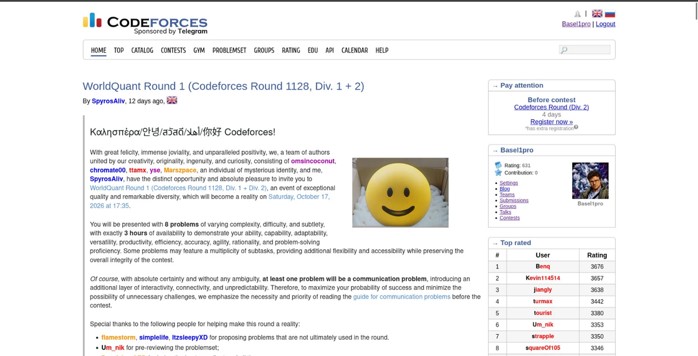
WHERE YOU SUBMIT
11
Codeforces
The online judge for our sheets and weekly contests.
codeforces.com
1
REGISTER
Same handle as on icpchue.com
2
OUR GROUP
Sheets and contests live there
3
SUBMIT
Language: GNU G++20
4
VERDICTS
AC ✓ · WA · TLE · CE

Slide 12
02
C++ basics
Everything you need to solve your first problems

Slide 13
C++ BASICS
13
Input & output
Read with cin, print with cout.
1
cin >>
#include <bits/stdc++.h>
using namespace std;
int main() {
int a, b;
cin >> a >> b; // read
cout << a + b << '\n'; // print
return 0;
}
Reads from the input
2
cout <<
Prints to the output
3
'\n'
New line — faster than endl
4
bits/stdc++.h
The whole standard library

Slide 14
C++ BASICS
14
Making variables
Every variable is a type, a name and a value.
1
THE PATTERN
int age = 19;
double price = 12.5;
char grade = 'A';
string name = "Horus";
long long big = 1e18;
age = age + 1; // now 20
type name = value;
2
NAMES
Letters, digits, _ — not starting with a digit
3
UPDATE
Change a variable any time

Slide 15
MEMORY & TYPES
15
Data types
Pick the type that fits the biggest value you'll store.
Type | Size | Holds | Example
int | 4 bytes | ±2·10⁹ | int n = 100;
long long | 8 bytes | ±9·10¹⁸ | long long x = 1e15;
double | 8 bytes | decimals | double pi = 3.14;
char | 1 byte | one character | char c = 'A';
string | any | text | string s = "HUE";

Slide 16
CRITICAL TRAPS
16
Two traps: overflow & ASCII
Both cost people Wrong Answer in their first contests.
OVERFLOW
ASCII
An int holds up to 2,147,483,647. Go past it and it wraps to a negative number.
Every char is a number: 'A' = 65, 'a' = 97, '0' = 48.
int a = 100000;
int bad = a * a; // ✗
long long ok = 1LL*a*a; // ✓
char c = 'a';
cout << (int)c; // 97
char up = c - 32; // 'A'

Slide 17
FORMATTING OUTPUT
17
Rounding decimal numbers
Problems often say: print exactly 2 digits after the decimal point.
1
fixed
double pi = 3.14159265;
cout << fixed << setprecision(2);
cout << pi << '\n'; // 3.14
cout << setprecision(4) << pi; // 3.1416
Normal form, never scientific
2
setprecision(X)
Exactly X digits after the point
3
SET ONCE
It stays for every next cout

Slide 18
OPERATORS
18
Arithmetic operators
Watch out for integer division.
+
-
*
/
%
add
subtract
multiply
divide
remainder
7 + 2 = 9
7 - 2 = 5
7 * 2 = 14
7 / 2 = 3 (int!)
7 % 2 = 1
TIP
int / int drops the decimals — use 7.0 / 2 to get 3.5. Even number? n % 2 == 0

Slide 19
CONTROL FLOW
19
Logical operators & conditions
Combine checks with && and ||, branch with if / else.
== !=
equal / not equal
int n; cin >> n;
if (n % 2 == 0 && n > 0) {
cout << "positive even";
} else if (n < 0 || n == 0) {
cout << "not positive";
} else {
cout << "positive odd";
}
< > <= >=
compare
&&
and — both true
||
or — at least one
!
not

Slide 20
ICPC HUE
HOMEWORK
20
Your first sheet
Five problems on icpchue.com — start tonight.
https://www.icpchue.com/dashboard/sheets/level-0/sheet-a
16 Problam
16 problem must be done by 24/10
( the time of the next session )

Slide 21
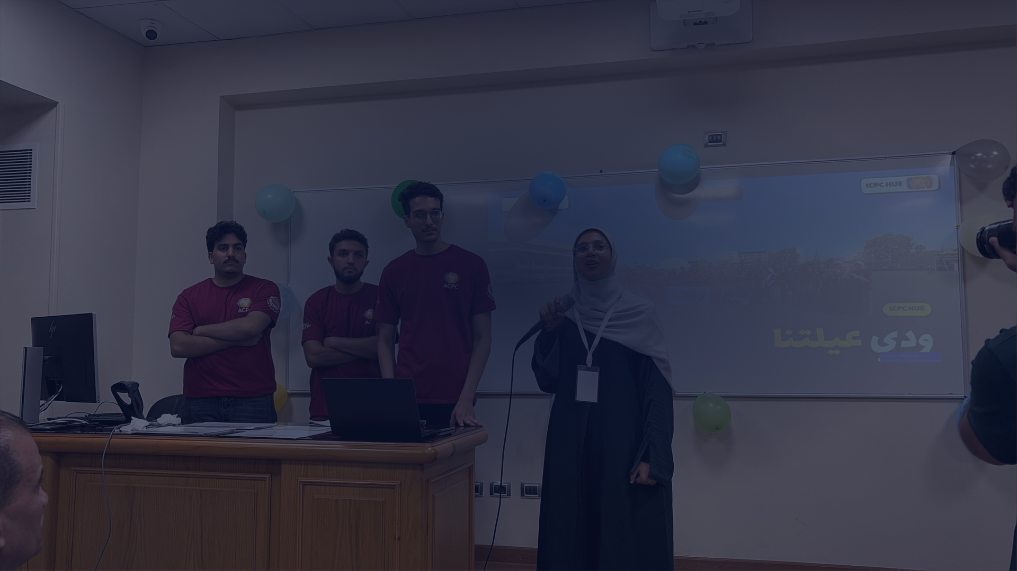




Questions?
See you on Wednesday's contest · icpchue.com

