Slide 1
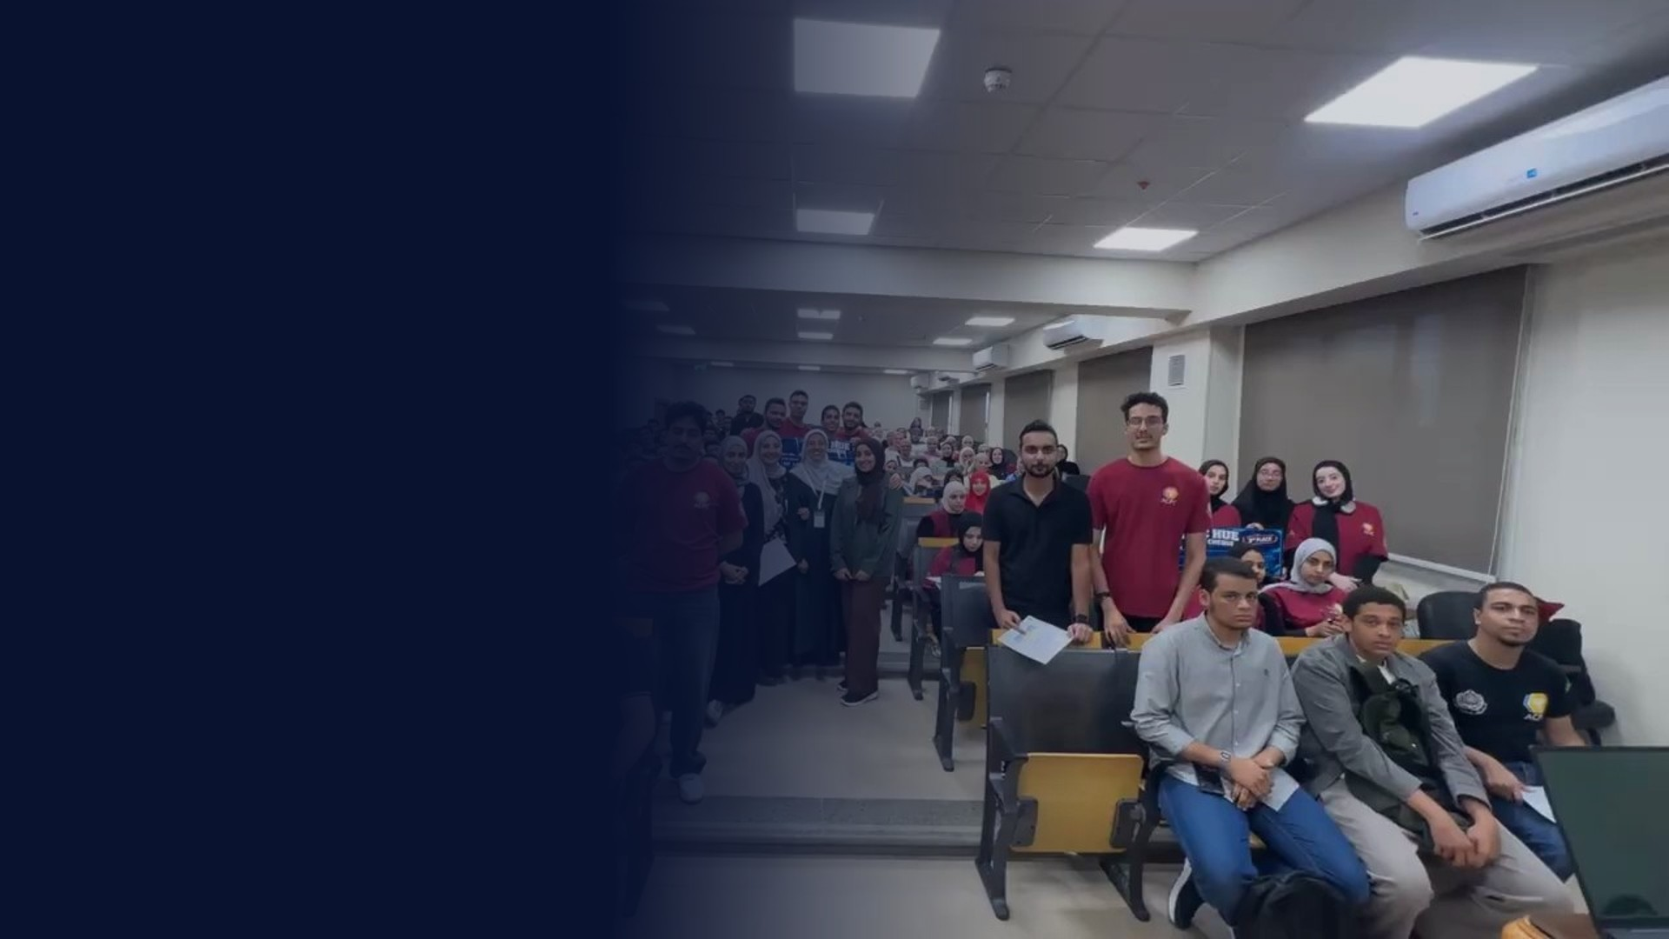



ICPC HUE
SESSION 04 · LEVEL 0
Arrays
Many values under one name · frequency arrays · 2D grids
Monday · Season 2027

Slide 2
Today's plan
TODAY
Learn the tool, then solve three real problems with it.
1
ARRAYS
What an array is, how it sits in memory, how to initialize it
TODAY'S GOAL
Stop declaring a variable per value. One array, one loop, any n.
2
FREQUENCY ARRAY
Count anything in one pass
3
2D ARRAYS
Rows and columns, grids
4
PRACTICE
Count Frequency, ICPC Balloons, Search in Matrix

Slide 3
00
Arrays
Many values under one name

Slide 4
Why do we need arrays?
WHY ARRAYS?
Read 5 numbers, then imagine reading 100,000.
WITHOUT AN ARRAY
WITH AN ARRAY
One variable per value. Impossible for big n.
One name, any n. A loop does the reading.
int a1, a2, a3, a4, a5;
cin >> a1 >> a2 >> a3
>> a4 >> a5;
int n; cin >> n;
int a[n];
for (int i = 0; i < n; i++)
cin >> a[i];

Slide 5
How arrays are stored
MEMORY
int a[5] = {7, 3, 9, 1, 4}; side by side, 4 bytes each.
1
SIDE BY SIDE
a
7
3
9
1
4
No gaps between elements
[0]
[1]
[2]
[3]
[4]
index
2
SAME SIZE
1000
1004
1008
1012
1016
address
a[i] lives at start + 4 × i
3
INSTANT ACCESS
a[2] is one jump, not a search
a[2] = 1000 + 4 × 2 = address 1008 → 9

Slide 6
Array initialization
INITIALIZATION
What is inside the array before you write to it?
1
LOCAL, NO VALUES
int g[100]; // global: all 0
int main() {
int a[5]; // garbage!
int b[5] = {1, 2, 3}; // 1 2 3 0 0
int c[5] = {}; // 0 0 0 0 0
int d[] = {4, 5}; // size 2
}
Random leftovers. Always initialize
2
PARTIAL LIST
Missing values become 0
3
GLOBAL
Declared outside main: all zeros

Slide 7
Built-in array functions
BUILT-IN
Every example starts from a = {4, 1, 3}, n = 3. The range is [a, a + n).
Call | What it does | Result
sort(a, a + n) | Ascending order | 1 3 4
sort(a, a + n, greater<int>()) | Descending order | 4 3 1
reverse(a, a + n) | Flips the order | 3 1 4
*max_element(a, a + n) | Largest value | 4
*min_element(a, a + n) | Smallest value | 1
accumulate(a, a + n, 0LL) | Sum (0LL = long long) | 8
count(a, a + n, 3) | How many 3s | 1
fill(a, a + n, 0) | Set every cell | 0 0 0

Slide 8
01
Frequency array
Count how many times each value appears

Slide 9
Frequency array
COUNTING
Count how many times each value appears. Values here are 0 to 100.
1
INDEX = VALUE
int n; cin >> n;
int freq[101] = {};
for (int i = 0; i < n; i++) {
int x; cin >> x;
freq[x]++; // one more x
}
cout << freq[3]; // how many 3s
freq[x] holds the count of x
2
SIZE
Largest possible value + 1
3
LIMIT
Only when values are small, up to about 10^7

Slide 10
Follow the frequency array
HOW IT RUNS
Input: 3 1 3 2 3
Step | x | freq[1] | freq[2] | freq[3]
1 | 3 | 0 | 0 | 1
2 | 1 | 1 | 0 | 1
3 | 3 | 1 | 0 | 2
4 | 2 | 1 | 1 | 2
5 | 3 | 1 | 1 | 3
One pass over the input. After that, "how many 3s?" is a single lookup: freq[3] = 3.

Slide 11
A. Count Frequency
PROBLEM
Codeforces · 1 second · 256 MB · codeforces.com/group/MWSDmqGsZm/contest/219774/problem/V
SAMPLE
STATEMENT
Given N, M and an array A of N numbers. For every number from 1 to M, print how many times it appears in A.
// input
10 5
1 2 3 4 5 3 2 1 5 3
LIMITS
1 ≤ N, M ≤ 10^5
1 ≤ A[i] ≤ M
// output
2 2 3 1 2 (one per line)

Slide 12
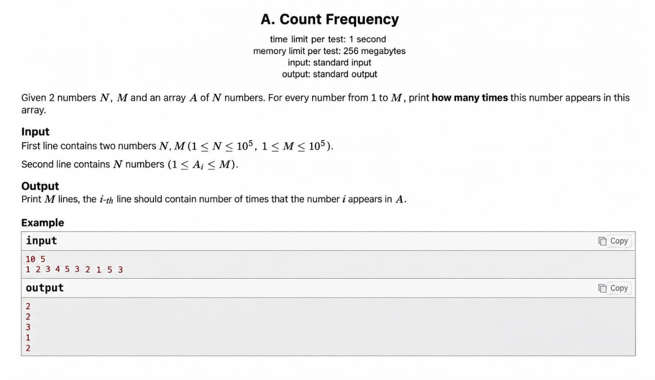
A. Count Frequency
ON CODEFORCES
codeforces.com/group/MWSDmqGsZm/contest/219774/problem/V

Slide 13
Without a frequency array
FIRST TRY
Works on the sample. Count the steps before you submit it.
1
IDEA
int n, m; cin >> n >> m;
int arr[n];
for (int i = 0; i < n; i++) cin >> arr[i];
for (int i = 1; i <= m; i++) {
int cnt = 0;
for (int j = 0; j < n; j++)
if (arr[j] == i) cnt++;
cout << cnt << endl;
}
For each i from 1 to M, scan the whole array
2
COST
N × M = 10^5 × 10^5 = 10^10 steps
3
VERDICT
About 10^8 steps fit in 1 second: Time Limit Exceeded

Slide 14
With a frequency array
BETTER
Read once, count while reading, print the counts.
1
COST
int n, m; cin >> n >> m;
int freq[m + 1] = {}; // cells 0 … m
for (int i = 0; i < n; i++) {
int x; cin >> x;
freq[x]++;
}
for (int i = 1; i <= m; i++)
cout << freq[i] << '\n';
N + M ≈ 2 × 10^5 steps. Accepted
2
NO ARR NEEDED
Each number is counted the moment it is read
3
'\N' NOT ENDL
endl flushes every line, slow for 10^5 lines

Slide 15
F. ICPC Balloons
PROBLEM
Codeforces · 1 second · 256 MB · codeforces.com/group/lEfcMyt0UC/contest/728697/problem/F
SAMPLE (FIRST 2 TESTS)
STATEMENT
Every solve gives that team a balloon. The first team to solve a problem gets one extra. Given the order of solves as a string of letters A–Z, count all balloons.
// input
2
3
ABA
1
A
LIMITS
1 ≤ t ≤ 100 test cases
1 ≤ n ≤ 50, uppercase letters
// output
5
2

Slide 16
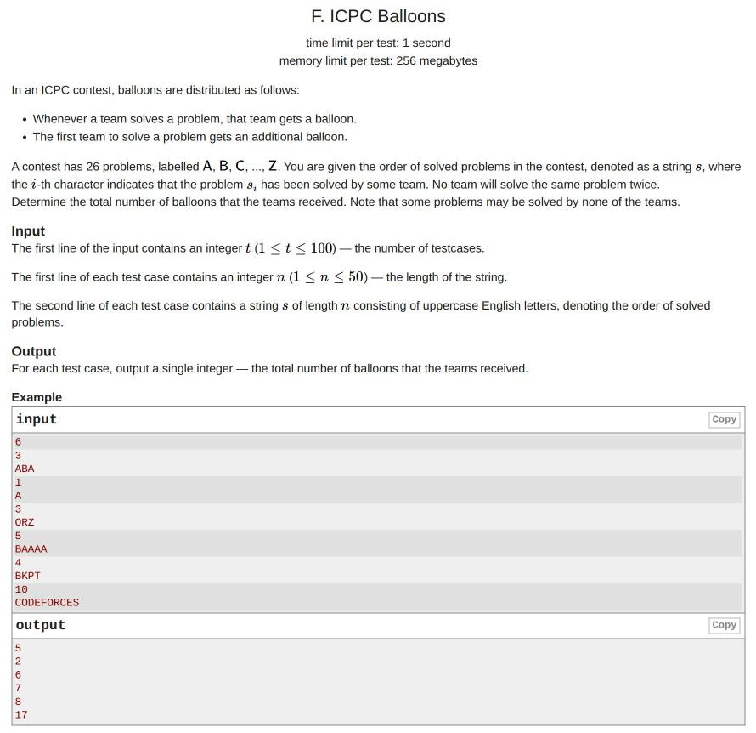
F. ICPC Balloons
ON CODEFORCES
codeforces.com/group/lEfcMyt0UC/contest/728697/problem/F

Slide 17
ICPC Balloons, solved
SOLUTION
ABA: A first → 2, B first → 2, A again → 1. Total 5.
1
LETTER TO INDEX
int t; cin >> t;
while (t--) {
int n; cin >> n;
int freq[27] = {};
long long cnt = 0;
for (int i = 1; i <= n; i++) {
char c; cin >> c;
freq[c - 'A' + 1]++;
if (freq[c - 'A' + 1] <= 1) cnt += 2;
else cnt++;
}
cout << cnt << '\n';
}
c - 'A' + 1 turns A…Z into 1…26
2
FIRST SOLVE
Count just became 1, so 2 balloons
3
NEW TEST
freq is declared inside the loop, so it resets

Slide 18
02
2D arrays
Rows and columns

Slide 19
Multidimensional arrays
MULTIDIMENSIONAL
An array of arrays: g[row][column].
columns j
0
1
2
3
int g[3][4]; // 3 rows, 4 cols
for (int i = 0; i < 3; i++)
for (int j = 0; j < 4; j++)
cin >> g[i][j];
cout << g[1][2]; // row 1, column 2
0
1
2
3
4
1
5
6
7
8
2
9
10
11
12
g[1][2] = 7. Outer loop walks rows, inner loop walks columns.

Slide 20
A. Search in Matrix
PROBLEM
Codeforces · 1 second · 256 MB
SAMPLE
STATEMENT
Given an N × M grid of numbers and a number X, print YES if X is in the grid, otherwise NO.
// input
2 2
1 2
3 4
3
LIMITS
2 ≤ N, M ≤ 100
1 ≤ A[i][j] ≤ 10^5, 0 ≤ X ≤ 10^5
// output
YES

Slide 21
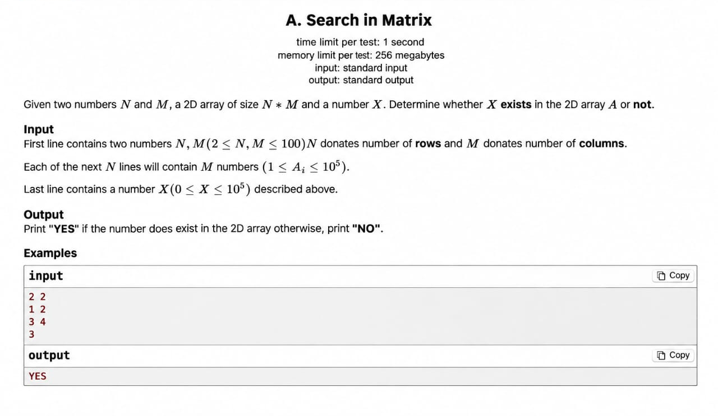
A. Search in Matrix
ON CODEFORCES
The original statement

Slide 22
Search in Matrix, solved
SOLUTION
Read the grid, then check every cell.
1
READ
int n, m; cin >> n >> m;
int arr[n][m];
for (int i = 0; i < n; i++)
for (int j = 0; j < m; j++)
cin >> arr[i][j];
int x; cin >> x;
for (int i = 0; i < n; i++)
for (int j = 0; j < m; j++)
if (x == arr[i][j]) {
cout << "YES" << endl;
return 0;
}
cout << "NO" << endl;
Outer loop rows, inner loop columns
2
STOP EARLY
return 0 ends the program at the first match
3
NOT FOUND
Reached only when no cell matched

Slide 23
Two traps: out of bounds & freq size
CRITICAL TRAPS
Both cost Wrong Answer or Runtime Error in a first contest.
OUT OF BOUNDS
FREQ TOO SMALL
Valid indexes are 0 to n - 1. a[n] is memory that is not yours.
Values go up to M, so freq needs M + 1 cells: index M must exist.
int a[5];
a[5] = 1; // ✗
for (int i = 0; i <= 5; i++) // ✗
for (int i = 0; i < 5; i++) // ✓
int freq[m]; // ✗ no freq[m]
int freq[m + 1] = {}; // ✓ 0 … m

Slide 24
What to remember
RECAP
Five lines to take home.
1
ARRAYS
One name, indexes 0 to n - 1, stored side by side
2
INITIALIZATION
Partial list fills 0s, globals are 0, locals are garbage
3
FUNCTIONS
sort, reverse, max_element, accumulate… all on [a, a + n)
4
FREQUENCY
freq[x]++ counts in one pass instead of N × M
5
2D ARRAYS
g[row][col], outer loop rows, inner loop columns

Slide 25


