Slide 1
WellCo: priority outreach
Yuval Dan

Slide 2
Overview
WellCo is experiencing increased member churn
Outreach has a cost, so they need an outreach priority list for efficiency
WellCo collected various user data sources from 14-days observation window.
For that purpose, we built a data-driven prioritization model
Output: ranked list of members with a prioritization score

Slide 3
What Affect Churn Risk?
Member lifecycle: time since signup
Health burden: Diabetes, dietary counseling, hypertension etc.
App usage: number of WellCo app sessions, frequency
Web history: topics of interests, movement/health share
Lower engagement and higher health burden correlate with churn risk

Slide 4
Why Uplift (Not Just Churn Risk)
Outreach can change churn outcomes.
We estimate:
  P(churn | no outreach)
  P(churn | outreach)
Uplift = difference between these probabilities
The goal: prioritize members by uplift value

Slide 5
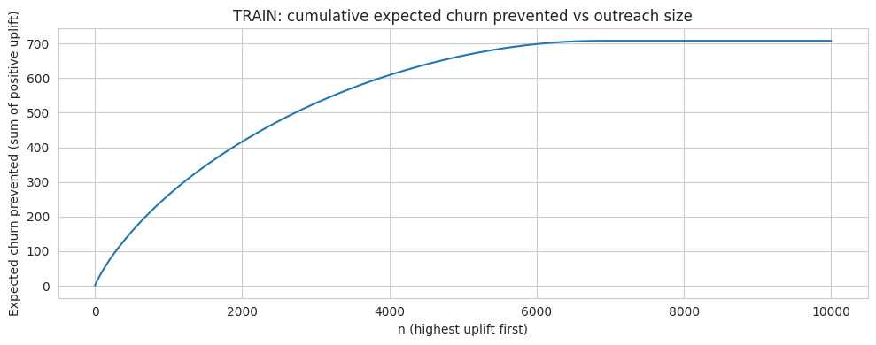
Performance & Validation
Members ranked by uplift, show better churn reduction vs random outreach.
~60 % of the members found with positive uplift value

Slide 6
Next Steps
Outreach size n chosen by the slope of cumulative expected churn
Align the number of outreaches with operational capacity and cost:
    Cost per outreach
    Cost per churn
Keep tracking churns and outreaches made for future model improvements and better predictions

