Slide 1
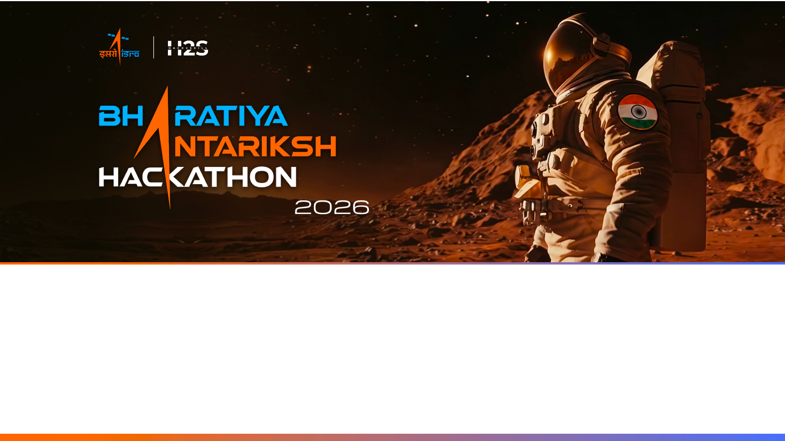
Team Name : Dubai_Kurukku_sandhu
Team Leader Name : Sudharsan M
Problem Statement : Route Resilience — Occlusion-Robust Road Extraction & Graph-Theoretic Criticality Analysis for Urban Mobility

Slide 2

Team Members
Team Leader: Name: Sudharsan M College: Vellore Institute of Technology (Chennai) | Team Member-1: Name: Yuvaraj R College: Vellore Institute of Technology (Chennai)
Team Member-2: Name: Skandan Suresh College: Vellore Institute of Technology (Chennai) | Team Member-3: Name: Harsha Vardan M Sakamuri College: Vellore Institute of Technology (Chennai)

Slide 3
Opportunity — what makes this different
Different: we optimise road CONNECTIVITY (clDice topology loss) and HEAL broken masks into a routable graph — not just ship pixel masks like standard extractors.
Solves the problem: sees through canopy/shadow occlusions, reconnects gaps, then flags the intersections whose failure would break the city.
USP: cycle-preserving graph healing + a global-efficiency Resilience Index + a plain-English LangGraph assistant for non-technical planners.

Slide 4
List of features offered by the solution
Occlusion-robust road segmentation (U-Net/SegFormer + topology-preserving clDice loss).
Topological healing: skeletonize + RDP cleanup + cycle-preserving gated gap-bridging → connected, weighted, routable graph.
Criticality map: betweenness centrality flags 'Gatekeeper Nodes' / bottlenecks.
Node-ablation stress test → Resilience Index (global network efficiency, survives disconnection).
Interactive dashboard: click a node to disable it → live reroute + travel-time increase.
Conversational LangGraph/LangChain assistant (Claude) — ask resilience questions in plain English.

Slide 5
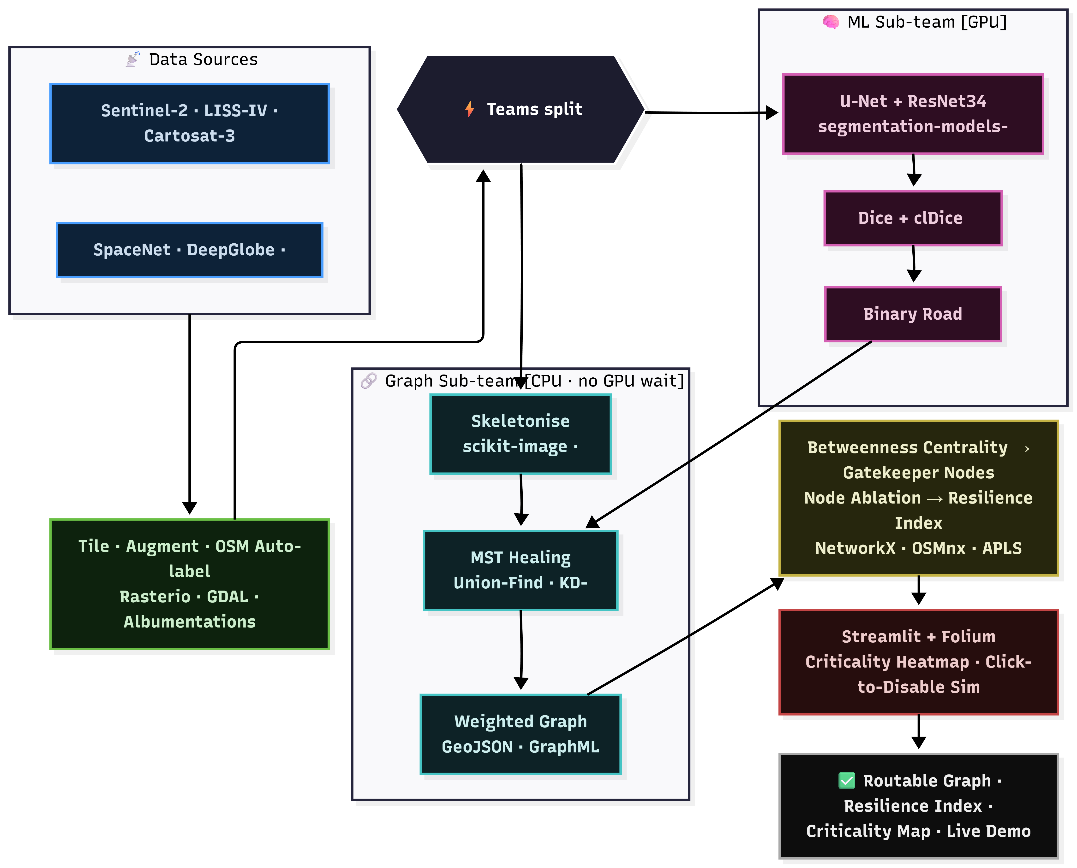
Process Flow
Imagery → Segmentation → Topological Healing → Graph Analysis → Interactive Dashboard.

Slide 6
Wireframe / Mock of the dashboard
Dark urban map; road network glows blue; key intersections pulse red, scaled by betweenness centrality.
Side chat panel: user asks 'if the main highway floods, what happens?' — map greys out the closure, highlights detours, shows the Resilience Index drop.

Slide 7
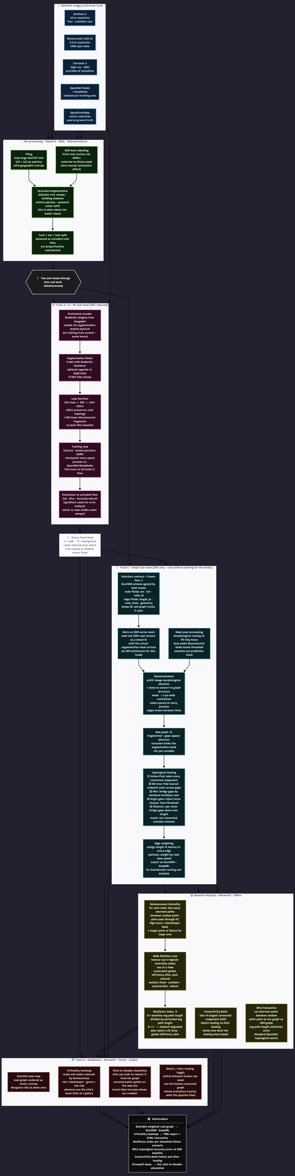
Architecture diagram of the proposed solution

Slide 8
Technologies to be used in the solution
ML / CV: PyTorch, segmentation-models-pytorch, Albumentations.
Geospatial / Graph: Rasterio, GDAL, scikit-image, sknw, NetworkX, OSMnx.
App / AI: Streamlit, folium/Leaflet, LangGraph, LangChain, Anthropic Claude.
Data: Cartosat-3 (primary) + pan-sharpened LISS-IV; Sentinel-2 / DeepGlobe / SpaceNet (pre-train); OSM ground truth.

Slide 9
Estimated implementation cost (optional)
Compute: 1 owned GPU workstation for fine-tuning — ~zero incremental cost.
LLM API (Claude) for the assistant: a few dollars for the demo.
Data: open datasets + OSM are free; Cartosat-3 provided at the event.
Graph analysis + dashboard: CPU-only — no cloud cost.

Slide 10


