Slide 1
RAVEN CHURN ANALYSIS
CHURN ANALYSIS:
Churn Analysis Is The Act Of Determining, Understanding, And Forecasting Why Consumers Stop Using A Product Or Service. Churn Analysis Helps Businesses Minimize Customer Attrition And Enhance Retention Tactics By Studying Customer Behaviour, feedback, And Historical Data.
KEY METRICS FOR CHURN ANALYSIS
Churn Rate
CLV (Customer Lifetime Value)
Retention Rate
Net Promoter Score (NPS)
Average Revenue Per User (ARPU)
Engagement Rate
Customer Acquisition Cost (CAC)

Slide 2
Business Problem
High Customer Churn Directly Impacts Revenue And Growth.
Need To Understand Who Is Churning, Why They Churn, And When
Goal: Provide Insights For Customer Retention Strategies.

Slide 3
KPI Overview
Total Customers: 5K
Onboarded: 3.758K
Monthly Revenue: ₹36.01L
Churned: 1.401K (28%)
On Trial: 1.545K

Slide 4
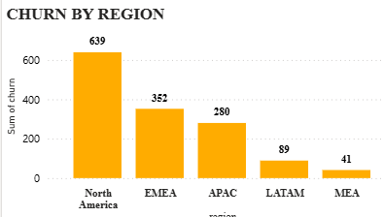
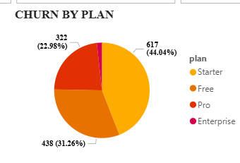
CHURN ANALYSIS OF THIS STUDY
This Charts Shows How Churn Happened In Region
North America Has The Highest Churn (~600+ Customers).
Emea & Apac Show Moderate Churn Levels.
Latam & Mea Have Minimal Churn → Potential For Growth Focus.
This Charts Says Churn By Plan
Starter plan: 44% churn → weak retention for entry-level users.
Pro & Enterprise plans show relatively lower churn.
Free plan still losing 31% of customers.

Slide 5
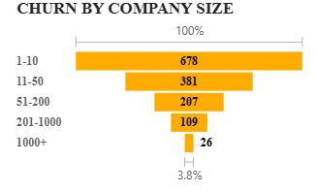
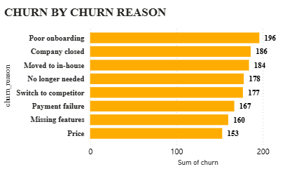
Small Businesses (1–10 Employees) Contribute Most Churn.
Larger Enterprises (201+) Have Significantly Lower Churn.
Indicates Need For Better Sme Onboarding & Support.
Top Reasons: Poor Onboarding, Company Closed, Moved To In-house, Competitor Switch.
Price Sensitivity & Missing Features Also Major Drivers.
Suggests Customer Success & Product Improvement Focus.

Slide 6
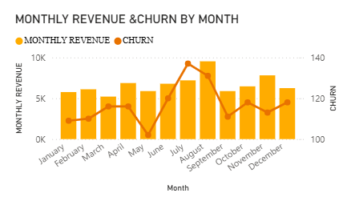
Revenue Dips In Aug–sept Align With Peak Churn Months.
Indicates Seasonality Or Product Dissatisfaction Cycles.
Action: Targeted Retention Campaigns During High-risk Months.

Slide 7
ADVANTAGES
Provides Data-driven Insights Into Customer Churn Patterns.
Helps Identify At-risk Customer Segments (By Plan, Region, Company Size).
Supports Targeted Retention Strategies To Reduce Churn.
Improves Decision-making For Pricing, Onboarding, And Product Features.
Visual, Interactive Dashboard For Real-time Monitoring.
Saves Time For Stakeholders Through Automated Analysis.
Strengthens Ability To Forecast Revenue Risks.

Slide 8
KEY INSIGHTS
28% Churn Rate High
Free & Starter Churn High
Poor Onboarding Major Issue
Mid-sized Firms Vulnerable
SUGGESTIONS
Improve onboarding
Add features
Adjust pricing for mid firms
Free → Paid conversion funnels
Focus on NA & EMEA
Customer success teams5

Slide 9
CONCLUSION
The Churn Analysis Reveals That Small Businesses And Starter Plan Users Contribute The Most Churn, With Poor Onboarding And Competitive Pressure As Key Drivers. Seasonal Spikes In Churn Directly Impact Monthly Revenue. By Addressing Onboarding Challenges, Enhancing Product Features, And Implementing Targeted Retention Campaigns, Organizations Can Significantly Reduce Churn And Improve Customer Satisfaction.

