Slide 1
CS213 ADVANCED JAVA PROJECT (TEAM 6)
CTI-Driven Intelligent Threat Detection and Attack Attribution for Connected Vehicle Networks
Submitted By
Yuvraj Singh (AP25110090004 - Lead) | Likhith Sai Ande (AP25110090196) | Charan Krishna Y (AP25110090041)
Nandam Pardhu Kumar (AP25110090149) | Kaushik Kaligotla (AP25110090168)
Department of CSE | Semester II | Regulation 2025 | Academic Year 2025 - 2026
SRM University - AP, Amaravati

Slide 2
Project Overview
Project title: CTI-Driven Intelligent Threat Detection and Attack Attribution for Connected Vehicle Networks
Domain: Automotive Cybersecurity & Cyber Threat Intelligence (CAN Bus + V2X Networks)
Project type: Pure Java 27 Desktop Console using java.awt.* (Native Win32 AWT Peers)
Data scope: 7,683 seeded alerts in SQLite 3 + raw CICIoV2024 (1.4M frames), VeReMi (225 .tgz), and STIX 2.1 (994 techniques)
Team 6: AP25110090004, AP25110090196, AP25110090041, AP25110090149, AP25110090168

Slide 3
1. Identification of the Project
Project title: Connected Vehicle CTI Security Operations Console (Java AWT - Full Dataset)
Target users: VSOC Analysts, Incident Responders, and Fleet Safety Engineers
Platform & tooling: Windows 11, JDK 27, SQLite JDBC 3.46.1.3, Google Gson 2.11.0, Batch scripts
Why Java SE 27: Strict OOP typing, ExecutorService concurrency, Streams API, and portable JDBC layer
Deliverable: Pre-seeded SQLite console, 23 automated test suite (20x repeatable), Report & PPT

Slide 4
2. Project Background
Vehicular threat attribution across CAN buses and wireless V2X channels.
Context: Vehicles interconnect 70+ ECUs over CAN buses alongside wireless V2X Basic Safety Messages.
Current limitation: CAN frames lack cryptographic authentication and V2X beacons can be location-spoofed.
Motivation: Binary intrusion labels do not tell analysts which ECU, MITRE ATT&CK ID, or CWE is affected.
Datasets used: CICIoV2024 (6 raw CSVs, 1,408,219 CAN frames), VeReMi (225 simulation runs), attack-stix-data.
Attribution benefit: Links intrusion alerts directly to CWE weaknesses, physical ECUs, and risk weights.

Slide 5
3. Problem Statement
Existing problem: Vehicle security teams lack unified desktop tooling tying CAN and V2X alerts to CTI graphs.
Root causes: Siloed bus/V2X telemetry parsers and absence of transparent asset-aware risk scoring.
Operational impact: Slow incident triage and difficulty auditing experimental detection models against real files.
Proposed solution: Pure Java AWT desktop console with SQLite persistence and live disk dataset verification.
Success criteria: 100% pass repeatability (23/23 x 20 runs) and zero mock data across all UI screens.

Slide 6
4. Objectives and Functionalities
Objective 1: Deliver a modular N-tier Pure Java AWT console backed by 7 SQLite relational tables.
Objective 2: Implement complete OOP hierarchy (Alert, CanAlert, V2xAlert) and Repository<T,ID> interfaces.
Objective 3: Stream raw CICIoV2024, VeReMi .tgz, and STIX 2.1 JSON asynchronously off the AWT EDT.
Core CRUD: Create alerts/nodes/telemetry, Stream-filter records, Edit with risk recalc, Modal confirm delete.
Additional functions: Salted SHA-256 auth, native FileDialog CSV export with audit log, 14 real result views.

Slide 7
5. System Design - Overall Architecture
Presentation layer: Pure Java AWT frames, CardLayout tabs, custom Canvas, and modal dialogs.
Business logic layer: Team6_AlertManagement, ThreatGraph, TelemetryIngest, RiskRanking, UserReports.
Data access layer: Generic Repository<T, ID> DAOs with parameterized PreparedStatements & ACID batches.
Database & storage: SQLite 3 (vehicle_cti.db) + live disk bundles (CICIoV2024, VeReMi, STIX 2.1, Dataset CSVs).
User Interface
Pure Java AWT
Business Logic
Team6 Services
Data Access
DAO / JDBC
Database & Disk
SQLite 3 + CSVs

Slide 8
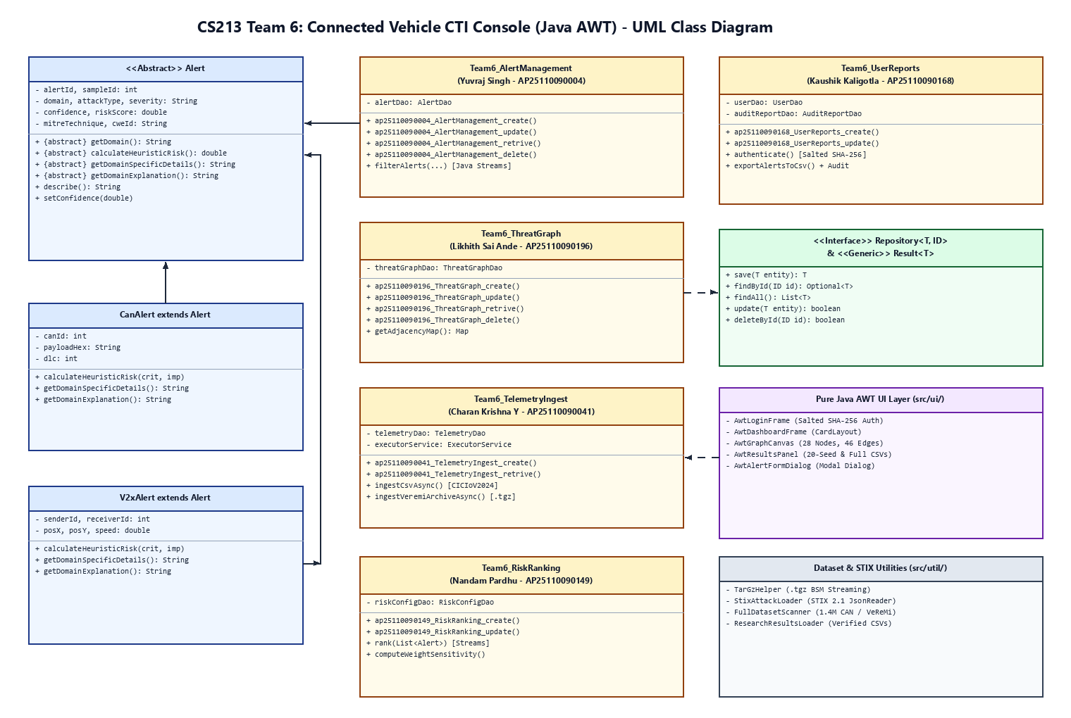
5. System Design - UML Class Diagram
Abstract Alert base class extended by CanAlert & V2xAlert | Generic Repository<T, ID> across 6 DAOs | 5 Team6_* services -> Pure AWT UI

Slide 9
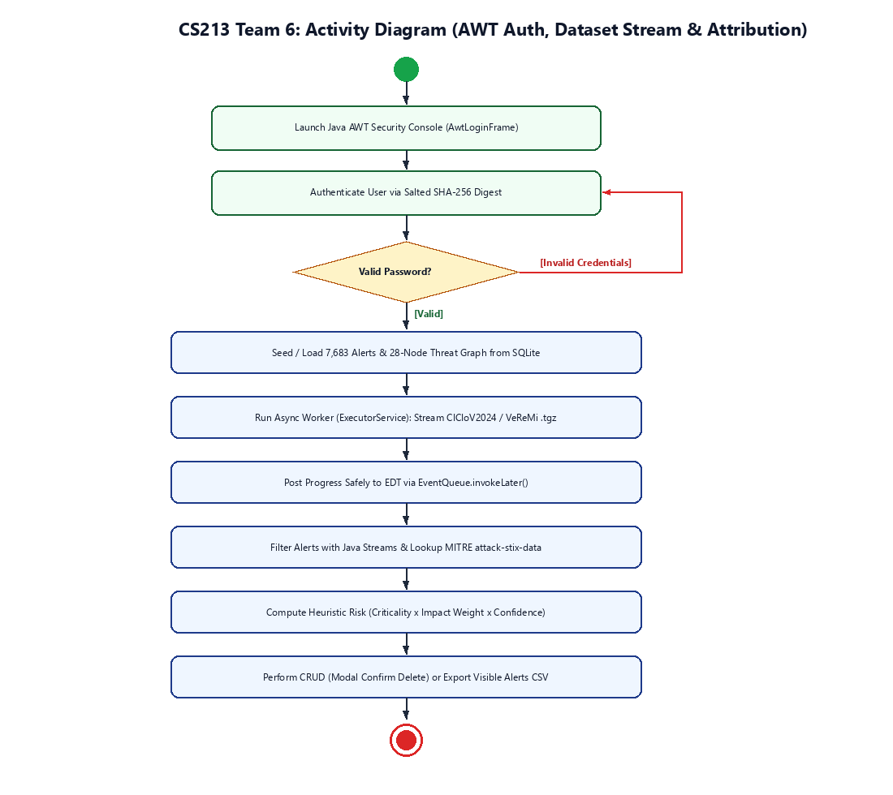
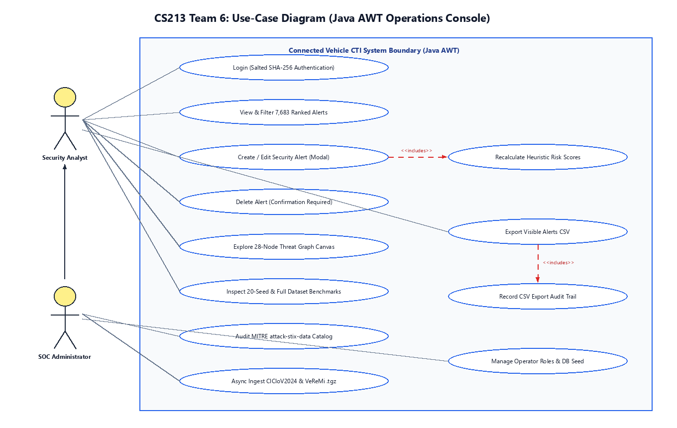
5. System Design - Supporting Diagrams
Use-case diagram (Left): Security Analyst & SOC Admin workflows | Activity diagram (Right): Auth -> Async Ingest -> EDT Attribution

Slide 10
6. Object-Oriented Programming Concepts
Concept-to-code mapping across domain models, interfaces, and services.
Classes & objects: ThreatNode, ThreatEdge, CanAlert, V2xAlert, RiskConfig, User, AuditReport.
Encapsulation: Private fields in Alert enforce confidence in [0.0, 1.0] or throw ValidationException.
Inheritance: CanAlert and V2xAlert extend abstract Alert with CAN ID/DLC or V2X transmitter coordinates.
Polymorphism: Dynamic calculateHeuristicRisk() (= Criticality x Impact x Confidence) + domain details.
Abstraction: Alert declares abstract getDomain(), calculateHeuristicRisk(), and explanation contracts.
Interfaces: Repository<T, ID> and Ranker<T> separate persistence and stream ranking contracts.

Slide 11
7. Advanced Java Concepts
Exception handling: ValidationException, AuthenticationException, and DataAccessException with try-with-resources.
Multithreading: 3-thread ExecutorService + CompletableFuture posting progress to AWT EDT via EventQueue.invokeLater().
Collections Framework: Map<String, List<ThreatEdge>> graph adjacency, List<Alert>, and Set<String> CAN IDs.
Generics: Parameterized Repository<T, ID>, Ranker<T>, and Result<T> response wrapper.
Java Streams API: filter(), sorted(), Collectors.groupingBy(), and asset mapping pipelines in services.

Slide 12
8. Graphical User Interface (GUI)
Framework: Pure Java AWT (java.awt.*), native Win32 peer controls, CardLayout navigation.
Tab 1 Ranked Alerts: Search box, CAN/V2X domain & MITRE filters, 7,683 rows, async STIX 2.1 lookup.
Tab 2 Threat Graph: Custom AwtGraphCanvas drawing 28 nodes and 46 edges with gold selection highlight.
Tab 3 Verified Real Results: 14 genuine views loading 20-seed, 5-seed, full CAN/V2X CSVs, and plots.
Tab 4 Full Datasets: Background scans for 6 CICIoV2024 CSVs (1.4M), 225 VeReMi .tgz, and STIX bundles.

Slide 13
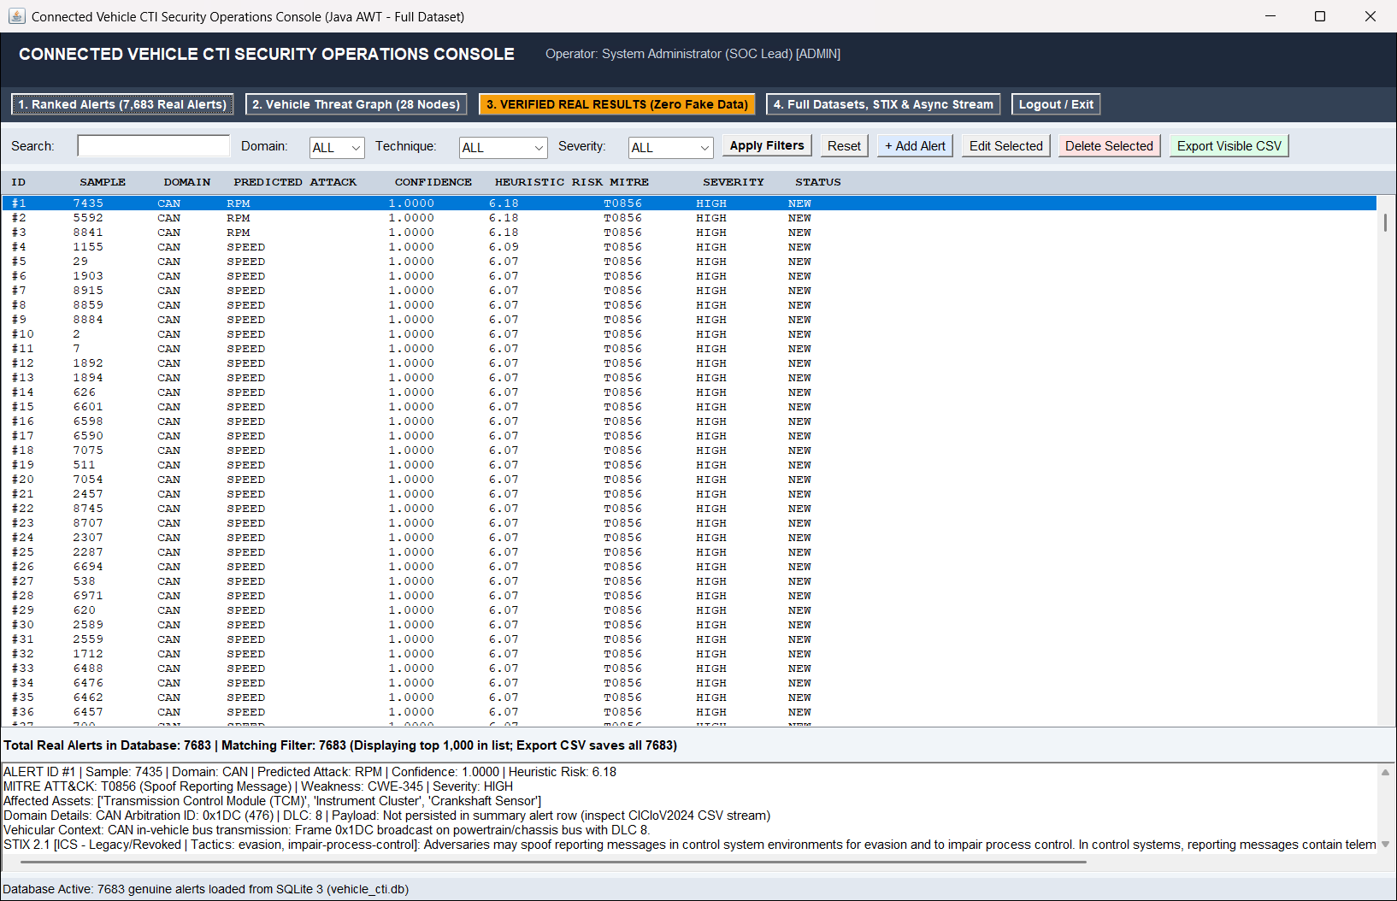
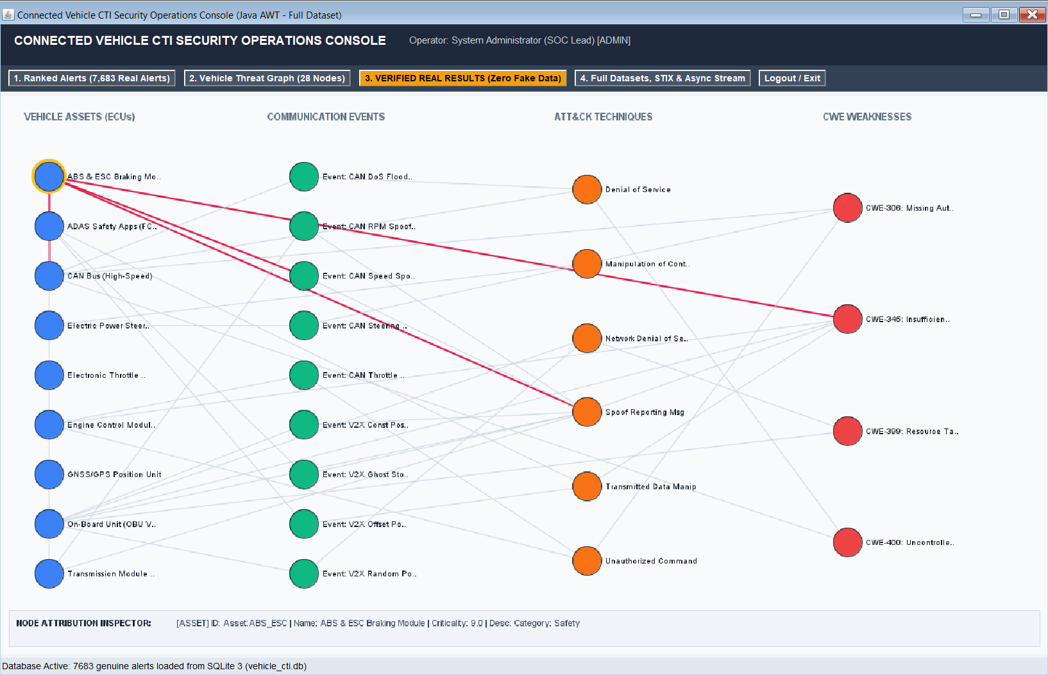
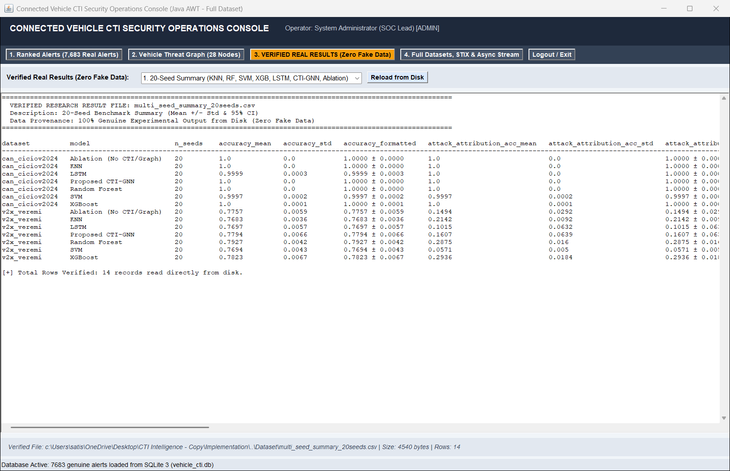
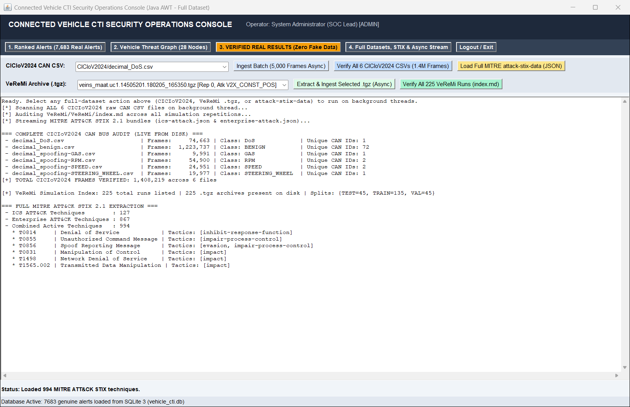
8. GUI - Live Application Screenshots (Java AWT)
Genuine Win32-captured frames: Top [Alerts Dashboard | 28-Node Graph] | Bottom [Verified 20-Seed Results | Full Dataset Scan]

Slide 14
9. Database Connectivity - JDBC
Database & Driver: Embedded SQLite 3 via org.sqlite.JDBC (sqlite-jdbc-3.46.1.3.jar).
Connection URL: jdbc:sqlite:database/vehicle_cti.db (no embedded passwords; PRAGMA foreign_keys = ON).
PreparedStatements: Every INSERT, SELECT, UPDATE, DELETE uses parameterized SQL placeholders.
Schema integrity: 7 normalized tables with primary keys, CASCADE foreign keys, and CHECK bounds.
Transactions & Security: 1,000-row batch commits with rollback plus 16-byte salted SHA-256 auth.

Slide 15
10. Source Code and Key Routines
Package structure: Main, TestRunner, model/ (11), dao/ (8), service/ (5), ui/ (5), util/ (11).
Module CRUD methods: ap25110090004_AlertManagement_*, ap25110090196_ThreatGraph_*, ap25110090041_TelemetryIngest_*.
Risk & User modules: ap25110090149_RiskRanking_* and ap25110090168_UserReports_*.
Risk scoring: Math.round(assetCriticality * impactWeight * confidence * 100.0) / 100.0.
Raw Parsers: FullDatasetScanner (1.4M CAN + 225 VeReMi), TarGzHelper, StixAttackLoader (994 STIX).

Slide 16
11. Testing and Results
20-Run Verification: 20 / 20 runs passed (460 / 460 cumulative tests; mean 2.934s, std 0.433s).
TC-01 to TC-18: Validated CRUD, exception checks, salted SHA-256 auth, Streams ranking, CSV export, polymorphism.
TC-19 to TC-23: 7,683 seeded alerts (Row 1 RPM @ 6.18), 994 STIX techniques, 1,408,219 CAN frames, 225 VeReMi .tgz.
20-Seed Benchmarks: CAN CTI-GNN F1 1.0000; V2X RF 0.4595 +/- 0.0127, XGB 0.4560 +/- 0.0163, CTI-GNN 0.3056 +/- 0.0486.
Full Datasets: CICIoV2024 XGBoost F1 0.8026 (Acc 0.9822); VeReMi XGBoost F1 0.4754 (Acc 0.8349); Zero-Day LOAO F1 1.0.

Slide 17
12. Conclusion and Future Enhancements
Conclusion: Delivered a Pure Java AWT N-tier Connected Vehicle CTI Console tested on real datasets.
Objectives met: All 5 student modules, 7 SQLite tables, interactive 28-node graph, and 14 real metric views.
Repeatability: 460 / 460 test assertions passed across 20 consecutive execution cycles.
Honest limitation: Tabular V2X detection favors tree ensembles (RF/XGB) over static GNN message passing.
Future work: SocketCAN hardware listener support, TAXII 2.1 live polling, and telemetry packet rate plots.

Slide 18
THANK YOU
CS213 Advanced JAVA Programming - Team 6 (SRM University - AP)
AP25110090004 | AP25110090196 | AP25110090041 | AP25110090149 | AP25110090168 - Questions & Discussion

