Slide 1
Service Request And Workflow Automation System
PROJECT MEMBERS:
D. DURGA PRASAD 23225A0505
P. KASI 23225A0510
Y. V. D. SAI 23225A0512
K.SAI RAM 23225A0506
S. S. R. CH. PHANI KUMAR 23225A0511
Project Co-Ordinator:
Mr. M. V. K. SUBASH
M. Tech., (Ph. D)
Project Supervisor:
Mrs. B. REVATHI
M. Tech.
Head Of the Department
Dr. MEERA SHARIF SHEIK
M. Tech., Ph. D
Department Of Computer Science And Engineering
2025-2026

Slide 2
Abstract
The Service Request And Workflow Automation System is a web-based application designed to automate the process of raising, tracking, and resolving service requests within an organization. The system enables users to submit service requests online and ensures that each request follows a predefined workflow for approval, processing, and resolution. This reduces manual intervention and improves operational efficiency.
The application provides separate interfaces for users and administrators. Users can create service requests, track request status, and receive updates, while administrators can manage workflows, assign tasks, monitor progress, and generate reports. The system is developed using Java Full Stack technologies such as Spring Boot, REST APIs, MySQL, and modern frontend frameworks. The proposed solution improves transparency, accountability, and efficiency in handling organizational service operations.

Slide 3
Introduction
Service requests include IT support, maintenance, approvals, and assistance
Manual handling causes delays, poor tracking, and lack of accountability
Traditional methods like paper forms and emails are inefficient
No centralized system to monitor request status
Manual approvals increased workload and reduced transparency
Requests follow predefined workflow stages
Role-based access for users, admins, and service staff
Real-time status updates improve transparency
Faster processing and reduced manual effort

Slide 4
Problem Statement
Organizations handle service requests (IT support, maintenance, approvals) using manual or semi-automated methods such as emails, phone calls, or paper forms.
These traditional approaches lead to:
Delays in request processing
Lack of transparency and tracking
Poor communication between users and service teams
There is no centralized system to manage and monitor service requests efficiently.
Manual workflows increase human errors, workload, and inefficiency.
Users are unable to track the real-time status of their requests.

Slide 5
Objectives of the Project
• To automate the service request handling process • To provide a centralized platform for managing service requests • To reduce manual effort and paperwork • To improve transparency in request processing • To enable real-time tracking of service requests • To ensure faster response and resolution time • To improve efficiency in workflow management

Slide 6
Existing System
Service requests are handled manually or semi-automatically
Requests raised through emails, phone calls, paper forms, or verbal communication
No standardized or centralized request management system
Basic ticketing or email-based systems are used in some cases
Approvals, task assignments, and closures are done manually
No real-time tracking of request status for users
Absence of automated notifications causes delays
No proper role-based access control
Limited reporting, monitoring, and analytics

Slide 7
Proposed System
Centralized, automated, and role-based service request management system
Eliminates limitations of manual and semi-automated systems
Structured workflow from request submission to closure
Users submit requests through a web-based interface
Each request is assigned a unique request ID
Requests pass through predefined stages: validation, approval, processing,
completion
Workflow automation controls request movement
Reduces manual intervention and human dependency
Ensures consistent and efficient request handling
Admin dashboard for monitoring and management
Administrators can configure workflows and assign tasks

Slide 8
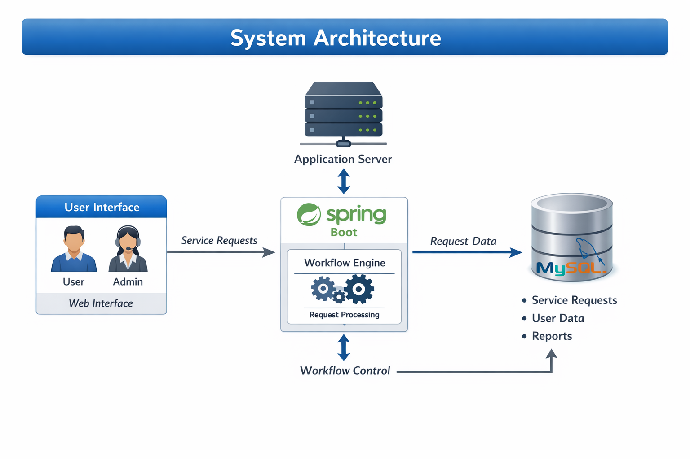

Slide 9
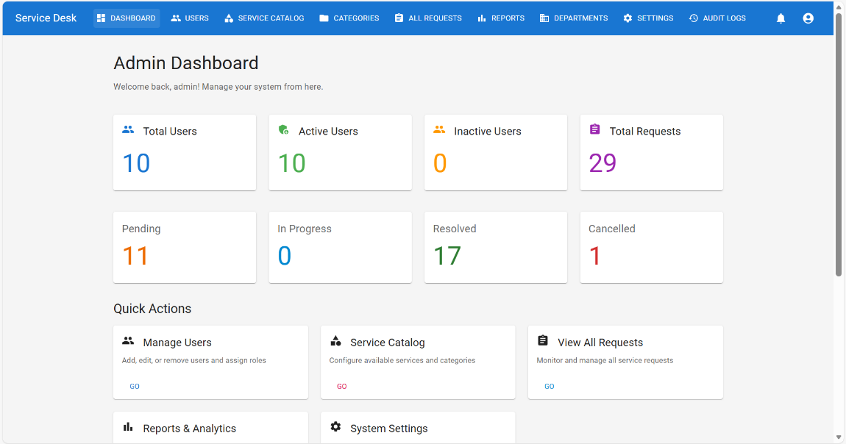
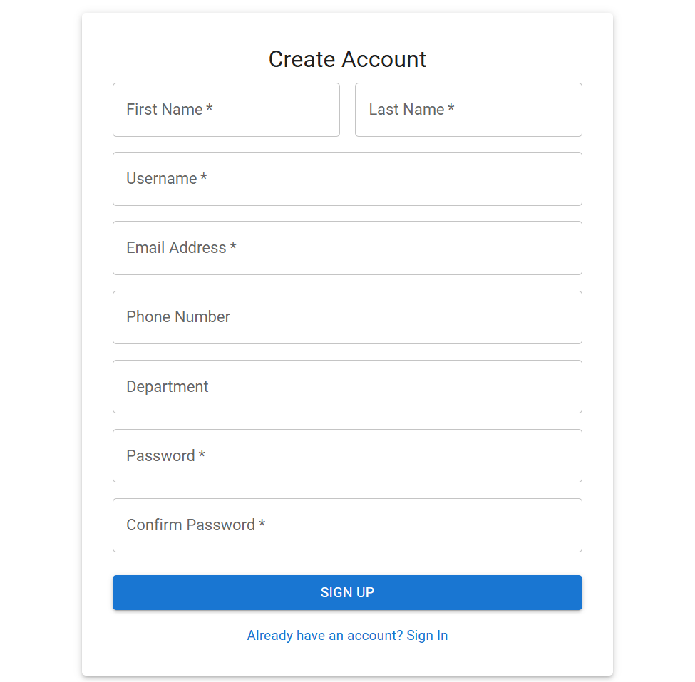
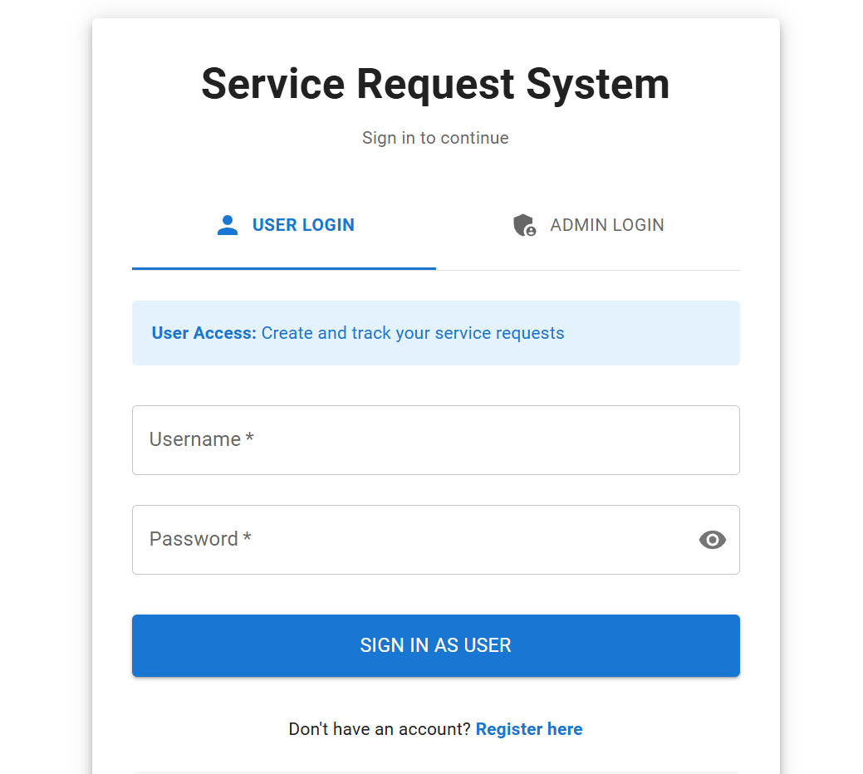
MODULES USED IN PROJECT
1. Admin Module
Central control unit of the system
Manages users, request categories, and priorities
Configures workflow rules
Monitors service requests at all stages
Ensures control and accountability
2. User Registration & Login Module
Provides secure system access
Allows user registration and login
Implements authentication and role-based access
Prevents unauthorized access

Slide 10
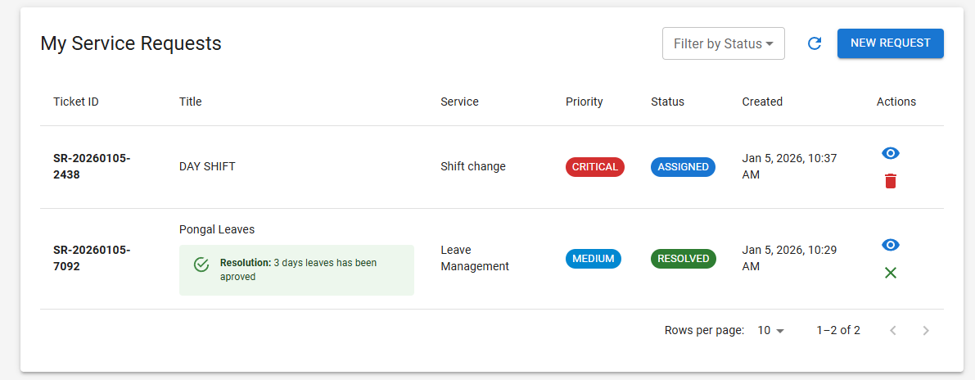
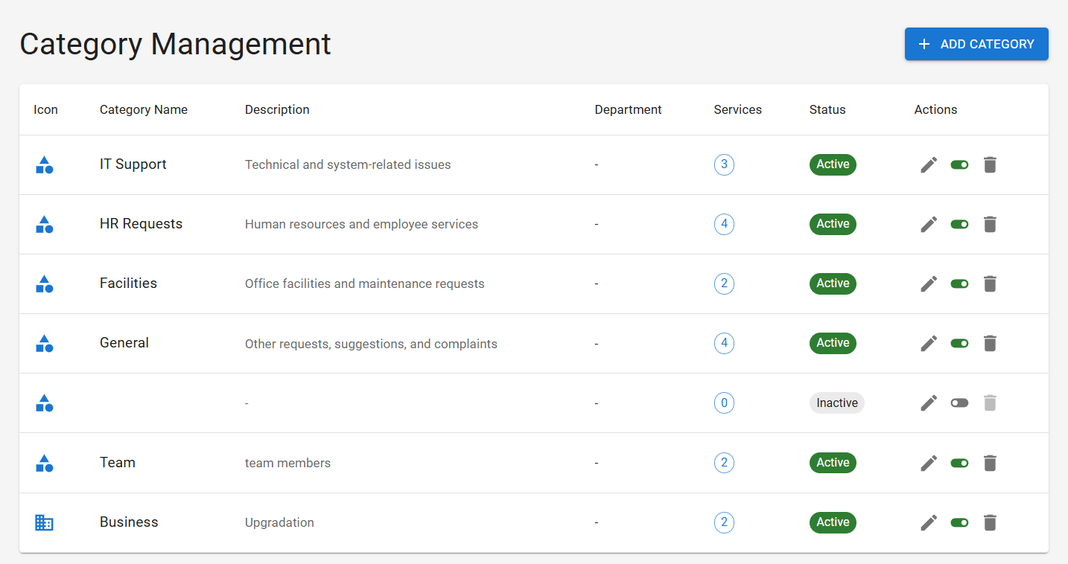
3. Service Request Module
Enables users to submit service requests
Captures request type, description, and priority
Generates unique request ID
Allows users to track request status
4. Workflow Automation Module
Automates request flow through predefined stages
Routes requests based on configured rules
Eliminates manual forwarding
Improves efficiency and transparency
5. Task Assignment & Tracking Module
Assigns requests to service teams
Tracks task progress in real time
Ensures timely request completion
Improves workload management

Slide 11
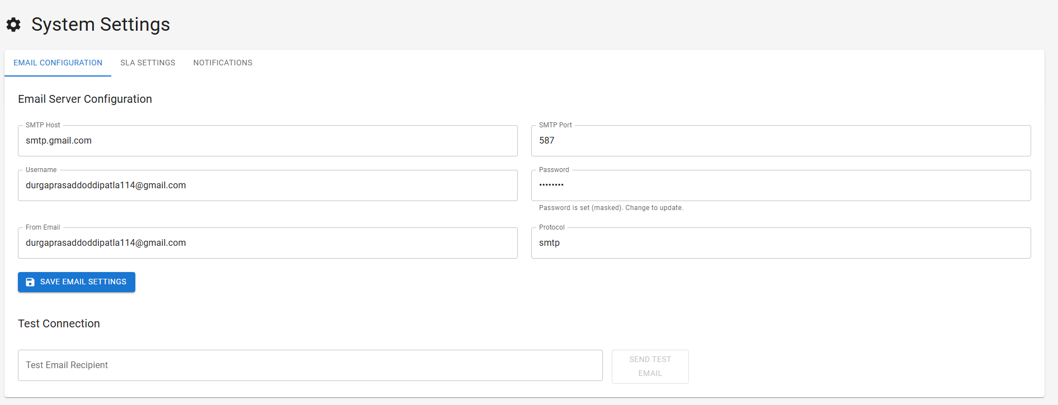
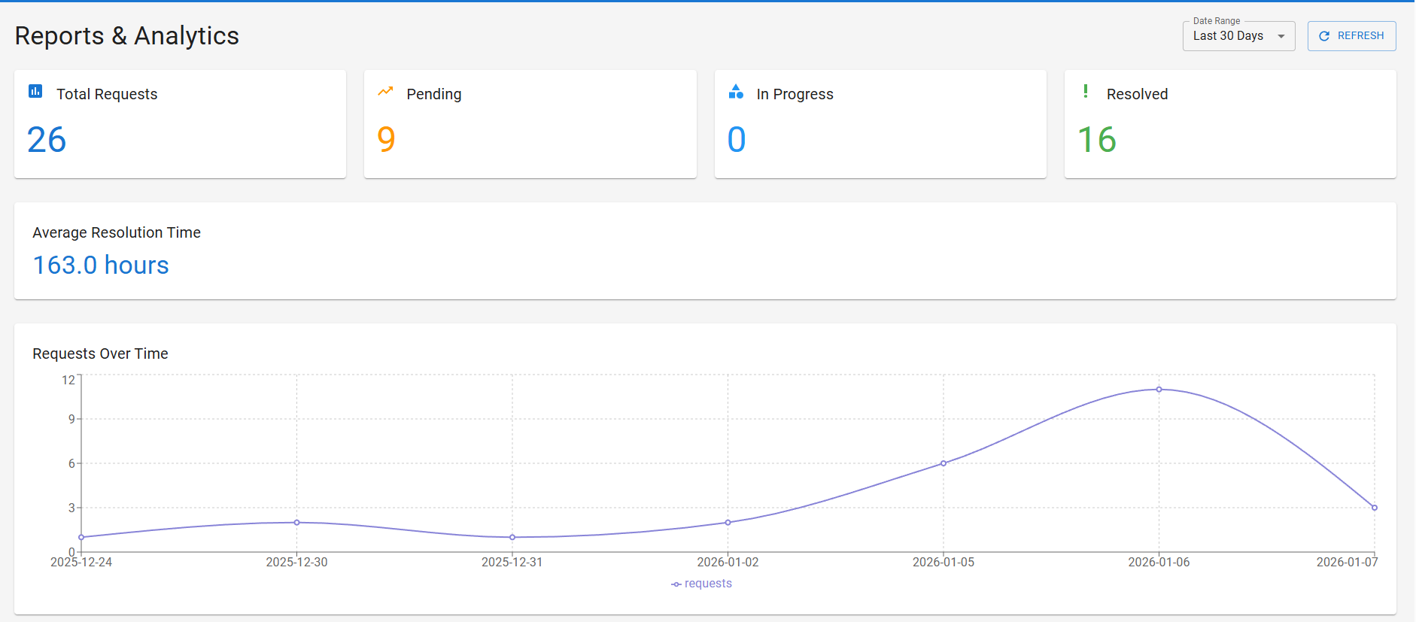
6. Notification Module
Sends alerts for request updates
Notifies users during approval and
completion
Reduces manual follow-ups
Improves communication
7. Report & Analytics Module
Generates reports on request status
Analyzes response time and performance
Helps in decision-making
Improves service quality

Slide 12
REQUIREMENT ANALYSIS
Hardware Requirements
• Processor: Intel Core i3 or above
• RAM: Minimum 4 GB
• Hard Disk: Minimum 250 GB
• Internet Connection: Required
• Input Devices: Keyboard, Mouse
• Output Device: Monitor
Software Requirements
• Operating System: Windows 10 / Linux
•Frontend Technologies: HTML, CSS, Bootstrap, JavaScript / React
•Backend Technology: Java, Spring Boot, REST(Representational State Transfer) APIs
• Database: MySQL
• Web Server: Apache Tomcat
• Development Tools: Eclipse / IntelliJ IDEA, Postman, VS code
• Browser: Google Chrome / Mozilla Firefox

Slide 13
Advantages and Disadvantages of the System
Advantages:
Automates the complete service request process
Reduces manual effort and paperwork
Provides centralized request management
Improves transparency with real-time status tracking
Faster request processing and response time
Role-based access ensures security
Disadvantages:
Initial setup and configuration cost
Requires internet connectivity
Needs user training for effective usage
Depends on system availability
Maintenance and updates are required
Data security must be managed properly

Slide 14
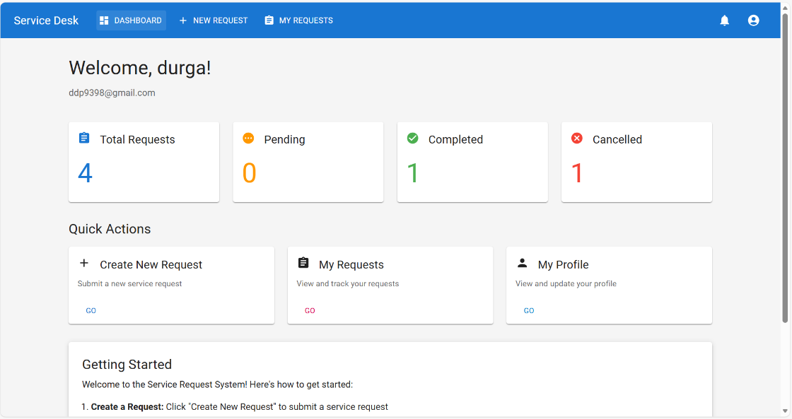
Result Analysis
User Login Screen
User Registration Screen
User Dashboard

Slide 15
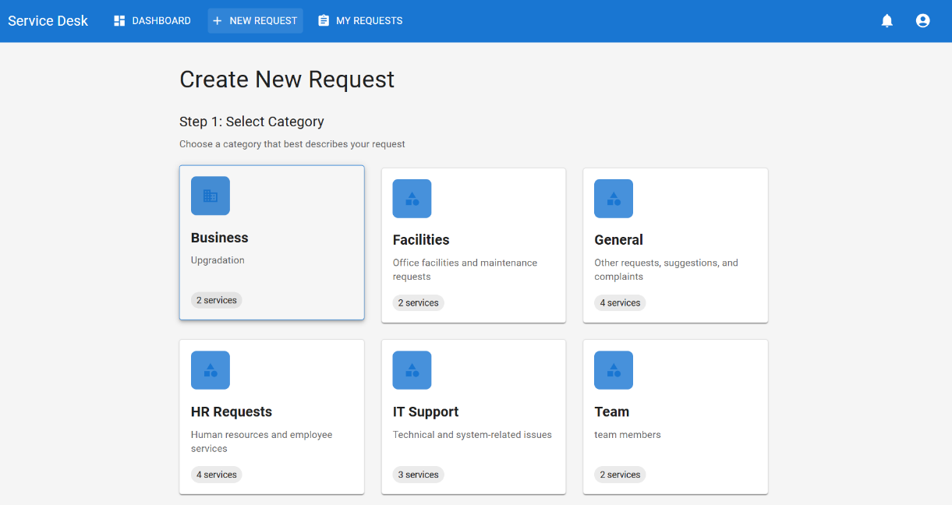
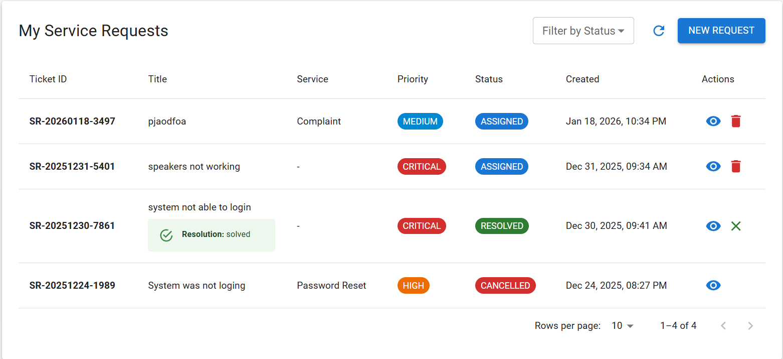
Create New Request – Category Selection
My Service Requests

Slide 16
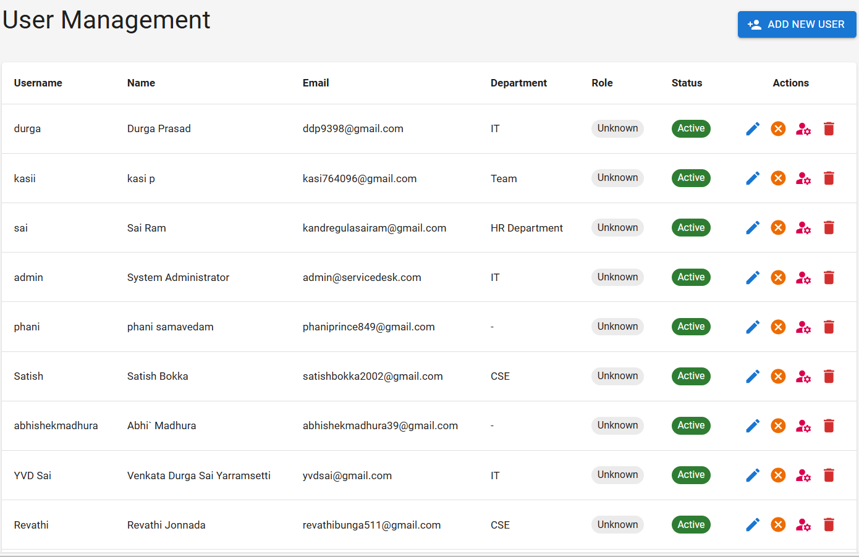
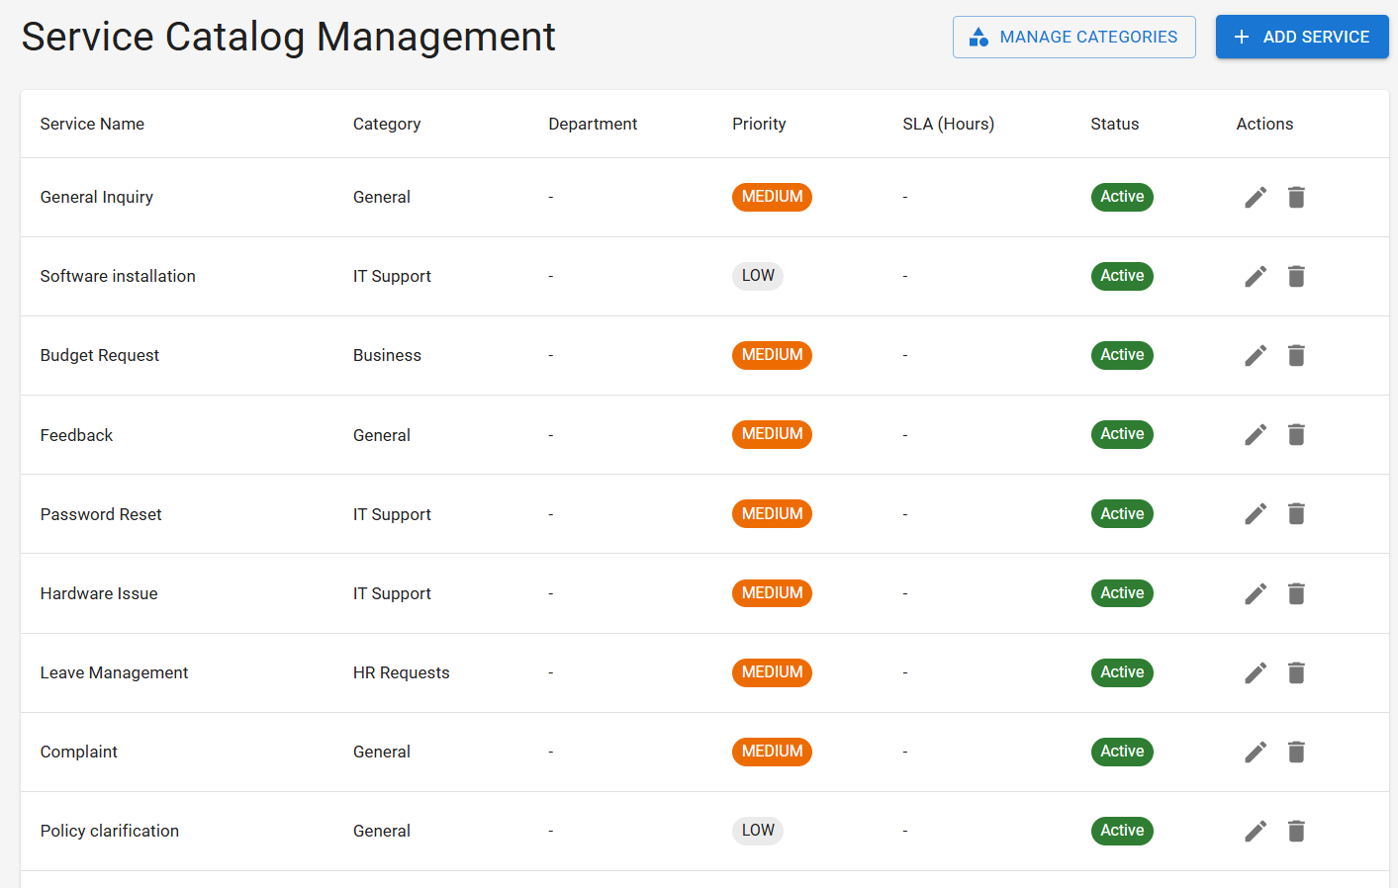
Admin Dashboard
User Management
Service Catalog Management

Slide 17
Conclusion & Future Scope
Conclusion
The Service Request & Workflow Automation System successfully automates service request handling
Eliminates manual processes and improves efficiency
Provides centralized and transparent request management
Ensures faster response and better accountability
Enhances overall organizational productivity and user satisfaction
Future Scope
Development of mobile application support
Integration with email and SMS notifications
Advanced reporting and analytics features
AI-based request prioritization and routing
Cloud deployment for scalability and availability
Integration with third-party enterprise systems

Slide 18
Thank you

