Slide 1
Data Analysis
With Seaborn

Slide 2
Introduction
Seaborn is a Python data visualization library based on matplotlib. It provides a high-level interface for drawing attractive and informative statistical graphics.
To analyse a set of data using Python, we make use of Matplotlib, a widely implemented 2D plotting library.

Slide 3
Seaborn Vs Matplotlib
It is summarized that if Matplotlib “tries to make easy things easy and hard things possible”, Seaborn tries to make a well-defined set of hard things easy too.”
Seaborn helps resolve the two major problems faced by Matplotlib; the problems are −
Default Matplotlib parameters
Working with data frames
As Seaborn compliments and extends Matplotlib, the learning curve is quite gradual. If you know Matplotlib, you are already half way through Seaborn.

Slide 4
Important Features of Seaborn
Seaborn is built on top of Python’s core visualization library Matplotlib. It is meant to serve as a complement, and not a replacement. However, Seaborn comes with some very important features. Let us see a few of them here. The features help in −
Built in themes for styling matplotlib graphics
Visualizing univariate and bivariate data
Fitting in and visualizing linear regression models
Plotting statistical time series data
Seaborn works well with NumPy and Pandas data structures
It comes with built in themes for styling Matplotlib graphics

Slide 5
Seaborn - Matplotlib
Seaborn splits the matplotlib parameters in two groups :
1)Plot Styles 2)Plot scale
Plot styles - set_style() or seaborn.set() which sets aesthetic parameters in one group.
set- parameters include context,style,palette,font,font_scale and color_ codes.
Themes are Darkgrid,Whitegrid,Dark,White,ticks.We can control the scale of plot using set_context() or context function which takes four preset parameters - paper,notebook,talk,poster.

Slide 6
Installing Seaborn and getting started
For Windows, Linux & Mac using Anaconda
conda install seaborn
For Windows, Linux & Mac using Python
pip install seaborn

Slide 7
Seaborn - Importing Datasets and Libraries
Importing Libraries
Let us start by importing Pandas, which is a great library for managing relational (table-format) datasets. Seaborn comes handy when dealing with DataFrames, which is most widely used data structure for data analysis.
#Pandas for managing datasets
import pandas as pd
Now, let us import the Matplotlib library, which helps us customize our plots.
from matplotlib import pyplot as plt
We will import the Seaborn library with the following command −
import seaborn as sb

Slide 8
Importing Datasets
We have imported the required libraries. In this section, we will understand how to import the required datasets.
Seaborn comes with a few important datasets in the library. When Seaborn is installed, the datasets download automatically.
load_dataset()
Importing Data as Pandas DataFrame
Example:
import seaborn as sb
df = sb.load_dataset('tips')
print df.head()

Slide 9
output:
total_bill tip sex smoker day time size
0 16.99 1.01 Female No Sun Dinner 2
1 10.34 1.66 Male No Sun Dinner 3
2 21.01 3.50 Male No Sun Dinner 3
3 23.68 3.31 Male No Sun Dinner 2
4 24.59 3.61 Female No Sun Dinner 4

Slide 10
Seaborn - Figure Aesthetic
Visualizing data is one step and further making the visualized data more pleasing is another step. Visualization plays a vital role in communicating quantitative insights to an audience to catch their attention.
Aesthetics means a set of principles concerned with the nature and appreciation of beauty,especially in art.Thus Visualization is an art of representing data in effective and easiest possible way.

Slide 11
Seaborn - Matplotlib
A Palette means a flat surface on which a painter arranges and mixes paints,similarly color_palette() or palette function can be used to give colors to plots
seaborn.color_palette(palette = None, n_colors = None, desat = None)
Available seaborn palette names : deep,muted,bright,pastel,dark,colorblind
n_colors - no.of colors,by default - 6 colors,desat - proportion to desaturate each color.

Slide 12
Seaborn Histogram
Histograms represent the data distribution by forming bins along the range of the data and then drawing bars to show the number of observations that fall in each bin.
Example: Histogram.py

Slide 13
Kernel Density Estimation
Kernel Density Estimation (KDE) is a way to estimate the probability density function of a continuous random variable. It is used for non-parametric analysis.
Setting the hist flag to False in distplot will yield the kernel density estimation plot.

Slide 14
Fitting Parametric Distribution
distplot() is used to visualize the parametric distribution of a dataset.

Slide 15
Plotting Bivariate Distribution
Bivariate Distribution is used to determine the relation between two variables. This mainly deals with relationship between two variables and how one variable is behaving with respect to the other.
The best way to analyze Bivariate Distribution in seaborn is by using the jointplot() function.
Jointplot creates a multi-panel figure that projects the bivariate relationship between two variables and also the univariate distribution of each variable on separate axes.

Slide 16
Scatter Plot:
Scatter plot is the most convenient way to visualize the distribution where
each observation is represented in two-dimensional plot via x and y axis.

Slide 17
Visualizing pairwise relationship
To plot multiple pairwise bivariate distributions in a dataset, you can use the pairplot() function. This shows the relationship for (n,2) combination of variable in a DataFrame as a matrix of plots and the diagonal plots are the univariate plots.
Usage:
seaborn.pairplot(data,…)
Parameters
Following table lists down the parameters for Axes −
data - Dataframe
hue - Variable in data to map plot aspects to different colors.
palette - Set of colors for mapping the hue variable
kind - Kind of plot for the non-identity relationships. {‘scatter’, ‘reg’}
diag_kind - Kind of plot for the diagonal subplots. {‘hist’, ‘kde’}

Slide 18
Point Plots
A point plot represents an estimate of central tendency for a numeric variable by the position of scatter plot points and provides some indication of the uncertainty around that estimate using error bars.
Point plots can be more useful than bar plots for focusing comparisons between different levels of one or more categorical variables.
Point plots serve same as bar plots but in a different style. Rather than the full bar, the value of the estimate is represented by the point at a certain height on the other axis.

Slide 19
Bar Plot
The barplot() shows the relation between a categorical variable and a continuous variable. The data is represented in rectangular bars where the length the bar represents the proportion of the data in that category.

Slide 20
Box Plot
Boxplot is a convenient way to visualize the distribution of data through their quartiles.
Box plots usually have vertical lines extending from the boxes which are termed as whiskers. These whiskers indicate variability outside the upper and lower quartiles, hence Box Plots are also termed as box-and-whisker plot and box-and-whisker diagram. Any Outliers in the data are plotted as individual points.
median (Q2/50th Percentile): the middle value of the dataset
first quartile (Q1/25th Percentile): the middle number between the smallest number (not the “minimum”) and the median of the dataset
third quartile (Q3/75th Percentile): the middle value between the median and the highest value (not the “maximum”) of the dataset

Slide 21
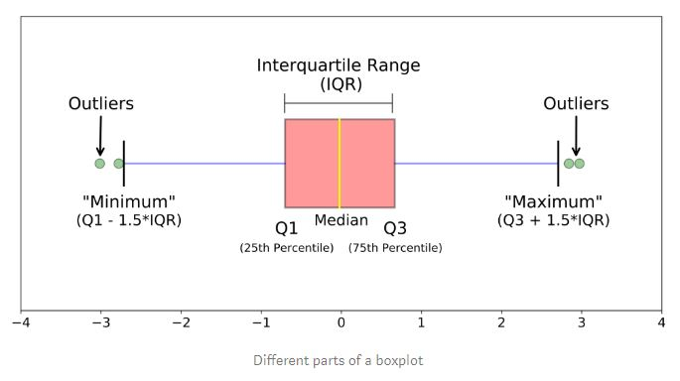
Interquartile range(IQR) - 25th to 75th percentile
whiskers (shown in blue color) and outliers shown in green color

Slide 22
Violin Plots
Violin Plots are a combination of the box plot with the kernel density estimates. So, these plots are easier to analyze and understand the distribution of the data.
Let us use tips dataset called to learn more into violin plots. This dataset contains the information related to the tips given by the customers in a restaurant.

Slide 23
Multi Panel Categorical Plots
Categorical data can we visualized using two plots, you can either use the functions pointplot(), or the higher-level function factorplot().
Factorplot
Factorplot draws a categorical plot on a FacetGrid. Using ‘kind’ parameter we can choose the plot like boxplot, violinplot, barplot and stripplot. FacetGrid uses pointplot by default.

Slide 24
PairGrid
PairGrid allows us to draw a grid of subplots using the same plot type to visualize data.
Unlike FacetGrid, it uses different pair of variable for each subplot. It forms a matrix of sub-plots. It is also sometimes called as “scatterplot matrix”.
The usage of pairgrid is similar to facetgrid. First initialise the grid and then pass the plotting function.

