Slide 1
Docker Training

Slide 2
AGENDA
Docker Introduction
Docker Principles
Docker Operations

Slide 3
What is Docker?
Docker is a tool that allows you to package an application with all of its dependencies into a standardized unit for software development.
It’s open source Linux software but works well on most operating systems such as Windows, Mac OS X, or Linux.
Docker is a command-line program, a background daemon, and a set of remote services that take a logistical approach to solving common software problems and simplifying your experience installing, running, publishing, and removing software.

Slide 4
Why Docker?
Docker uses an Unix technology called Containers
Docker containers wrap up a piece of software in a complete filesystem that contains everything it needs to run: code, runtime, system tools, system libraries – anything you can install on a server. This guarantees that it will always run the same, regardless of the environment it is running in.
How is Docker container different from Virtual machines?

Slide 5
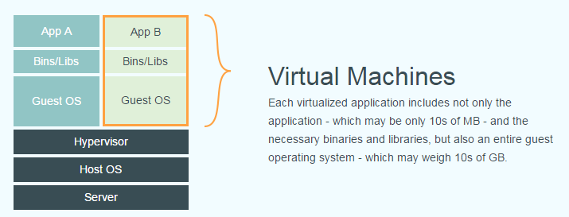
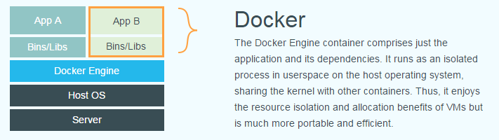
Docker Vs VM?

Slide 6
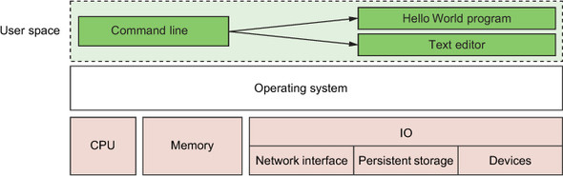
Another Example
A basic computer stack running two programs that were started from the command line

Slide 7
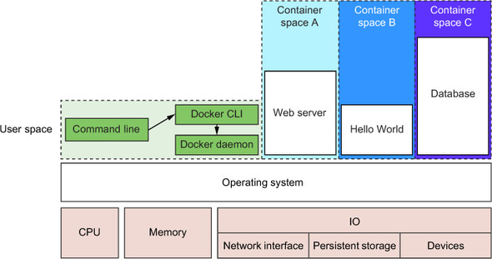
Another Example
Docker running three containers on a basic Linux computer system

Slide 8
Why Docker?
Advantages of Dockers:
Lightweight
Containers running on a single machine all share the same operating system kernel so they start instantly and make more efficient use of RAM. Images are constructed from layered filesystems so they can share common files, making disk usage and image downloads much more efficient.
Open
Docker containers are based on open standards allowing containers to run on all major Linux distributions and Microsoft operating systems with support for every infrastructure.
Secure
Containers isolate applications from each other and the underlying infrastructure while providing an added layer of protection for the application.

Slide 9
Why Docker
Advantages of Dockers continued…
Helps build Better software
When your app is in Docker containers, you don’t have to worry about setting up and maintaining different environments or different tooling for each language. Focus on creating new features, fixing issues and shipping software.
Accelerate Developer Onboarding
Stop wasting hours trying to setup developer environments, spin up new instances and make copies of production code to run locally. With Docker, you can easily take copies of your live environment and run on any new endpoint running Docker.
Empower Developer Creativity
The isolation capabilities of Docker containers free developers from the worries of using “approved” language stacks and tooling. Developers can use the best language and tools for their application service without worrying about causing conflict issues.
Eliminate Environment Inconsistencies
By packaging up the application with its configs and dependencies together and shipping as a container, the application will always work as designed locally, on another machine, in test or production. No more worries about having to install the same configs into a different environment.

Slide 10
Why Docker?
Advantages of Dockers continued…
Easily Share and Collaborate on Applications
Docker creates a common framework for developers and sysadmins to work together on distributed applications
Distribute and share content
Store, distribute and manage your Docker images in your Docker Hub with your team. Image updates, changes and history are automatically shared across your organization.
Simply share your application with others
Ship one or many containers to others or downstream service teams without worrying about different environment dependencies creating issues with your application. Other teams can easily link to or test against your app without having to learn or worry about how it works.
Easily Remediate Issues
Docker make it easy to identify issues and isolate the problem container, quickly roll back to make the necessary changes then push the updated container into production. The isolation between containers make these changes less disruptive than traditional software models.

Slide 11
Docker?
Docker includes three basic concepts
Image (Image)
Container (Container)
Warehouse (Repository)

Slide 12
1. Docker Image
Docker Image also known as Docker mirror is a read only template. It is used to create Docker container.
Three main ways to install Docker images:
Docker Hub and other registries
Using image files with docker save and docker load
Building images with Dockerfiles
Docker Hub: Docker Hub is the default Docker registry.
docker pull command installs the image (does not start the containers within the image) . It is used to download a particular image, or set of images (i.e., a repository)
When you issue a docker pull or docker run command without specifying an alternative registry, Docker will default to looking for the repository on Docker Hub.
docker run command is used to start a new container.

Slide 13
1. Docker Image
Docker Hub: Docker Hub is the default Docker registry.
docker pull command installs the image (does not start the containers within the image) . It is used to download a particular image, or set of images (i.e., a repository)
When you issue a docker pull or docker run command without specifying an alternative registry, Docker will default to looking for the repository on Docker Hub.
Example: $ docker pull debian
Using default tag: latest
latest: Pulling from library/debian
fdd5d7827f33: Pull complete
a3ed95caeb02: Pull complete
Digest: sha256:e7d38b3517548a1c71e41bffe9c8ae6d6d29546ce46bf62159837aad072c90aa
Status: Downloaded newer image for debian:latest
If no tag is provided, Docker Engine uses the :latest tag as a default. This command pulls the debian:latest image:

Slide 14
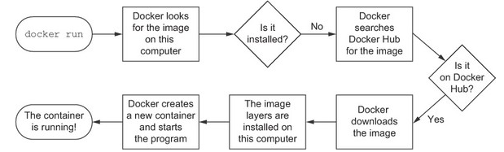

Docker Image
docker run command is used to start a new container.

Slide 15
Docker Image
Docker Save and Docker Load: Docker provides a command to load and save images into Docker from a file.
docker load command -> Used for Loading images
docker save command -> Used to save the image to a file . It creates TAR archive files

Slide 16
Docker Image
docker images shows all images. It lists the images you have locally on our host.
$ docker images
REPOSITORY TAG IMAGE ID CREATED SIZE
ubuntu 14.04 1d073211c498 3 days ago 187.9 MB
busybox latest 2c5ac3f849df 5 days ago 1.113 MB
training/webapp latest 54bb4e8718e8 5 months ago 348.7 MB
docker import creates an image from a tarball.
docker build creates image from Dockerfile. Dockerfile that contains a set of instructions that tell Docker how to build our image. Docker build is used to build an image
docker commit creates image from a container, pausing it temporarily if it is running.

Slide 17
Docker Image
docker rmi removes an image. This command remove images on your Docker host. The docker rmi command allows you to specify a space-separated list of images to be removed.
Usage: docker rmi <image_name>
Note: To remove an image from the host, please make sure that there are no containers actively based on it.
docker load loads an image from a tar archive as STDIN, including images and tags
docker save saves an image to a tar archive stream to STDOUT with all parent layers, tags & versions
docker history shows history of image.
docker tag tags an image to a name (local or registry).
Cleaning up
While you can use the docker rmi command to remove specific images, there's a tool called docker-gc that will clean up images that are no longer used by any containers in a safe manner.

Slide 18
2. Docker Container
Docker uses container (Container) to run the application.
Container is a running instance created from the image. It can be started, stopped, deleted. Each container is isolated from each other to ensure the safety of the platform.
The container can be seen as a simple version of the Linux environment (including root user permissions, process space, user space and cyberspace, etc.) to run the applications.
Commands:
docker create creates a container but does not start it.
docker rename allows the container to be renamed.
docker run creates and starts a container in one operation.
docker rm deletes a container.
docker update updates a container's resource limits.
If you want a transient container, docker run --rm will remove the container after it stops.

Slide 19
2. Docker Container
Usage: docker update [OPTIONS] CONTAINER [CONTAINER...]
Update configuration of one or more containers
--help=false Print usage
--blkio-weight=0 Block IO (relative weight), between 10 and 1000
--cpu-shares=0 CPU shares (relative weight)
--cpu-period=0 Limit the CPU CFS (Completely Fair Scheduler) period
--cpu-quota=0 Limit the CPU CFS (Completely Fair Scheduler) quota
--cpuset-cpus="" CPUs in which to allow execution (0-3, 0,1)
--cpuset-mems="" Memory nodes (MEMs) in which to allow execution (0-3, 0,1) -m,
--memory="" Memory limit
--memory-reservation="" Memory soft limit --memory-swap="" A positive integer equal to memory plus swap. Specify -1 to enable unlimited swap --kernel-memory="" Kernel memory limit: container must be stopped --restart Restart policy to apply when a container exits

Slide 20
2. Docker Container
--memory-swap="" A positive integer equal to memory plus swap. Specify -1 to enable unlimited swap --kernel-memory="" Kernel memory limit: container must be stopped
--restart Restart policy to apply when a container exits
The docker update command dynamically updates container configuration. You can use this command to prevent containers from consuming too many resources from their Docker host. With a single command, you can place limits on a single container or on many. To specify more than one container, provide space-separated list of container names or IDs.
With the exception of the --kernel-memory value, you can specify these options on a running or a stopped container. You can only update--kernel-memory on a stopped container. When you run docker updateon stopped container, the next time you restart it, the container uses those values.
Another configuration you can change with this command is restart policy, new restart policy will take effect instantly after you run docker update on a container.

Slide 21
2. Docker Container
Example1: To update a container with cpu-shares=512
To limit a container’s cpu-shares to 512, first identify the container name or ID. You can use docker ps to find these values. You can also use the ID returned from the docker run command. Then, do the following:
$ docker update --cpu-shares 512 abebf7571666
Example2: Update a container with cpu-shares and memory
To update multiple resource configurations for multiple containers:
$ docker update --cpu-shares 512 -m 300M abebf7571666 hopeful_morse

Slide 22
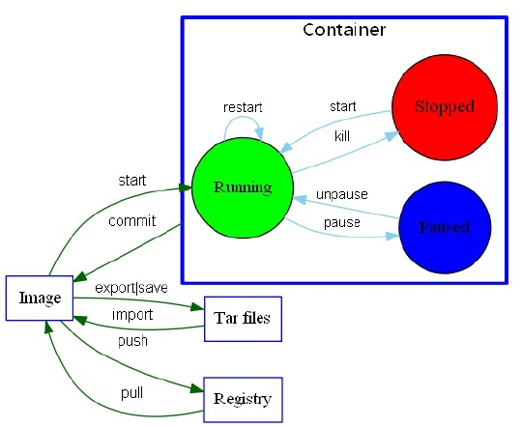
Docker Container
docker start starts a container so it is running.
docker stop stops a running container.
docker restart stops and starts a container.
docker pause pauses a running container, "freezing" it in place.
docker unpause will unpause a running container.
docker wait blocks until running container stops.
docker kill sends a SIGKILL to a running container.
docker attach will connect to a running container.
docker logs gets logs from container.
docker inspect looks at all the info on a container
including (IP address).

Slide 23
Docker Container
docker ps shows only running containers by default
“docker ps –a” shows running and stopped containers.
Running the command will display the following information about each running container:
The container ID
The image used
The command executed in the container
The time since the container was created
The duration that the container has been running
The network ports exposed by the container
The name of the container

Slide 24
Docker Container
docker events gets events from container.
docker port shows public facing port of container.
docker top shows running processes in container.
docker stats shows containers' resource usage statistics.
“docker stats –all” shows a running list of containers.
docker diff shows changed files in the container's FS.
Import / Export
docker cp copies files or folders between a container and the local filesystem..
docker export turns container filesystem into tarball archive stream to STDOUT.
Executing Commands
docker exec to execute a command in container.
To enter a running container, attach a new shell process to a running container called foo, use: docker exec -it foo /bin/bash.

Slide 25
3. Docker Warehouse (Repository)
A repository is a hosted collection of tagged images that together create the file system for a container.
A registry is a host -- a server that stores repositories and provides an HTTP API for managing the uploading and downloading of repositories.
Docker.com hosts its own index to a central registry which contains a large number of repositories.
Warehouse is divided into two forms of
public warehouses (Public) and private warehouse (Private).
Docker Hub is the largest public warehouse . It stores a huge number of images available for users to download.
Users can also create a private warehouse within the local network.
Tutum.co, and Google Container Registry are the few examples
Note: Docker Hub and Quay.io warehouses are distributed between public and private

Slide 26
Docker Warehouse (Repository)
docker login to login to a registry.
docker logout to logout from a registry.
docker search searches registry for image.
docker pull pulls an image from registry to local machine.
docker push pushes an image to the registry from local machine.

Slide 27
References
Safari book: Docker in Action: http://techbus.safaribooksonline.com/search?q=docker%20in%20action
https://yeasy.gitbooks.io/docker_practice/content/introduction/why.html
https://github.com/wsargent/docker-cheat-sheet
https://www.docker.com/enterprise

Slide 28


Thank You

Slide 29


