Slide 1
Strings
Module 4: Data Types

Slide 2
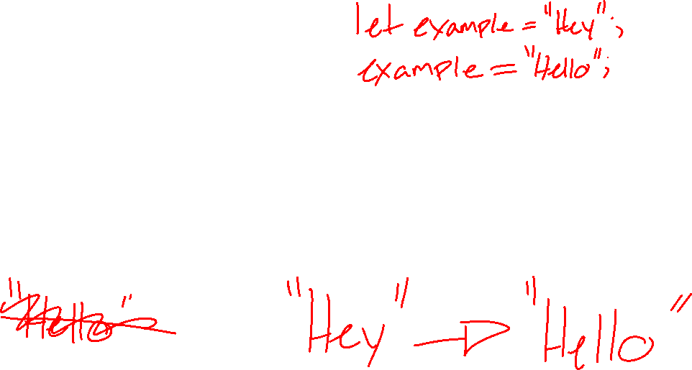
String Recap
Strings are used to store and manipulate text
Strings are immutable
Strings are 0 or more characters inside of quotation marks (“”)
Strings can use ‘single quotes’, “double quotes”, or `backticks`

Slide 3
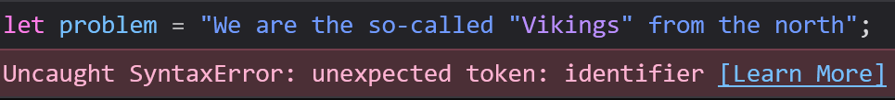

Escape Character
Sometimes we want to use an apostrophe or quotes inside of a string
If we tried to use a set of quotes around a word, but we had already used that as part of the string, it would end the string
We can solve this using the escape character

Slide 4
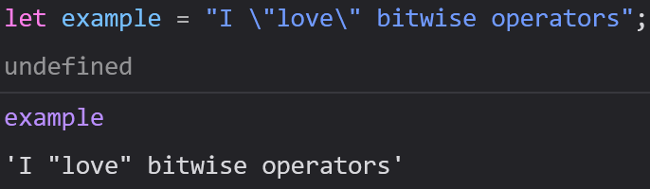

Escape Character
We can use a backslash (\) followed by a single quote, double quote, or another backslash to insert a quotes or backslashes into our strings
There are others designed for typewriters, fax machines, and teletypes, but they are now obsolete (or very niche)

Slide 5
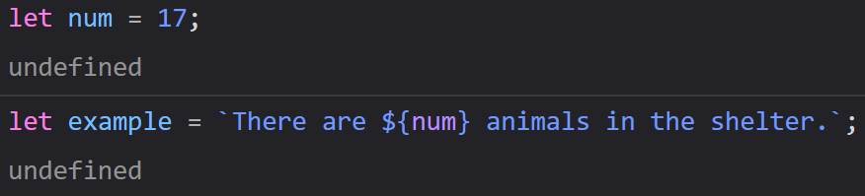
Template Strings
A template string uses `backticks` instead of regular quotes
Template strings allow you to insert a variable into a string without needing to use the + operator
These make formatting strings much easier than they would be with a regular string

Slide 6
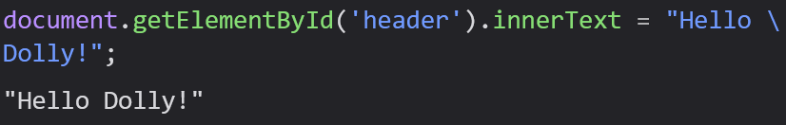
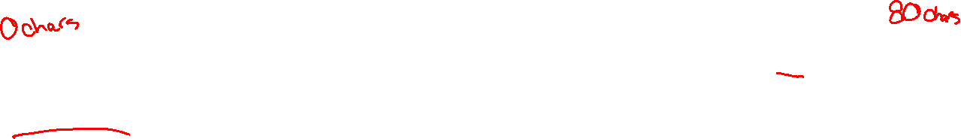
Line Breaks
Remember, we generally want to keep our lines of code to 80 characters
If a line takes more than 80 characters, we bump the rest to the next line
We can break up lines while we are still inside of a string using a single backslash

Slide 7
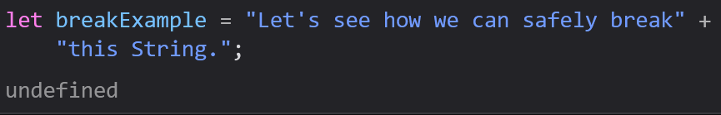
Line Breaks
Some browsers do not support the backslash character, so it’s not always the best way to handle this
We can use string addition to break strings up safely

Slide 8
Strings as Objects
It’s important for you all to know that there is a pre-written String object you can use
Do Not Use It
Objects take more space, slow down code execution, and cannot be compared like regular strings

Slide 9
String Methods

Slide 10
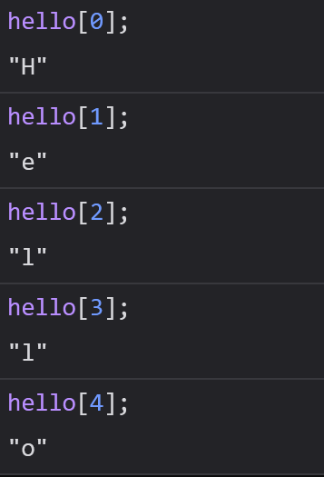
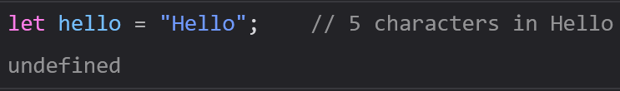
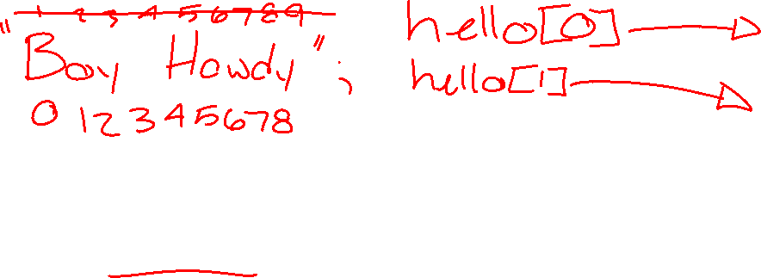
String Indexes
Indexes are the positions of elements in a string
In JavaScript, indexes begin at 0 and end at 1 less than the length of the string

Slide 11
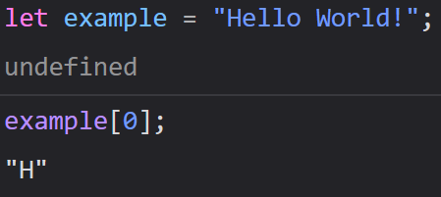
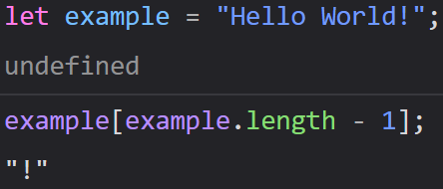
String Indexes
We can always access the first character of a string using index 0
We can always access the last character of a string using the length of the string - 1

Slide 12
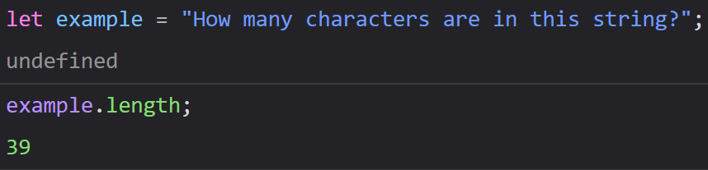
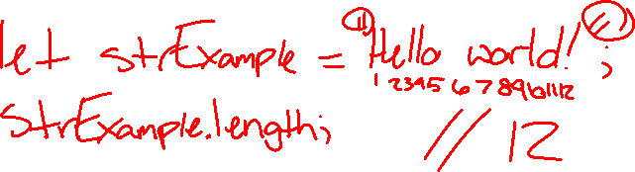
String Properties and Methods
In JavaScript, properties and methods are available to primitives, like Strings
Length
  Property for how many characters are in a string
  One of the most used properties in JavaScript

Slide 13
Extracting String Parts
Especially in Web Development, we will want to pull out specific parts from a string
We have 3 methods that can extract from a string:
  slice(start, end), substring(start, end), and substr(start, length)

Slide 14


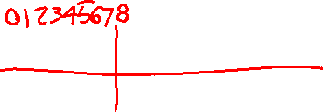
slice(start, end)
Captures part of a string and returns it as a new string
start is the index to start at
(Optional) end is the index to stop before
In JavaScript, indexes count up from 0

Slide 15

slice(start, end)

Slide 16
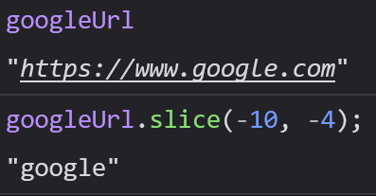
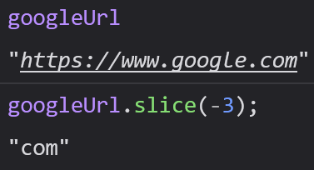
slice(start, end)
We can also make our parameters (start and end) negative
If start or end value is negative, we count from the end of the string
To slice out “com” we would need to count back 3 characters

Slide 17
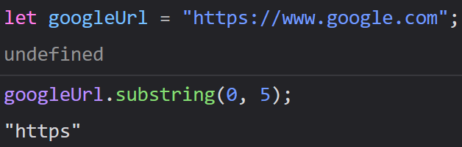
substring(start, end)
Similar to slice(start, end)
However, if start or end is less than 0, we treat it as 0 (We do not use negatives)
Start – index to start at
End (Optional) – index to end at

Slide 18
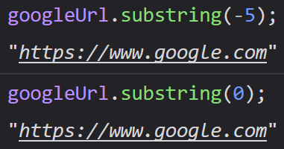
substring(start, end)

Slide 19
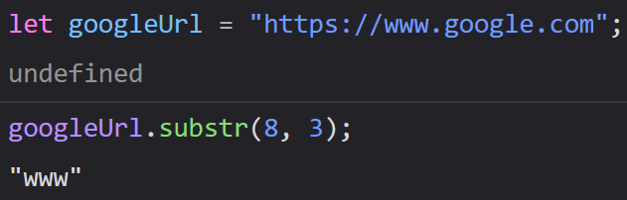
substr(start, length)
Substr(start, length) is also similar to slice(start, end)
start – the first index to use
Length (Optional) – length of the desired substring

Slide 20
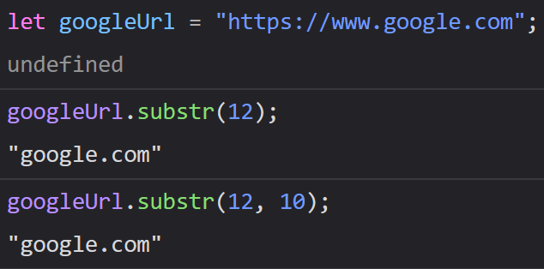
substr(start, length)

Slide 21
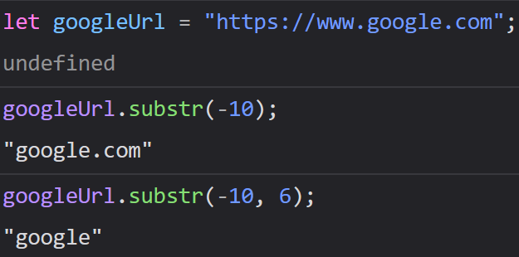
substr(start, length)
We can make the start negative to count from the end, and then use length as normal

Slide 22
String Methods
Any of these three methods can be used when you want to take a substring
Feel free to use which ever you like the best or makes the most sense to you

Slide 23
Replacing String Content
Again, strings are immutable (cannot be changed/altered), so all methods return a new string with your changes
Just like we can take substrings of larger strings, we can also replace substrings with other strings
We can use the replace(searchValue, newValue) method to handle this

Slide 24
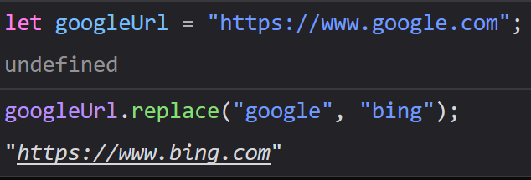

replace(searchValue, newValue)
Replaces the searchValue with a newValue

Slide 25
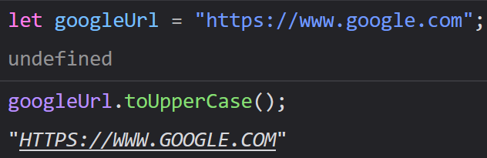
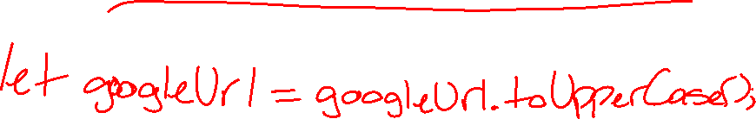
toUpperCase()
We use toUpperCase() to change a string to all caps
No parameters

Slide 26
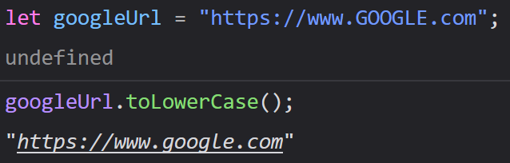
toLowerCase()
We can use the toLowerCase() method to convert a string to all lowercase
No parameters

Slide 27
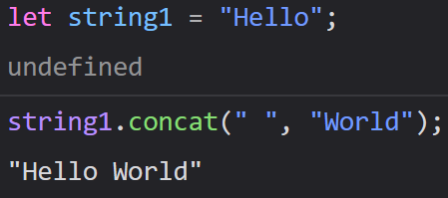
concat(stringToAdd1, stringToAdd2, …)
Sometimes you want to add strings together
With concat(), we can add as many strings as we want all at once
We can use concat() instead of the + operator

Slide 28
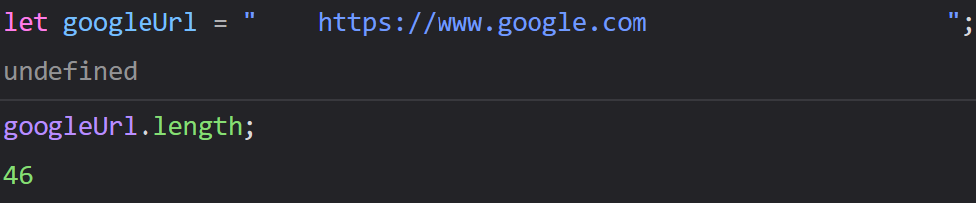

trim()
It’s common to receive inputs that do not match the format you need
Each whitespace counts as a character, so it will throw off your string operations
We can get rid of excess whitespace using trim()

Slide 29
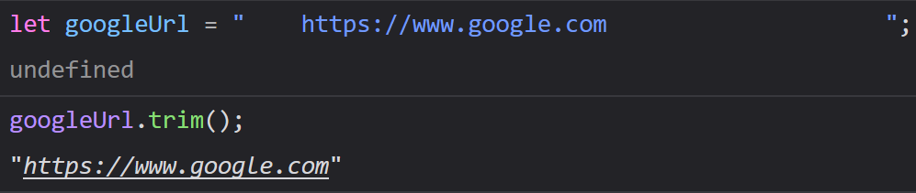
trim()

Slide 30
Padding
Sometimes we want to add characters to either side of string
padStart() and padEnd() allow us to do this

Slide 31
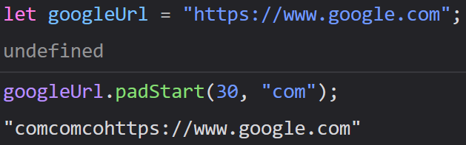
padStart(length, character)
padStart() adds characters to the beginning of your string
It will add that character until it reaches a certain length

Slide 32
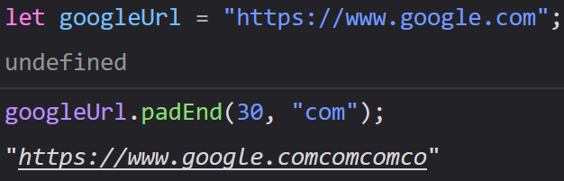

padEnd(length, character)
Works similar to padStart(), but adds to the end of the string instead of the beginning

Slide 33
Accessing String Characters
We have three ways we can access string characters
charAt(index)
charCodeAt(index)
string[index]

Slide 34
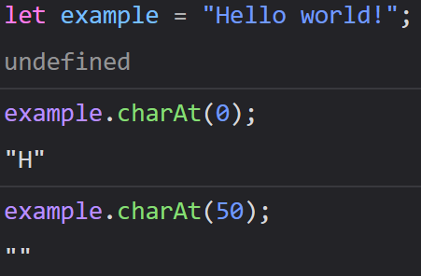

charAt(index)
Returns the character at the given index of a string
Returns an empty string if you access an index that does not exist

Slide 35
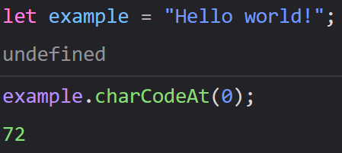

charCodeAt(index)
Sometimes you might have to work with strings/characters in languages other than English
Unicode is a set of characters that encompasses all characters in every language
charCodeAt() ensures that you will be able to work with any character of every language
Returns a Unicode of the character at a specified index of a string
Notes:
The charCode can be converted to a character using String.fromCharCode(charCode)

Slide 36
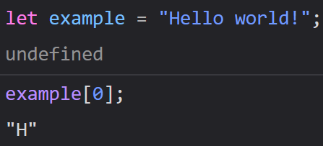
Property Access
We can access the indexes of an array using brackets []
This is the same way you access the values of an array, however this does not mean the string you are accessing is an array

Slide 37
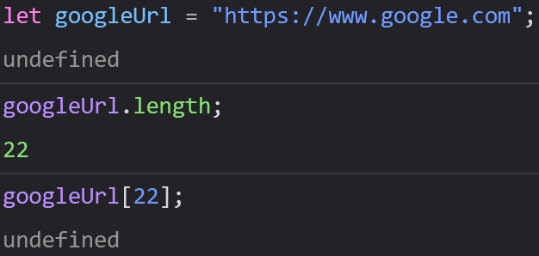
Property Access
This method can be misleading
It makes strings appear like they are arrays
It returns undefined if there is no character at the index specified

Slide 38
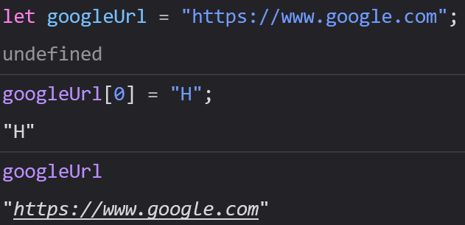
Property Access
You can read indexes this way, but not assign them (remember, strings are immutable)
You will not get an error if you try to assign something to an index this way, but it will not work

Slide 39
Convert String to Array
Arrays are essentially a list of numbers that represent a block of memory
We can store whatever we want in an array
Sometimes it is easier to operate on an array than on a string

Slide 40
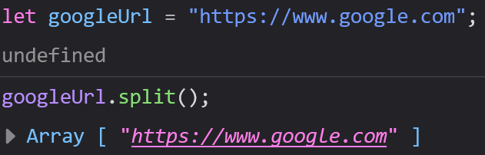
split()
Split allows you to convert a string to an array based on an optional delimiter
A delimiter is used to separate items in a list, like commas in an object, or commas in an array

Slide 41
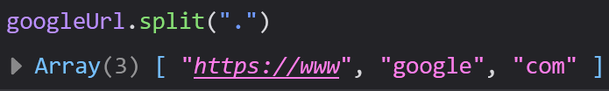

split()
When the parameter is an empty string, it splits the string into an array with each letter of the string as its own index

Slide 42
For Today
Module 4 Day 1 Exercises
Atometric
Portfolio
Calculator
To Do List

