Slide 1
Arrays
Module 4 – Data Types

Slide 2
Arrays
Used to store a list of values in a variable
Can hold any number of values

Slide 3
Creating an Array
Created using bracket [] notation
let ourFirstArray = [ firstValue, secondValue, thirdValue];
Can be created on a single line, or on multiple like we do with objects

Slide 4
Accessing Array Elements
You can find the value at any position by using an index, which work the same way they do with Strings
Again, Indexes in JS always begin with 0, so we count the positions of an Array from 0.

Slide 5
Accessing Array Elements
To get the first element of the array we created earlier, we would use myFirstArray[0]; // firstValue
To get the last element of the array, we use myFirstArray[myFirstArray.length - 1]
We can access the entire array by using its variable

Slide 6
Changing Array Elements
Unlike Strings, Arrays are mutable, meaning you can change their values at will
We can assign a value to arrays using their indexes as well
Ex: myFirstArray[0] = “I am assigning this array a value”;

Slide 7
Arrays as Objects
Arrays are Objects in JavaScript, but they do not function the same way Objects do
Arrays use Numbers to access elements instead of using Names to access its “Members”
Arrays can hold any kind of data, including Objects, Functions, and other Arrays

Slide 8
Array Properties and Methods
Length
Used to find the number of elements in an array
Always the highest index + 1
Push(element)
Adds an element to the end of the array
toString()
Returns a String with each element separated by a comma

Slide 9
Manipulating Arrays
join()
Also returns all elements in a String, but you can choose any separator you’d like instead of just using a comma
pop()
Removes and returns the last element of an array
push(element)
Adds a new element to the end of the array and returns the new length

Slide 10
Manipulating Arrays
shift()
Sometimes you need to remove something from an array, but you would prefer to remove it from the front of the array instead of the back (like with push()). All other elements are moved one position lower (toward front)
This will return the method that was removed from the front of the array
unshift(element)
Adds an element to the front of the array and moves existing elements toward the back by one position
Returns the new length of the array

Slide 11
Assigning Elements
We can always access an array’s elements using it’s index inside brackets
Again, indexes start from 0 and the last element is always 1 less than the length of the array
Ex: let students = [“Isaiah ”, “Carmen”, “Reality”, “Carolina”, “Mohammad”]; students[0] = “Graham”; // Now updated with my name

Slide 12
Assigning Elements
You can also use the length property to assign a new element
Ex: array[array.length] = “Another element”
This works the best for shorter arrays, but be careful about leaving “holes” in your array

Slide 13
Deleting Elements
It is possible to remove elements using the delete keyword like such:
delete student[0]; // “Graham” -> Undefined
Try to use pop() or shift() instead, since Undefined values can mess with our operations by creating “holes” in the array

Slide 14
splice(startIndex, deleteCount, item1, item2, …)
Used for adding AND/OR removing elements from an array
Returns an array of the removed elements, or an empty array if none were removed
It is possible to add and remove elements at the same time

Slide 15
splice(startIndex, deleteCount, item1, item2, …)
startIndex: index to start changing the array at
deleteCount: number of elements to remove (0 if you want to add)
items 1 – n (optional): items to add

Slide 16
Merging Arrays
concat(array1, array2, …)
Concatenates array1 on to array2
Returns a new array
Allows any number of arrays to be concatenated

Slide 17
slice(startIndex, endIndex)
“Slices” a portion of an array beginning with the index you give it
endIndex is optional, but will allow a slice of all elements up to (not including) endIndex
Returns a new array with all elements starting from your index

Slide 18
toString()
Arrays, like all objects in JavaScript, have a built-in toString method
However, when a primitive type (Number, String, etc.) is expected, passing in an array with automatically call toString()

Slide 19
Sorting Arrays
We can store all kinds of values in an array, but unorganized data is much more difficult to work with
Many problems will become much easier if we can sort an array
For these situations, we have sort() and reverse().
sort(): 1 – n or a –z
Reverse(): n -1 or z - a

Slide 20
Sorting
While sort() can sort Numbers, it is not as accurate as with Strings
To keep our sorting as accurate and flexible as possible, we need to provide sort() with a Compare function.
This will make sure that we can compare multiple types of data accurately

Slide 21
Sorting
Compare functions will be defined inside of sort() as an argument, so it does not need a name
This will seem strange for now, but we’ll cover an entire class of functions similar to this one in Module 7
It will usually look like function(a, b) { return a – b;}
If the result is negative, a goes first. It its positive, b goes first.

Slide 22
Finding Smallest and Largest Values
JavaScript arrays do not have methods for finding the max or min value, but it becomes very easy if you sort
After a sort, the lowest value is always the first index, and the highest is the last
However, this is an inefficient way to do this if you only want the max or min

Slide 23
Finding Smallest and Largest Values
We can use the Math.max.apply(null, arr) method as a better way to find the highest number
We also have Math.min.apply(null, arr) method to find the lowest number
The fastest way would be to sort in a loop, but we’ll talk more about that in Module 6

Slide 24
Sorting Object Arrays
Many times we do not have primitive types in our arrays and need to sort based on property values
Our compare function will work here as well!
function(a, b) { return a.property – b.property; }

Slide 25
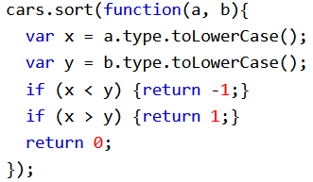
Sorting Object Arrays
Many times our property values are strings, so we’ll have to format them so they will sort properly

Slide 26
Iteration
Many times when we manipulate arrays, we want to do something to every element
We’ll learn all about this in Module 6, but for now we just need to know about array’s forEach() method

Slide 27
Array methods
Many of our Array methods will ask for a callback function – a function passed to another function as a parameter
Array methods will apply a function to all elements of an array.

Slide 28
Array methods
Array methods usually take three parameters:
element : The element of the array we want to operate on
index: The index we are currently on
array: The array we are referencing
Depending on the needs of our program, we may not need all three

Slide 29
Anonymous functions
Generally, we will not use the callback functions we write for anything other than the array method we write them for
Because we only need them once, we do not need to name them if they are written inside the array method
This kind of function is called an Anonymous function since it does not have a name

Slide 30
Foreach()
Receives a callback function – a function used as an argument for another function
The callback function will operate on each index of the array
The forEach() method will apply the callback function you wrote to each element of the array

Slide 31
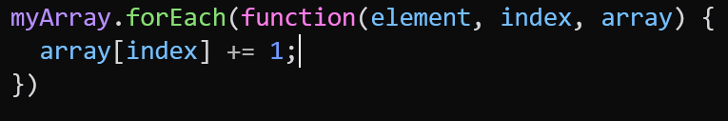
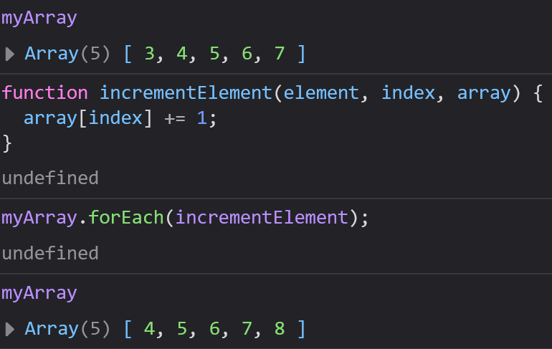
Foreach()
Here is an example of the forEach method
There are 2 ways to write the callback function:
Write a normal function and pass it (no parentheses)
Write an anonymous function – a function with no name
forEach() modifies the original array

Slide 32
Map()
Performs a function on each element of an array just like forEach()
Does not modify the original array, returns a new array with the modification to your original
Will not affect elements without values

Slide 33
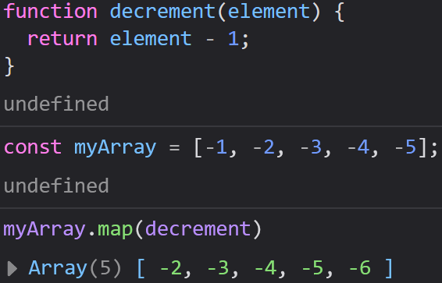
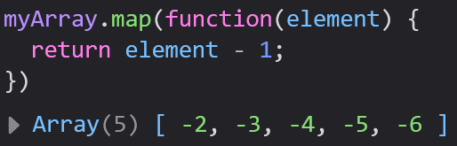
Map()
We have two examples that perform an identical operation, but one regular function and one with an anonymous function
Notice, since map is only intended to return a new array, we do need an array or index argument

Slide 34
Filter()
filter() creates a new array that contains only elements that pass a test that we write in a callback function
It will “filter” out every element that does not pass this test
This method relies on our comparison operators to run this test

Slide 35
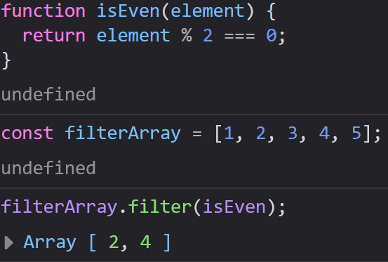
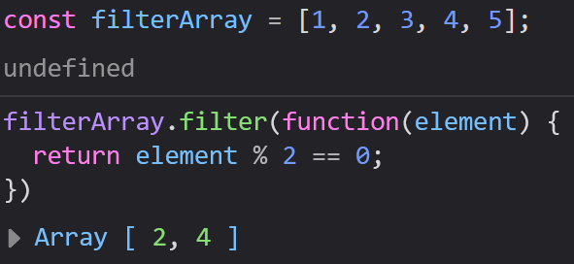
Filter()
In these functions, we check if element is even by doing Modulus division
We’re giving a test to each element, which is a preview of what conditionals are.

Slide 36
Reduce()
Runs our callback function on each element to reduce them to (and return) a single value
Reduce() will not alter our original array
This is very useful when we want to know something about an array like finding its lowest value, its highest value, or its sum.

Slide 37
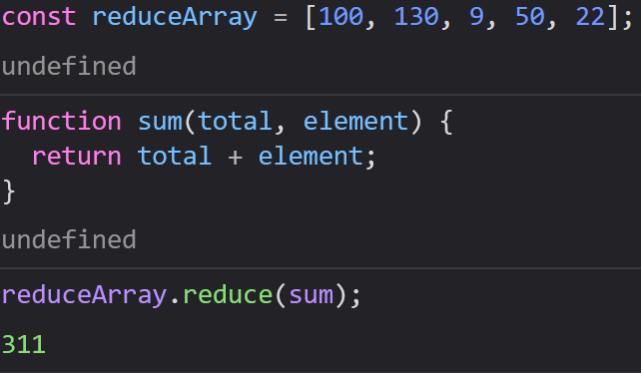
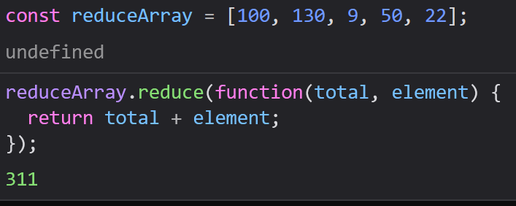
Reduce()
Here we see both methods of finding the sum of an array using reduce
reduce() may take up to 4 parameters:
total
element
index
Array
This particular function only needed two

Slide 38
Reduceright()
reduceRight() is the same as reduce(), however it reads the array from right to left, rather than left to right

Slide 39
Every()
Checks if a test is true or false for every single element in an array
Returns a Boolean, rather than an array

Slide 40
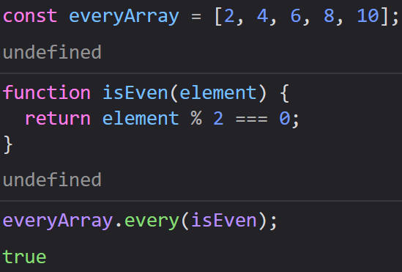
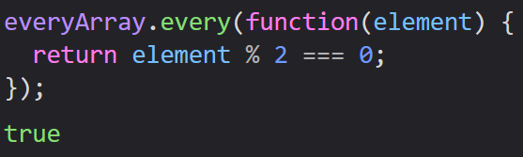
Every()
These examples check if every element in an array is even

Slide 41
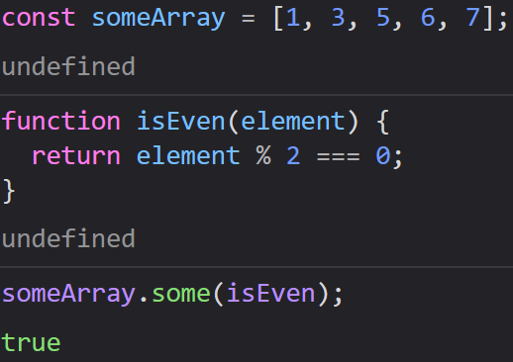
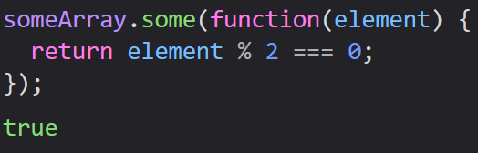
Some()
Similar to every(), but checks that at least one element passed the test
Returns a boolean

Slide 42
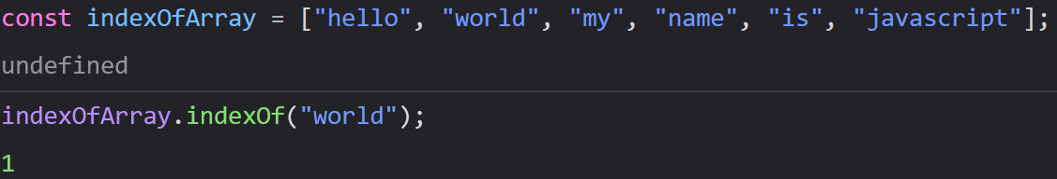
Indexof()
Searches an array for a value and returns its position
Optional second parameter: index to start looking at
Returns -1 if the value does not exist in the array
Only returns first occurrence of the value

Slide 43

Lastindexof()
Works the same way indexOf() works, but always returns the last occurrence of the search value
Supports an optional second parameter of the index to beginning searching from

Slide 44
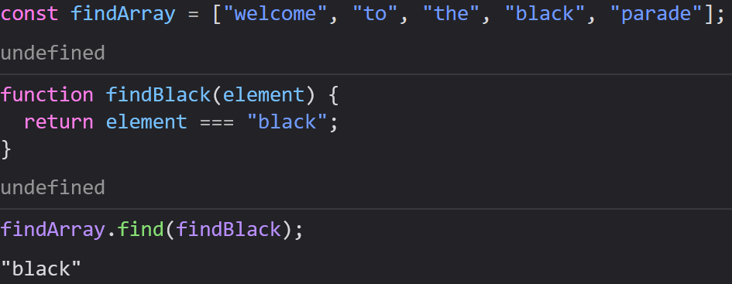
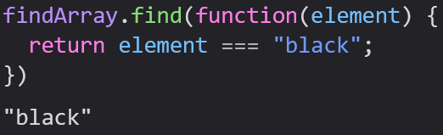
Find()
Returns the value of the first index that passes a test that you write in a callback function parameter

