Slide 1
Arrays
Module 4 – Data Types

Slide 2
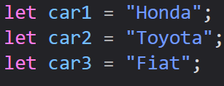
What is an Array?
Arrays are special variables that can hold more than one value at a time
If you have a list of items (like car names), we would normally have to store each value in its own variable
The more variables we needed to save, the more difficult it would be to keep track of

Slide 3
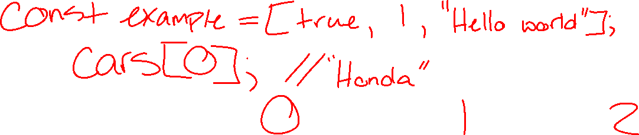
What is an Array?
Using an array we can keep all of our values under a single name
The values we store in an array are called elements
We can access these values using its index number

Slide 4
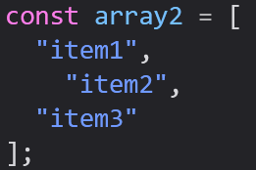

Creating an Array
We create arrays using an array literal (brackets)
Can be created on a single line, or on multiple like we do with objects

Slide 5

Accessing Array Elements
You can access an array element by referring to the index number
Indexes in JS always begin with 0, so we count the positions of an Array starting from 0.
The first element of an array is always at index 0

Slide 6
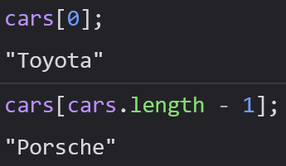
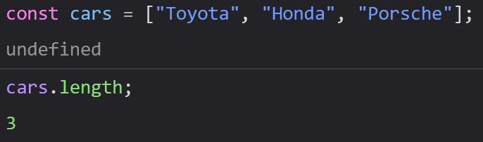

Accessing Array Elements
We can access the entire array by using its variable
An array’s last element always has a value of one less than its length
We can find an array’s length using the length property

Slide 7
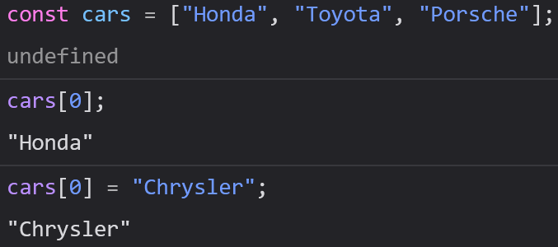

Changing Array Elements
Unlike Strings, Arrays are mutable, meaning you can change their values at will
We can assign a value to arrays using their indexes as well

Slide 8
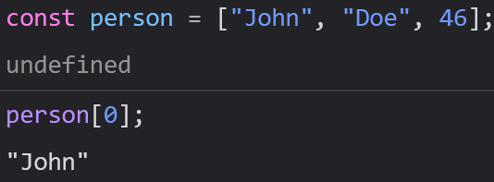
Arrays are Objects
Arrays are a special kind of object, like we saw when the typeof operator returned “object” when used on an array
However, arrays do not function like regular objects
Arrays use numbers to access their “elements”

Slide 9
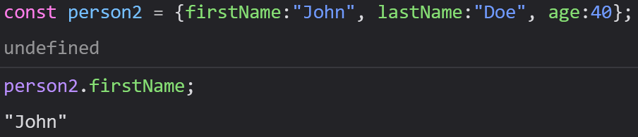
Arrays are Objects
Objects use names to access their values (sometimes called “members”)

Slide 10
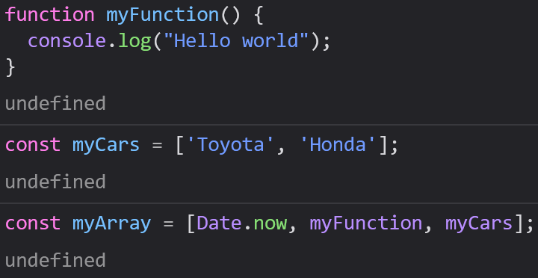
Array Elements Can Be Objects
We can have different types of variables in the same array
Arrays can hold objects, functions, and even other arrays!

Slide 11
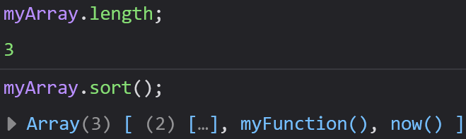
JavaScript Arrays
JavaScript’s arrays are much more powerful than other language’s arrays, like Java or C
JavaScript arrays have built in properties and methods to handle common operations we need to perform on arrays

Slide 12
How to Recognize an Array
When you are working with a variable, you may not know what data it contains
It can be difficult to figure out sometimes, since the typeof operator returns “object” when used on an array

Slide 13
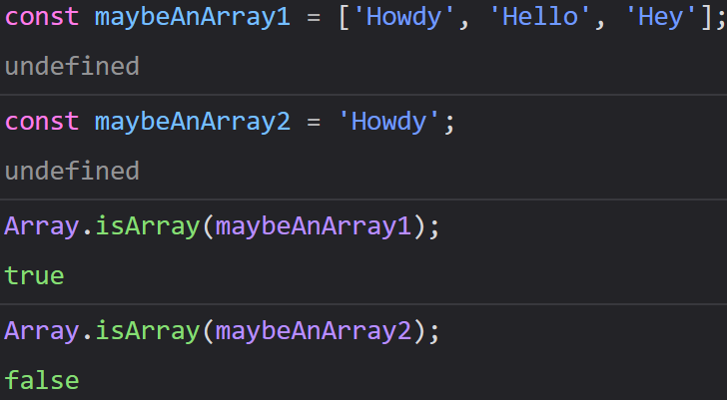
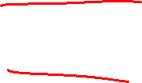
How to Recognize an Array
One way to figure out if a variable is an array is to call Array.isArray(yourArrayHere)

Slide 14

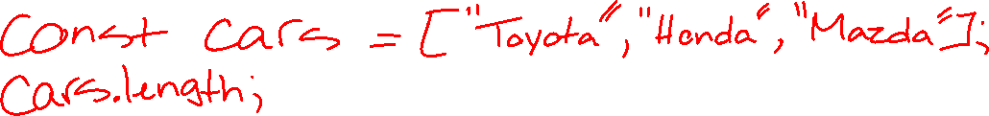
Array Properties - length
The length property returns the number of elements in an array

Slide 15
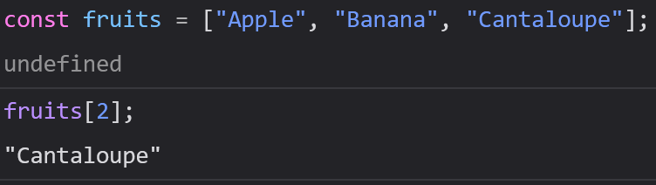
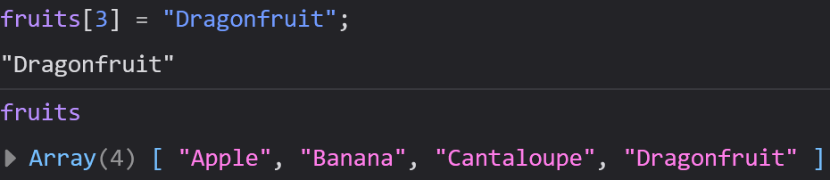
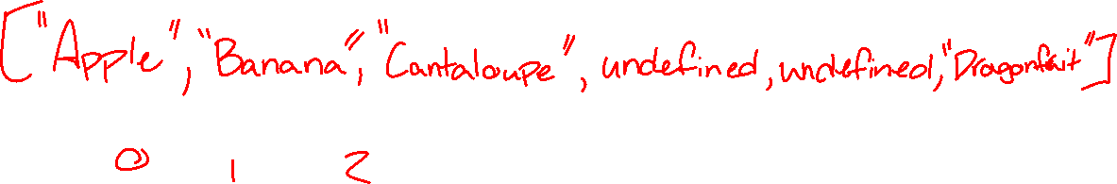
Array Properties – length
We can also add elements to the end of an array using the length property
However, it is much safer to add elements using push(element), so that is the preferred way to do so

Slide 16
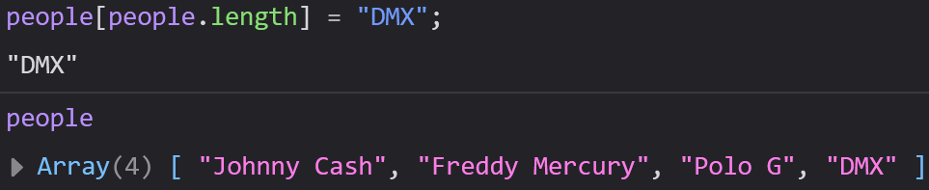
Assigning Elements
You can also use the length property to assign a new element
This works the best for shorter arrays, but be careful about leaving “holes” in your array

Slide 17
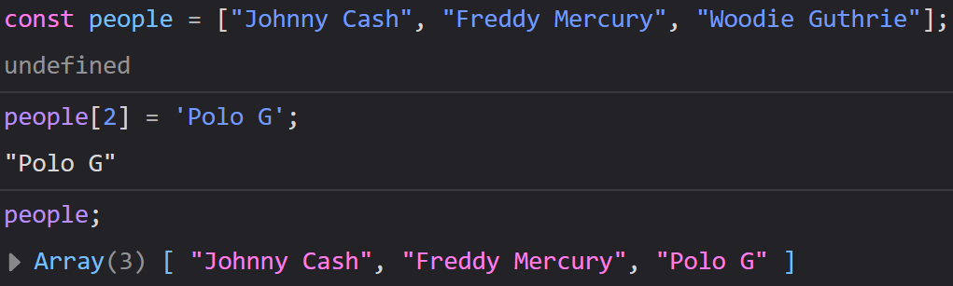
Assigning Elements
We can reassign a value to an existing index
Again, indexes start from 0 and the last element is always 1 less than the length of the array

Slide 18
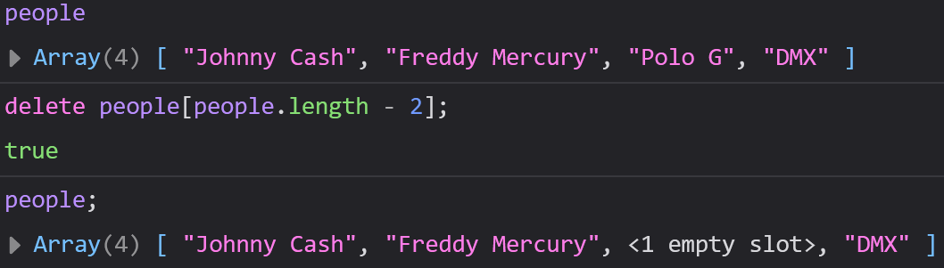

Deleting Elements
It is possible to remove elements using the delete keyword like such:
delete student[0]; // “Graham” -> Undefined
Try to use pop() or shift() instead, since Undefined values can mess with our operations by creating “holes” in the array

Slide 19
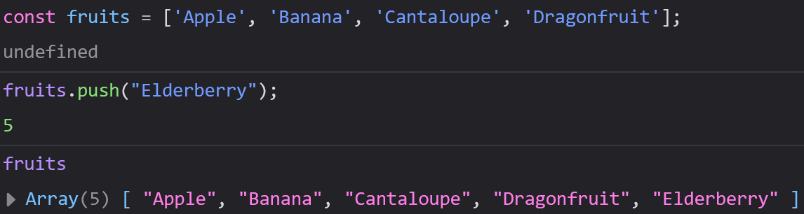


Array Methods – push(element)
The easiest way to add an element to the end of an array is using the push(element) method

Slide 20
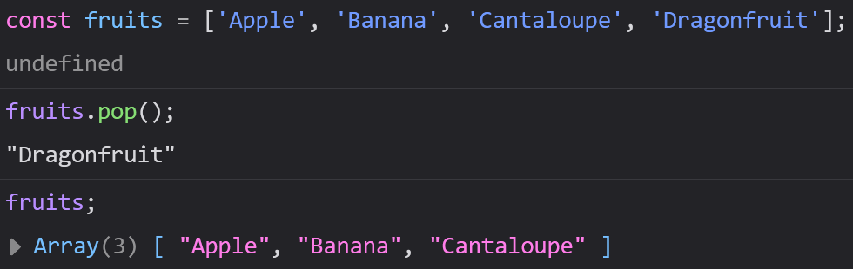

Array Methods – pop()
pop() removes and returns the last element of the the array

Slide 21
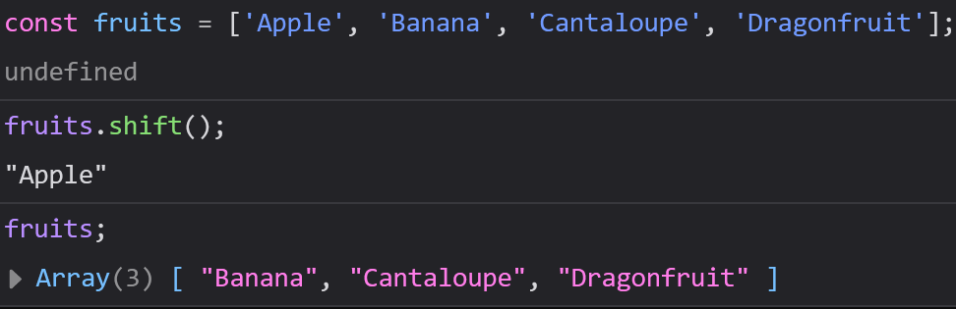
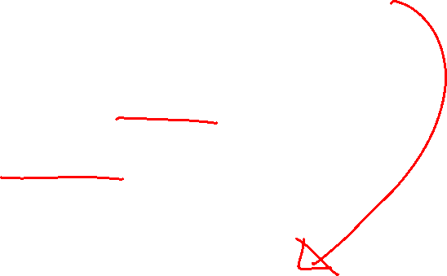
Array Methods – shift()
shift() removes and returns the first element of the array, then shifts the other elements to the left

Slide 22
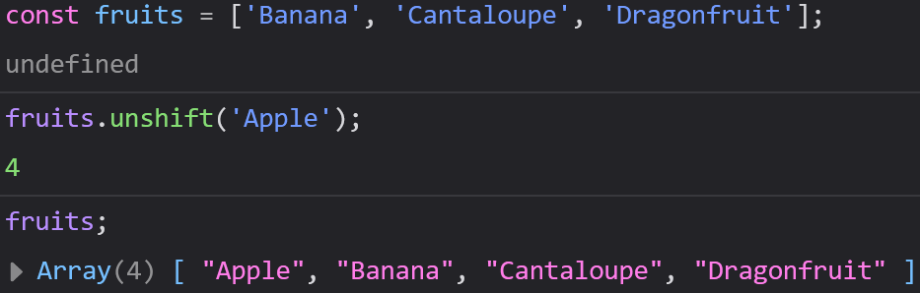

Array Methods – unshift()
unshift() adds an element to the beginning of the array and shifts all the other elements to the right

Slide 23
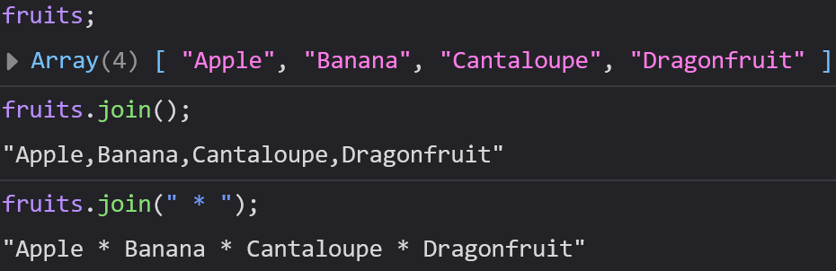

Array Methods – join()
join() returns the entire array in the form of a string
join() takes an optional parameter that allows you to separate each element of the array with a substring of your choice in the new string

Slide 24
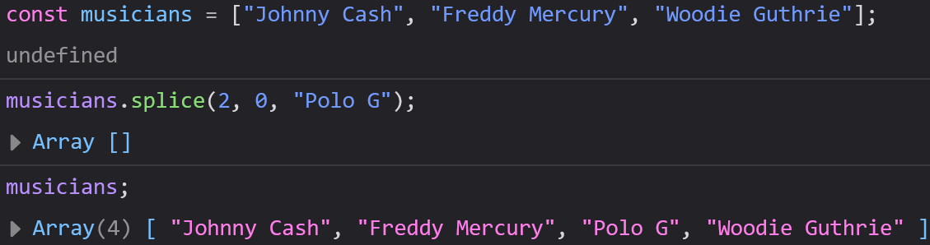
splice(startIndex, deleteCount, item1, item2, …)
Used for adding AND/OR removing elements from an array
Returns an array of the removed elements, or an empty array if none were removed
It is possible to add and remove elements at the same time

Slide 25
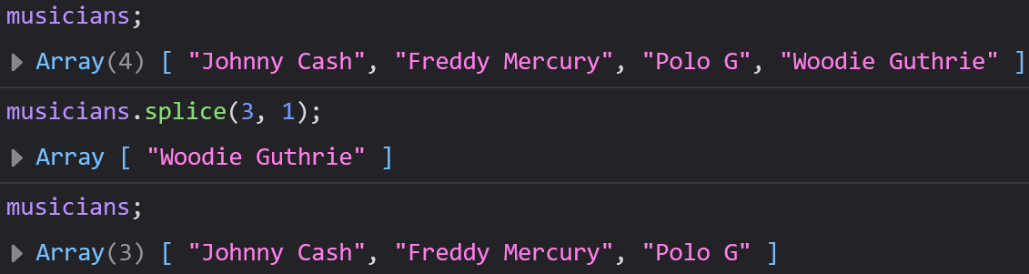

splice(startIndex, deleteCount, item1, item2, …)
startIndex: index to start changing the array at
deleteCount: number of elements to remove (0 if you want to add)
items 1 – n (optional): items to add

Slide 26
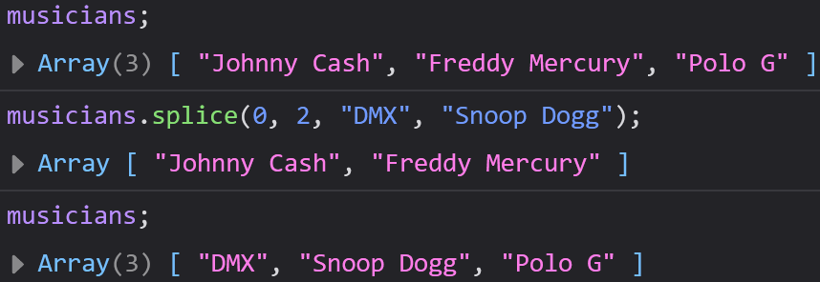

splice(startIndex, deleteCount, item1, item2, …)

Slide 27
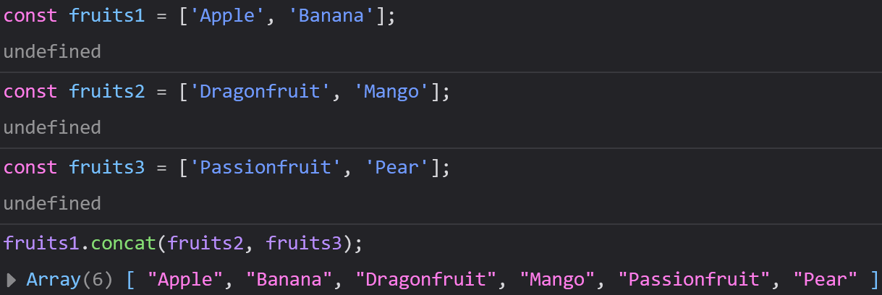
concat(array1, array2, …)
Concatenates array1 on to array2
Returns a new array

Slide 28

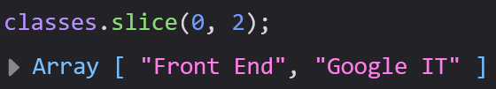
slice(startIndex, endIndex)
Returns a “slice” (subarray) of an array between the start and end indexes
Does not alter the original array
The endIndex is optional

Slide 29
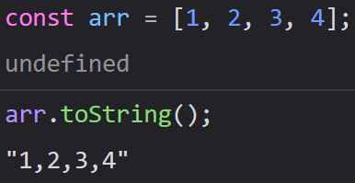
toString()
Arrays, like all objects in JavaScript, have a built-in toString method

Slide 30
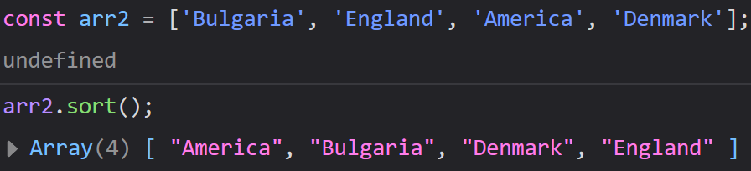
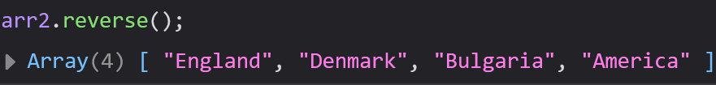
Sorting Arrays
We can store all kinds of values in an array, but unorganized data is much more difficult to work with
Many problems will become much easier if we can sort an array
For these situations, we have sort() and reverse().
sort(): 1 – n or a –z
Reverse(): n -1 or z - a

Slide 31
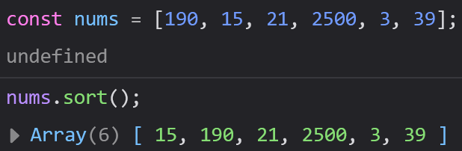
Sorting Numbers
While sort() can sort Numbers, it is not as accurate as with Strings
By default, sort() converts Numbers to Strings, and it will compare the first Number of each string.
This will sort incorrectly in situations like with “50” and “250”, since it will read the 5 in 50 and the 2 in 250 first and 5 > 2.

Slide 32
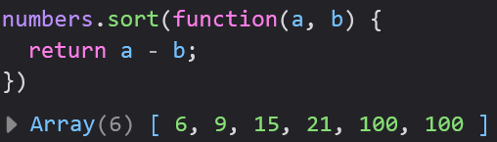
Sorting Numbers
We will need to sort Numbers frequently, so to solve this issue, we have to write a compare function to give to the sort() method
Don’t worry too much about how the function works for right now: only that a – b will sort ascending, and b – a will sort descending.
Notice - this function does not have a name.

Slide 33
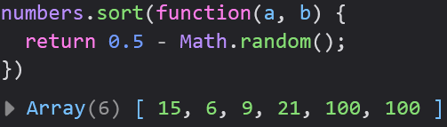
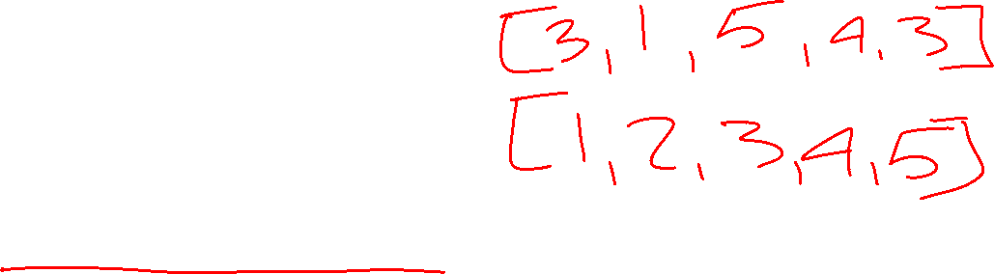
Random Sort
Sometimes you might want to “reset” an array back to a random order
We can use a special compare function to achieve this
Fairly niche

Slide 34
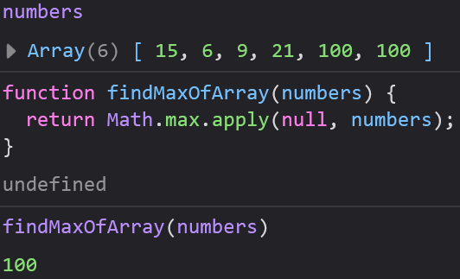
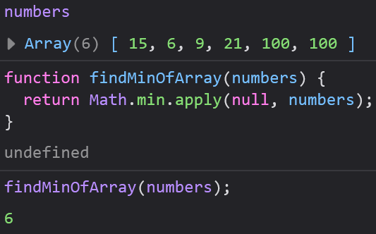

Finding the Min and Max of an Array
Max:
Math.max.apply()
Min:
Math.min.apply()

Slide 35
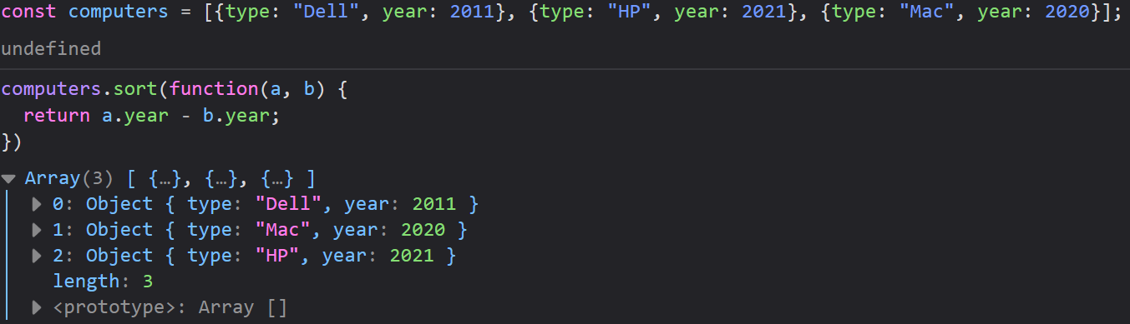
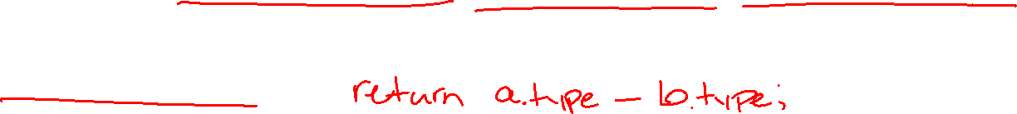
Sorting Object Arrays
Many times you arrays will be full of objects
We can use our compare function with our object’s properties/values

Slide 36
Array Iteration
A lot of times when we work with arrays we want to do something to each element of the array
Iteration methods all take a callback function: a function used as a parameter of another function
We need to write a callback function to manipulate an element, then the iteration method will apply our callback function to every element in the array

Slide 37
Anonymous Functions
Many of our callback functions will only be used a single time inside of an iteration method (similar to compare functions)
Functions like these can be defined inside of the parentheses of another function and do not need to be named
We call these functions anonymous functions since they only get used once and are never named

Slide 38

forEach()
Applies a callback function to each element of your array
Three possible parameters:
element – the element to operate on
index – the element’s index
array – the array you want to operate on
You will not always need all three parameters, often one is plenty

Slide 39
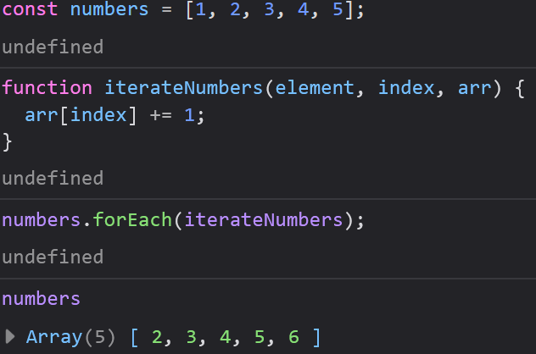
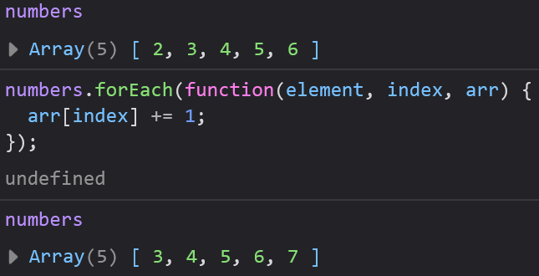

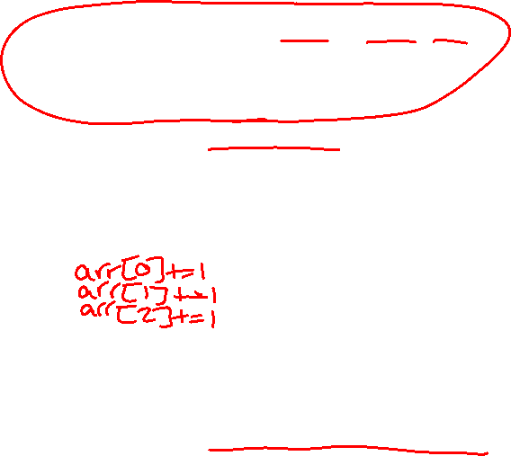
forEach()
We can either use anonymous functions as our callback functions, or ignore them entirely and define our functions like normal
These two examples function identically

Slide 40
map()
Creates a new array by performing an operation on each element in an array
Does not modify the original array
Does not execute on elements without values

Slide 41
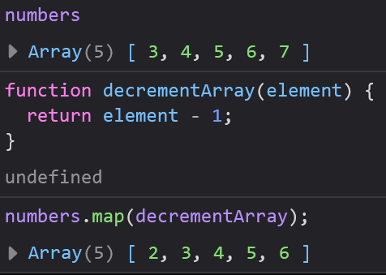
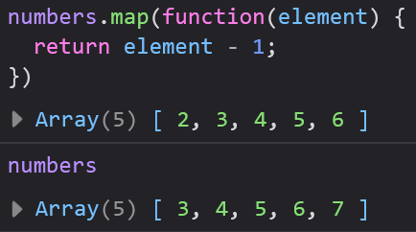

map()
These examples use the same array as before, but this time they reduce each element by one
When we write our callback functions, many times we only need to operate on a single element
The map() method will then apply our function to each element

Slide 42
filter()
Creates a new array of all the elements in an array that pass a test
Does not modify the original array
This is a great preview into conditionals

Slide 43
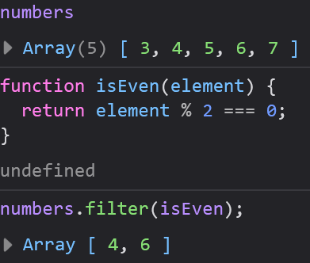
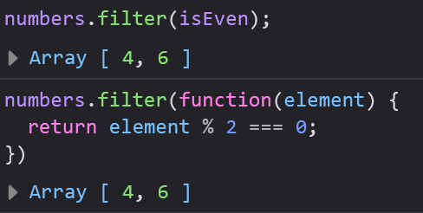
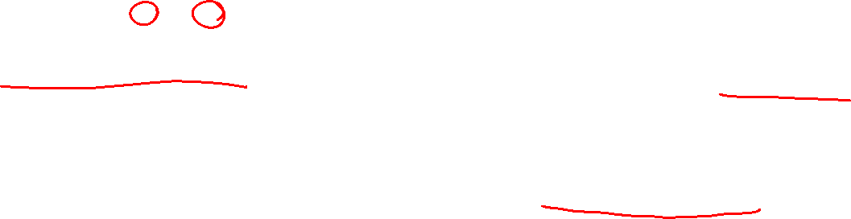
filter()
These examples check if each element in an array is even
The test can be anything you can imagine
Returns a new array

Slide 44
reduce()
Runs a function on each element and returns a single value
Works left to right (reduceRight() is the opposite)
Has an extra parameter for a total

Slide 45
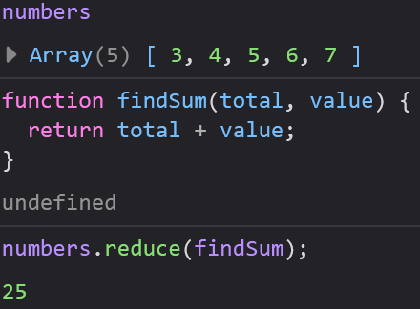


reduce()
Always returns a single value rather than another array
Comes up often when we want to find an array’s Sum, Max, Min, etc.
May accept an initial value for the value parameter

Slide 46


every()
Checks if all elements in an array pass a test
Returns a boolean

Slide 47


some()
Similar to every()
Checks if at least one element in an array passed a test
Returns a boolean

Slide 48


indexOf()
Does not require a callback function
item: parameter of element to search for
start: parameter of index to search from (optional)
Returns the element, or -1 if not found

Slide 49


lastIndexOf()
Works just like indexOf(), but returns the last occurrence of the searchItem instead of the first
Also supports optional startIndex parameter
Returns the element if found, -1 if not found

Slide 50


find()
Returns the first element that passes a test
Not supported in older browsers

Slide 51


findIndex()
Returns the index of the first element that passes a test
Not supported by older browsers

Slide 52
For Today:
Module 4 Exercises Part 3
Previous Exercises
Atometric
Portfolio
Calculator
To Do List

