Slide 1
Arrays
Module 4 – Data Types

Slide 2
Arrays
Used to store a list of values in a variable
Can hold any number of values

Slide 3
Creating an Array
Created using bracket [] notation
let ourFirstArray = [ firstValue, secondValue, thirdValue];
Can be created on a single line, or on multiple like we do with objects

Slide 4
Accessing Array Elements
You can find the value at any position by using an index, which work the same way they do with Strings
Again, Indexes in JS always begin with 0, so we count the positions of an Array from 0.

Slide 5
Accessing Array Elements
To get the first element of the array we created earlier, we would use myFirstArray[0]; // firstValue
To get the last element of the array, we use myFirstArray[myFirstArray.length - 1]
We can access the entire array by using its variable

Slide 6
Changing Array Elements
Unlike Strings, Arrays are mutable, meaning you can change their values at will
We can assign a value to arrays using their indexes as well
Ex: myFirstArray[0] = “I am assigning this array a value”;

Slide 7
Arrays as Objects
Arrays are Objects in JavaScript, but they do not function the same way Objects do
Arrays use Numbers to access elements instead of using Names to access its “Members”
Arrays can hold any kind of data, including Objects, Functions, and other Arrays

Slide 8
Array Properties and Methods
Length
Used to find the number of elements in an array
Always the highest index + 1
Push(element)
Adds an element to the end of the array
toString()
Returns a String with each element separated by a comma

Slide 9
Manipulating Arrays
join()
Also returns all elements in a String, but you can choose any separator you’d like instead of just using a comma
pop()
Removes and returns the last element of an array
push(element)
Adds a new element to the end of the array and returns the new length

Slide 10
Manipulating Arrays
shift()
Sometimes you need to remove something from an array, but you would prefer to remove it from the front of the array instead of the back (like with push()). All other elements are moved one position lower (toward front)
This will return the method that was removed from the front of the array
unshift(element)
Adds an element to the front of the array and moves existing elements toward the back by one position
Returns the new length of the array

Slide 11
Assigning Elements
We can always access an array’s elements using it’s index inside brackets
Again, indexes start from 0 and the last element is always 1 less than the length of the array
Ex: let students = [“Isaiah ”, “Carmen”, “Reality”, “Carolina”, “Mohammad”]; students[0] = “Graham”; // Now updated with my name

Slide 12
Assigning Elements
You can also use the length property to assign a new element
Ex: array[array.length] = “Another element”
This works the best for shorter arrays, but be careful about leaving “holes” in your array

Slide 13
Deleting Elements
It is possible to remove elements using the delete keyword like such:
delete student[0]; // “Graham” -> Undefined
Try to use pop() or shift() instead, since Undefined values can mess with our operations by creating “holes” in the array

Slide 14
splice(startIndex, deleteCount, item1, item2, …)
Used for adding AND/OR removing elements from an array
Returns an array of the removed elements, or an empty array if none were removed
It is possible to add and remove elements at the same time

Slide 15
splice(startIndex, deleteCount, item1, item2, …)
startIndex: index to start changing the array at
deleteCount: number of elements to remove (0 if you want to add)
items 1 – n (optional): items to add

Slide 16
Merging Arrays
concat(array1, array2, …)
Concatenates array1 on to array2
Returns a new array
Allows any number of arrays to be concatenated

Slide 17
slice(startIndex, endIndex)
“Slices” a portion of an array beginning with the index you give it
endIndex is optional, but will allow a slice of all elements up to (not including) endIndex
Returns a new array with all elements starting from your index

Slide 18
toString()
Arrays, like all objects in JavaScript, have a built-in toString method
However, when a primitive type (Number, String, etc.) is expected, passing in an array with automatically call toString()

Slide 19
Sorting Arrays
We can store all kinds of values in an array, but unorganized data is much more difficult to work with
Many problems will become much easier if we can sort an array
For these situations, we have sort() and reverse().
sort(): 1 – n or a –z
Reverse(): n -1 or z - a

Slide 20
Sorting Numbers
While sort() can sort Numbers, it is not as accurate as with Strings
By default, sort() converts Numbers to Strings, and it will compare the first Number of each string.
This will sort incorrectly in situations like with “50” and “250”, since it will read the 5 in 50 and the 2 in 250 first and 5 > 2.

Slide 21
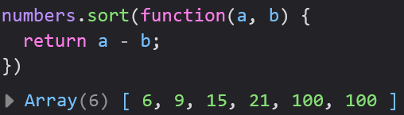
Sorting Numbers
We will need to sort Numbers frequently, so to solve this issue, we have to write a compare function to give to the sort() method
Don’t worry too much about how the function works for right now: only that a – b will sort ascending, and b – a will sort descending.
Notice: this function does not have a name.

Slide 22
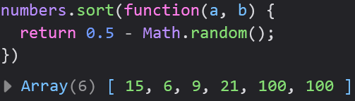
Random Sort
Sometimes you might want to “reset” an array back to a random order
We can use a special compare function to achieve this
Fairly niche

Slide 23
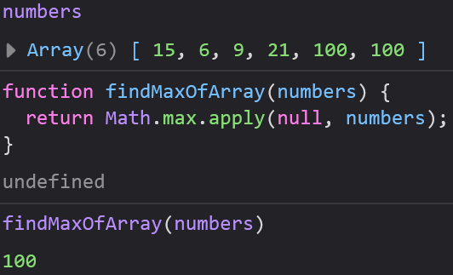
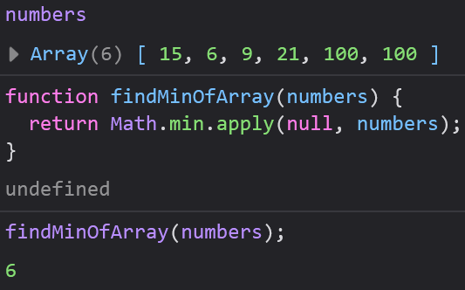
Finding the Min and Max of an Array
Max:
Math.max.apply()
Min:
Math.min.apply()

Slide 24
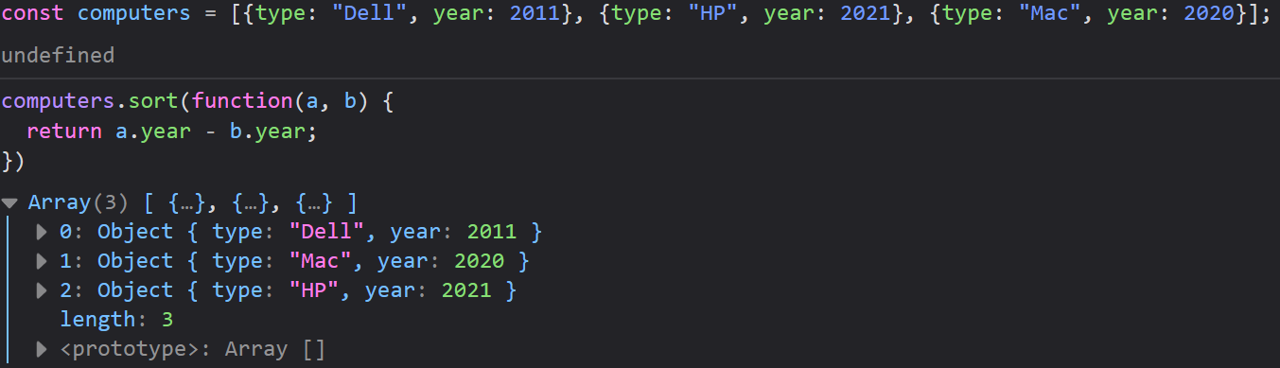
Sorting Object Arrays
Many times you arrays will be full of objects
We can use our compare function with our object’s properties/values

Slide 25
Array Iteration
A lot of times when we work with arrays we want to do something to each element of the array
Iteration methods all take a callback function: a function used as a parameter of another function
We need to write a callback function to manipulate an element, then the iteration method will apply our callback function to every element in the array

Slide 26
Anonymous Functions
Many of our callback functions will only be used a single time inside of an iteration method (similar to compare functions)
Functions like these can be defined inside of the parentheses of another function and do not need to be named
We call these functions anonymous functions since they only get used once and are never named

Slide 27
forEach()
Applies a callback function to each element of your array
Three possible parameters:
element – the element to operate on
index – the element’s index
array – the array you want to operate on
You will not always need all three parameters, often one is plenty

Slide 28
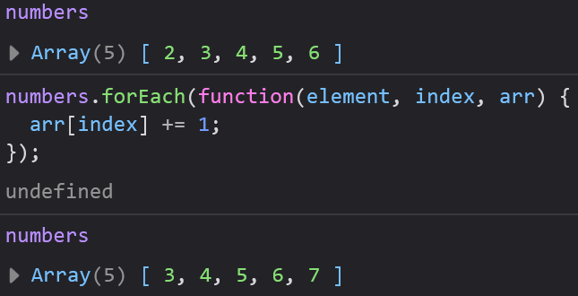
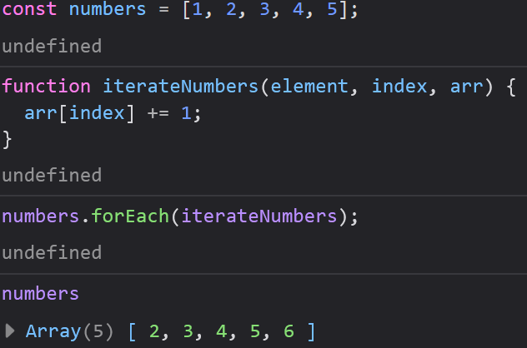
forEach()
We can either use anonymous functions as our callback functions, or ignore them entirely and define our functions like normal
These two examples function identically

Slide 29
map()
Creates a new array by performing an operation on each element in an array
Does not modify the original array
Does not execute on elements without values

Slide 30
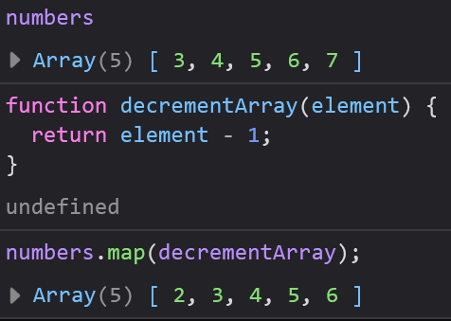
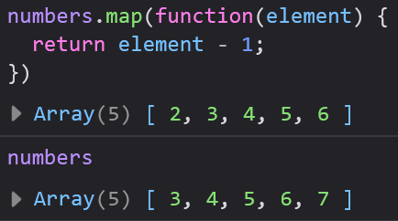
map()
These examples use the same array as before, but this time they reduce each element by one
When we write our callback functions, many times we only need to operate on a single element
The map() method will then apply our function to each element

Slide 31
filter()
Creates a new array of all the elements in an array that pass a test
Does not modify the original array
This is a great preview into conditionals

Slide 32
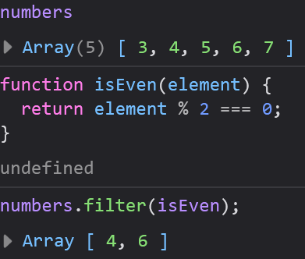
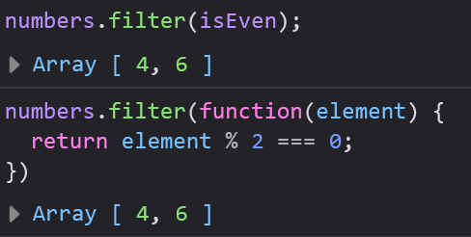
filter()
These examples check if each element in an array is even
The test can be anything you can imagine
Returns a new array

Slide 33
reduce()
Runs a function on each element and returns a single value
Works left to right (reduceRight() is the opposite)
Has an extra parameter for a total

Slide 34
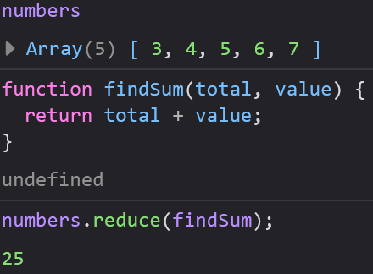
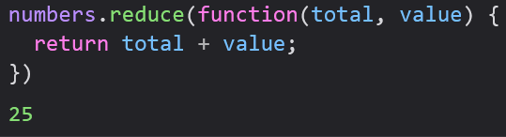
reduce()
Always returns a single value rather than another array
Comes up often when we want to find an array’s Sum, Max, Min, etc.
May accept an initial value for the value parameter

Slide 35
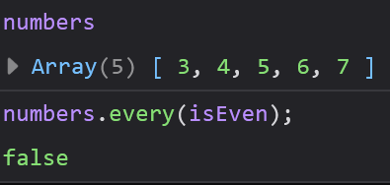
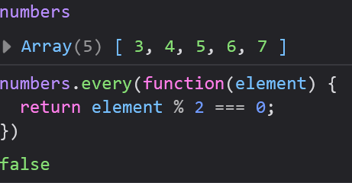
every()
Checks if all elements in an array pass a test
Returns a boolean

Slide 36
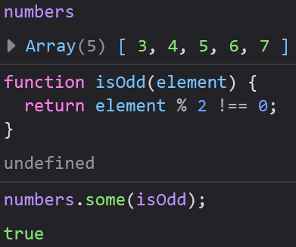
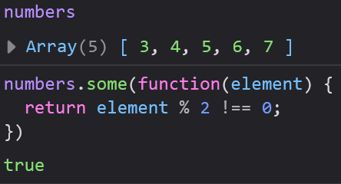
some()
Similar to every()
Checks if at least one element in an array passed a test
Returns a boolean

Slide 37
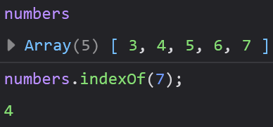
indexOf()
Does not require a callback function
item: parameter of element to search for
start: parameter of index to search from (optional)
Returns the element, or -1 if not found

Slide 38
lastIndexOf()
Works just like indexOf(), but returns the last occurrence of the searchItem instead of the first
Also supports optional startIndex parameter
Returns the element if found, -1 if not found

Slide 39
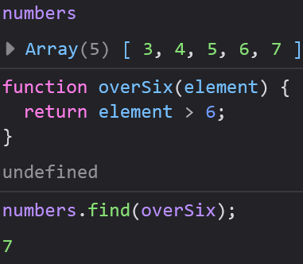
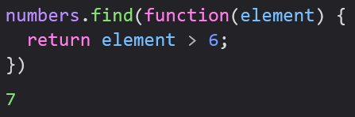
find()
Returns the first element that passes a test
Not supported in older browsers

Slide 40
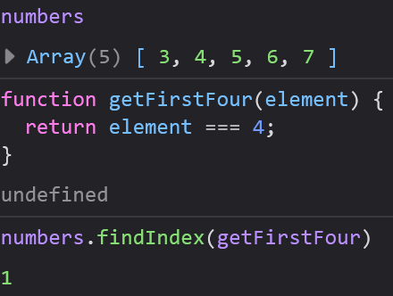
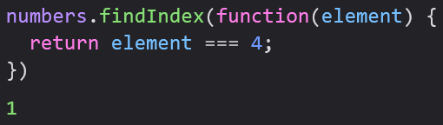
findIndex()
Returns the index of the first element that passes a test
Not supported by older browsers

