Slide 1
Numbers
Module 4 – Data Types

Slide 2


JavaScript’s Number
JavaScript’s Number type does not discriminate between numbers with decimals (floats) and whole numbers (integers)
Numbers are always 64-bit Floating Point, meaning they always use the same amount of memory and always has assumes 2 decimals (00 integers)

Slide 3


Precision
Integers are accurate up to 15 digits
Numbers can have up to 17 decimals
Math using decimals tends to be inaccurate, but you can multiply and divide to solve this
Ex: (.5 * 10 + .5 * 10) / 10 = .25

Slide 4

Numbers and Strings
When you “add” a Number and a String, the process is called concatenation.
You are attaching the Number to the end of the String or attaching a Number to the beginning of a String.
This will convert the Number to a String, which is why we are able to use the + operator to combine Strings and Numbers

Slide 5


Numbers and String
JavaScript will treat the statement as a Number, until it encounters a String.
Ex: (10 + 10 + “ Hello”) encounters 10 + 10 (Numbers) before it encounters “Hello” (String), so it will add them, but concatenate the string and will result in “20 Hello”
Ex: (“Hello” + 10 + 10) encounters “Hello” (a String) before it encounters 10 + 10, so it treats them as a String and will result in “Hello1010”

Slide 6
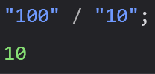
Numeric Strings
JavaScript uses type and will try to convert Strings to Numbers in numeric operations
Ex: “100” / “10” will be 10

Slide 7

Numeric Strings
“100” * “10” would be 1000

Slide 8

Numeric Strings
“100” – “10” would be 90

Slide 9

Numeric Strings
“100” + “10” would not be 110
With strings the + operator is used for concatenation, not addition

Slide 10


NaN
The NaN keyword means “Not a Number”
Trying to do Math with a non-numeric String will result in NaN
Any time you do Math with a NaN value, the result with be NaN

Slide 11
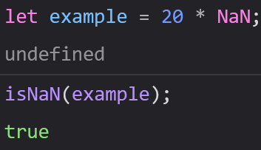
isNaN()
isNan() is a global function for determining whether a something is Not a Number
You can place any type inside it, and it will tell you if that type is NaN

Slide 12

Infinity
A keyword that represents a Number larger than the largest possible Number
Does not have a Mathematical value, but is larger than all other Numbers

Slide 13
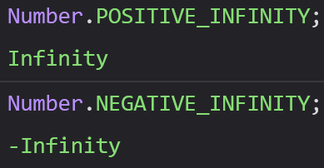
Infinity
You will get an Infinity value if you try to do Math above the max possible Number, or if you try to divide by 0
Note: In Math, anything divided by 0 is undefined, not Infinity, but this is how JS represents it.

Slide 14

Hexadecimal
Numbers are interpreted as Hexadecimal if 0x comes before them
By default, JavaScript Number are shown as base 10 (regular numbers).
We can convert them to other bases (2 – 36) using toString().

Slide 15
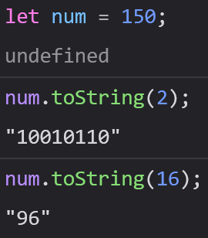
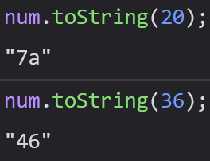
Hexadecimal
We can convert them to other bases (2 – 36) using toString().

Slide 16
Number Methods and Properties
JavaScript treats Numbers as Objects for the purpose of executing methods and accessing properties (just like with Strings)
All Number methods can be used on any type of Number (variables, literals, expressions)

Slide 17
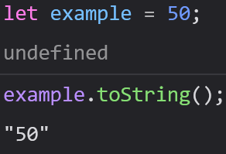

toString()
Returns a string of the Number it is called from

Slide 18
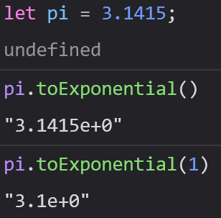

toExponential()
Returns a String of the Number it was called from where the Number is rounded and written using scientific/exponential notation
The parameter is optional – if you do not use it, the number does not get rounded

Slide 19
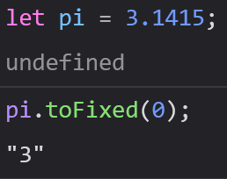
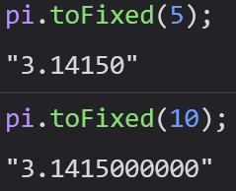
toFixed()
Returns a Number with a specified number of decimal places
toFixed() is often used to work with Money

Slide 20
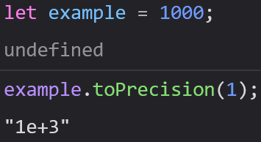
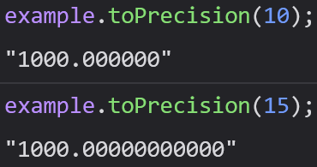
toPrecision()
Returns a Number with a specified number of digits

Slide 21
valueOf()
Returns a Number (primitive) of a Number (object)
You will not need to use this, since we should be avoiding Number Objects

Slide 22
Converting Variables to Numbers
There are three methods to do this, and all are Global (not Number methods)
Number()
parseInt()
parseFloat()

Slide 23
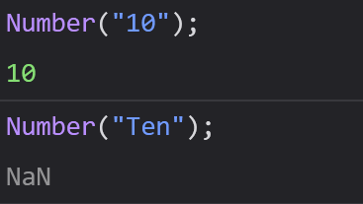
Number()
Converts a variable to a Number if possible, otherwise returns NaN
Used for Type Coercion (forcing a piece of data from one type to another)

Slide 24
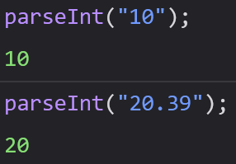
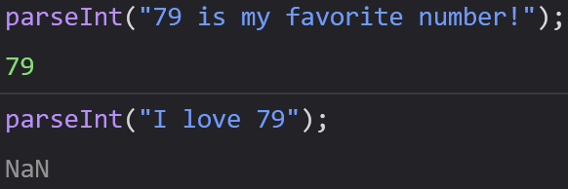
parseInt()
Reads through a string and returns the first integer (whole number)

Slide 25
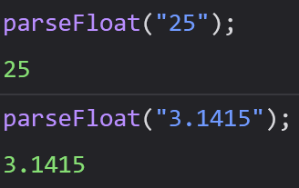
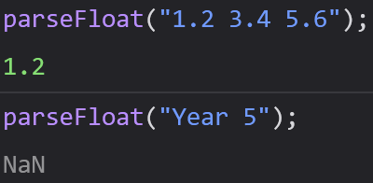
parseFloat()
Reads through a String and returns the first float (number with a decimal).

Slide 26
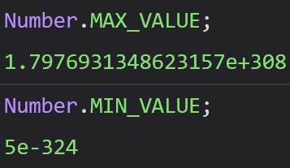
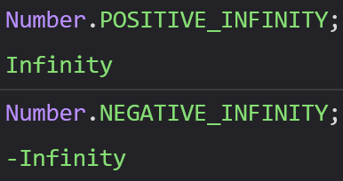
Number Properties
Helpful Properties of JS Numbers
MAX_VALUE = Largest possible Number in JS
MIN_VALUE = Smallest possible Number in JS
POSITIVE_INFINITY – Seen when Number is too large for Number’s 64-bit limit
NEGATIVE_INFINITY – Works like Positive Infinity

Slide 27

Number Properties
Properties belong to JS’s Number Object Wrapper class called Number
To access those properties, use Number.property
They cannot be accessed through a variable of type Number

Slide 28

Number Properties Do Not Work on Variables
Number properties belong to JavaScript’s object wrapper called Number
These properties can only be accessed using Number.property
You will not be able to access any of these properties through a variable holding a number

Slide 29
For Today
Module 4 Exercises Day 2
Atometric
Portfolio
Calculator
To Do List

