Slide 1
HTML Forms
Module 7

Slide 2
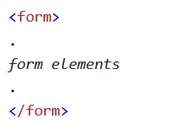
The <form> Element
The <form> element is used to create a form to take user input
<form>s are containers for different types of input elements
What we can do with forms right now is limited, but they are incredible once we learn JavaScript

Slide 3
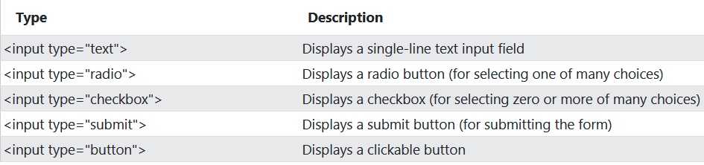

The <input> Element
<input> is the most used form element
There are several types of <input> element, depending on the type attribute

Slide 4
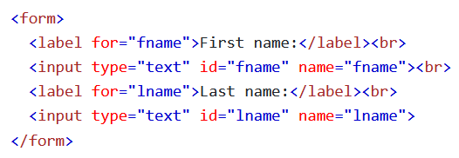
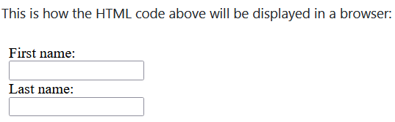

Text Fields
The <input type=“text”> element defines a one line text input field
Text input fields default to 20 chars, but can be resized with CSS
The form itself does not get displayed

Slide 5
The <label> Element
A <label> element creates a label for a form element
Labels are helpful for accessibility, since screen readers will read the name of the label when focusing the input
Helpful for people with poor eyesight or motor skills, since clicking the label will be treated like clicking the input

Slide 6
The <label> Element
<label> has a for attribute that should be set equal to the ID of the input element
This creates a link between the two elements

Slide 7
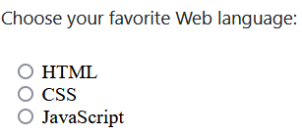
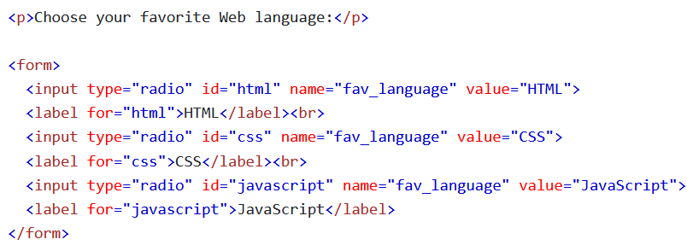

Radio Buttons
<input type=“radio”> defines a radio button
A radio button allows a user to select one of many choices

Slide 8
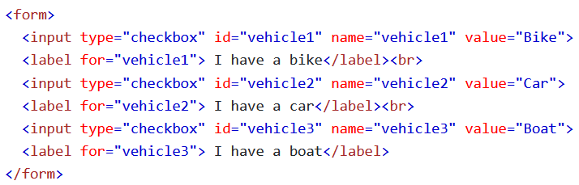
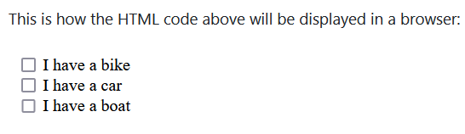
Checkboxes
The <input type=“checkbox”> defines a checkbox
Checkboxes let a user choose 0 or more of a set of options

Slide 9
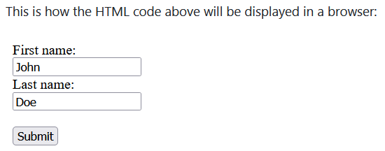
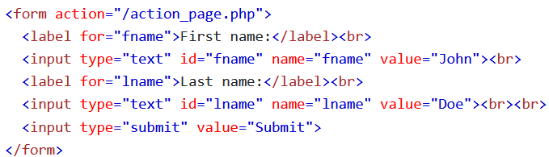
The Submit Button
The <input type=“submit”> element defines a button for submitting our form
Forms are generally submitted to a form handler, which is generally a file on a server that has a program for processing user input
Form handlers can be specified in the form’s action attribute

Slide 10
The name Attribute for <input>
Every input field must have a name attribute in order to submit it
The value of an input cannot be sent to the server if you do not add a name attribute

Slide 11
Form Attributes

Slide 12
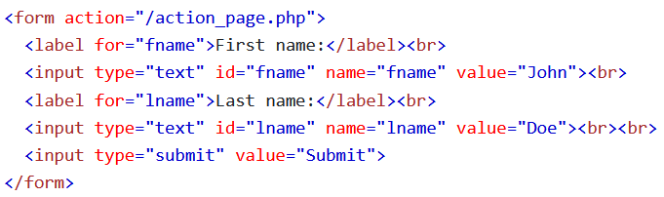
The action Attribute
The action attribute defines the action to be executed when the form is submitted
The input data is sent to a file on a server that you specify as the value of the action attribute
The server file contains instructions to process the data in some way

Slide 13
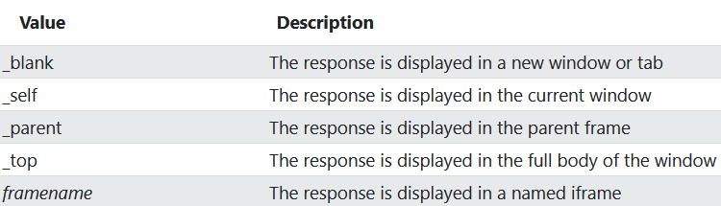

The target Attribute
The target attribute specifies where we should display the response we get from the server after submitting our user input
target can have any of these values:
Notes:
Target always defaults to _self, so the response will display in the current tab

Slide 14
The method Attribute
The method attribute specifies the HTTP method to be used when submitting form data
There are 4 main HTTP methods: GET (Receive), POST (Send), PUT (Update), Delete (Delete)
The default method when submitting form data is GET

Slide 15
GET Requests
GET requests put the form data at the end of the URL in name/value pairs
Have limited length (2048 characters)
Useful for non-sensitive data

Slide 16
GET Requests
Although GET requests are for receiving data, they can send a small amount of data as well
The data you send it data necessary to receive the data you need, like how you must send Google something to search in order to get a result
Should never be used with sensitive data, as the data can be seen in the url

Slide 17
POST Requests
POST requests put the data from the form inside the body of the request, so it is never shown in the URL
POST does not have any size limits, since it is designed for sending information
You cannot use bookmarks with a POST request

Slide 18
POST Requests
Sensitive data like debit/credit card info, phone numbers, SSNs, Passport Numbers, etc should only be sent using POST
It could be disastrous if you use GET

Slide 19
The autocomplete Attribute
The autocomplete attribute specifies whether a form should have autocomplete on or off.
When set to on, the browser autocompletes values based off info the user has entered before

Slide 20

The novalidate Attribute
The novalidate Attribute is a Boolean attribute
When used, it specifies that the data entered should not be validated when submitted

Slide 21
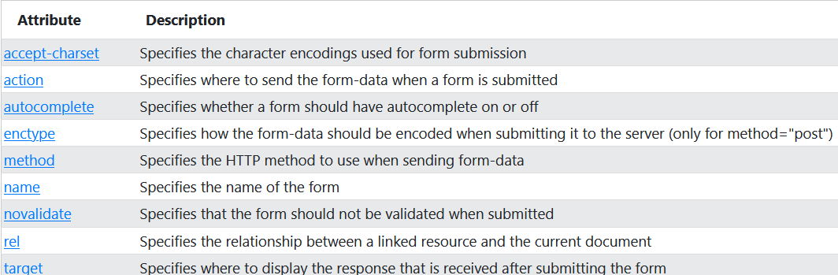
All <form> Attributes

Slide 22
Form Elements

Slide 23
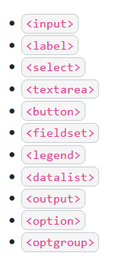
HTML <form> Elements
There are many elements that can be used with a <form> element

Slide 24
The <input> Element
<input> is the most used form element
Can be displayed in many ways, depending on the type attribute value

Slide 25

The <label> Attribute
The <label> element defines a label for any of a number of form elements
Useful for accessibility
The for attribute of the <label> should be equal to the id attribute of the <input> in order for them to be linked

Slide 26
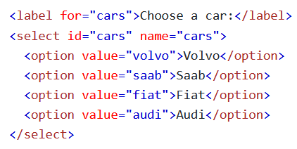

The <select> Element
The <select> element creates a dropdown list
It is used with <option> elements that creates a dropdown list option
By default, the first item in the dropdown list is selected

Slide 27
The <select> Element
To create a pre-selected option, add the selected attribute to the option

Slide 28
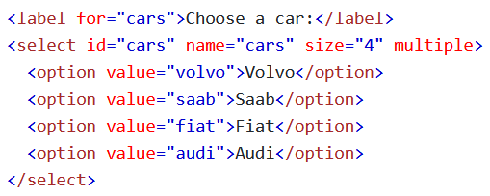
Allow Multiple Selections
Use the multiple attribute to allow the user to select more than one value
Just because you can doesn’t mean you should

Slide 29
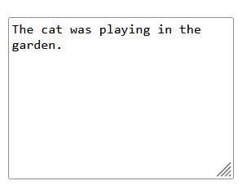

The <textarea> Element
The <textarea> element defines a multi-line input field (text area)
The rows attribute specifies the number of lines visible in the text area
The cols attribute specifies the width of the text area

Slide 30

The <button> Element
The <button> element defines a clickable button
Be sure to specify the type of the button

Slide 31
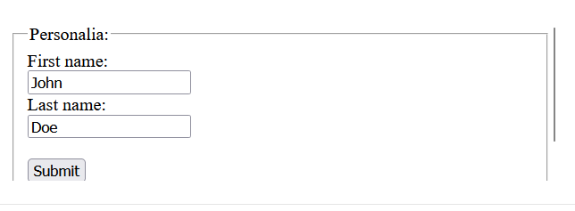
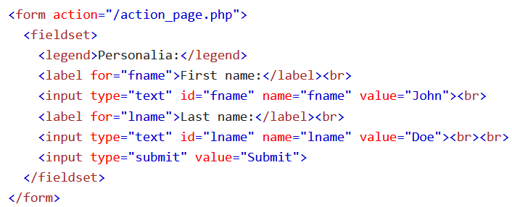
The <fieldset> and <legend> Elements
The <fieldset> element is used to group related data together inside a form
The <legend> element defines a caption for the <fieldset> element

Slide 32
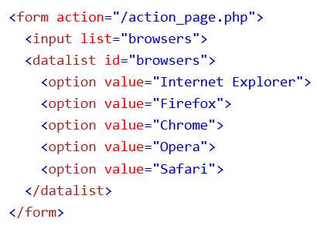
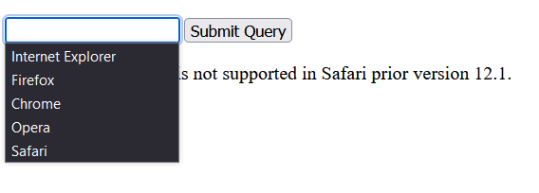

The <datalist> Element
The <datalist> element specifies a list of pre-defined options for an <input> element
It creates a dropdown list of options for a text input as the user types
The list attribute of the <input> element must refer to the id attribute of the <datalist> element

Slide 33
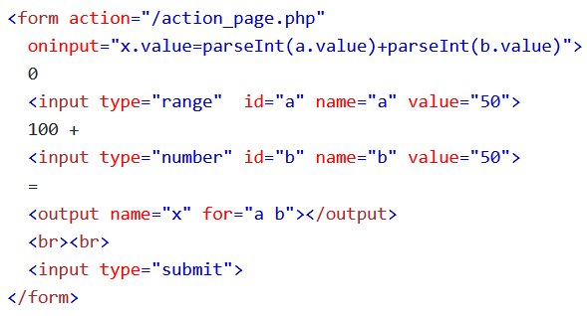
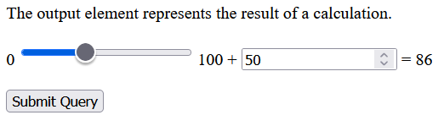
The <output> Element
The <output> element represents the result of a calculation (like one executed by a JavaScript)

Slide 34
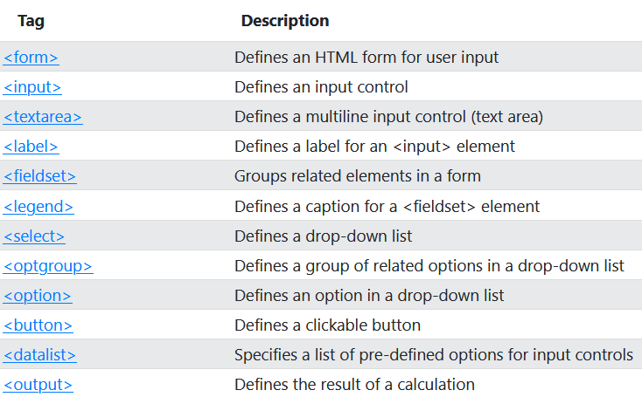
HTML Form Elements

Slide 35
HTML Input Types

Slide 36
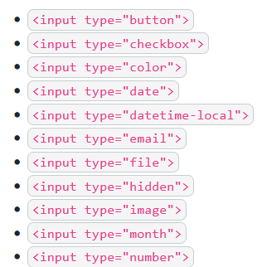
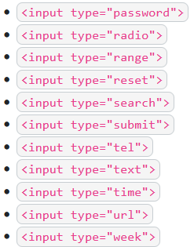
HTML Input Types
There are a lot of input types
The default value is text

Slide 37
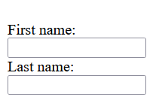
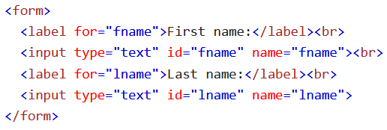
Input Type - Text
<input type=“text”> creates a one line text input field

Slide 38
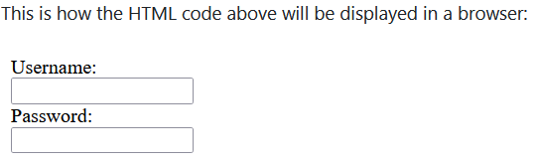
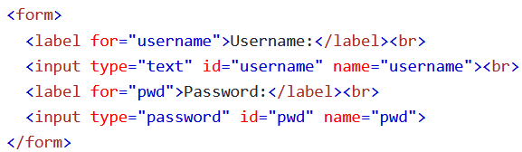
Input Type - Password
<input type=“password”> creates a password field
Characters typed in the password field display add dots

Slide 39
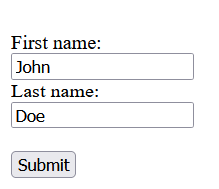
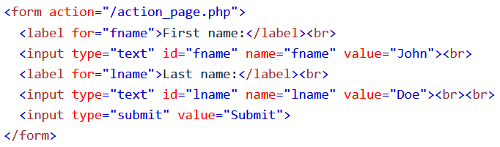
Input Type - Submit
<input type=“submit”> defines a button for submitting data to a form handler
Form handlers are a script on a server used for processing data
The form handler file gets specified in a form’s action attribute

Slide 40
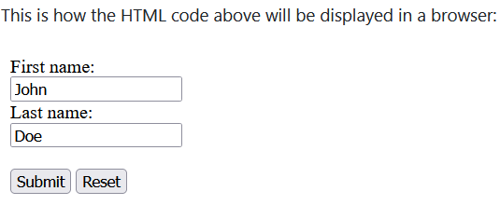
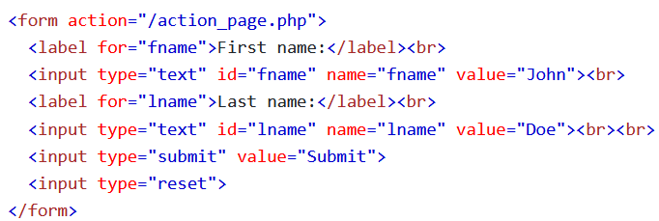
Input Type - Reset
<input type=“reset”> defines a reset button that will reset all form values to their default values

Slide 41
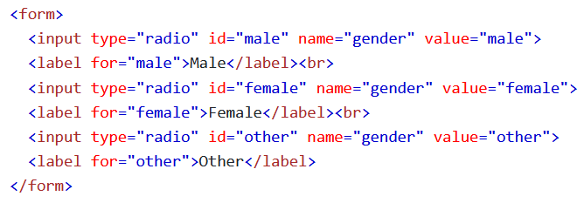
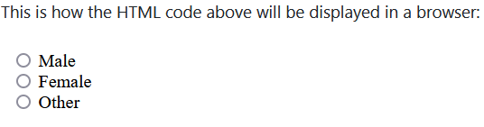
Input Type - Radio
<input type=“radio”> defines a radio button
Radio buttons allow a user to select one of a limited number of choices

Slide 42
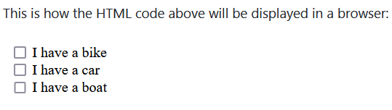
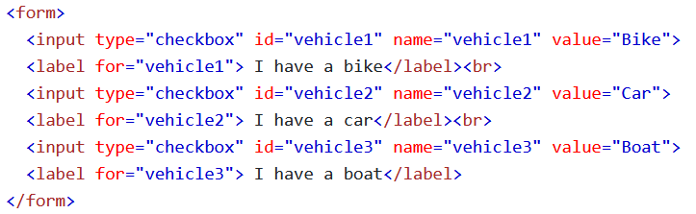
Input Type - Checkbox
<input type=“checkbox”> creates a checkbox
Checkboxes let users select 0 or more options from a limited number of choices

Slide 43
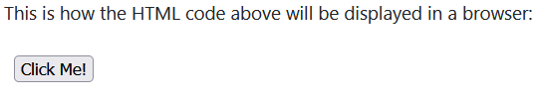
Input Type - Button
<input type=“button”> creates a new button

Slide 44
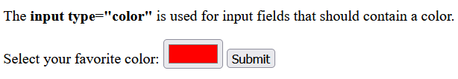
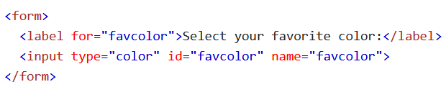
Input Type - Color
<input type=“color”> creates an input field that accepts a color
Input field may contain a color picker (not supported on IE or older versions of Safari)

Slide 45
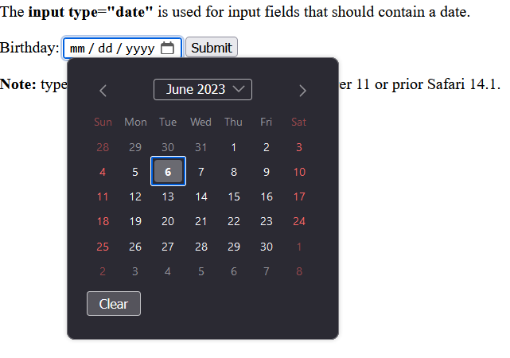
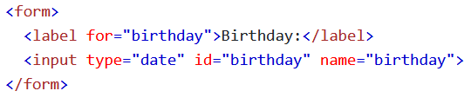
Input Type - Date
<input type=“date”> creates an input field for dates
Creates a date picker on supported browsers

Slide 46
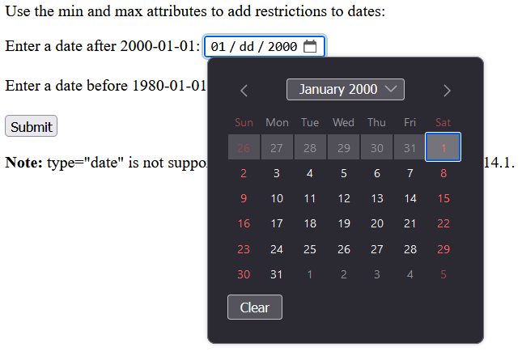
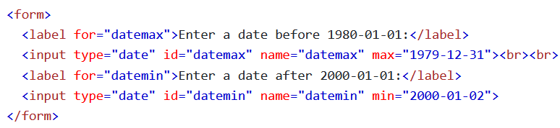

Input Type - Date
Supports min and max attributes to add restrictions
Users will only be able to select from a range of dates

Slide 47
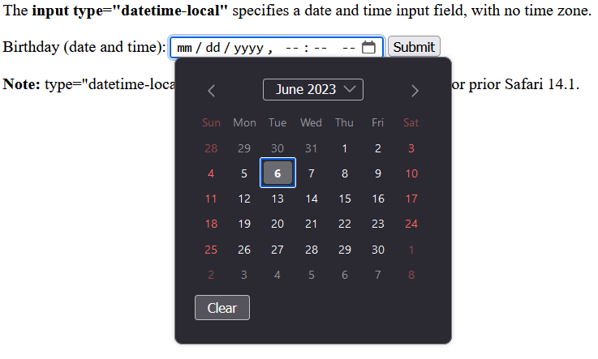
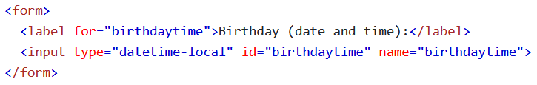
Input Type – Datetime-local
<input type=“datetime-local”> creates an input field for a date and time
Collects time in your local time zone
We can use JavaScript to convert to ISO time

Slide 48
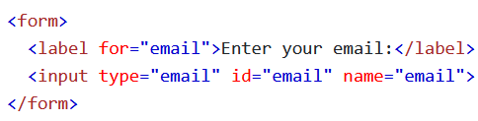

Input Type - Email
<input type=“email”> is used for input fields that accept an email
All modern browsers offer some level of automatic email validation with this field

Slide 49
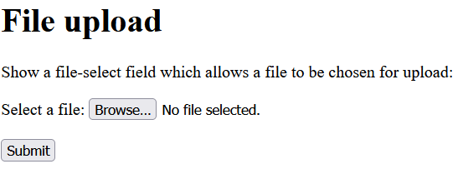
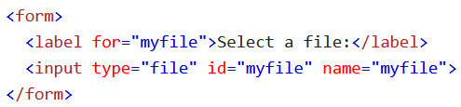
Input Type - File
<input type=“file”> defines a file-select field and a “browse” button for file uploads

Slide 50


Input Type - Month
<input type=“month”> allows a user to select a month and year
Not supported on Firefox, Safari, or IE

Slide 51


Input Type - Number
<input type=“number”> defines a numeric input field
You can set limits on which numbers are accepted

Slide 52


Input Restrictions

Slide 53


Input Restrictions

Slide 54


Input Type - Range
<input type=“range”> creates a slider for you to select a number, where the exact number is not very important
Useful for working with percentages, terrible for working with precise numbers

Slide 55


Input Type - Search
<input type=“search”> creates a search field that looks identical to a text field, but has semantic meaning (good for accessibility)
Although search and text look identical, search is optimized for search
Mobile devices will display a different keyboard layout than when using type=“text”
Notes:
Mic option

Slide 56


Input Type - Tel
<input type=“tel”> creates an input field for a phone number
Allows you to specify a pattern as a regular expression
We’ll learn more about how these work when we cover JavaScript

Slide 57


Input Type - Time
<input type=“time”> allows a user to select a time (in local time) using a time picker
Modern browsers support the time picker (minus IE)

Slide 58


Input Type - URL
<input type=“url”> creates an input field that accepts a URL
Most browsers will have some level of auto-validation

Slide 59


Input Type - Week
<input type=“week”> allows the user to select a week and year
Not supported on Firefox, Safari, or IE

Slide 60
Input Attributes

Slide 61


The value Attribute
The input value attribute specifies an initial value for an input field

Slide 62


The readonly Attribute
The input readonly attribute makes a field read-only
A read-only field can’t be modified, but can still be highlighted, tabbed to, and copied from
The value of the readonly field gets sent when submitting the form

Slide 63


The disabled Attribute
The disabled attribute specifies that an input field should be disabled
A disabled input field is unusable and unclickable
The value of a disabled field does not get sent when it is submitted

Slide 64


The size Attribute
Input’s size attribute specifies the visible width (number of characters wide) of an input field
The default size is 20 characters
Size works with: text, search, tel, url, email, and password

Slide 65

The maxlength Attribute
Input’s maxlength attribute specifies the max number of characters in a field
The input field won’t accept more than the max number of characters, but will not provide any feedback
If you want to alert the user, you need JavaScript

Slide 66

The min and max Attributes
The input min and max attributes create a min and max value for an input field
min and max work with: number, range, date, datetime-local, month, time, and week
Max and Min are often used together to create a range of values

Slide 67

The multiple Attribute
Input’s multiple attribute specifies that the user is allowed to enter more than one value in an input field
The multiple attribute works with: email and file

Slide 68

The pattern Attribute
The input pattern attribute specifies a regular expression that the input field’s value is checked against, when the form is submitted
pattern works with the following types: text, date, search, url, tel, email, and password
You can use the title attribute to describe the pattern for the user

Slide 69
The placeholder Attribute
Input’s placeholder attribute specifies a short hint that describes the expected value of an input field
A short hint gets displayed in the input field before a user enters a value
placeholder works with: text, search, url, tel, email, and password

Slide 70

The required Attribute
Input’s required attribute specifies that an input field must be filled out before submitting the form
The required attribute works with: text, search, tel, email, password, date pickers, number, checkbox, radio, and file

Slide 71

The step Attribute
Input’s step attribute specifies the legal number of intervals for an input field
Ex: When step = 2, nums: 0, 2, 4, 6, …
Works with: number, range, date, datetime-local, month, time, and week

Slide 72

The autofocus Attribute
Input’s autofocus attribute specifies that an input field should automatically be focused when a page loads
Focus is when you highlight an input
You can focus an input by pressing the tab key while on a web page

Slide 73


The height and width Attributes
Input’s height and width attributes specify the height and width of an <input type=“image”> element (basically a submit button with an image)

Slide 74

The list Attribute
Input’s list attribute refers to a <datalist> element that contains predefined options for an <input> element

Slide 75

The autocomplete Attribute
Input’s autocomplete attribute specifies whether a form should have autocomplete on or off
Autocomplete will let the browser predict what the user is typing based off values they have typed before
Works with: text, search, url, tel, email, password, datepickers, range, and color

Slide 76
HTML Input Form Attributes

Slide 77


The form Attribute
Input’s form attribute specifies the form the <input> element belongs to
The value of this attribute must be equal to the id attribute of the <form> element it belongs to

Slide 78

The formaction Attribute
Input’s formaction attribute specifies the URL of the file that processes the data from the form when it is submitted
This overrides the action attribute of the <form> element
Works with: submit and image

Slide 79

The formenctype Attribute
Input’s formenctype attribute specifies how form-data should be encoded when submitted (only for form using POST)
This overrides the enctype attribute of the <form> element
Works with: submit and image

Slide 80

The formmethod Attribute
Input’s formmethod attribute defines the HTTP method used to send the URL with
This overrides the method attribute of the <form> element
Works with: submit and image

Slide 81

The formtarget Attribute
Input’s formtarget attribute specifies a name or keyword that indicates where to display the response that was received after submitting the form
This overrides the target attribute of the <form> element
Works with: submit and image

Slide 82

The formnovalidate Attribute
Input’s formnovalidate attribute specifies that an <input> element shouldn’t be validated when submitted
This overrides the novalidate attribute of the <form> element
Works with: submit

