Slide 1
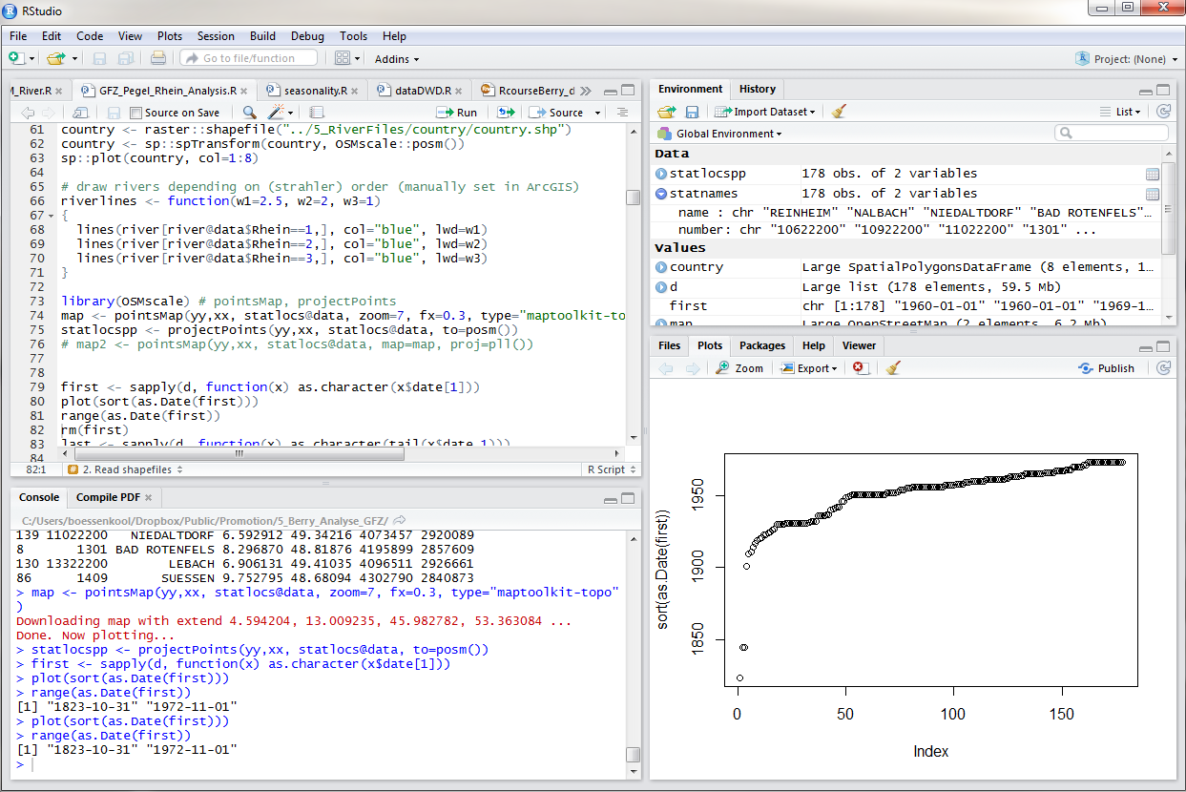
RUN CODE
OBJECTS IN
WORKSPACE
SCRIPTS
DOCUMENTATION
PLOTS
CODE EXECUTION

Slide 2
Scripts
(shareable .R files)
Graphical
output
and more
The console to the actual R

