Slide 1
Churn Prediction for Kuwo Music Box -- DS-501 Capstone Project
Presenter:
Yuxuan Chen
Group members:
Ye Yuan
Zehui Wang
Jiahao Wang
Date: July 28, 2017

Slide 2
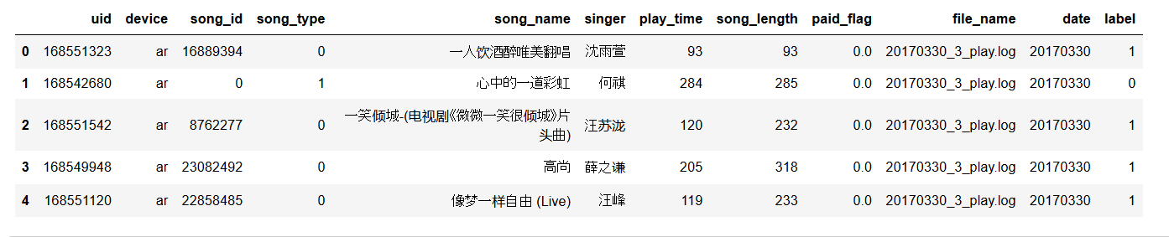
Data Source
Play logs of Kuwo Music Box from March 30 ~ May 12, 2017

Slide 3
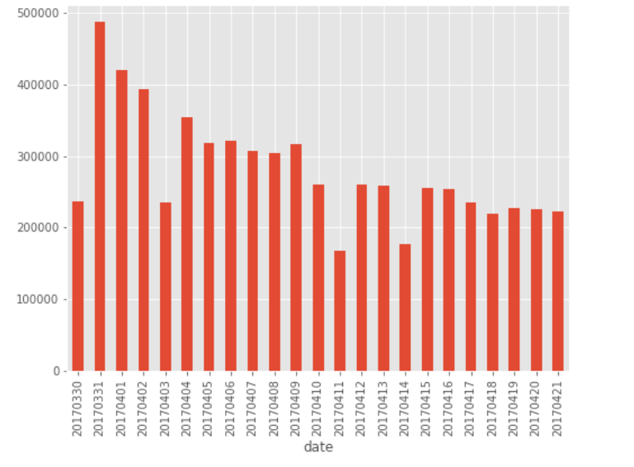
Project Description:
Observtion
>50% reduction of
daily play activities
Over
~ 3 weeks
Objective:
Predict churn users
Find out correlation/ casual relation between churn and users’ behaviors

Slide 4
Problem defination
Active users:
users who has played more than three times in Period 1 ( March 30 ~ April 21, 2017)
490K active uses
Good users:
active users who had at least played once in Period 2( April 22 ~ May 12, 2017)
230K of them are good
Churn users:
active users who had on play activity in Period 2
~ 230K churned. Churn rate 50%
Down sampling: 20: 1
My data: 12K good users + 12K churns

Slide 5
EDA and Feature engineering
1. Count: No. of play logs in 5 time windows:
1.1 04/21: "count_play_1"
1.2 04/19 - 04/21: "count_play_3"
1.3 04/15 - 04/21: "count_play_7"
1.4 04/08 - 04/21: "count_play_14"
1.5 03/30 - 04/21: "count_play_23"
2. Ratio: (to be defined) : "ratio_[period 1]_over_[period 2]", e.g. "ratio_1_over_14"
3. User profile
3.1 preferred device: majority vote of devices, if more than one device is used: "device"
4. Music related property
4.1 Total time playing music: "total_play_time"
4.2 Ratio of time played for each user: "completion_ratio_avg"
4.3 Popularity of musics played

Slide 6
EDA and Feature engineering – Unique features
Average song completion ratio:
average of individual play time divided by song length
How many popular songs a user played
Popular songs: top 200 most played songs
How many rare songs a user played
Rare songs: songs only played once in Period 1
Facts:
there are 390K songs played in Period 1
190K of them has only been played once

Slide 7
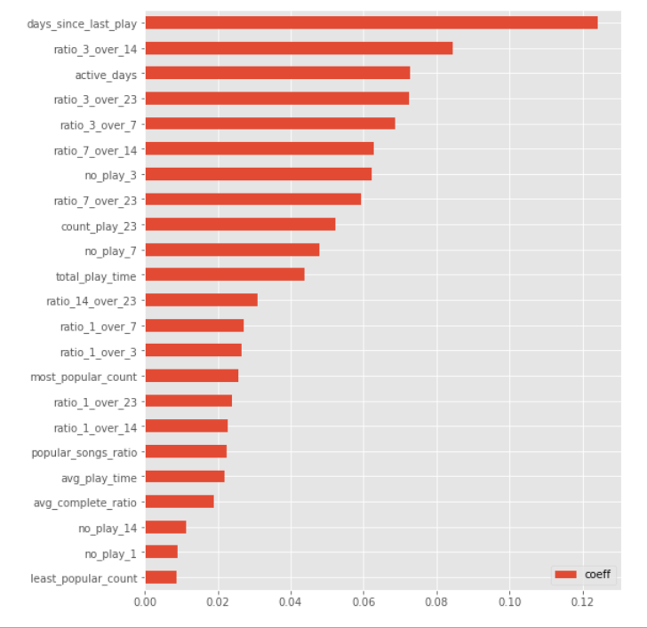
Machine Learning models -- Random Forest
500 trees
Max depth = 15
Min leaves = 10
Features per tree = sqrt(n)
Metrics:
Accuracy: 0.751
Most important features:
Days_since_last_play
Ratios involves the most recent 3 days
Active days
Total play time
…

Slide 8
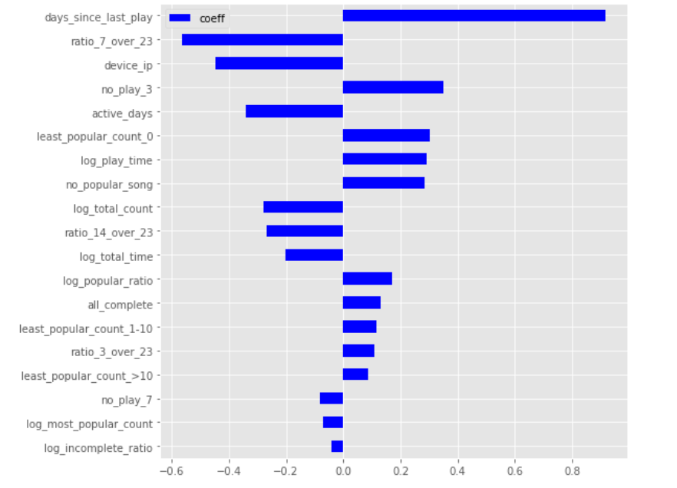
Machine Learning models -- Logistic Regression
500 trees
Max depth = 15
Min leaves = 10
Features per tree = sqrt(n)
Metrics:
Accuracy: 0.756
Most important features:
Days_since_last_play
Device
Active days
Total play time
If there are rare songs played

Slide 9
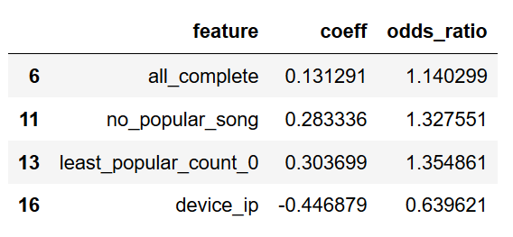
Model selecion
Logistic regress
Low variance
Easy to interprete

Slide 10
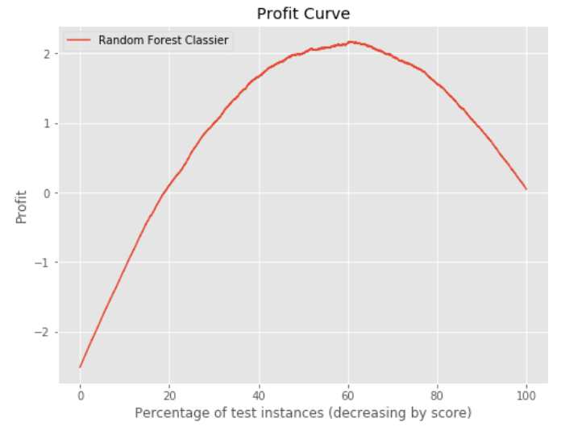
Business value
Accuracy: 0.751476959433 Precision: 0.709943551889 Recall: 0.85445518683
Benefit – cost matrix:
[[10,-5],
[-10,0]]
The best threshold is 0.38,
which gives a max profit of 2.173
Accuracy: 0.751476959433
Precision: 0.709943551889
Recall: 0.85445518683

Slide 11
Future Plan
A/B testing on the casual relationship between features and churns
Collaborative filtering Recommendation system.

Slide 12
Thank you for your attention!!

