Slide 1
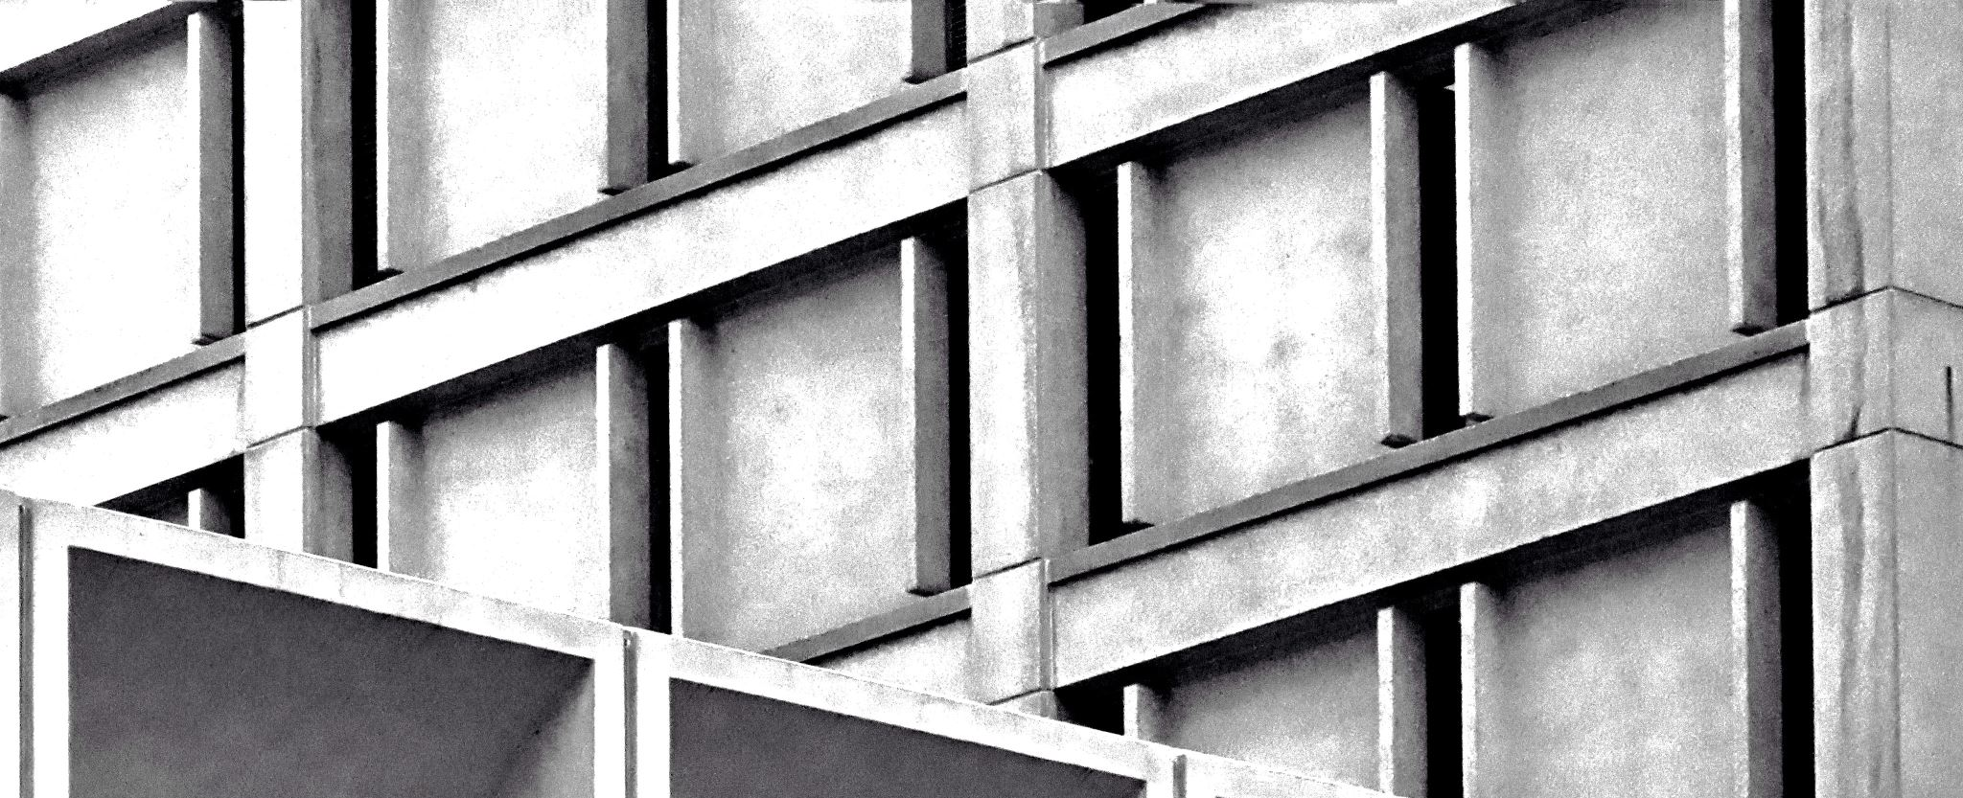
SegNet: A Deep Convolutional Encoder-Decoder Architecture for Image Segmentation
Yasaswi Jonnalagadda
700746840

Slide 2
Motivation
Semantic segmentation has numerous applications including scene understanding, autonomous driving, and object support relationships.
Traditional methods lack accuracy in boundary localization and are computationally intensive.
The motivation for SegNet arises from the need for an efficient architecture that retains boundary information while being computationally feasible.

Slide 3
Problem Statement
Challenges in Semantic Segmentation:
- Mapping low-resolution features to high-resolution for pixel-wise classification.
- Balancing the trade-off between computational efficiency and segmentation accuracy.
Current Limitations:
- Existing methods often produce coarse results due to max pooling and sub-sampling which reduce feature map resolution.

Slide 4
Objectives
Design an Efficient Architecture:
- Develop an architecture that can perform high-quality semantic segmentation with efficient use of memory and computational resources.
Improve Boundary Localization:
- Ensure that the architecture can accurately map low-resolution features to input resolution for precise boundary delineation.

Slide 5
Contributions
SegNet Architecture:
- An encoder-decoder network where the encoder is identical to the VGG16 network.
- Novel decoder that uses max-pooling indices from the encoder for non-linear upsampling.
Efficiency and Performance:
- Significantly fewer parameters than other architectures, enabling end-to-end training.
- Competitive performance with reduced memory usage during inference.
Comparative Analysis:
- Detailed comparison with other architectures like FCN and DeepLab-LargeFOV showing SegNet’s trade-offs between memory and accuracy.

Slide 6
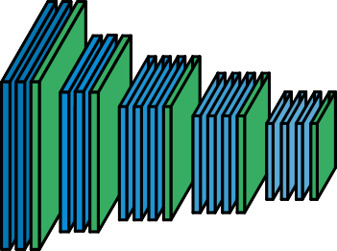
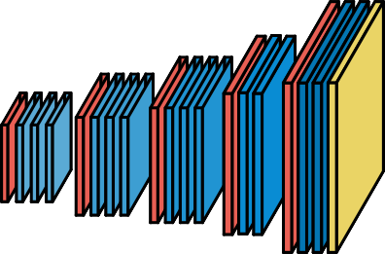
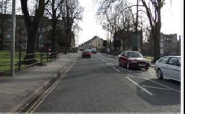

















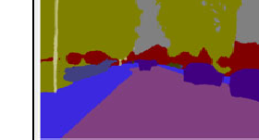




























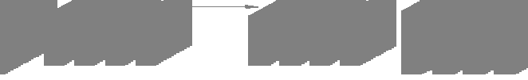


Results
Benchmarking on Datasets:
- CamVid road scenes and SUN RGB-D indoor scenes.
Performance Metrics:
- High accuracy and efficient memory usage during inference.
- Quantitative results demonstrating SegNet’s performance on segmentation tasks compared to other methods.
- Visualization of segmentation results showcasing boundary delineation.

Slide 7
Critical Analysis
Strengths:
- Efficient memory and computational usage.
- Good performance on boundary localization.
- Versatility for real-time applications.
Weaknesses:
- May have slightly lower accuracy compared to models with higher parameter counts in certain scenarios.
- Dependent on the quality of the encoder’s feature maps.
Future Work:
- Explore more sophisticated decoder architectures.
- Incorporate additional context information for further improvement.

Slide 8
References
V. Badrinarayanan, A. Handa, and R. Cipolla, “SegNet: A deep convolutional encoder-decoder architecture for robust semantic pixel-wise labelling,” arXiv preprint arXiv:1505.07293, 2015.
K. Simonyan and A. Zisserman, “Very deep convolutional networks for large-scale image recognition,” arXiv:1409.1556, 2014.
J. Long, E. Shelhamer, and T. Darrell, “Fully convolutional networks for semantic segmentation,” in Proc. IEEE Conf. Comput. Vis. Pattern Recognit., 2015, pp. 3431–3440.

